Slide 1
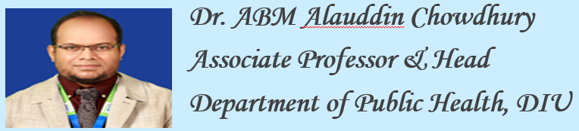

COVID 19
Global Health and Public Health threats & challenges
BakiBillah
DPH, DIU

Slide 2
Learning Outcomes
Difference between Global Health and Public Health
Urgent health challenges & tackle in 2020
COVID-19 and Bangladesh: Challenges

Slide 3
What is the difference between Global Health and Public Health?
Global Health and Public Health as two specialties of healthcare have similar overarching goals with professionals engaged in betterment of individual health, constant improvement in longevity, improve quality of life, socioeconomic upliftment, manage and mitigate short term and long-term health risks, etc.
However, the approach and operations of both the specialties differ in relation to geopolitical symbiosis, population health, healthcare economics and interrelationship among allied disciplines.

Slide 4
Global Health and Public Health
Items | Global Health | Public Health
Geopolitical | Healthcare problems and policy issues that transcend internationally | Major focus is on specific communities or meeting national goals
Collaboration and Alliances | Global. Strongly propagates interdependence and not merely a flow of resources and information from the developed to the developing nations | National. Based on economic and knowledge dependence of the developing on the developed, directly or via world associations and organizations.
Population Health | Prevention and clinical | Primarily Prevention
Healthcare economics and outreach | Equitable distribution of healthcare resources including finances among nations | Healthcare equity within a nation or locality
Interrelationship amongst Allied Disciplines | Supports high interdisciplinary approach | Multidisciplinary, especially with healthcare and social sciences

Slide 5
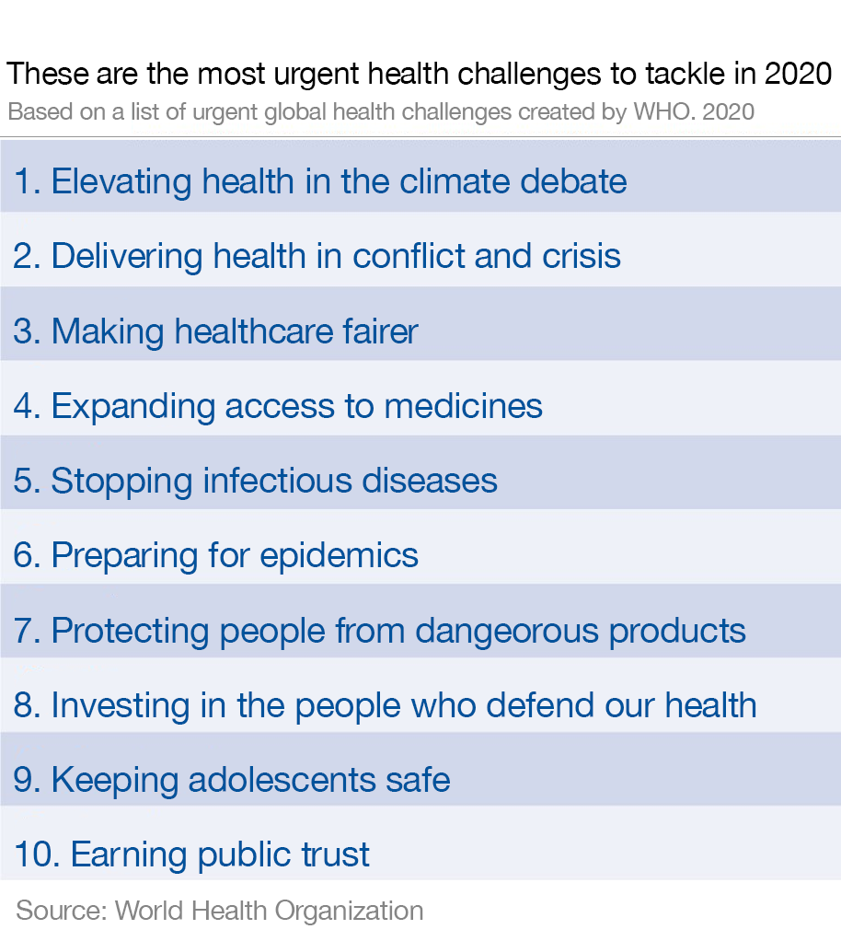

Slide 6
1. Elevating health in the climate debate
The climate crisis poses one of the biggest threats to both the planet and the health of the people who live on it.
Emissions kill around 7 million people each year, and are responsible for more than a quarter of deaths from diseases including heart attacks, stroke and lung cancer.
At the same time, more – and more intense – extreme weather events like drought and floods increase malnutrition rates and help spread infectious diseases like malaria.

Slide 7
2. Delivering health in conflict and crisis
The already difficult task of containing disease outbreaks is made more challenging in countries rife with conflict.
Nearly 1,000 attacks on healthcare workers and medical facilities in 11 countries were recorded in 2019, leaving 193 medical staff dead. Despite stricter surveillance, many healthcare workers remain vulnerable.
For the tens of millions of people forced to flee their homes, there is often little or no access to healthcare.

Slide 8
3. Making healthcare fairer
The gap between the haves and have-nots is growing, especially in terms of access to healthcare.
People in wealthy nations can expect to live 18 years longer than their poorer neighbours, and wealth can determine access to healthcare within countries and individual cities, as well.
Rising global rates of diseases like cancer, diabetes and chronic respiratory conditions have a greater impact on low- and middle-income countries, where medical bills can quickly deplete the limited resources of poorer families

Slide 9
4. Expanding access to medicines
Although many in the world take access to medication for granted, medicines and vaccines are not an option for almost one-third of the global population.
The challenge of expanding access to medicines in areas where few, if any, healthcare products are available includes combatting substandard and imitation medical products. In addition to putting lives at risk by failing to treat the patient’s condition, these products can undermine confidence in medicines and healthcare providers.

Slide 10
5. Stopping infectious diseases
Infectious diseases continue to kill millions of people, most of them poor. This picture looks unlikely to change in the near future.
Preventing the spread of diseases like HIV, tuberculosis and malaria depends on sufficient levels of funding and robust healthcare systems. But in some areas where they are most needed, these resources are in short supply.
Greater funding and political will is required to develop immunization programmes, share data on disease outbreaks and reduce the effects of drug resistance.

Slide 11
6. Preparing for epidemics
Airborne viruses or diseases transferred by mosquito bite can spread quickly, with potentially devastating consequences.
Currently, more time and resources are spent reacting to a new strain of influenza or an outbreak of yellow fever, rather than preparing for future outbreaks. But it’s not a question of if a dangerous virus will come about – but when.

Slide 12
7. Protecting people from dangerous products
Many poorer parts of the world face malnutrition and food insecurity, while at the same time, global obesity levels and diet-related problems are on the rise.
We need to rethink what we eat, reduce the consumption of food and drinks high in sugar, salt and harmful fats, and promote healthy, sustainable diets. To this end, the WHO is working with countries to develop policies that reduce our reliance on harmful foodstuffs.

Slide 13
8. Investing in the people who defend our health
Health workers are in short supply the world over. Sustainable health and social care systems depend on well-paid and properly trained staff who can deliver quality care. WHO research predicts that by 2030, there will be a shortfall of 18 million health workers, mostly in low- and middle-income countries.
New investment is needed to properly train health workers and provide decent salaries for people in the profession, it says.

Slide 14
9. Keeping adolescents safe
Every year, more than 1 million adolescents – aged between 10 and 19 – die. The main causes include road accidents, suicides, domestic violence and diseases like HIV or lower respiratory conditions. But many of these premature deaths are preventable.
Policymakers, educators and health practitioners need to promote positive mental health among adolescents, to prevent illicit drug use, alcohol abuse and self harm. Programmes that raise awareness of things like contraception, sexually transmitted infections and pregnancy care help address some of the underlying causes of adolescent fatalities.

Slide 15
10. Earning public trust
Delivering safe, reliable healthcare to patients involves first gaining their confidence and trust; a trust which can be undermined by the rapid spread of misinformation on social media. For example, the anti-vaccination movement has led to an increase in deaths from preventable diseases.
But social media can also be used to spread reliable information and build public trust in healthcare. Community programmes are another way to boost confidence in healthcare provision and practices that prevent the spread of diseases, such as vaccinations or condom use.

Slide 16
COVID-19 : Globally (as of August 23,2020)
139,768,352 : confirmed cases
3,001,658: deaths

Slide 17
COVID-19 : Bangladesh (as of August 23,2020)
707,362 : confirmed cases
10,081 : deaths

Slide 18
COVID-19 and Bangladesh: Challenges
As the coronavirus outbreak quickly surges worldwide, many countries are adopting non-therapeutic preventive measures, which include travel bans, remote office activities, country lockdown, and most importantly, social distancing.
However, these measures face challenges in Bangladesh, a lower-middle-income economy with one of the world's densest populations. Social distancing is difficult in many areas of the country, and with the minimal resources the country has, it would be extremely challenging to implement the mitigation measures. Mobile sanitization facilities and temporary quarantine sites and healthcare facilities could help mitigate the impact of the pandemic at a local level.
A prompt, supportive, and empathic collaboration between the Government, citizens, and health experts, along with international assistance, can enable the country to minimize the impact of the pandemic.

Slide 19
COVID-19 and Bangladesh: Challenges
Social Distancing Protocol is Tough to Maintain in Many Areas of Bangladesh
Inadequacy of COVID-19 Testing Facilities
Mitigation Measures to Fight COVID-19 With Limited Resources
Coping With Mental Stress Due to COVID-19

Slide 20
COVID-19 and Bangladesh: Challenges
Preparedness is the key to addressing any health crisis, and so far, Bangladesh, as a lower-middle-income country, has numerous limitations in restricting the spread of the virus.
While continuing the lockdown at any cost with more strict maintenance, the country has to expand its testing and healthcare facilities. It has to ensure a constant supply of PPE for healthcare workers. Above all, improvised and timely measures taken with proper coordination may help the country to fight the lethal virus.
The Government will not be able to mitigate the situation alone (60); individual efforts from the citizens, direct involvement of the nation's public health experts, and international help are urgently needed. As the situation intensifies, the world is closely watching how Bangladesh will navigate this crisis.

Slide 21


Slide 22


