Slide 1
EEE 333
Power System Analysis
Bus Admittance Matrix - Y_{BUS}
Prepared by
Mahzuba Islam
Assistant Professor, Dept. of EEE

Slide 2
Lecture Contents
Introduction to Power Flow and Bus Admittance
Formation of Bus Admittance Matrix

Slide 3
Learning Outcomes
The students will be able to…
Importance of Y_{BUS}
Find Y_{BUS} from impedance diagram
Solve the power flow equations

Slide 4
Introduction
The system is assumed to be operating under balanced condition and is represented by single-phase network
Network contains hundreds of nodes and branches with impedances specified in per unit on a common MVA base
The node-voltage method is commonly used for many power system analysis
In power system, powers are known rather than currents
Thus, resulting equations in terms of power known as power flow equation become non-linear and must be solved by iterative techniques

Slide 5
Introduction
Power flow studies (load flow) are the backbone of power system analysis and design
  power flow determines how the power flows in a network
  also used to determine all bus voltages and all currents,
  because of constant power models, power flow is a nonlinear analysis technique,
  power flow is a steady-state analysis tool.
Essential for planning, operation and exchange power between utilities
Power flow also is required for many other analyses such as transient stability and contingency studies

Slide 6
Formation of Bus Admittance Matrix or Y_{BUS}
First step in solving the power flow is to create what is known as the bus admittance matrix, often called the Y_{BUS}.
The Y_{BUS} gives the relationships between all the bus current injections I, and all the bus voltages V, then I = Y_{BUS} V
The Y_{BUS} is developed by applying KCL at each bus in the system to relate the bus current injections, the bus voltages, and the branch impedances and admittances.
Nodes represent substation bus bars
Branches represent transmission lines and transformers
Injected currents are the flows from generators and loads

Slide 7
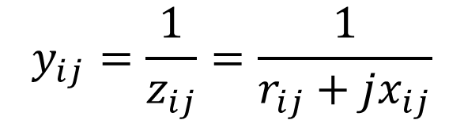
Formation of Bus Admittance Matrix or Y_{BUS}
Form the nodal solution based upon Kirchhoff’s Current Law (KCL)
Impedances are converted to Admittances
$$I_{k−inj}=y_{k0}V_{k}+y_{k1}{(V}_{k}−V_{1})+y_{k2}{(V}_{k}−V_{2})+y_{kn}{(V}_{k}−V_{n})$$
$$y_{ij}=\frac{1}{z_{ij}}=\frac{1}{r_{ij}+jx_{ij}}$$

Slide 8
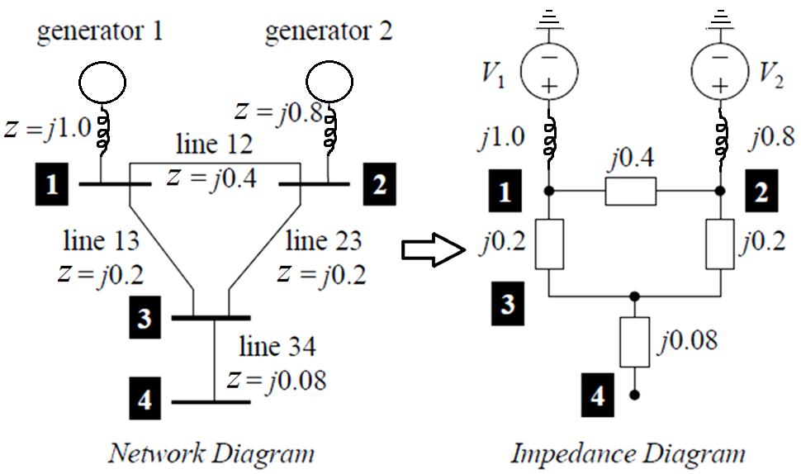
Example of Bus Admittance Matrix or Y_{BUS} Formation

Slide 9
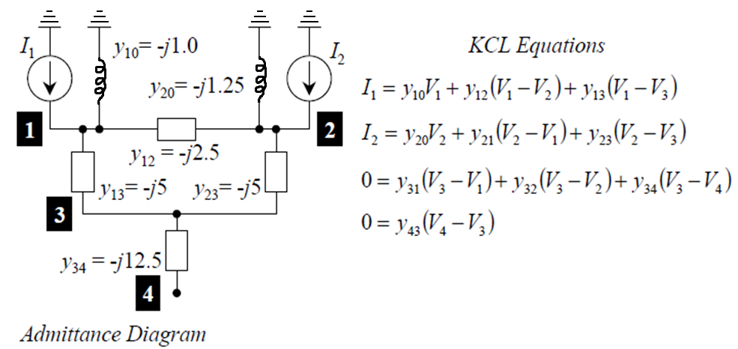
Example of Bus Admittance Matrix or Y_{BUS} Formation
The circuit has been redrawn in Figure below in terms of admittances and transformation to current sources. Node O (ground) is taken as reference. Applying KCL to the independent nodes 1 through 4 :

Slide 10
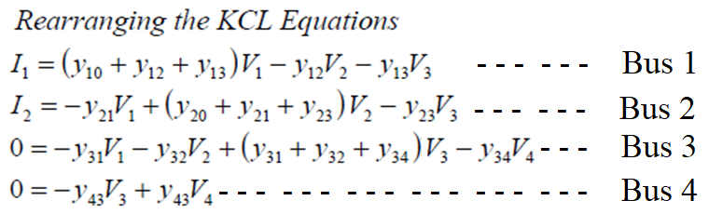
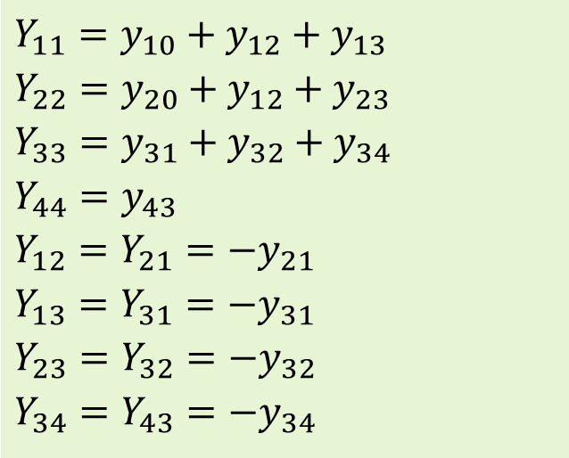
Example of Bus Admittance Matrix or Y_{BUS} Formation
Rearranging the KCL Equations:
Admittances:
$$Y_{11}=y_{10}+y_{12}+y_{13} \\ Y_{22}=y_{20}+y_{12}+y_{23} \\ Y_{33}=y_{31}+y_{32}+y_{34} \\ Y_{44}=y_{43} \\ Y_{12}=Y_{21}=−y_{21} \\ Y_{13}=Y_{31}=−y_{31} \\ Y_{23}=Y_{32}=−y_{32} \\ Y_{34}=Y_{43}=−y_{34}$$

Slide 11
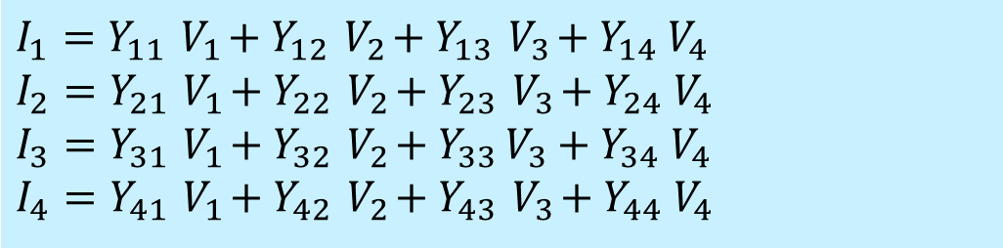
Example of Bus Admittance Matrix or Y_{BUS} Formation
The node equation reduces to:
$$I_{1}=Y_{11}{ V}_{1}+Y_{12}{ V}_{2}+Y_{13}{ V}_{3}+Y_{14}{ V}_{4} \\ I_{2}=Y_{21}{ V}_{1}+Y_{22}{ V}_{2}+Y_{23}{ V}_{3}+Y_{24}{ V}_{4} \\ I_{3}=Y_{31}{ V}_{1}+Y_{32}{ V}_{2}+Y_{33 }V_{3}+Y_{34}{ V}_{4} \\ I_{4}=Y_{41}{ V}_{1}+Y_{42}{ V}_{2}+Y_{43}{ V}_{3}+Y_{44}{ V}_{4}$$
In the network given, since there is no connection between bus 1 and bus 4, Y₁₄ = Y₄₁ = 0; Y₂₄ = Y₄₂ = 0
Where :
I_{bus} is the vector of injected bus currents (external current sources).
V_{bus} is the vector bus voltages measured from the reference node (node voltages)
Y_{bus} is known as the bus admittance matrix

Slide 12
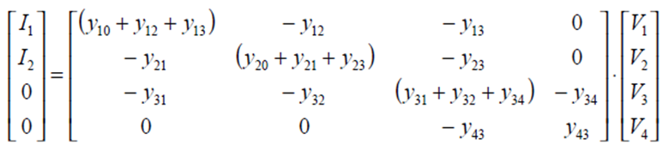
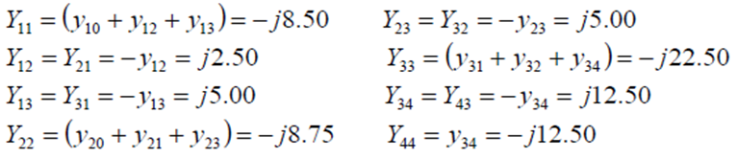
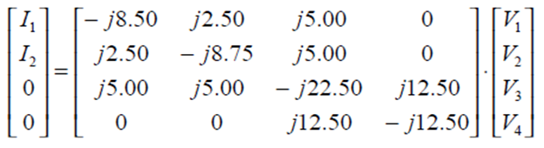
Example of Bus Admittance Matrix or Y_{BUS} Formation
The matrix formation of the equations:
Completed matrix equations:
And, finally…

Slide 13
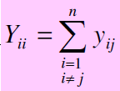


Y_{BUS} Matrix Building Rules
The diagonal element of each node = the sum of admittances connected to it. Commonly known as Self-admittance or driving point admittance
The off-diagonal element = the negative of the admittance between the nodes. Commonly known as mutual admittance or transfer admittance
With large systems, Y_{bus} is a sparse matrix (most entries are zero)
Shunt terms, such as π-line model, only affect the diagonal terms

Slide 14
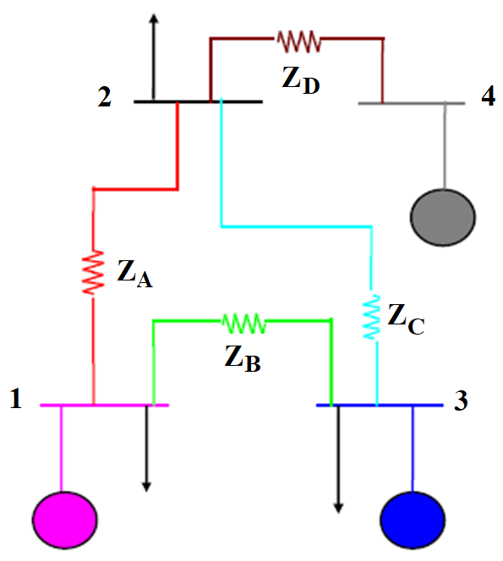
Example 1
Determine the bus admittance matrix for the network below in Figure 1, assuming the current injection at each bus i is I_{i} = I_{Gi} – I_{Di} where I_{Gi} is the current injection into the bus from generator and I_{Di} is the current flowing into the load

Slide 15
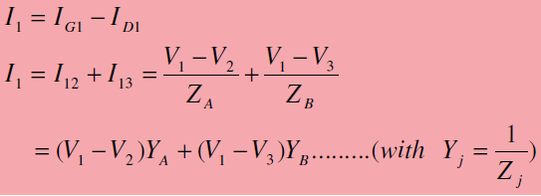
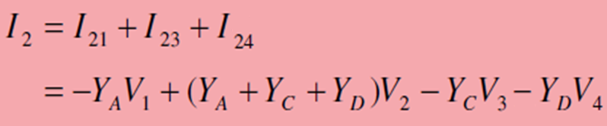
Example 1
By Kirchhoff’s Current Law at bus 1,

Slide 16
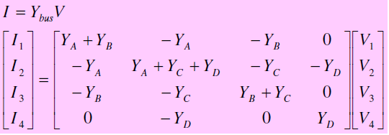
Example 1
Similar relationships for buses 3 and 4. The results can be expressed in matrix form

Slide 17
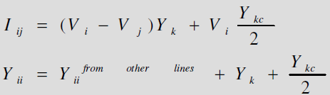

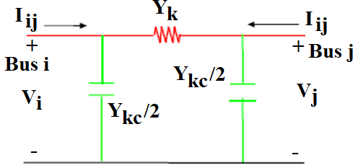
Modeling Shunt in the Y_{BUS}

Slide 18
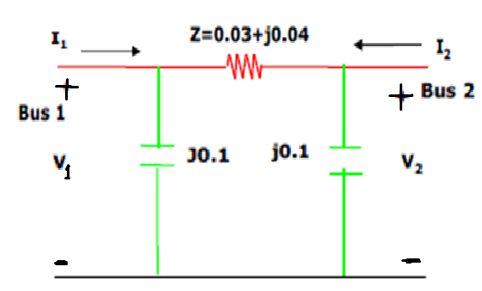
Modeling Shunt in the Y_{BUS}
Example 2
Modeling Shunts in the Y_{bus}. Find the power injected at bus 1 if V_{bus} is given and find the power injected if I_{bus} is given in Figure 2
Figure 2

Slide 19
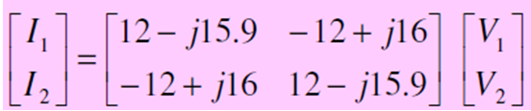


Modeling Shunt in the Y_{BUS}
Example 2: Solution
Solving for Bus Current, I_{bus} if V_{bus} given below:-

Slide 20



Modeling Shunt in the Y_{BUS}
Example 2: Solution
Therefore, the power injected at bus 1 is:
Solving for Bus Voltage, V_{bus} if I_{bus} given below:-

Slide 21

Modeling Shunt in the Y_{BUS}
Example 2: Solution
Therefore, the power injected is:

Slide 22
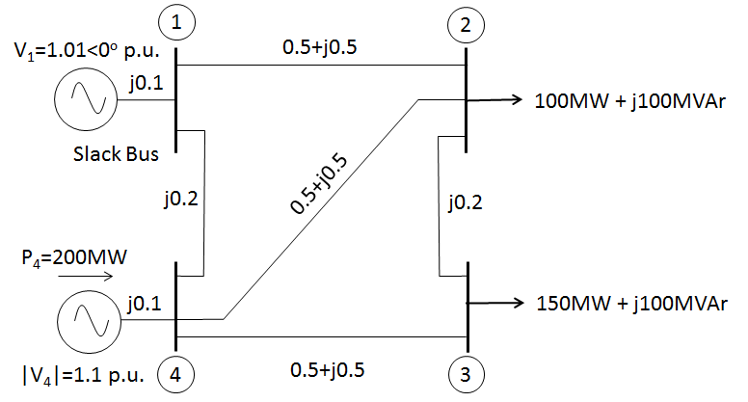
Modeling Shunt in the Y_{BUS}
Example 3
Figure 3 shows the one-line diagram of four-bus power system with generation at bus 1 and bus 4. The voltage at bus 1 is V₁ =1.01 <0º per unit. The Voltage magnitude at bus 4 is fixed at 1.1 pu with a real power generation of 200 MW. The scheduled loads on buses 2 and 3 are marked on the diagram. Line impedances are marked in per unit on a 100-MVA base. Create the admittance matrix bus using KCL method.
Figure 3

Slide 23
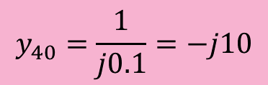
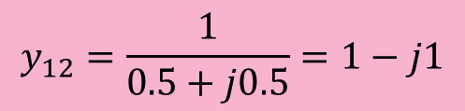
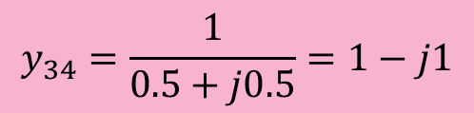
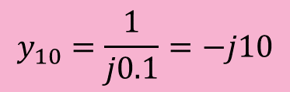
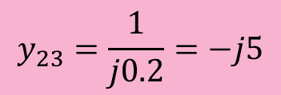
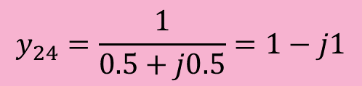

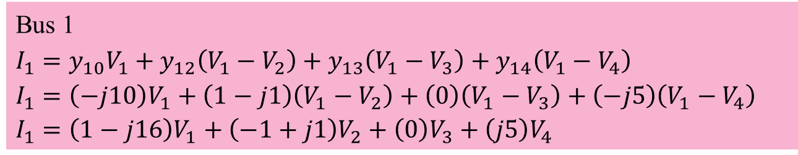
Modeling Shunt in the Y_{BUS}
Example 3: Solution
$$y_{10}=\frac{1}{j0.1}=−j10$$
$$y_{12}=\frac{1}{0.5+j0.5}=1−j1$$
$$y_{14}=\frac{1}{j0.2}=−j5$$
$$y_{23}=\frac{1}{j0.2}=−j5$$
$$y_{24}=\frac{1}{0.5+j0.5}=1−j1$$
$$y_{34}=\frac{1}{0.5+j0.5}=1−j1$$
$$y_{40}=\frac{1}{j0.1}=−j10$$
Bus 1
$$I_{1}=y_{10}V_{1}+y_{12}\left(V_{1}−V_{2}\right)+y_{13}\left(V_{1}−V_{3}\right)+y_{14}\left(V_{1}−V_{4}\right)$$
$$I_{1}=\left(−j10\right)V_{1}+\left(1−j1\right)\left(V_{1}−V_{2}\right)+\left(0\right)\left(V_{1}−V_{3}\right)+\left(−j5\right)\left(V_{1}−V_{4}\right)$$
$I_{1}=\left(1−j16\right)V_{1}+\left(−1+j1\right)V_{2}+\left(0\right)V_{3}+\left(j5\right)V_{4}$

Slide 24
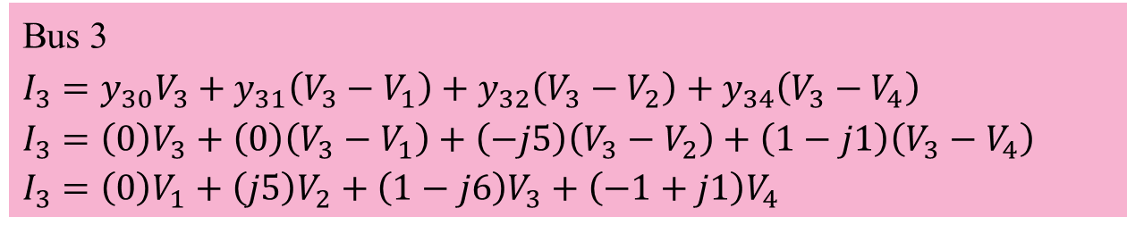
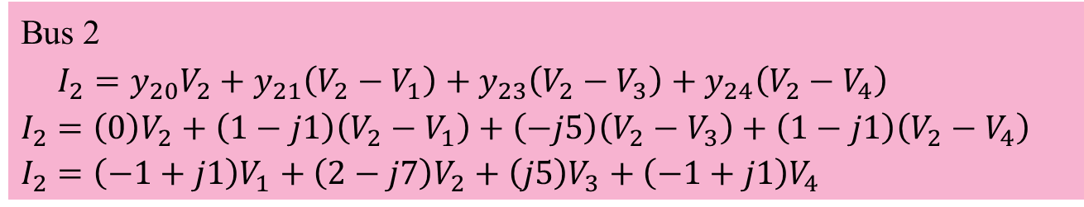
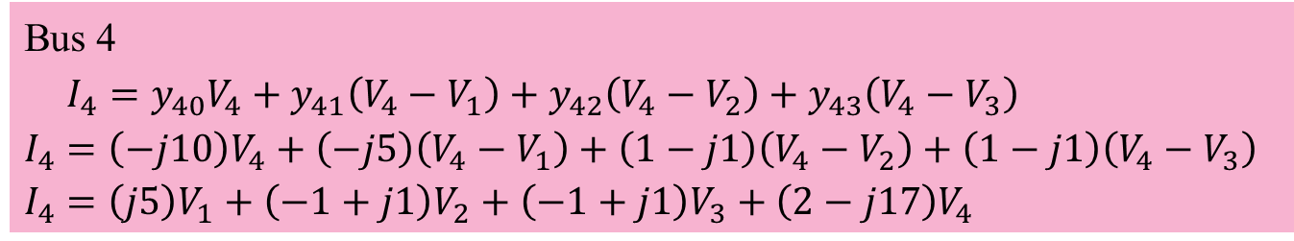
Modeling Shunt in the Y_{BUS}
Example 3: Solution
Bus 2
$$I_{2}=y_{20}V_{2}+y_{21}\left(V_{2}−V_{1}\right)+y_{23}\left(V_{2}−V_{3}\right)+y_{24}\left(V_{2}−V_{4}\right)$$
$$I_{2}=\left(0\right)V_{2}+\left(1−j1\right)\left(V_{2}−V_{1}\right)+\left(−j5\right)\left(V_{2}−V_{3}\right)+\left(1−j1\right)\left(V_{2}−V_{4}\right)$$
$I_{2}=\left(−1+j1\right)V_{1}+\left(2−j7\right)V_{2}+\left(j5\right)V_{3}+\left(−1+j1\right)V_{4}$
Bus 3
$$I_{3}=y_{30}V_{3}+y_{31}\left(V_{3}−V_{1}\right)+y_{32}\left(V_{3}−V_{2}\right)+y_{34}\left(V_{3}−V_{4}\right)$$
$$I_{3}=\left(0\right)V_{3}+\left(0\right)\left(V_{3}−V_{1}\right)+\left(−j5\right)\left(V_{3}−V_{2}\right)+\left(1−j1\right)\left(V_{3}−V_{4}\right)$$
$I_{3}=\left(0\right)V_{1}+\left(j5\right)V_{2}+\left(1−j6\right)V_{3}+\left(−1+j1\right)V_{4}$
Bus 4
$$I_{4}=y_{40}V_{4}+y_{41}\left(V_{4}−V_{1}\right)+y_{42}\left(V_{4}−V_{2}\right)+y_{43}\left(V_{4}−V_{3}\right)$$
$$I_{4}=\left(−j10\right)V_{4}+\left(−j5\right)\left(V_{4}−V_{1}\right)+\left(1−j1\right)\left(V_{4}−V_{2}\right)+\left(1−j1\right)\left(V_{4}−V_{3}\right)$$
$I_{4}=\left(j5\right)V_{1}+\left(−1+j1\right)V_{2}+\left(−1+j1\right)V_{3}+\left(2−j17\right)V_{4}$

Slide 25
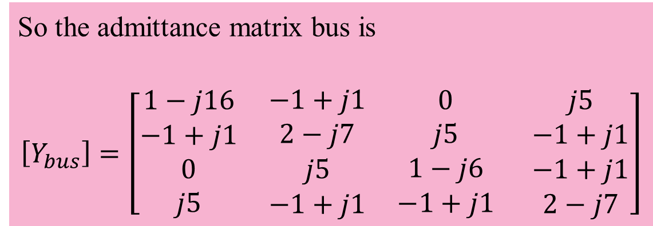
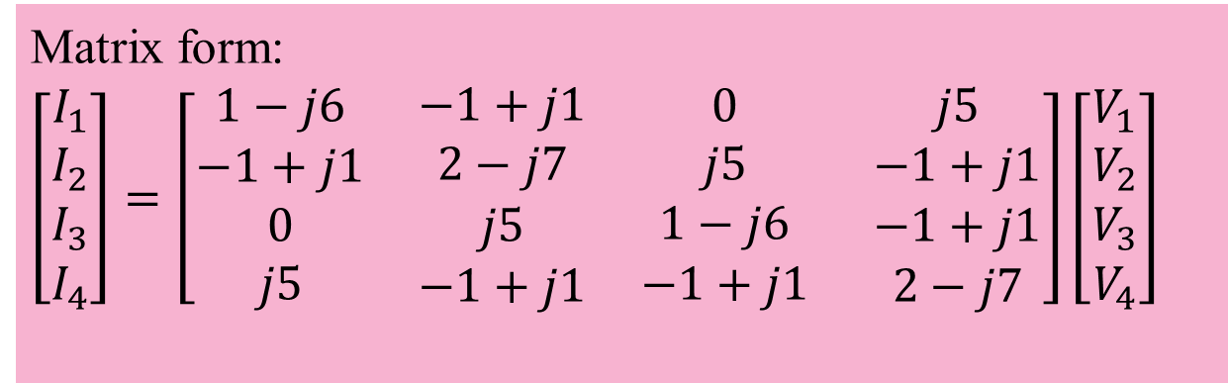
Modeling Shunt in the Y_{BUS}
Example 3: Solution
Matrix form:
$\left[\begin{aligned}I_{1} \\ I_{2} \\ I_{3} \\ I_{4}\end{aligned}\right]=\left[\begin{aligned}1−j6 \\ −1+j1 \\ 0 \\ j5\end{aligned} \begin{aligned}−1+j1 \\ 2−j7 \\ j5 \\ −1+j1\end{aligned} \begin{aligned}0 \\ j5 \\ 1−j6 \\ −1+j1\end{aligned} \begin{aligned}j5 \\ −1+j1 \\ −1+j1 \\ 2−j7\end{aligned}\right]\left[\begin{aligned}V_{1} \\ V_{2} \\ V_{3} \\ V_{4}\end{aligned}\right]$
So the admittance matrix bus is
$$\left[Y_{bus}\right]=\left[\begin{aligned}1−j16 \\ −1+j1 \\ 0 \\ j5\end{aligned} \begin{aligned}−1+j1 \\ 2−j7 \\ j5 \\ −1+j1\end{aligned} \begin{aligned}0 \\ j5 \\ 1−j6 \\ −1+j1\end{aligned} \begin{aligned}j5 \\ −1+j1 \\ −1+j1 \\ 2−j7\end{aligned}\right]$$

Slide 26
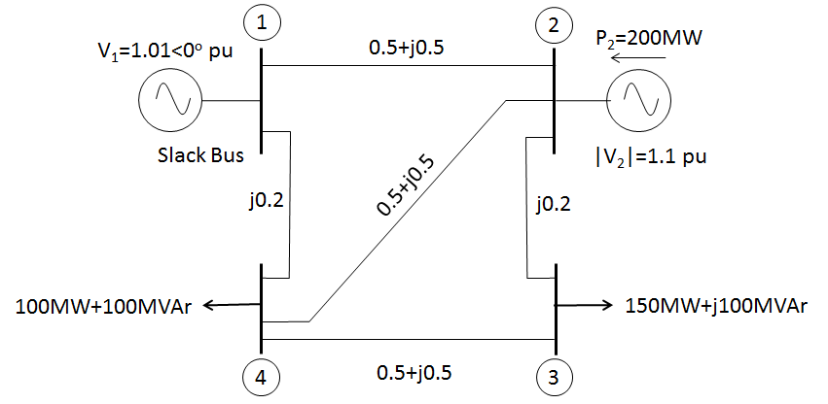
Modeling Shunt in the Y_{BUS}
Exercise 1:
Figure 1 shows the one-line diagram of four-bus power system with generation at bus 1 and bus 2. The voltage at bus 1 is V₁ =1.01 <0º per unit. The Voltage magnitude at bus 2 is fixed at 1.1 pu with a real power generation of 200 MW. The scheduled loads on buses 3 and 4 are marked on the diagram. Line impedances are marked in per unit on a 100-MVA base. Form the bus admittance matrix using KCL method.
Figure 1

Slide 27
Modeling Shunt in the Y_{BUS}
Exercise 2:
Figure 2 shows the single-line diagram of a three-bus power system with generation at buses 1 and 3. The voltage at bus 1 is V₁ = 1.03∠0° p.u. The scheduled load on bus 2 is marked on the diagram. The line impedance is marked in p.u on a 100 MVA base. Line resistances and line charging susceptances are neglected. Form the bus admittance matrix using KCL method.
Figure 2

Slide 28
Modeling Shunt in the Y_{BUS}
Exercise 3:
Figure 3 shows a power system network. The generator at buses 1 and 2 are represented by their equivalent sources with their reactances in per unit on a 100-MVA base. The lines are represented by π model where series reactances and shunt reactances are also expressed in per unit on a 100 MVA base. The loads at buses 3 and 4 are expressed in MW and MVAR. Assuming voltage magnitude of 1.0 per unit at buses 3 and 4, convert the loads to per unit impedances. Convert network impedances to admittances and obtain the bus admittance matrix.
Figure 3

Slide 29
Exercise 3
Figure 3 shows a power system network. The generator at buses 1 and 2 are represented by their equivalent sources with their reactances in per unit on a 100-MVA base. The lines are represented by π model where series reactances and shunt reactances are also expressed in per unit on a 100 MVA base. The loads at buses 3 and 4 are expressed in MW and MVAR. Assuming voltage magnitude of 1.0 per unit at buses 3 and 4, convert the loads to per unit impedances. Convert network impedances to admittances and obtain the bus admittance matrix.
Figure 3

Slide 30


