Slide 1
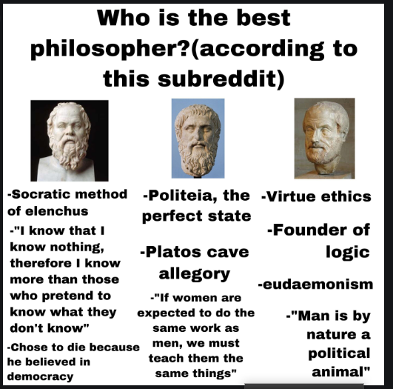

Slide 2
https://www.slideshare.net/sabarai1/major-themes-and-analysis-of-aristotle-poetics
https://www.slideshare.net/stmaryspg2014/aristotles-poetics-57380837
Poetry is th
https://www.powershow.com/view/f0b65-MjBiZ/Aristotles_Poetics_powerpoint_ppt_presentation?varnishcache=1e most ancient form of Art

Slide 3
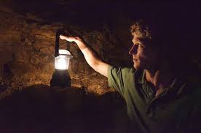
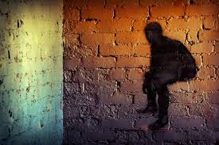
Cave Allegory
There is an ideal place of real things rest in the world are mere imitation.
Real Unreal

Slide 5
Kinds of Poetry

Slide 6
TRAGEDY- FOUR TYPES OF EVOLVMENT
Dithyrambic(Chorus)
Aeschylus( Chorus+ 2nd character)
Sophocles (Chorus+ 2nd+ 3rd character)
Episodic

Slide 7
Tragedy

Slide 10
SIX PARTS OF TRAGEDY
Plot
Character
Spectacle
Diction
Melody
Thought

Slide 11
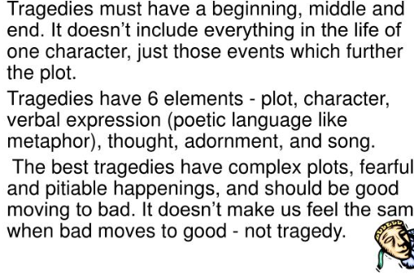
PLOT= Action+ Unity
Plot/ mythos=action+ incident=story

Slide 12
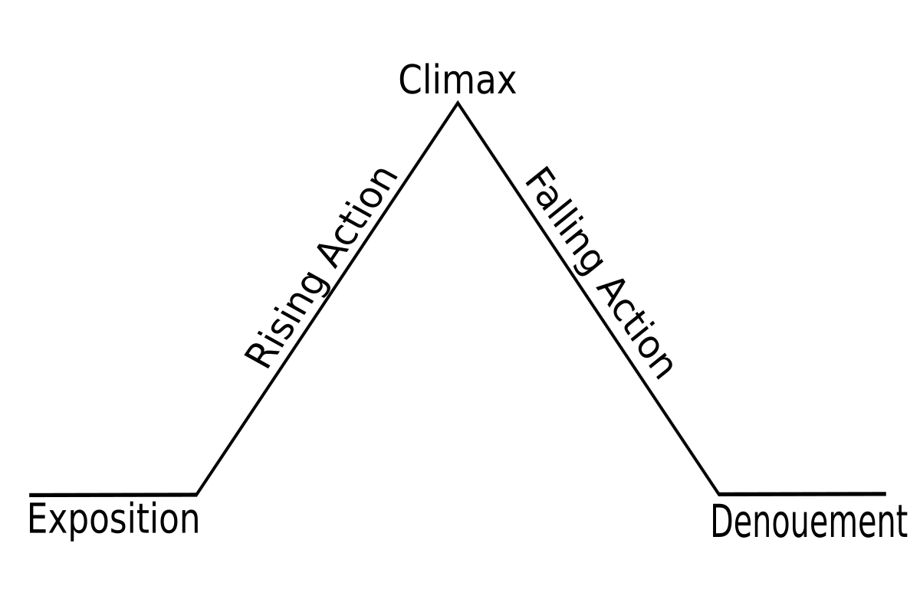
This Photo by Unknown Author is licensed under CC BY-SA

Slide 17
Action
Beginning---middle---end

Slide 18
Unity
Unity of time
Unity of place
Unity of action

Slide 19
Tragic hero should be
Good
Appropriate
Real
Consistent

Slide 20
Some ideas a plot should have
Hamartia
Anagnorsis
Peripetia

Slide 21
Anagnorisis (6 types)

Slide 22
How to construct plot(7 points)

Slide 23
Diction

Slide 24
Epic poetry

Slide 25
Answers to the allegation

