Slide 1
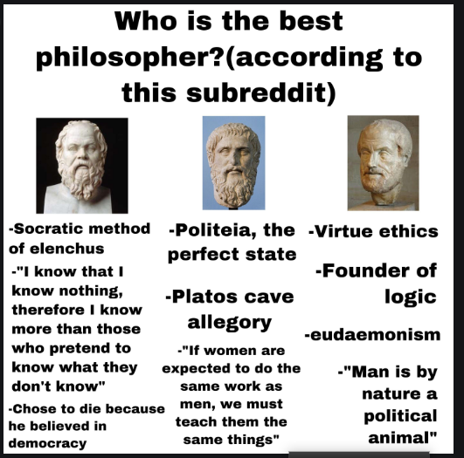

Slide 2
https://www.slideshare.net/sabarai1/major-themes-and-analysis-of-aristotle-poetics
https://www.slideshare.net/stmaryspg2014/aristotles-poetics-57380837
Poetry is th
https://www.powershow.com/view/f0b65-MjBiZ/Aristotles_Poetics_powerpoint_ppt_presentation?varnishcache=1e most ancient form of Art

Slide 3
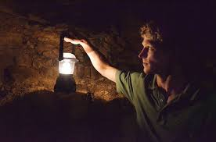
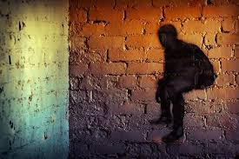
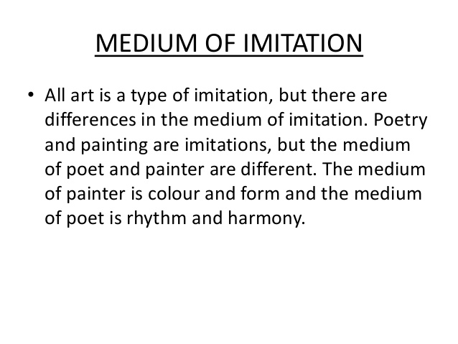
Cave Allegory
There is an ideal place of real things rest in the world are mere imitation.
Real Unreal

Slide 4
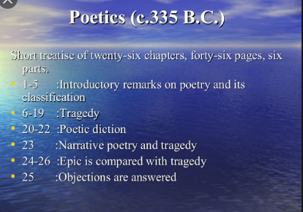

Slide 5
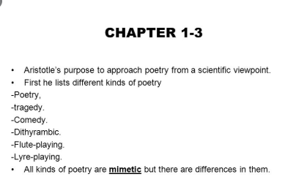
Kinds of Poetry

Slide 6
TRAGEDY- FOUR TYPES OF EVOLVMENT
Dithyrambic(Chorus)
Aeschylus( Chorus+ 2nd character)
Sophocles (Chorus+ 2nd+ 3rd character)
Episodic

Slide 7
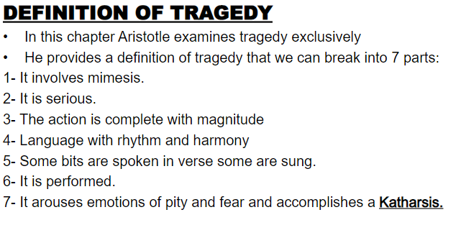
Tragedy

Slide 8
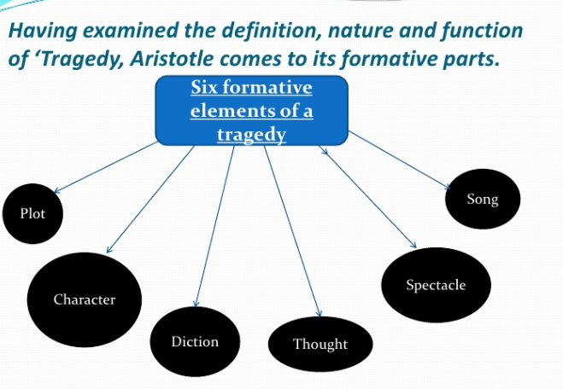

Slide 9
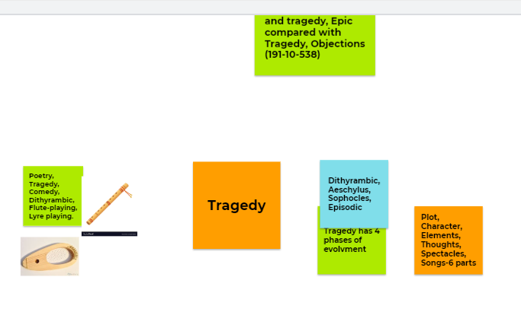

Slide 10
SIX PARTS OF TRAGEDY
Plot
Character
Spectacle
Diction
Melody
Thought

Slide 11
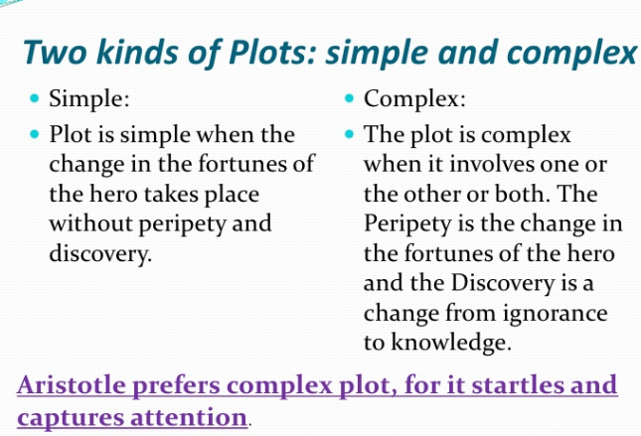
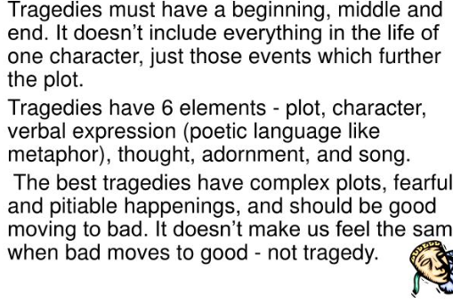
PLOT= Action+ Unity
Plot/ mythos=action+ incident=story

Slide 12
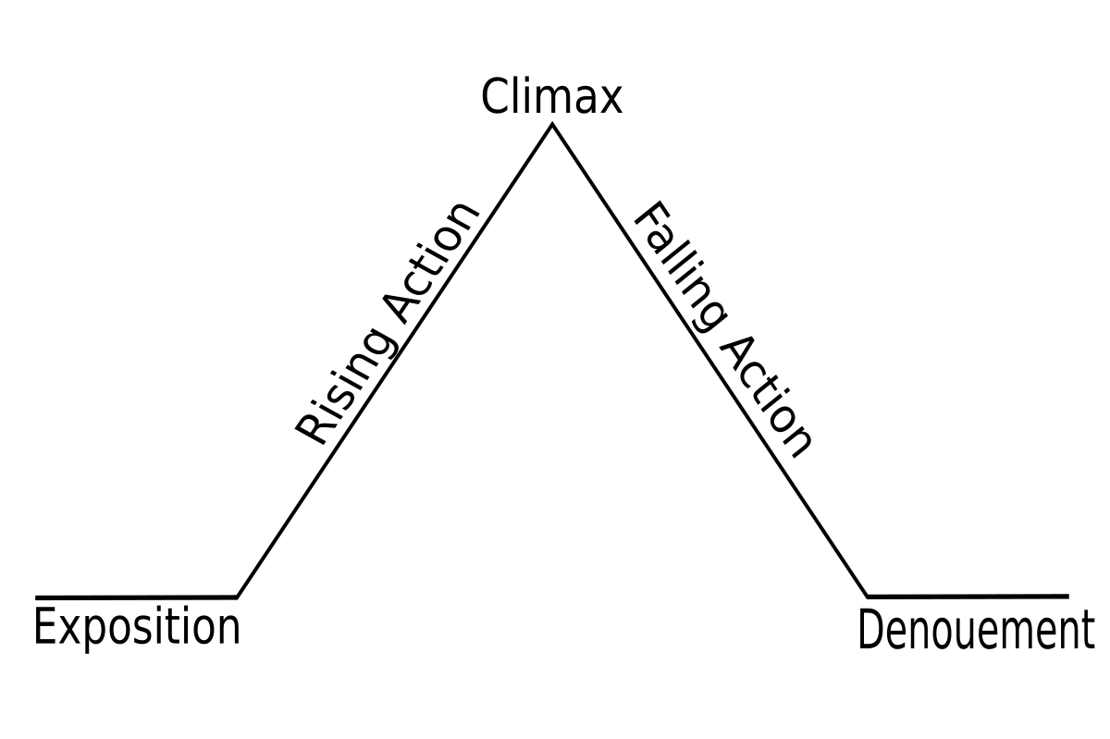
This Photo by Unknown Author is licensed under CC BY-SA

Slide 13
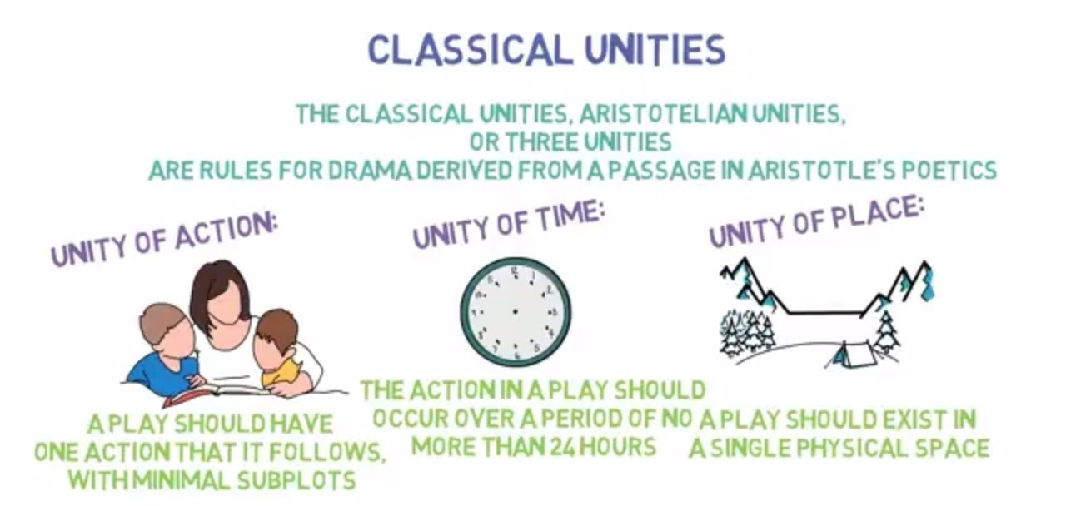

Slide 14
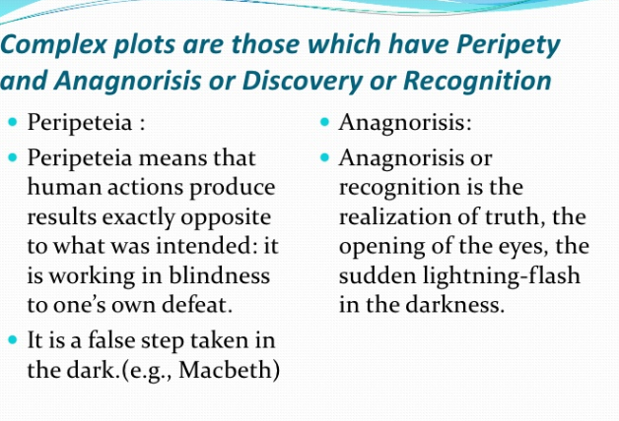
Features of Complex Plot Anagnorisis
Sign and marks(Swollen foot)
Recognition set by the author
Memory spoken by some character
Deductive reasoning by some character
Disguised charcter breaking faulty reasoning
Logical reasoning from the events of the play.

Slide 15
Seven rules by Aristotle to make better plot
Visualize the action
The poet should try to act out
Outline the plot then device the episodes
Should have desis, rising to complication and lusis or denouement
There are four types of tragedy.(the water should ft well into one of these: complex tragedy /tragedy of character/trgedy of suffering /tragey of spectacle.
Should not tell the whole story in details like Iliad, rather poetry one episode
Chorus should be treated like an actor and chorus song integral pat of the story.

Slide 16
Tragic hero should be
Good
Appropriate
Real
Consistent

Slide 17
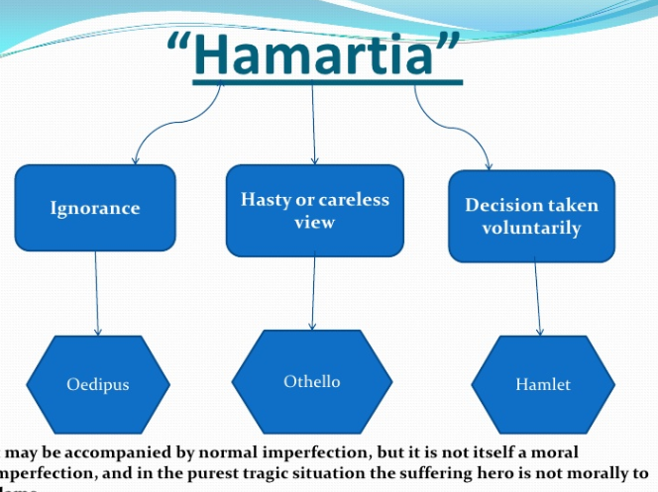
A great tragic hero shows Hamaratia or Tragic Flaw

Slide 18
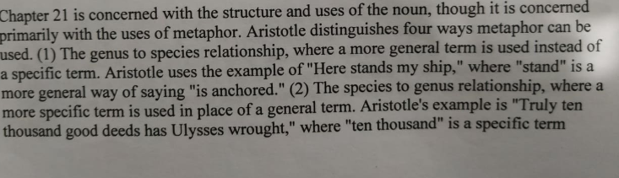
Diction
Letter
Syllable
Conjunction
Article
Noun
Verb
Case
Speech

Slide 19
Metaphors
*general term is used instead of specific term.
*begin very specific .
* specific can ne more specific in literature. Ten thousand good deeds =1good deeds jesus christ
*some time metaphor is analogous.

Slide 20
Tragedy vs Narrative poetry
1) Narrative poetry and Tragedy differences: 1) Only language vs Action based on dialogue
2) Longer vs shorter
3) No Music and no theatre vs Music and theatre
4) Many fantastic events vs No fantastic events
5) No visualization but imagination vs Visualization but no imagination
6) Improbable vs Probable
7) Elevated meter and lofty language vs Iambic meter
8) Digression and Too many episodes vs Less digression and less episode

Slide 21
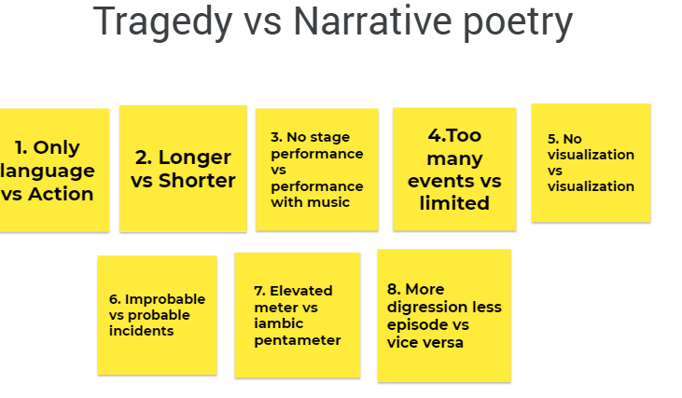

Slide 22
Which is better?
First says Epic poetry is less vulgar/refined audience who can read who need not be made happy a crowd audience with melodramatic acting /more cultivated as it does not rely on gesture to express its message.
But finally, he says Tragedy is superior, because overacting of tragedy is not the fault of the poet. It has all the elements of epic plus sng and dance.

Slide 23
Answers to the allegation against poetry (chapter 26)
Events depicted are impossible
Less grave
No fact but fiction
Aristotle replies that
Poetry is higher reality and what ought to be not what is
Surpass reality.

Slide 24
Quiz Questions(1 broad + 1 short=10+5)
Broad
Paint or create chart(poster like) of the whole essay. 10 marks.
Write a drama following the rules of tragedy as given by Aristotle.
What ideas do you dislike in each chapters .Refute.
Short
Anagnorisis in a movie or any story. 5 marks
Three unities in a movie or any story.
Hamartia in a movie star .

