Slide 1
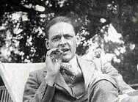
Tradition and Individual Talent

Slide 2
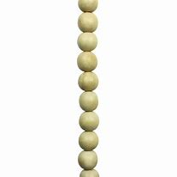
Which one is Traditional?

Slide 3
