Slide 1
CSE 412: Artificial Intelligence
Topic – 3: Solving Problems by Searching
Course Teacher:
Md. Tarek Habib
Assistant Professor
Department of Computer Science and Engineering
Daffodil International University
Notes:
1

Slide 2
Topic Contents
Problem Solving Agents
Problem Formulation and Search Spaces
Example Problems
Tree Search Algorithm
Breadth-First Search
Uniform-Cost Search
Depth-First Search
Depth-Limited Search
Iteratively Deepening Search
Bidirectional Search
2

Slide 3
Introduction
In this topic, we see how an agent can find a sequence of actions that achieves its goals, when no single action will do.
Md. Tarek Habib
3

Slide 4
Problem-Solving Agent
Four general steps in problem solving:
Goal formulation
What are the successful world states
Problem formulation
What actions and states to consider given the goal
Search
Examine different possible sequences of actions that lead to states of known value and then choose the best sequence
Execute
Perform actions on the basis of the solution
Md. Tarek Habib
4

Slide 5
Example: Romania
Md. Tarek Habib
5

Slide 6
Example: Romania
On holiday the agent is in Romania visiting in Arad. Flight leaves tomorrow from Bucharest.
Formulate goal
Be in Bucharest
Formulate problem
States: various cities
Actions: drive between cities
Find solution
Sequence of cities; e.g. Arad, Sibiu, Fagaras, Bucharest,…
Md. Tarek Habib
6

Slide 7
Problem Formulation
A problem is defined by:
An initial state, e.g. In(Arad)
A successor function S(x) = set of action-state pairs
S(In(Arad)) = {(Go(Sibiu), In(Sibiu)), (Go(Zerind), In(Zerind)), (Go(Timisoara), In(Timisoara))}
initial state + successor function = state space
Goal test
Explicit, e.g. x=‘In(Bucharest)’
Path cost (assume additive)
e.g. sum of distances, number of actions executed, …
A solution is a sequence of actions from initial to goal state
the optimal solution has the lowest path cost
Md. Tarek Habib
7

Slide 8
Example Problems
The problem-solving approach has been applied to a vast array of task environments.
Some of the best known are listed here, distinguishing between toy and real-world problems.
A toy problem is intended to illustrate or exercise various problem-solving methods.
It is usable by different researchers to compare the performance of algorithms.
A real-world problem is one whose solutions people actually care about.
We will mainly focus on toy problems in this topic.
Md. Tarek Habib
8

Slide 9
Toy Problems: 8-Puzzle
States: location of each tile plus blank
Initial state: Any state can be initial
Actions: Move blank {Left, Right, Up, Down}
Goal test: Check whether goal configuration is reached
Path cost: Number of actions to reach goal
Md. Tarek Habib
9

Slide 10
Toy Problems: 8-Queens
Place eight queens on a chessboard such that no queen attacks any other.
Two kinds of problem formulation:
Complete-state formulation
Incremental formulation
Md. Tarek Habib
10

Slide 11
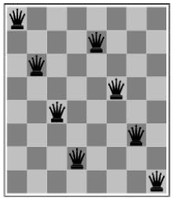
Toy Problems: 8-Queens
Incremental-state formulation
States: Any arrangement of 0 to 8 queens on the board
Initial state: No queens
Actions: Add queen to any empty square
Goal test: 8 queens on board and none attacked
Path cost: N/A
64.63.62…..57 ≈ 3 x 10¹⁴ possible sequences to investigate
Md. Tarek Habib
11

Slide 12
Toy Problems: 8-Queens
Complete State formulation
States: n (0 to 8) queens on the board, one per column in the n leftmost columns with no queen attacking any other
Actions: Add queen in leftmost empty column such that the queen is not attacking any other queen
2057 possible sequences to investigate; solutions are easy to find
But with 100 queens the problem is much harder
12

Slide 13
Real-World Problems
Route-finding problems
Touring problems
Traveling Salesman problem
VLSI layout problem
Robot navigation
Automatic assembly sequencing
Internet searching
Md. Tarek Habib
13

Slide 14
Basic Search Algorithms
How do we find the solutions of previous problems?
Search the state space
State space can be represented by a search tree
Root of the tree is the initial state
Children generated through successor function
In general we may have a search graph rather than tree (same state can be reached through multiple paths)
Md. Tarek Habib
14

Slide 15
Simple Tree Search Example
Md. Tarek Habib
15

Slide 16
Simple Tree Search Example
Md. Tarek Habib
16

Slide 17
Simple Tree Search Example
Md. Tarek Habib
17

Slide 18
State Space vs. Search Tree
A state corresponds to a configuration of the world
A node is a data structure in a search tree
e.g. node = <state, parent-node, action, path-cost, depth>
Md. Tarek Habib
18

Slide 19
Search Strategies
A search strategy is defined by picking the order of node expansion
Problem-solving performance is measured in four ways:
Completeness: Is a solution found if one exists?
Optimality: Does the strategy find the optimal solution?
Time Complexity: How long does it take to find a solution?
Space Complexity: How much memory is needed to perform the search?
Time and space complexity are measured in terms of problem difficulty defined by:
b - branching factor of the search tree
d - depth of the shallowest goal node
m - maximum length of any path in the state space
Md. Tarek Habib
19

Slide 20
Uninformed Search Strategies
Uninformed search (or blind search)
Strategies have no additional information about states beyond that provided in the problem definition
Uninformed strategies (defined by order in which nodes are expanded):
Breadth-first search
Uniform-cost search
Depth-first search
Depth-limited search
Iterative deepening search
Bidirectional search
Md. Tarek Habib
20

Slide 21
Informed Search Strategies
Informed (or heuristic) search
Search strategies know whether one state is more promising than another
Examples of informed search strategies:
Greedy best-first search
A* search
Iterative-deepening A* (IDA*) search
Recursive best-first search (RBFS)
Memory-bounded A* (MA*) search
Simplified memory-bounded A* (SMA*) search
Md. Tarek Habib
21

Slide 22
Breadth-First Search
Expand shallowest unexpanded node
Fringe is the collection of nodes that have been generated but not yet expanded.
The set of all leaf nodes available for expansion at any given point is called the frontier.
Implementation: fringe/frontier is a FIFO queue
22

Slide 23
Breadth-First Search
Md. Tarek Habib
23

Slide 24
Breadth-First Search
Md. Tarek Habib
24

Slide 25
Breadth-First Search
Md. Tarek Habib
25

Slide 26
Breadth-First Search
Completeness: is a solution always found if one exists?
YES
If shallowest goal node is at some finite depth d
If branching factor b is finite
BF search is optimal if the path cost is a non-decreasing function of the depth of the node
Md. Tarek Habib
26

Slide 27
Breadth-First Search
Time complexity: Assume a state space where every state has b successors
Assume solution is at depth d
Worst case: expand all but the last node at depth d
Total number of nodes generated:
b + b² + b³ + ...+ b^{d} + (b^{d +1}− b) = O(b^{d +1})
Space complexity: every node generated must remain in memory, so same as time complexity
Md. Tarek Habib
27

Slide 28
Breadth-First Search
Memory requirements are a bigger problem than execution time.
Md. Tarek Habib
28

Slide 29
Uniform-Cost Search
Extension of BF-search:
Expand node with lowest path cost
Implementation: fringe = queue ordered by path cost
UC-search is the same as BF-search when all step costs are equal
Md. Tarek Habib
29

Slide 30
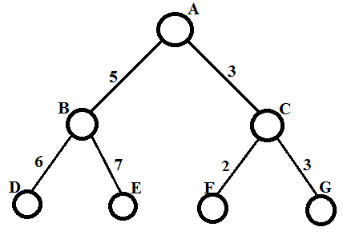
Uniform-Cost Search
Let us consider the following search tree, where A and G are the initial and goal node, respectively.
Md. Tarek Habib
30

Slide 31
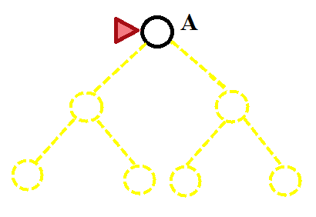
Uniform-Cost Search
Md. Tarek Habib
31

Slide 32
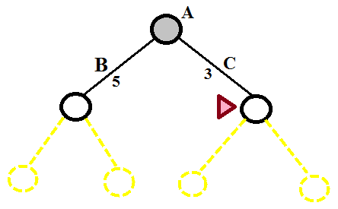
Uniform-Cost Search
Md. Tarek Habib
32

Slide 33
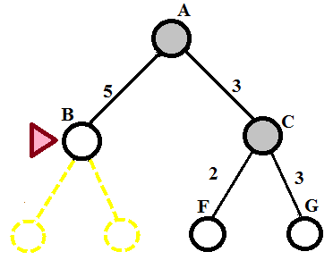
Uniform-Cost Search
Md. Tarek Habib
33

Slide 34
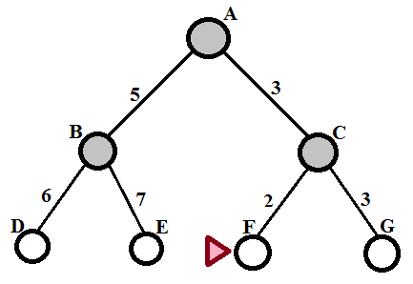
Uniform-Cost Search
Md. Tarek Habib
34

Slide 35
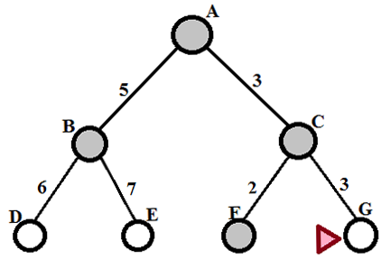
Uniform-Cost Search
Md. Tarek Habib
35

Slide 36
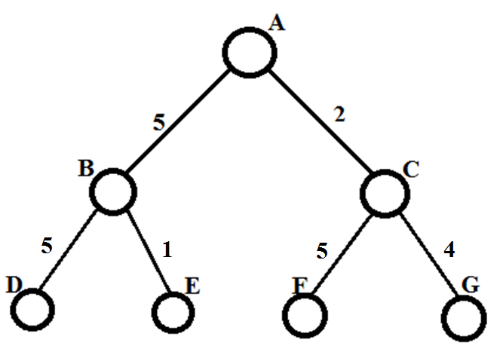
Uniform-Cost Search
Let us consider the another search tree, where A and G are the initial and goal node, respectively.
Md. Tarek Habib
36

Slide 37
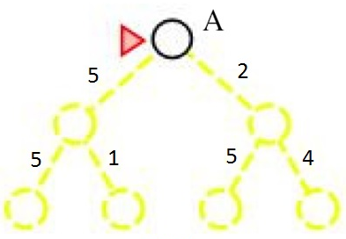
Uniform-Cost Search
Md. Tarek Habib
37

Slide 38
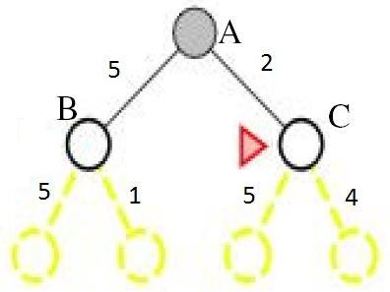
Uniform-Cost Search
Md. Tarek Habib
38

Slide 39
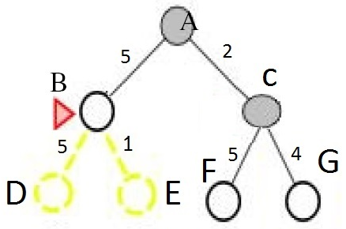
Uniform-Cost Search
Md. Tarek Habib
39

Slide 40
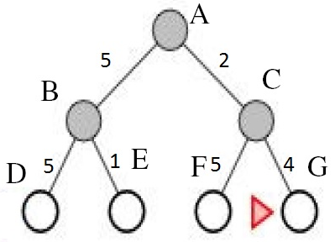
Uniform-Cost Search
Md. Tarek Habib
40

Slide 41
Uniform-Cost Search
Completeness:
YES, if step-cost > some small positive constant ε
Optimality:
nodes expanded in order of increasing path cost
YES, if complete
Time and space complexity:
Uniform-cost search is guided by path costs rather than depths, so its complexity cannot easily be characterized in terms of b and d.
Instead, assume C* is the cost of the optimal solution
Assume that every action costs at least ε
Worst-case: O(b^{C*/ε})
Md. Tarek Habib
41

Slide 42
Depth-First Search
Expand deepest unexpanded node
Implementation: fringe is a LIFO queue (= stack)
Md. Tarek Habib
42

Slide 43
Depth-First Search
Expand deepest unexpanded node
Implementation: fringe is a LIFO queue (= stack)
Md. Tarek Habib
43

Slide 44
Depth-First Search
Expand deepest unexpanded node
Implementation: fringe is a LIFO queue (= stack)
Md. Tarek Habib
44

Slide 45
Depth-First Search
Expand deepest unexpanded node
Implementation: fringe is a LIFO queue (= stack)
Md. Tarek Habib
45

Slide 46
Depth-First Search
Expand deepest unexpanded node
Implementation: fringe is a LIFO queue (= stack)
Md. Tarek Habib
46

Slide 47
Depth-First Search
Expand deepest unexpanded node
Implementation: fringe is a LIFO queue (= stack)
Md. Tarek Habib
47

Slide 48
Depth-First Search
Expand deepest unexpanded node
Implementation: fringe is a LIFO queue (= stack)
Md. Tarek Habib
48

Slide 49
Depth-First Search
Expand deepest unexpanded node
Implementation: fringe is a LIFO queue (= stack)
Md. Tarek Habib
49

Slide 50
Depth-First Search
Expand deepest unexpanded node
Implementation: fringe is a LIFO queue (= stack)
Md. Tarek Habib
50

Slide 51
Depth-First Search
Expand deepest unexpanded node
Implementation: fringe is a LIFO queue (= stack)
Md. Tarek Habib
51

Slide 52
Depth-First Search
Expand deepest unexpanded node
Implementation: fringe is a LIFO queue (= stack)
Md. Tarek Habib
52

Slide 53
Depth-First Search
Expand deepest unexpanded node
Implementation: fringe is a LIFO queue (= stack)
Md. Tarek Habib
53

Slide 54
DF-Search: Evaluation
Completeness:
Is a solution always found if one exists?
No (unless search space is finite and no loops are possible)
Optimality:
Is the least-cost solution always found?
No
Md. Tarek Habib
54

Slide 55
DF-Search: Evaluation
Time complexity: O(b^{m})
In general, time is terrible if m (maximal depth) is much larger than d (depth of shallowest solution)
But if there exist many solutions then faster than BF-search
Space complexity: O(bm)
Backtracking search uses even less memory (one successor instead of all b)
Md. Tarek Habib
55

Slide 56
Depth-Limited Search
DF-search with depth limit l
i.e. nodes at depth l have no successors
Problem knowledge can be used
Solves the infinite-path problem
If l < d then incompleteness results
Time complexity: O(b^{l})
Space complexity: O(bl)
Depth-first search can be viewed as a special case of depth-limited search with l = ∞.
Md. Tarek Habib
56

Slide 57
Depth-Limited Search with l = 2
Md. Tarek Habib
57

Slide 58
Depth-Limited Search with l = 2
Md. Tarek Habib
58

Slide 59
Depth-Limited Search with l = 2
Md. Tarek Habib
59

Slide 60
Depth-Limited Search with l = 2
Md. Tarek Habib
60

Slide 61
Depth-Limited Search
DF-search with depth limit l
i.e. nodes at depth l have no successors
Problem knowledge can be used
Sometimes, depth limits can be based on knowledge of the problem.
For example, on the map of Romania there are 20 cities.
Therefore, we know that if there is a solution, it must be of length 19 at the longest, so l = 19 is a possible choice.
Md. Tarek Habib
61

Slide 62
Depth-Limited Search
But in fact if we studied the map carefully, we would discover that any city can be reached from any other city in at most 9 steps.
This number, known as the diameter of the state space, gives us a better depth limit, which leads to a more efficient depth-limited search.
Diameter of state space is the maximum distance from one state to another in the state space.
For most problems, however, we will not know a good depth limit until we have solved the problem.
Md. Tarek Habib
62

Slide 63
Iterative Deepening Search
A general strategy to find best depth limit l
Goal is found at depth d, the depth of the shallowest goal-node
Often used in combination with DF-search
Combines benefits of DF- and BF-search
Like depth-first search, its memory requirements are very modest: O(bd) to be precise.
Like breadth-first search, it is complete when the branching factor is finite and optimal when the path cost is a nondecreasing function of the depth of the node.
Md. Tarek Habib
63

Slide 64
Iterative Deepening Search
Iterative deepening search may seem wasteful, because states are generated multiple times.
It turns out this is not very costly.
The reason is that in a search tree with the same (or nearly the same) branching factor at each level, most of the nodes are in the bottom level, so it does not matter much that the upper levels are generated multiple times.
Md. Tarek Habib
64

Slide 65
Iterative Deepening Search
In an iterative deepening search, the nodes on the bottom level (depth d) are generated once, those on the next to bottom level are generated twice, and so on, up to the children of the root, which are generated d times.
So the total number of nodes generated is
N(IDS) = d.b + (d - 1).b² + ...+ 1.b^{d} = O(b^{d})
We can compare this to the nodes generated by a breadth-first search:
N(BFS) = b + b² + ...+ b^{d} + (b^{d+1} – b)= O(b^{d+1})
Notice that breadth-first search generates some nodes at depth d+1, whereas iterative deepening does not.
The result is that iterative deepening is actually faster than breadth-first search, despite the repeated generation of states.
Md. Tarek Habib
65

Slide 66
Iterative Deepening Search
For example, if b = 10 and d = 5,
Md. Tarek Habib
66

Slide 67
ID-Search: Example
Md. Tarek Habib
67

Slide 68
ID-Search: Example
Md. Tarek Habib
68

Slide 69
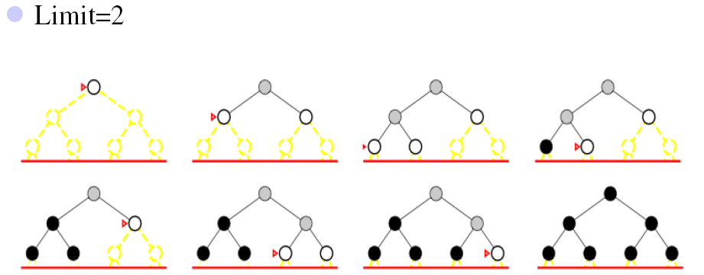
ID-Search: Example
Md. Tarek Habib
69

Slide 70
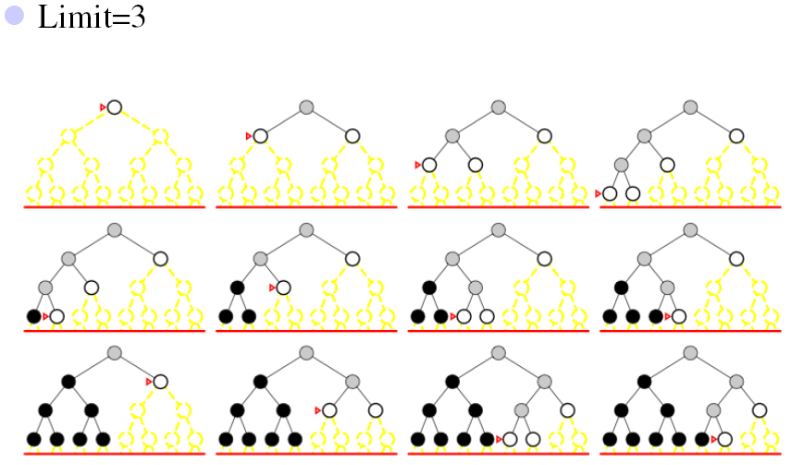
ID-Search: Example
Md. Tarek Habib
70

Slide 71
Bidirectional Search
Two simultaneous searches run from start and goal.
Motivation:
One forward from the initial state
Other backward from goal
Stops when the two searches meet in the middle
Check whether the node belongs to the other fringe before expansion
71

Slide 72
Bidirectional Search
Time complexity: O(b^{d/2})
Space complexity: O(b^{d/2})
This space complexity is the most significant weakness of bidirectional search.
Completeness and Optimality: Yes
If step costs are uniform
If both searches are breadth-first search.
Md. Tarek Habib
72

Slide 73
Bidirectional Search
The reduction in time complexity makes bidirectional search attractive, but how do we search backwards?
The predecessor of each node should be efficiently computable.
When actions are easily reversible.
Md. Tarek Habib

Slide 74
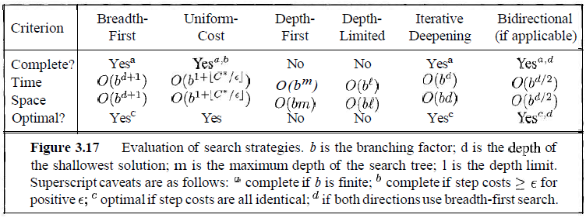
Summary of Algorithms
Md. Tarek Habib
74

