Slide 1
Spring 2021
CSE 412: Artificial Intelligence
Topic – 5: Game Playing

Slide 2
Topic Contents
Case Studies: Playing Grandmaster Chess
Game Playing as Search
Optimal Decisions in Games
Greedy search algorithm
Minimax algorithm
Alpha-Beta Pruning

Slide 3
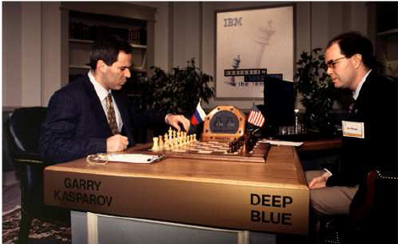
Case Studies: Playing Grandmaster Chess
The real success of AI in game-playing was achieved much later after many years’ effort.
It has been shown that this search based approach works extremely well.
In 1996 IBM Deep Blue beat Gary Kasparov for the first time. and in 1997 an upgraded version won an entire match against the same opponent.
3

Slide 4
Case Studies: Playing Grandmaster Chess…
Kasparov vs. Deep Blue, May 1997
6 game full-regulation match sponsored by ACM
Kasparov lost the match 1 wins to 2 wins and 3 tie
This was a historic achievement for computer chess being the first time a computer became the best chess player on the planet.
Note that Deep Blue plays by “brute force” (i.e. raw power from computer speed and memory). It uses relatively little that is similar to human intuition and cleverness.
4

Slide 5
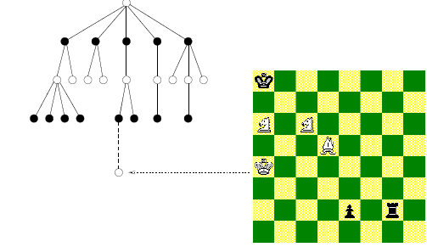
Game Playing and AI
Why would game playing be a good problem for AI research?
game playing is non-trivial
players need “human-like” intelligence
games can be very complex (e.g. chess, go)
requires decision making within limited time
game playing can be usefully viewed as a search problem in a space defined by a fixed set of rules
Nodes are either white or black corresponding to reflect the adversaries’ turns.
The tree of possible moves can be searched for favourable positions.
5

Slide 6
Game Playing and AI…
Why would game playing be a good problem for AI research?
games often are:
well-defined and repeatable
easy to represent
fully observable and limited environments
can directly compare humans and computers
6

Slide 7
Game Playing as Search
Consider two-player, turn-taking, board games
e.g., tic-tac-toe, checkers, chess
Representing these as search problem:
states: board configurations
edges: legal moves
initial state: start board configuration
goal state: winning/terminal board configuration
7

Slide 8
Game Playing as Search: Game Tree
What's the new aspect to the search problem?
There’s an opponent that we cannot control!
…
X
X
X
X
X
…
X
O
X
O
X
X
X
O
O
O
…
X
X
X
X
X
O
O
X
O
X
X
O
How can this be handled?
8

Slide 9
Adversarial search is search when there is an "enemy" or "opponent" changing the state of the problem every step in a direction you do not want.
Examples: Chess, business, trading, war. You change state, but then you don't control the next state.

Slide 10
Game Playing as Search: Complexity
Assume the opponent’s moves can be predicted given the computer's moves.
How complex would search be in this case?
worst case: O(b^{d}) ; b is branching factor, d is depth
Tic-Tac-Toe: ~5 legal moves, 9 moves max game
5⁹ = 1,953,125 states
Chess: ~35 legal moves, ~100 moves per game
35¹⁰⁰ ~10¹⁵⁴ states, but only ~10⁴⁰ legal states
Common games produce enormous search trees.
10

Slide 11
Greedy Search Game Playing
A utility function maps each terminal state of the board to a numeric value corresponding to the value of that state to the computer.
positive for winning, > + means better for computer
negative for losing, > - means better for opponent
zero for a draw
typical values (lost to win):
-infinity to +infinity
-1.0 to +1.0
11

Slide 12
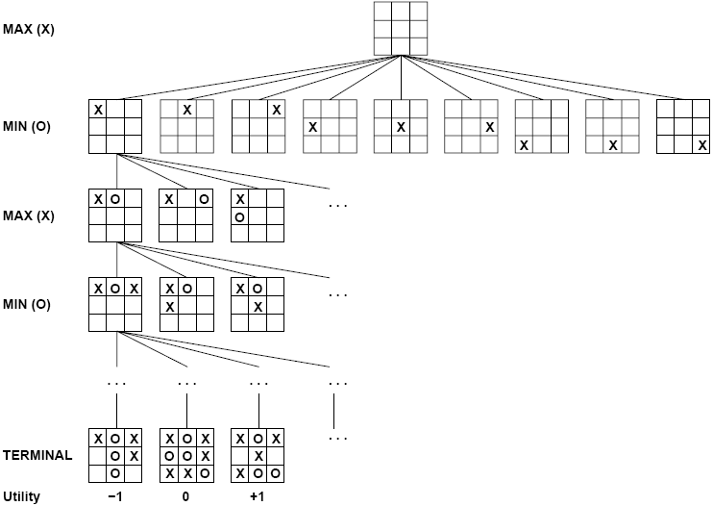
12

Slide 13
Greedy Search Game Playing
Expand each branch to the terminal states
Evaluate the utility of each terminal state
Choose the move that results in the board configuration with the maximum value
A
A
9
computer's possible moves
B
B
-5
C
C
9
D
D
2
E
E
3
opponent's possible moves
F
F
-7
G
G
-5
H
H
3
I
I
9
J
J
-6
K
K
0
L
L
2
M
M
1
N
N
3
O
O
2
board evaluation from computer's perspective
terminal states
13

Slide 14
Greedy Search Game Playing
Assuming a reasonable search space, what's the problem with greedy search?
It ignores what the opponent might do!
e.g. Computer chooses C. Opponent chooses J and defeats computer.
A
9
computer's possible moves
B
-5
C
9
D
2
E
3
opponent's possible moves
F
-7
G
-5
H
3
I
9
J
-6
K
0
L
2
M
1
N
3
O
2
board evaluation from computer's perspective
terminal states
14

Slide 15
Minimax: Idea
Assuming the worst (i.e. opponent plays optimally):
given there are two plays till the terminal states
If high utility numbers favor the computer
Computer should choose which moves?
maximizing moves
If low utility numbers favor the opponent
Smart opponent chooses which moves?
minimizing moves
15

Slide 16
Minimax: Idea
The computer assumes after it moves the opponent will choose the minimizing move.
It chooses its best move considering both its move and opponent’s best move.
A
A 1
computer's possible moves
B
B
-7
C
C
-6
D
D
0
E
E
1
opponent's possible moves
F
-7
G
-5
H
3
I
9
J
-6
K
0
L
2
M
1
N
3
O
2
board evaluation from computer's perspective
terminal states
16

Slide 17
Minimax: Passing Values up Game Tree
Explore the game tree to the terminal states
Evaluate the utility of the terminal states
Computer chooses the move to put the board in the best configuration for it assuming the opponent makes best moves on her turns:
start at the leaves
assign value to the parent node as follows
use minimum of children when opponent’s moves
use maximum of children when computer's moves
17

Slide 18
Deeper Game Trees
Minimax can be generalized for > 2 moves
Values backed up in minimax way
A
A
3
computer max
B
B
-5
C
C
3
D
0
E
E
-7
opponent
min
F
F
4
G
-5
H
3
I
8
J
J
9
K
K
5
L
2
M
M
-7
computer
max
N
4
O
O
-5
P
9
Q
-6
R
0
S
3
T
5
U
-7
V
-9
opponent
min
W
-3
X
-5
terminal states
18

Slide 19
Minimax: Direct Algorithm
For each move by the computer:
Perform depth-first search to a terminal state
Evaluate each terminal state
Propagate upwards the minimax values
if opponent's move minimum value of children backed up
if computer's move maximum value of children backed up
choose move with the maximum of minimax values of children
Note:
minimax values gradually propagate upwards as DFS proceeds: i.e., minimax values propagate up in “left-to-right” fashion
minimax values for sub-tree backed up “as we go”, so only O(bd) nodes need to be kept in memory at any time
19

Slide 20
Minimax: Algorithm Complexity
Assume all terminal states are at depth d
Space complexity?
depth-first search, so O(bd)
Time complexity?
given branching factor b, so O(b^{d})
Time complexity is a major problem! Computer typically only has a finite amount of time to make a move.
20

Slide 21
Minimax: Algorithm Complexity
Direct minimax algorithm is impractical in practice
instead do depth-limited search to ply (depth) m
What’s the problem for stopping at any ply?
evaluation defined only for terminal states
we need to know the value of non-terminal states
Static board evaluator (SBE) function uses heuristics to estimate the value of non-terminal states.
It was first proposed by Shannon in his paper, Programming a computer for playing chess, in 1950.
21

Slide 22
Minimax: Static Board Evaluator (SBE)
A static board evaluation function estimates how good a board configuration is for the computer.
it reflects the computer’s chances of winning from that state
it must be easy to calculate from the board configuration
For Example, Chess:
SBE = α * materialBalance + β * centerControl + γ * …
material balance = Value of white pieces - Value of black pieces (pawn = 1, rook = 5, queen = 9, etc).
22

Slide 23
Minimax: Static Board Evaluator (SBE)
How to design good static board evaluator functions?
First, the evaluation function should order the terminal states in the same way as the true utility function; otherwise, an agent using it might select suboptimal moves even if it can see ahead all the way to the end of the game.
Second, the computation must not take too long!
Third, for nonterminal states, the evaluation function should be strongly correlated with the actual chances of winning.
23

Slide 24
Minimax: Static Board Evaluator (SBE)
Evaluation function is a heuristic function, and it is where the domain experts’ knowledge resides.
Example of an evaluation function for Tic-Tac-Toe:
f(n) = [# of 3-lengths open for me] - [# of 3-lengths open for you],
where a 3-length is a complete row, column, or diagonal.
Alan Turing’s function for chess
f(n) = w(n)/b(n), where w(n) = sum of the point value of white’s pieces and b(n) is sum for black.
Most evaluation functions are specified as a weighted sum of position features:
f(n) = w₁*feat1(n) + w₂*feat2(n) + ... + w_{n}*featk(n)
Example features for chess are piece count, piece placement, squares controlled, etc.
Deep Blue has about 6,000 features in its evaluation function.

Slide 25
Minimax: Algorithm with SBE
int minimax (Node s, int depth, int limit) {
if (isTerminal(s) || depth == limit) //base case
return(staticEvaluation(s));
else {
Vector v = new Vector();
//do minimax on successors of s and save their values
while (s.hasMoreSuccessors())
v.addElement(minimax(s.getNextSuccessor(), depth+1, limit));
if (isComputersTurn(s))
return maxOf(v); //computer's move returns max of kids
else
return minOf(v); //opponent's move returns min of kids
}
}
25

Slide 26
Minimax: Algorithm with SBE
The same as direct minimax, except
only goes to depth m
estimates non-terminal states using SBE function
How would this algorithm perform at chess?
if could look ahead ~4 pairs of moves (i.e. 8 ply) would be consistently beaten by average players
if could look ahead ~8 pairs as done in typical pc, is as good as human master
26

Slide 27
Recap
Can't minimax search to the end of the game.
if could, then choosing move is easy
SBE isn't perfect at estimating.
if it was, just choose best move without searching
27

Slide 28
Alpha-Beta Pruning Idea
Some of the branches of the game tree won't be taken if playing against a smart opponent.
Use pruning to ignore those branches.
While doing DFS of game tree, keep track of:
alpha at maximizing levels (computer’s move)
highest SBE value seen so far (initialize to -infinity)
is lower bound on state's evaluation
beta at minimizing levels (opponent’s move)
lowest SBE value seen so far (initialize to +infinity)
is higher bound on state's evaluation
28

Slide 29
Alpha-Beta Pruning Idea
Beta cutoff pruning occurs when maximizing if child’s alpha ≥ parent's beta Why stop expanding children?
opponent won't allow computer to take this move
Alpha cutoff pruning occurs when minimizing if parent's alpha ≥ child’s beta Why stop expanding children?
computer has a better move than this
29

Slide 30
Alpha-Beta Search Example
minimax(A,0,4)
alpha initialized to -infinity
Expand A? Yes since there are successors, no cutoff test for root
A
Call Stack
A
max
A
α=-
B
C
D
0
E
F
G
-5
H
3
I
8
J
K
L
2
M
N
4
O
P
9
Q
-6
R
0
S
3
T
5
U
-7
V
-9
W
-3
X
-5
A
30

Slide 31
Alpha-Beta Search Example
minimax(B,1,4)
beta initialized to +infinity
Expand B? Yes since A’s alpha >= B’s beta is false, no alpha cutoff
A
α=-
Call Stack
max
B
B
B β=+
C
D
0
E
min
F
G
-5
H
3
I
8
J
K
L
2
M
N
4
O
P
9
Q
-6
R
0
S
3
T
5
U
-7
V
-9
B
W
-3
X
-5
A
31

Slide 32
Alpha-Beta Search Example
minimax(F,2,4)
alpha initialized to -infinity
Expand F? Yes since F’s alpha >= B’s beta is false, no beta cutoff
A
α=-
Call Stack
max
B β=+
C
D
0
E
min
F
F
F α=-
G
-5
H
3
I
8
J
K
L
2
M
max
N
4
O
P
9
Q
-6
R
0
S
3
T
5
U
-7
V
-9
F
B
W
-3
X
-5
A
32

Slide 33
Alpha-Beta Search Example
minimax(N,3,4)
evaluate and return SBE value
A
α=-
Call Stack
max
B β=+
C
D
0
E
min
F α=-
G
-5
H
3
I
8
J
K
L
2
M
max
N
N
4
N
4
O
P
9
Q
-6
R
0
S
3
T
5
U
-7
V
-9
F
B
W
-3
X
-5
green: terminal state
A
33

Slide 34
Alpha-Beta Search Example
back to
minimax(F,2,4)
alpha = 4, since 4 >= -infinity (maximizing)
Keep expanding F? Yes since F’s alpha >= B’s beta is false, no beta cutoff
A
α=-
Call Stack
max
B β=+
C
D
0
E
min
F α=-
F α=4
G
-5
H
3
I
8
J
K
L
2
M
max
N
4
O
P
9
Q
-6
R
0
S
3
T
5
U
-7
V
-9
F
B
W
-3
X
-5
A
34

Slide 35
Alpha-Beta Search Example
minimax(O,3,4)
beta initialized to +infinity
Expand O? Yes since F’s alpha >= O’s beta is false, no alpha cutoff
A
α=-
Call Stack
max
B β=+
C
D
0
E
min
F α=4
G
-5
H
3
I
8
J
K
L
2
M
max
O
N
4
O
O
O β=+
P
9
Q
-6
R
0
S
3
T
5
U
-7
V
-9
F
B
min
W
-3
X
-5
A
35

Slide 36
Alpha-Beta Search Example
minimax(W,4,4)
evaluate and return SBE value
A
α=-
Call Stack
max
B β=+
C
D
0
E
min
F α=4
G
-5
H
3
I
8
J
K
L
2
M
W
max
O
N
4
O β=+
P
9
Q
-6
R
0
S
3
T
5
U
-7
V
-9
F
B
min
W
-3
A
W
-3
X
-5
blue: non-terminal state (depth limit)
36

Slide 37
Alpha-Beta Search Example
back to
minimax(O,3,4)
beta = -3, since -3 <= +infinity (minimizing)
Keep expanding O?
No since F’s alpha >= O’s beta is true: alpha cutoff
A
α=-
Call Stack
max
B β=+
C
D
0
E
min
F α=4
G
-5
H
3
I
8
J
K
L
2
M
max
O
N
4
O β=+
O β=-3
P
9
Q
-6
R
0
S
3
T
5
U
-7
V
-9
F
B
min
W
-3
X
-5
A
37

Slide 38
Alpha-Beta Search Example
Why?
Smart opponent will choose W or worse, thus O's upper bound is –3. Computer already has better move at N.
A
α=-
Call Stack
max
B β=+
C
D
0
E
min
F α=4
G
-5
H
3
I
8
J
K
L
2
M
max
O
N
4
O β=-3
P
9
Q
-6
R
0
S
3
T
5
U
-7
V
-9
F
B
min
W
-3
X
-5
A
X
-5
red: pruned state
38

Slide 39
Alpha-Beta Search Example
back to
minimax(F,2,4)
alpha doesn’t change, since -3 < 4 (maximizing)
Keep expanding F? No since no more successors for F
A
α=-
Call Stack
max
B β=+
C
D
0
E
min
F α=4
G
-5
H
3
I
8
J
K
L
2
M
max
N
4
O β=-3
P
9
Q
-6
R
0
S
3
T
5
U
-7
V
-9
F
B
min
W
-3
X
-5
A
X
-5
39

Slide 40
Alpha-Beta Search Example
back to
minimax(B,1,4)
beta = 4, since 4 <= +infinity (minimizing)
Keep expanding B?
Yes since A’s alpha >= B’s beta is false, no alpha cutoff
A
α=-
Call Stack
max
B β=+
B β=4
C
D
0
E
min
F α=4
G
-5
H
3
I
8
J
K
L
2
M
max
N
4
O β=-3
P
9
Q
-6
R
0
S
3
T
5
U
-7
V
-9
B
min
W
-3
X
-5
A
X
-5
40

Slide 41
Alpha-Beta Search Example
minimax(G,2,4)
evaluate and return SBE value
A
α=-
Call Stack
max
B β=4
C
D
0
E
min
F α=4
G
-5
G
-5
H
3
I
8
J
K
L
2
M
max
N
4
O β=-3
P
9
Q
-6
R
0
S
3
T
5
U
-7
V
-9
G
B
min
W
-3
X
-5
A
X
-5
green: terminal state
41

Slide 42
Alpha-Beta Search Example
back to
minimax(B,1,4)
beta = -5, since -5 <= 4 (minimizing)
Keep expanding B? No since no more successors for B
A
α=-
Call Stack
max
B β=4
B β=-5
C
D
0
E
min
F α=4
G
-5
H
3
I
8
J
K
L
2
M
max
N
4
O β=-3
P
9
Q
-6
R
0
S
3
T
5
U
-7
V
-9
B
min
W
-3
X
-5
A
X
-5
42

Slide 43
Alpha-Beta Search Example
back to
minimax(A,0,4)
alpha = -5, since -5 >= -infinity (maximizing)
Keep expanding A? Yes since there are more successors, no cutoff test
A
α=
Call Stack
max
A
α=-5
B β=-5
C
D
0
E
min
F α=4
G
-5
H
3
I
8
J
K
L
2
M
max
N
4
O β=-3
P
9
Q
-6
R
0
S
3
T
5
U
-7
V
-9
min
W
-3
X
-5
A
X
-5
43

Slide 44
Alpha-Beta Search Example
minimax(C,1,4)
beta initialized to +infinity
Expand C? Yes since A’s alpha >= C’s beta is false, no alpha cutoff
A
α=
Call Stack
max
A
α=-5
B β=-5
C
C
C
β=+
D
0
E
min
F α=4
G
-5
H
3
I
8
J
K
L
2
M
max
N
4
O β=-3
P
9
Q
-6
R
0
S
3
T
5
U
-7
V
-9
C
min
W
-3
X
-5
A
X
-5
44

Slide 45
Alpha-Beta Search Example
minimax(H,2,4)
evaluate and return SBE value
A
α=
Call Stack
max
A
α=-5
B β=-5
C
β=+
D
0
E
min
F α=4
G
-5
H
3
H
3
I
8
J
K
L
2
M
max
N
4
O β=-3
P
9
Q
-6
R
0
S
3
T
5
U
-7
V
-9
H
C
min
W
-3
X
-5
A
X
-5
green: terminal state
45

Slide 46
Alpha-Beta Search Example
back to
minimax(C,1,4)
beta = 3, since 3 <= +infinity (minimizing)
Keep expanding C? Yes since A’s alpha >= C’s beta is false, no alpha cutoff
A
α=
Call Stack
max
A
α=-5
B β=-5
C
β=+
C
β=3
D
0
E
min
F α=4
G
-5
H
3
I
8
J
K
L
2
M
max
N
4
O β=-3
P
9
Q
-6
R
0
S
3
T
5
U
-7
V
-9
C
min
W
-3
X
-5
A
X
-5
46

Slide 47
Alpha-Beta Search Example
minimax(I,2,4)
evaluate and return SBE value
A
α=
Call Stack
max
A
α=-5
B β=-5
C
β=3
D
0
E
min
F α=4
G
-5
H
3
I
8
I
8
J
K
L
2
M
max
N
4
O β=-3
P
9
Q
-6
R
0
S
3
T
5
U
-7
V
-9
I
C
min
W
-3
X
-5
A
X
-5
green: terminal state
47

Slide 48
Alpha-Beta Search Example
back to
minimax(C,1,4)
beta doesn’t change, since 8 > 3 (minimizing)
Keep expanding C? Yes since A’s alpha >= C’s beta is false, no alpha cutoff
A
α=
Call Stack
max
A
α=-5
B β=-5
C
β=3
D
0
E
min
F α=4
G
-5
H
3
I
8
J
K
L
2
M
max
N
4
O β=-3
P
9
Q
-6
R
0
S
3
T
5
U
-7
V
-9
C
min
W
-3
X
-5
A
X
-5
48

Slide 49
Alpha-Beta Search Example
minimax(J,2,4)
alpha initialized to -infinity
Expand J? Yes since J’s alpha >= C’s beta is false, no beta cutoff
A
α=
Call Stack
max
A
α=-5
B β=-5
C
β=3
D
0
E
min
F α=4
G
-5
H
3
I
8
J
J
J
α=-
K
L
2
M
max
N
4
O β=-3
P
9
Q
-6
R
0
S
3
T
5
U
-7
V
-9
J
C
min
W
-3
X
-5
A
X
-5
49

Slide 50
Alpha-Beta Search Example
minimax(P,3,4)
evaluate and return SBE value
A
α=
Call Stack
max
A
α=-5
B β=-5
C
β=3
D
0
E
min
F α=4
G
-5
H
3
I
8
J
α=-
K
L
2
M
max
P
N
4
O β=-3
P
9
P
9
Q
-6
R
0
S
3
T
5
U
-7
V
-9
J
C
min
W
-3
X
-5
A
X
-5
green: terminal state
50

Slide 51
Alpha-Beta Search Example
back to
minimax(J,2,4)
alpha = 9, since 9 >= -infinity (maximizing)
Keep expanding J?
No since J’s alpha >= C’s beta is true: beta cutoff
A
α=
Call Stack
max
A
α=-5
B β=-5
C
β=3
D
0
E
min
F α=4
G
-5
H
3
I
8
J
α=-
J
α=9
K
L
2
M
max
N
4
O β=-3
P
9
Q
-6
Q
-6
R
0
R
0
S
3
T
5
U
-7
V
-9
J
C
min
W
-3
X
-5
A
X
-5
red: pruned states
51

Slide 52
Alpha-Beta Search Example
Why?
Computer will choose P or better, thus J's lower bound is 9. Smart opponent won’t let computer take move to J (since opponent already has better move at H).
A
α=
Call Stack
max
A
α=-5
B β=-5
C
β=3
D
0
E
min
F α=4
G
-5
H
3
I
8
J
α=9
K
L
2
M
max
N
4
O β=-3
P
9
Q
-6
R
0
S
3
T
5
U
-7
V
-9
J
C
min
W
-3
X
-5
A
X
-5
red: pruned states
52

Slide 53
Alpha-Beta Search Example
back to
minimax(C,1,4)
beta doesn’t change, since 9 > 3 (minimizing)
Keep expanding C? No since no more successors for C
A
α=
Call Stack
max
A
α=-5
B β=-5
C
β=3
D
0
E
min
F α=4
G
-5
H
3
I
8
J
α=9
K
L
2
M
max
N
4
O β=-3
P
9
Q
-6
R
0
S
3
T
5
U
-7
V
-9
C
min
W
-3
X
-5
A
X
-5
53

Slide 54
Alpha-Beta Search Example
back to
minimax(A,0,4)
alpha = 3, since 3 >= -5 (maximizing)
Keep expanding A? Yes since there are more successors, no cutoff test
A
α=-5
Call Stack
max
A
α=3
B β=-5
C
β=3
D
0
E
min
F α=4
G
-5
H
3
I
8
J
α=9
K
L
2
M
max
N
4
O β=-3
P
9
Q
-6
R
0
S
3
T
5
U
-7
V
-9
min
W
-3
X
-5
A
X
-5
54

Slide 55
Alpha-Beta Search Example
minimax(D,1,4)
evaluate and return SBE value
A
α=
Call Stack
max
A
α=3
B β=-5
C
β=3
D
0
D
0
E
min
F α=4
G
-5
H
3
I
8
J
α=9
K
L
2
M
max
N
4
O β=-3
P
9
Q
-6
R
0
S
3
T
5
U
-7
V
-9
D
min
W
-3
X
-5
A
X
-5
green: terminal state
55

Slide 56
Alpha-Beta Search Example
back to
minimax(A,0,4)
alpha doesn’t change, since 0 < 3 (maximizing)
Keep expanding A? Yes since there are more successors, no cutoff test
A
α=
Call Stack
max
A
α=3
B β=-5
C
β=3
D
0
E
min
F α=4
G
-5
H
3
I
8
J
α=9
K
L
2
M
max
N
4
O β=-3
P
9
Q
-6
R
0
S
3
T
5
U
-7
V
-9
min
W
-3
X
-5
A
X
-5
56

Slide 57
Alpha-Beta Search Example
How does the algorithm finish searching the tree?
A
α=
Call Stack
max
A
α=3
B β=-5
C
β=3
D
0
E
min
F α=4
G
-5
H
3
I
8
J
α=9
K
L
2
M
max
N
4
O β=-3
P
9
Q
-6
R
0
S
3
T
5
U
-7
V
-9
min
W
-3
X
-5
A
X
-5
57

Slide 58
Alpha-Beta Search Example
Stop Expanding E since A's alpha >= E's beta is true: alpha cutoff
Why?
Smart opponent will choose L or worse, thus E's upper bound is 2. Computer already has better move at C.
A
α=
Call Stack
max
A
α=3
B β=-5
C
β=3
D
0
E
β=2
min
F α=4
G
-5
H
3
I
8
J
α=9
K
α=5
L
2
M
max
N
4
O β=-3
P
9
Q
-6
R
0
S
3
T
5
U
-7
V
-9
min
W
-3
X
-5
A
X
-5
58

Slide 59
Alpha-Beta Search Example
Result: Computer chooses move to C.
A
α=
Call Stack
max
A
α=3
B β=-5
C
β=3
D
0
E
β=2
min
F α=4
G
-5
H
3
I
8
J
α=9
K
α=5
L
2
M
max
N
4
O β=-3
P
9
Q
-6
R
0
S
3
T
5
U
-7
V
-9
min
W
-3
X
-5
A
X
-5
green: terminal states, red: pruned states blue: non-terminal state (depth limit)
59

Slide 60
Alpha-Beta Effectiveness
Effectiveness depends on the order in which successors are examined.
What ordering gives more effective pruning?
More effective if best successors are examined first.
Best Case: each player’s best move is left-most
Worst Case: ordered so that no pruning occurs
no improvement over exhaustive search
In practice, performance is closer to best case rather than worst case.
60
Notes:
60

Slide 61
Alpha-Beta Effectiveness
If opponent’s best move where first more pruning would result:
A
α=3
A
α=3
E
β=2
E
β=2
K
α=5
L
2
M
L
2
K
M
S
3
T
5
U
-7
V
-9
S
3
T
5
U
-7
V
-9
61
Notes:
61

Slide 62
Alpha-Beta Effectiveness
In practice often get O(b^{(d/2)}) rather than O(b^{d})
same as having a branching factor of sqrt(b)
recall (sqrt(b))^{d} = b^{(d/2)}
For Example: chess
goes from b ~ 35 to b ~ 6
permits much deeper search for the same time
makes computer chess competitive with humans
62
Notes:
62

Slide 63
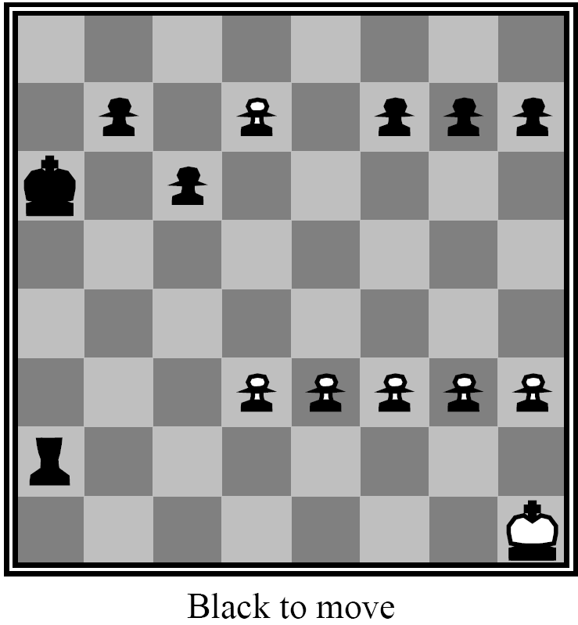
63

Slide 64
Other Issues: The Horizon Effect
Sometimes disaster lurks just beyond search depth
e.g. computer captures queen, but a few moves later the opponent checkmates
The computer has a limited horizon, it cannot see that this significant event could happen
How do you avoid catastrophic losses due to “short-sightedness”?
quiescence search
secondary search
64

Slide 65
Other Issues: The Horizon Effect
Quiescence Search
when SBE value frequently changing, look deeper than limit
looking for point when game quiets down
Secondary Search
find best move looking to depth d
look k steps beyond to verify that it still looks good
if it doesn't, repeat step 2 for next best move
65

Slide 66
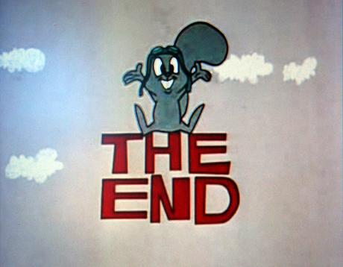
THANKS…

