Slide 1
Chapter 10
Human Relations and Motivation

Slide 2
Motivation
Motivation is act or process of stimulating to action, providing an incentive or motive, especially for an act. The term motivation has been derived from the Latin word, “ Movere” which means to make someone move.
Types-
Extrinsic
Intrinsic

Slide 3
Theories of Management and Needs

Slide 4
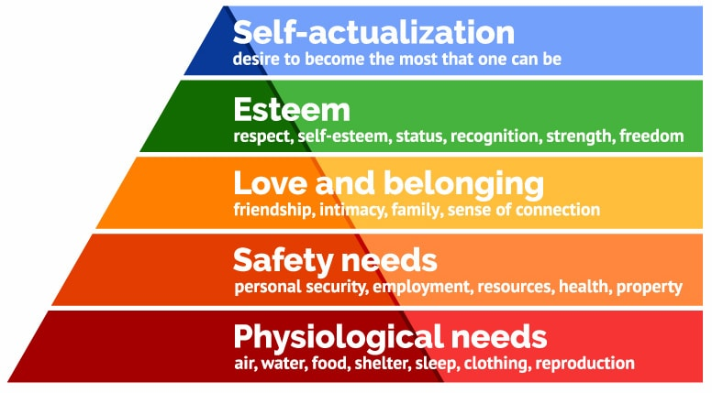
Maslow's Hierarchy of Needs

Slide 5
McGregor's Theory X and Theory Y

Slide 6
Ouchi's Theory Z

Slide 7
Herzberg Two Factors Theory of Motivation
Hygiene factors- status, job security, salary, fringe benefits, work conditions, good pay, paid insurance, vacations
Motivators-challenging work, recognition for one's achievement, responsibility, opportunity to do something meaningful, involvement in decision making, sense of importance to an organization

