Slide 1

Philip Sidney ?An Apology for Poetry/Defence of Poesie
Wrote against Stephen Gosson

Slide 2
Gosson said :
Poets are
Caterpillar of commonwealth
Enemies of virtues
Drama is debauchery
Pagan elements
Tragedy is cruel , full of blood shed, uncontrolled passion
Comedy is love affair of vulgar- degrading young.

Slide 3
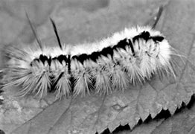
Catterpillar

Slide 4
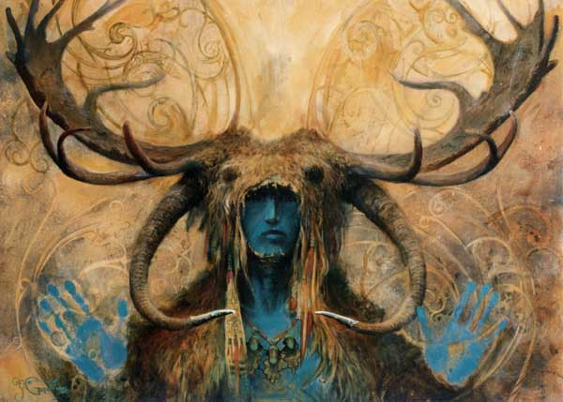
Pagan God

Slide 5
Sidney 1579 (Defence of poesie)
Poetry from ancient time valued , and is universal
Kinds of poetry /usefulness
Objection and reply
Contemporary drama (did not like tragi – comedy/breaking unities)

Slide 6
Ancient time
Poets are father of learning
2.From memorizing poetry learning begins
3.Greek and Roman used to term poets as maker and vates
4. Creative demigod, cyclops, chimeras, furies ,which make loveth earth more lovely ‘ brazen more golden’.
5.Bible, psalms, oracle of Delphi.

Slide 7
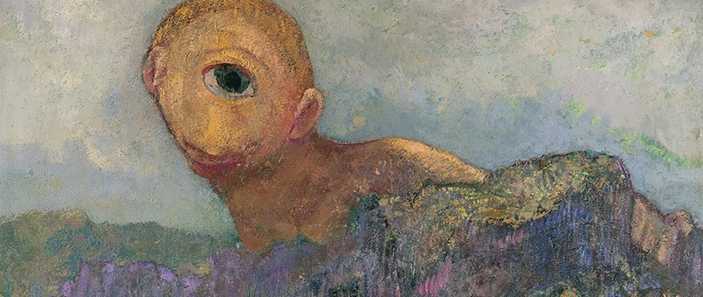
Cyclop

Slide 8
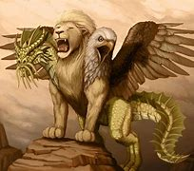
Chimera/Furies

Slide 9

Effntn

Slide 10
Division of poetry
Epic
Lyric
Tragedy
Comedy
satire
Elegy
Pastoral

Slide 11
Today/Fiction and Non-Fiction
Fiction
Poetry
Drama
Novel
Short story

Slide 12
why poetry is the best ?
Self knowledge/ universal truth / delight full truth
Abstract/ not concrete fact
Unlike History , science

Slide 13
Reply against the four charges
Mother of all lies
Effeminizing and pestilent desire
Debilitating, fancying and daydreaming
Plato hated poetry
Are poets and poetry useful or not?

Slide 14
Can you defend ?

Slide 15
Decline in contemporary English poetry drama
Sluggish, no spirt for poetic creation, only copies(servile nature) no practice ns constant exercise.
Tragedy should show:
  Fall of tyrants
  Have three unites
  He mentioned Gorbudoc as the best to follow suit
  Should not mingle comedy and tragedy(king clown and horn pipes with funerals)

