Slide 1
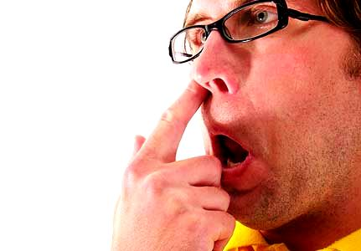
L EARNING TO LEARN
U
nlearn

Slide 2
L EARNING TO LEARN
U
nlearn

Slide 4
2
L
L

Slide 5
2
L
U

Slide 6
LEARNING TO LEARN
Lesson 2

Slide 7
How will you get there…
…if you don’t know where you are going ?

Slide 8
Improving the ability to learn
...for a lifetime.

Slide 9
Unlock Your

Slide 10
Allow your brain to learn

Slide 11
Learn & Grow

Slide 12
Learn & Grow like a human not like

Slide 13
Commit to Life Long Learning
Learn from every step of your life

Slide 14
hi

Slide 15
hi

Slide 16
hi

Slide 17
Racism

Slide 18
hi
Start .. . A fresh day … re-born like a new baby .. . Learn + Unlearn + Relearn

Slide 19
GGOODD DDAAYY

