Slide 1
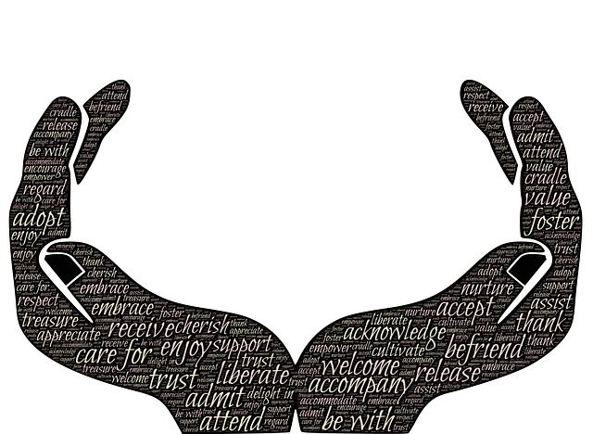
Universal Human Values

Slide 3
- That people adopt as their guidelines in daily activities.
Human values are the principles, standards, opinions and beliefs -

Slide 4
LOVE
PEACE
Core Human Values
TRUTH
RIGHT CONDUCT
NON VIOLENCE

Slide 5
LOVE
Kindness
Friendship
Forgiveness
Generosity

Slide 6
Patience
Concentration
PEACE
Positiveness
Self – acceptance
Self-discipline
Thankfulness

Slide 7
Honesty
TRUTH
Truthfulness
Fairness
Trust

Slide 8
Cooperation
Loyalty
NON VIOLENCE
Justice
Respect

Slide 9
Health Awareness
Helpfulness
Courage
Manner
Right
Conduct

Slide 10
