Slide 1
Cognitive Development
Juwel Rana
Lecturer
Dept. of Nutrition and Food Engineering, DIU

Slide 2
Cognitive development
Cognitive development is the construction of thought processes, including remembering, problem solving, and decision-making, from childhood through adolescence to adulthood. Read more: http://www.healthofchildren.com/C/Cognitive-Development.html#ixzz6wz565Tfi

Slide 3
Did you watch the video?
Watch the following YouTube Video
https://www.youtube.com/watch?v=BJYwTh3kxSw

Slide 4
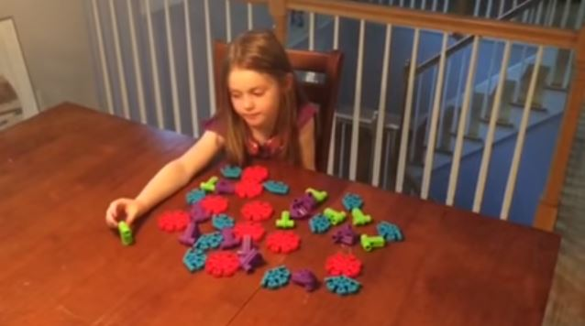

Slide 5
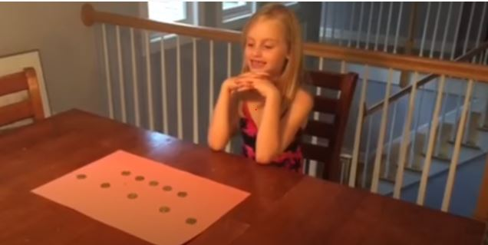

Slide 8
Introduction
It was once believed that infants lacked the ability to think or form complex ideas and remained without cognition until they learned language.
It is now known that babies are aware of their surroundings and interested in exploration from the time they are born.
From birth, babies begin to actively learn.
They gather, sort, and process information from around them, using the data to develop perception and thinking skills. Read more: http://www.healthofchildren.com/C/Cognitive-Development.html#ixzz6wz5LIt4j

Slide 9
Cognitive development
Cognitive development refers to how a person perceives, thinks, and gains understanding of his or her world through the interaction of genetic and learned factors.
Among the areas of cognitive development are information processing, intelligence , reasoning, language development , and memory. Read more: http://www.healthofchildren.com/C/Cognitive-Development.html#ixzz6wz5XgyzC

Slide 10
Cognitive development Stage
Age |  | Activity
One month | Watches person when spoken to.
Two months | Smiles at familiar person talking. Begins to follow moving person with eyes.
Four months | Shows interest in bottle, breast, familiar toy, or new surroundings.
Five months | Smiles at own image in mirror. Looks for fallen objects.
Six months | May stick out tongue in imitation. Laughs at peekaboo game. Vocalizes at mirror image. May act shy around strangers.

Slide 11
Seven months | Responds to own name. Tries to establish contact with a person by cough or other noise.
Eight months | Reaches for toys out of reach. Responds to "no."
Nine months | Shows likes and dislikes. May try to prevent face-washing or other activity that is disliked. Shows excitement and interest in foods or toys that are well-liked.
Ten months | Starts to understand some words. Waves bye-bye. Holds out arm or leg for dressing.
Eleven months | Repeats performance that is laughed at. Likes repetitive play. Shows interest in books.
Twelve months | May understand some "where is...?" questions. May kiss on request.

Slide 12
Fifteen months | Asks for objects by pointing. Starting to feed self. Negativism begins.
Eighteen months | Points to familiar objects when asked "where is...?" Mimics familiar adult activities. Know some body parts. Obeys two or three simple orders.
Two years | Names a few familiar objects. Draws with crayons. Obeys found simple orders. Participates in parallel play.
Two-and-a-half years | Names several common objects. Begins to take interest in sex organs. Gives full names. Helps to put things away. Peak of negativism.
Three years | Constantly asks questions. May count to 10. Begins to draw specific objects. Dresses and undresses doll. Participates in cooperative play. Talks about things that have happened.
Four years | May make up silly words and stories. Beginning to draw pictures that represent familiar things. Pretends to read and write. May recognize a few common words, such as own name.
Five years | Can recognize and reproduce many shapes, letters, and numbers. Tells long stories. Begins to understand the difference between real events and make-believe ones. Asks meaning of words.

Slide 13
IQ Score??
This four question IQ test can tell you how smart you are - try it here
https://www.chroniclelive.co.uk/interactives/four-question-iq-test-can-14837705

Slide 14
How do they calculate the IQ Score
The IQ score was calculated by dividing the test taker's mental age by his or her chronological age and then multiplying this number by 100.
﻿For example, a child with a mental age of 12 and a chronological age of 10 would have an IQ of 120 (12/10 x 100).

Slide 15
Presentation Topics
Alfred Binet and the History of IQ Testing

Slide 16
How did you score on this IQ test?
An IQ score over 140 indicates that you're a genius or nearly a genius, while 120 - 140 is classed as "very superior intelligence".
110 - 119 is "superior intelligence", while 90 - 109 is "normal or average intelligence". An IQ between 80 and 89 suggests "dullness", while a score of 70 to 79 is classed as "borderline deficiency".

Slide 17
My Result!!!!!!!!!!!!!!!!

Slide 18
Any Question

Slide 20
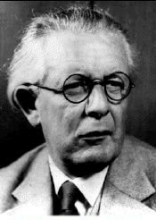
Who was Piaget?
Jean Piaget was a Swiss psychologist.
He is most famously known for his theory of cognitive development that looked at how children develop intellectually throughout the course of childhood.
Prior to Piaget's theory, children were often thought of simply as mini-adults.
Piaget studied his children’s intellectual development from infancy.

Slide 21
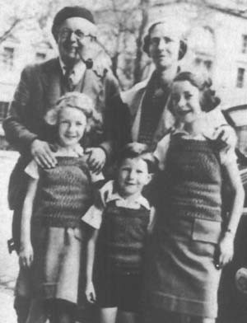
Theory of Cognitive Development
• While studying his children, Piaget developed theories concerning how children learn.
• His theory of Cognitive Development consists of four stages of intellectual development.

Slide 22
Theory of Cognitive Development (Piaget)
Disequilibrium
(Problem)
Equilibrium
(Solve)
Assimilation
Accommodation

Slide 23
Marriage? Who is this?

Slide 24
Stage 1—Cognitive Development Theory Sensorimotor Stage (0-2years)
In this period, intelligence is demonstrated through motor activity without the use of symbols.
Knowledge of the world is limited (but developing) because it is based on physical interactions and experiences.
Some symbolic abilities are developed at the end of this stage.

Slide 25
Stage 1—Cognitive Development Theory Sensorimotor Stage
Major Characteristics and Developmental Changes:
The infant knows the world through their movements and sensations
Born with reflex action sucking, grasping, looking, and listening
Children learn about the world through basic actions such as sucking, grasping, looking, and listening
Till 4 months he/she tries to solve the problem by this schema.
By 8 months, out of sight out of mind.
By 18 months object permanent.
They realize that their actions can cause things to happen in the world around them.

Slide 26
Stage 2—Cognitive Development Theory Preoperational Stage (2 - 7 years)
During this stage, the child begins to develop:
Ability to represent objects with images and words
Language skills
Imagination
During this period, children are thinking at a symbolic level but are not yet using cognitive operations.

Slide 27
Stage 2—Cognitive Development Theory Preoperational Stage (2 - 7 years)
Major Characteristics and Developmental Changes:
Children begin to think symbolically and learn to use words and pictures to represent objects.
Transductive Reasoning: (Absence of logical thinking)
Animism: (Living or non Living)
Irreversibility
Egocentric
Centration.

Slide 28
Stage 2—Cognitive Development Theory Preoperational Stage (2 - 7 years)
Example:
They also often struggle with understanding the idea of constancy.
For example, a researcher might take a lump of clay, divide it into two equal pieces, and then give a child the choice between two pieces of clay to play with.
One piece of clay is rolled into a compact ball while the other is smashed into a flat pancake shape.
Since the flat shape looks larger, the preoperational child will likely choose that piece even though the two pieces are exactly the same size.

Slide 29
Stage 3—Cognitive Development Theory Concrete Operational Stage (Age 7-11)
Piaget considered the concrete stage a major turning point in the child's cognitive development because it marks the beginning of logical or operational thought.
Major Characteristics and Developmental Changes
During this stage, children begin to thinking logically about concrete events
They begin to understand the concept of conservation; that the amount of liquid in a short, wide cup is equal to that in a tall, skinny glass, for example
Their thinking becomes more logical and organized, but still very concrete
Children begin using inductive logic, or reasoning from specific information to a general principle

Slide 30
Stage 3—Cognitive Development Theory Concrete Operational Stage (Age 7-11)
This means the child can work things out internally in their head (rather than physically try things out in the real world).
Children begin thinking in a formal systematic way
During this stage, children also become less egocentric and begin to think about how other people might think and feel.
Kids in the concrete operational stage also begin to understand that their thoughts are unique to them.

Slide 31
Summaries stage-3
Logical thinking
Reversibility
Decentration
Classification
Seriation
Transitivity

Slide 32
Stage 4—Cognitive Development Theory Formal Operational Stage (Age 11-15)
The formal operational stage begins at approximately age eleven and lasts into adulthood.
Major Characteristics and Developmental Changes:
At this stage, the adolescent or young adult begins to think abstractly and reason about hypothetical problems
Abstract thought emerges
Teens begin to think more about moral, philosophical, ethical, social, and political issues that require theoretical and abstract reasoning
Begin to use deductive logic, or reasoning from a general principle to specific information

Slide 33
Stage 4—Cognitive Development Theory Formal Operational Stage (Age 11-15)
He/she can do mathematical calculations, think creatively, use abstract reasoning, and imagine the outcome of particular actions.
The final stage of Piaget's theory involves an increase in logic, the ability to use deductive reasoning, and an understanding of abstract ideas.
At this point, people become capable of seeing multiple potential solutions to problems and think more scientifically about the world around them.

Slide 34
Summaries stage-4 (Home work)
Abstract thinking
Deductive thinking
Hypothetical Thinking

Slide 35
Theory of Cognitive Development Conclusion
It is important to note that Piaget did not view children's intellectual development as a quantitative process; that is, kids do not just add more information and knowledge to their existing knowledge as they get older.
Instead, Piaget suggested that there is a qualitative change in how children think as they gradually process through these four stages.
A child at age 7 doesn't just have more information about the world than he did at age 2; there is a fundamental change in how he thinks about the world.

Slide 36
Theory of Cognitive Development Conclusion
Based on his observations, he concluded that children were not less intelligent than adults, they simply think differently.
Piaget's stage theory describes the cognitive development of children. Cognitive development involves changes in cognitive process and abilities.
﻿ In Piaget's view, early cognitive development involves processes based upon actions and later progresses to changes in mental operations.

Slide 37
Any Question

Slide 38
References
Giles, T. W. (March 1995). A Piagetian View of Learning Styles. 1-4.
Huitt, W. (1997). Cognitive development: Applications. Retrieved
November 15, 2008, from Educational Psychology Interactive: http://
chiron.valdosta.edu/whuitt/col/cogsys/piagtuse.html
Miller, S. A. (2007). Developmental Research Methods. In S. A. Miller,
Developemental Research Methods (p. 405). SAGE.
Nderu-Boddington, D. E. (May 2008). Theories of Intelligence,
Learning, and Motivation as a Basis for Praxis. 1-17.
Society, J. P. (2008, November 13). Jean Piaget Society About Piaget.
Retrieved November 15, 2008, from Jean Piaget Society:
www.piaget.org/aboutPiaget.html
Thomas, W., & Kingma, J. (1996). Three Theories of Cognitive
Representation and Their Evaluation Standards of Training Effects.
1-49.

