Slide 1
Kirchhoff’s Law

Slide 2
Kirchhoff’s voltage law (KVL)
The algebraic sum of the voltages around any loop is zero.
Supply Voltage = Drop Voltage

Slide 3
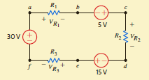
Kirchhoff’s voltage law (KVL)
+VR 1 − 5 + VR 2 − 15 + VR 3 − 30 = 0
which can be written as
+VR 1 + VR 2 + VR 3 = 5 + 15 + 30= 50
Now suppose that VR 1 and VR 2 are known to be 18 V and 12 V, respectively. Then VR 3 = 20 V.

Slide 4
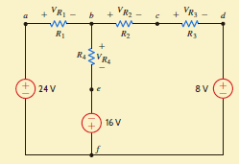
Kirchhoff’s voltage law (KVL)
Applying our policy for writing KVL equations and traversing the left loop starting at point
a, we obtain
VR 1 + VR 4 − 16 − 24 = 0
The corresponding equation for the right loop starting at point b is
VR 2 + VR 3 + 8 + 16 − VR 4 = 0
The equation for the outer loop starting at point a is
VR 1 + VR 2 + VR 3 + 8 − 24 = 0

Slide 5
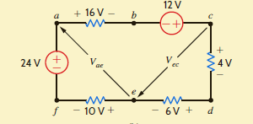
Kirchhoff’s voltage law (KVL)
Find Vae and Vec.

Slide 6
Kirchhoff’s current law (KCL)
The algebraic sum of the currents entering any node is zero.
Incoming current=Outgoing current

Slide 7
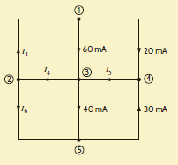
Kirchhoff’s current law (KCL)

