Slide 1
Equivalent Resistance (Req)

Slide 2
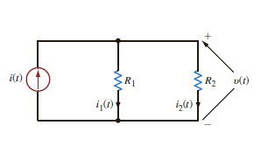
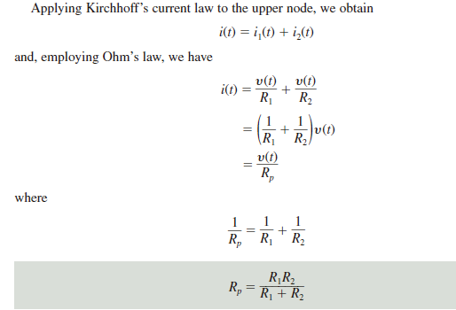
Parallel Resistor and Current Division

Slide 3
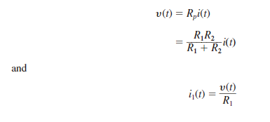
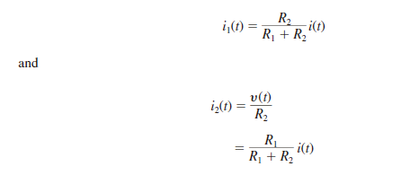
Parallel Resistor and Current Division

Slide 4
Equivalent Resistance (Req)
Series and Parallel Resistor Combinations

Slide 5
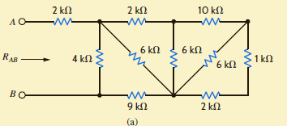
Equivalent Resistance (Req)
Series and Parallel Resistor Combinations

Slide 6
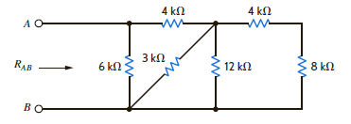
Equivalent Resistance (Req)
Series and Parallel Resistor Combinations

