Slide 1

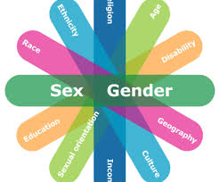
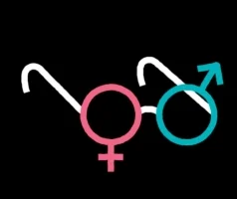
Global public health and gender theory
Dr. S. M. Rezoun Shafiullah

Slide 2
Learning Outcomes
On completion of this CLASS, the successful student will be able to:
understand the concept of gender at micro and macro level
- familiar with Connell model of hegemonic masculinity
know the position of biology in gender research
realize the essentiality to integrate gender as a theoretical concept and as an analytical category in global public health research

Slide 3
Contents
Concept of gender at micro and macro level
Concept of sex: three approaches
Connell model of hegemonic masculinity
Gender as determining the health
Position of biology in gender research
Essentiality to integrate gender as a theoretical concept and as an analytical category in global public health research
Ann Ohman’s two examples

Slide 4

Ann Ohman
Global public health and gender theory: The need for integration
Ann Ohman
PhD, Associate Professor
Epidemiology and Public Health Research
Director at Umea˚ Centre for Gender Studies
Umea˚ University
Sweden

Slide 5
Concept gender
Socially and culturally constructed conditions and processes for women and men, and girls and boys, in the world.
At the micro level : Deals with gendered lived experiences
At the macro level: Deals with structural and political conditions

Slide 6
Sex: three approaches:
When interpreting and explaining the impact on research findings of the sex variable, three approaches have been found:
1. a purely biomedical model explaining results by means of, for example, hormone differences between the two sexes
2. a purely social sciences model focusing on social and cultural contexts
3. a combination model allowing different scientific disciplines – biology, medicine, social sciences, humanities – to contribute to understanding and explanation.

Slide 7
Gender: Social and analytical categories in research
Many health conditions in the world would be impossible to analyse without comparing men and women. Gender is one of the most important social and analytical categories in research about human beings and their social conditions. And indeed, public health researchers often include sex and/or gender in such comparisons. Several reports have been launched lately that highlight the gap between men and women in terms of economic power, educational status, and health conditions. However, there is still much to wish for in order to properly integrate gender as a theoretical concept.
When gender theory is overlooked, there is a tendency to preserve existing and male-dominated views. There is also a risk that research will suffer from ‘‘gender-blindness’’, a condition that can be labelled ‘‘a serious diagnosis’’ of many public health publications.

Slide 8
Ann Ohman emphasizes….
Ohman emphasized the social, as the majority of the theoretical basis for gender lies within the social science paradigm. Being a social concept implies that gender is relative; fluctuating and changing with time, place and space. Furthermore, it is a relational concept, as it mirrors relations between men and women in specific social contexts.
Gender is regarded as permeating all spheres of social life, including the health of people . In addition, the concept is abstract, in that it embraces social norms, values and attitudes as well as power structures and symbolic dimensions such as language and thought. It operates at the individual level as well as at organizational and societal levels .
In recent times, there has been an unfortunate misuse of the concept when authors actually refer to biological sex. This makes the literature confusing and misleading. It confuses the social dimensions that a thorough gender analysis can offer.

Slide 9
Biology is intertwined with the social
Biology is overlooked in gender research, but rather that biology is intertwined with the social.
The biology and the social should be regarded as co-creating factors that situate humans in embodied practices.
The social construction of the body and how it affects health and well-being has gained an increased interest, for instance by some scholars within health and biology.

Slide 10
Gender considered an analytical tool for analyses of social factors creating & determining health
Gender should thus be considered an analytical tool for analyses of social factors creating and determining health. And again, people’s living conditions are usually acknowledged as being of crucial importance in public health research, and gender is often used in statistical analyses to control for background factors. Most often, a theoretical basis is lacking when such results are being discussed. Therefore, the conclusions that are drawn lack an important link to social theory and social explanations.

Slide 11

Connell model of hegemonic masculinity
If used within a theoretical framework, gender has far more potential to address health issues than merely to be a variable for controlling statistically significant differences between men and women. Gender and power structures are intertwined.
Connell has presented a theoretical model that might serve as a tool also for public health researchers. She regards all social practices as being gender-structured, and she claims that gender is a property of collectives and institutions as well as historical processes .

Slide 12
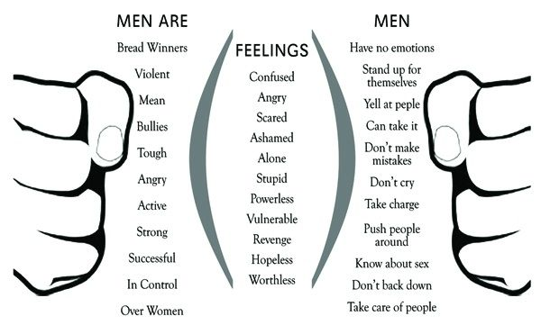

Slide 13
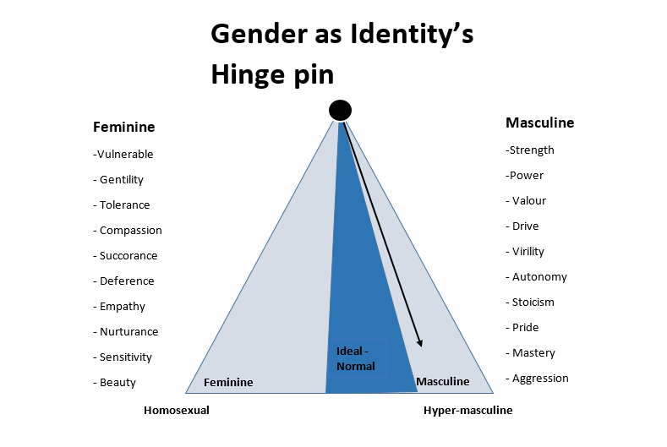

Slide 14
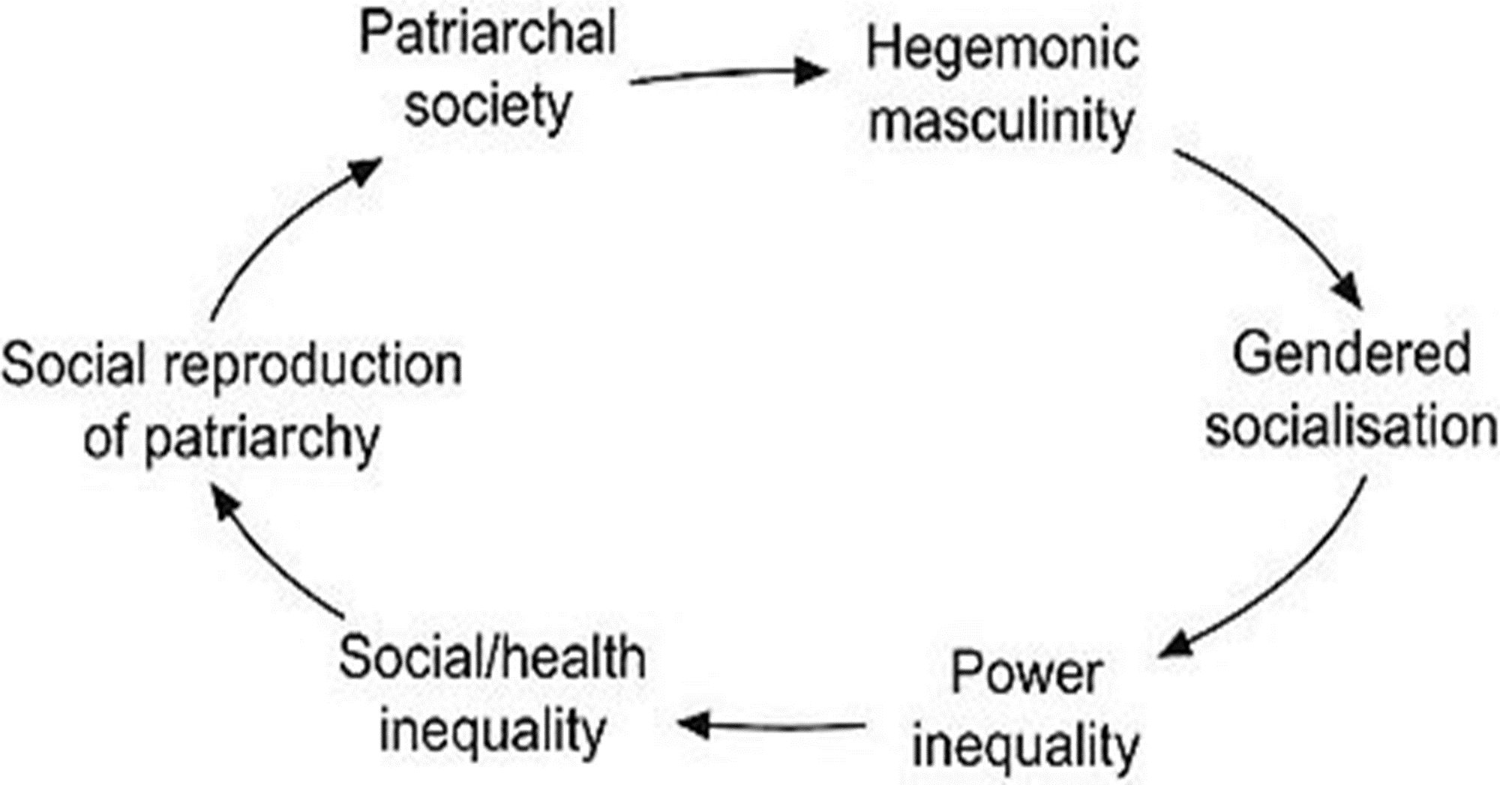
Connell model
Furthermore, supranational networks of capital and economic interests within the globalization process are steered by a hegemonic masculinity that is driven by male norms and values.
This hegemonic masculinity influences other social fields, e.g. the field of health and ill-health. Gender regimes and power structures that subordinate women to men create grounds for ill-health conditions that reflect this gender order.

Slide 15
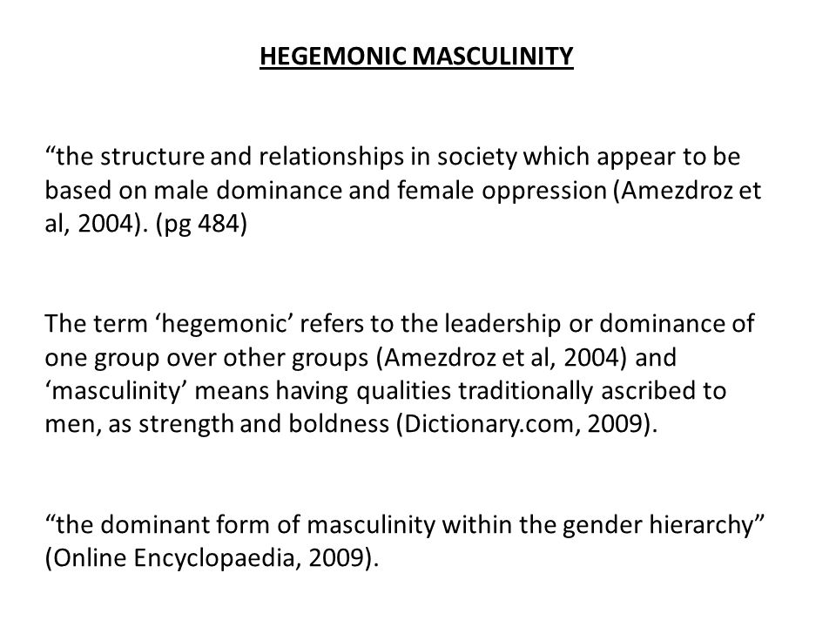

Slide 16
Hegemonic masculinity
Hegemonic masculinity is defined as a practice that legitimizes men's dominant position in society and justifies the subordination of the common male population and women, and other marginalized ways of being a man.

Slide 17
Pierre Bourdieu
Gender and feminist theory challenges existing gendered power structures and thereby questions mainstream research within academic disciplines, and so also public health. It may therefore be regarded as provocative and demanding for those in power in the field.
The French sociologist Pierre Bourdieu argues that new perspectives that challenge existing academic discourses have potentials to create new forms of knowledge.

Slide 18
Ann Ohman given two examples
Ann Ohman given two examples where it is essential to integrate gender as a theoretical concept and as an analytical category in global public health research.
Global health here refers to Kick Busch's definition: ‘‘health issues that transcend national boundaries and governments and call for action on the global forces of people’’

Slide 19
The first example
The first example is taken from research on noncommunicable disease (NCD) risk factors and prevention. Smoking is enormously gendered in a global perspective and therefore important to analyse with a gender theory lens.
In a qualitative study from central Java, we found gendered conditions that point to local and traditional customs of boys’ initiation to become men through tobacco smoking. At the same time, modern views on smoking permeated the boys’ thinking.
So, to become men, teenage boys felt almost forced to take up smoking habits. In contrast, girls were regarded to be ‘‘bad girls’’ and even prostitutes if they smoked.

Slide 20
The first example
Simultaneously, the tobacco companies now address young women and teenage girls in their campaigns and advertisements for cigarettes, and in doing so they emphasize modernity and women’s liberation as features of today’s Indonesian women.
They have discovered a ‘‘new and fresh market’’ and they approach women as potential smokers by propagating new forms of femininities.

Slide 21
Questions: call for challenging intellectual jumps for public health researchers and policy-makers
It is important here to analyse the intersection between modernity and gender regarding NCD risk factors and prevention.
The results from the study raise several questions:
1. How to empower women in low- and middle-income countries to become well educated and to lead modern and independent lives without them imitating men’s unhealthy behaviour?
2. How to avoid gender stereotyping in educational programmes on smoking?
3. How to deconstruct traditional masculinities when designing smoking cessation programmes?

Slide 22
The second example
The second example is probably more provocative from a global health perspective, namely sexual exploitation in terms of forced prostitution and trafficking. This kind of gender-based violence increases with globalization of trade and communication systems.
Gender-based violence is usually connected with intimate partner violence and/or domestic violence, and public health researchers have described this extensively elsewhere.
Sexual exploitation and trafficking goes far beyond what happens in the domestic sphere, and as such it is part of a larger global structure including health issues. The phenomenon reflects an extreme exploitation and subordination of women and young girls. Although boys are also included in the trafficking business, it would be incorrect not to mainly talk about women here.

Slide 23
The second example
Trafficking and forced prostitution embraces norms and views held by a significant number of people (and especially men) in the world; namely, that a woman’s body is a commodity that can be sold, trafficked and purchased. Otherwise, this trade would not have financial support and the prerequisites to survive.
This gendered exploitation causes tremendous mental and physical health problems for those being used and abused. It also enhances a global spread of sexually transmitted diseases, and in the wake of prostitution follows criminality of various kinds.
Global public health research needs to address this issue and thereby include a theoretical analysis that acknowledges gender power structures that enhance the exploitation.

Slide 24
Connell’s theoretical model of hegemonic masculinity might serve as a useful tool with which to describe and analyse how such power structures operate.

Slide 25
Conclusion
Public health research needs to embrace and encounter gender theory. As the bulk of gender theory emanates from social theory, there is also a need to develop interdisciplinary research collaborations within global public health research. Fruitful analyses and research questions could originate from collaborative efforts between, for instance, legal gender studies, medical sociology and public health gender research.

