Slide 1
Quality Control of Herbal Drugs

Slide 2
INTRODUCTION TO HERBAL MEDICINES:-
The basic resources of medicines come from nature and they are used as
medicaments from ancient time to present day.
The traditional medicines used about 85% of the world population for their health needs.
Indian healthcare consists of medical pluralism and Ayurveda still remains dominant compared to modern medicine, particularly for treatment of a variety of chronic disease conditions
It is essential to maintain safety, quality and efficacy of the plant and
their products to avoid and serious health problems

Slide 3
STANDARDIZATION:-
In recent years, there has been great demand for plant derived
products in developed countries. These products are increasingly being sought out as medicinal products, nutraceuticals and
cosmetics.
Standardization of herbal medicines is the process of prescribing a set of standards or inherent characteristics, constant parameters, definitive qualitative and quantitative values that carry an assurance of quality, efficacy, safety and reproducibility.
Standardization” expression is used to describe all measures, which are taken during the manufacturing process and quality control leading to a reproducible quality.

Slide 4
NEED OF STANDARDIZATION:-
When traditional medicines were developed technology and concept of standardization was quite different.
During past thousand years dynamic process of evolution may have changed the identity of plant material.
Due to commercialization, supply of genuine raw material has become a challenge.
Properties of botanicals may have undergone change due to time and environmental factors

Slide 5
QUALITY CONTROL METHODS FOR HERBAL DRUGS
Powder fineness and sieve size
Determination of foreign matter
Macroscopic and microscopic
examination
Thin-layer chromatography
Determination of ash
Determination of haemolytic activity
Determination of tannins
Determination of swelling index
Determination of foaming index
Determination of pesticide residues
Determination of arsenic and heavy metals
Determination of microorganisms
Radioactive contamination
Determination matter
Determination
volatile matter
of extractable
of water and
Determination of volatile oils
Determination of bitterness value

Slide 6
POWDER FINENESS AND SIEVE SIZE:-
Powders:-
The coarseness or fineness of a powder is classed according to the nominal aperture size expressed in hum of the mesh of the sieve through which the powder will pass.
Descriptive term | Particle size
Coarse (2000/355) | All the particles will pass through a No. 2000 sieve, and not more than 40% through a No. 355 sieve
Moderately coarse (710/250) | All the particles will pass through a No. 710 sieve, and not more than 40% through a No. 250 sieve
Moderately fine (355/180) | All the particles will pass through a No. 355 sieve, and not more than 40% through a No. 180 sieve
Fine (180) | All the particles will pass through a No. 180 sieve
Very fine (125) | All the particles will pass through a No. 125 sieve

Slide 7




DETERMINATION OF FOREIGN MATTER:-
Medicinal plant materials should be entirely free from visible signs of contamination by moulds or insects, and other animal contamination, including animal. No abnormal odour, discoloration, slime or signs of deterioration should be detected.
Procedure:-
100-500g of sample
Spread out as a thin layer Detected by inspection eye/lens Separate & weigh
Calculate the percentage

Slide 8
MACROSCOPIC AND MICROSCOPIC EXAMINATION:-
Macroscopic examination:-
Size:-measured by graduated ruler.
Colour:-sample Vs reference – colour comparison.
Surface characteristics, texture & fracture characteristics:-
Examined by using a magnifying lens.
Odour:-characteristic & strength of the odour (weak, none, distinct, strong)
and odour sensation (aromatic, fruity, rancid, mouldy etc.)
Taste:-applied only if required specifically.

Slide 9
Microscopic examination:-
13
Preliminary treatment.
Classification of microscopic particles
Chemical detection of cell walls & contents
Disintegration of tissues
Measurement of specimens-microscope, stage micrometer, ocular micrometer
Leaf surface data

Slide 10
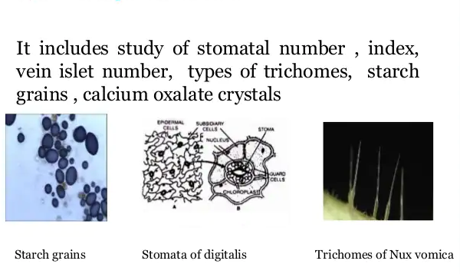

Slide 11
THIN-LAYER CHROMATOGRAPHY:-
14
Thin-layer chromatography is particularly valuable for the qualitative determination of small amounts of impurities.
  type of adsorbent and method of activation; if no information on the
latter can be obtained, heat at 110°C for 30 minutes;
  Method of preparation and concentration of the test and reference solutions;
  Volume of the solutions to be applied on the plate;
  Mobile phase and the distance of migration;
  Drying conditions (including temperature) and method of detection;
  For the spots obtained:
− Number and approximate position, or the R_{f} values
− Fluorescence and colour.
Distance travelled by solute
R_{f} Value = -------------------------------------
Distance travelled by solvent

Slide 12
DETERMINATION OF ASH:-
The residue remaining after incineration is the ash constant of the drug, which simply represents inorganic salts, naturally occurring in drug or adulterating, identification
https://www.youtube.com/watch?v=0YGRh8yjwws
Method:-Determination of Total ash:-
2-4g of powder
500-600º until white
Ignited on platinum or silica crucible
Cool in desiccators for 30min
Weigh & calculate the content of total ash in mg per g of air-dried material.

Slide 13

Determination of acid insoluble ash:-
Ash obtained in total ash
Add to the beaker & add 25mL of 2M HCl
Collect the insoluble matter by filtration using ash less filter paper
Ignite the filter paper
Cool the obtained ash in dessicator for 30 min
Weigh & calculate the content of acid insoluble ash in mg per g of air-dried material.
https://www.youtube.com/watch?v=JecqdeVUTpE

Slide 14





Determination of water-soluble ash
Ash obtained from total ash
Add to the beaker & add 25mL of water
Collect the insoluble matter by filtration using ash less filter paper Ignite the filter paper
Cool the obtained ash in dessicator for 30 min
Weigh & calculate the content of water soluble ash in mg per g of air-dried material.

Slide 15







DETERMINATION OF EXTRACTABLE MATTER:-
This method determines the amount of active constituents extracted with solvents from a given amount of medicinal plant material.
Hot-extraction method:-
4.0g of coarsely powdered air-dried material, accurately weighed, in a glass-stoppered conical flask.
Add 100ml of water and weigh to obtain the total weight including the flask.
Shake well and allow to stand for 1 hour.
Reflux condenser to the flask and boil gently for 1 hour; cool and weigh.
Shake well and filter rapidly through a dry filter.
Transfer 25 ml of the filtrate to a tarred flat-bottomed dish
Dry at 105°C for 6 hours, cool in a desiccator for 30 minutes,
Weigh & calculate the content of extract in mg per g of air-dried material.

Slide 16





Cold-extraction:-
4.0g of coarsely powdered air-dried material, accurately weighed, in a glass-stoppered conical flask.
Macerate with 100ml of the solvent specified for the plant material concerned for 6 hours, Shaking frequently, then allow to stand for 18 -24 hours.
Transfer 25 ml of the filtrate to a tared flat-bottomed dish Dry at 105°C for 6 hours, cool in a desiccator for 30 minutes
Weigh & calculate the content of extract in mg per g of air-dried material.
https://www.youtube.com/watch?v=RU4nr0xxMo0
https://www.youtube.com/watch?v=w8zi99R2t2o

Slide 17
DETERMINATION OF VOLATILE OILS:-
Volatile oils are characterized by their odour, oil-like appearance and ability to volatilize at room temperature.
https://www.youtube.com/watch?v=s_KuvXXvgX4
https://www.youtube.com/watch?v=iWwnH--TZuU
Method:-
Specified quantity of material
Heating 60-70 ° C
After 10 min, recorded volume of oil collected
Substract from solvent to use Difference gives volume of oil in sample
Calculate oil content as mL/100g

Slide 18
An excess of water in medicinal plant materials will encourage microbial growth, the presence of fungi or insects, and deterioration following hydrolysis.
The test for loss on drying determines both water and volatile matter.
Drying can be carried out either by heating to 100-105 °C or in a desiccator over phosphorus pentoxide R under atmospheric or reduced pressure at room temperature for a specified period of time.
The desiccation method is especially useful for materials that melt to a sticky mass at elevated temperatures.

Slide 19
DETERMINATION OF BITTERNESS VALUE:-
Medicinal plant materials that have a strong bitter taste ("bitters") are employed therapeutically, mostly as appetizing agents.
The bitter properties of plant material are determined by comparing the threshold bitter concentration of an extract of the materials with that of a dilute solution of quinine hydrochloride. The bitterness value is expressed in unit’s equivalent to the bitterness of a solution containing 1g of quinine
hydrochloride in 2000 ml.
2000xC
axb
Bitterness =
Where a = the concentration of the stock solution (Sa_{T}) (mg/ml),
b = the volume of S_{T} (in ml) in the tube with the threshold bitter concentration,
c = the quantity of quinine hydrochloride (in mg) in the tube with the threshold bitter concentration.

Slide 20


DETERMINATION OF HAEMOLYTIC ACTIVITY:-
The haemolytic activity of plant materials, or a preparation containing saponins, is determined by comparison with that of a reference material, saponins, which has a haemolytic activity of 1000 units per g.
Method:-
Suspension of erythrocytes
Mixed
Equal volumes of a serial dilution of the plant material extract.
Stand for 10 min
Lowest concentration to effect complete haemolysis is determined
Haemolytic activity =
1000xa
b
Where 1000 = the defined haemolytic activity of saponins R in relation to ox blood, a= quantity of saponins
b= quantity of drug

Slide 21
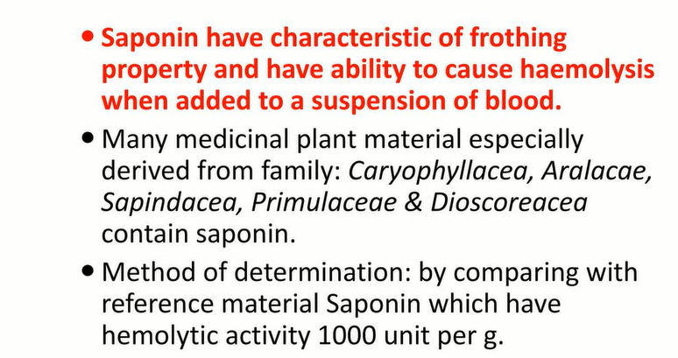
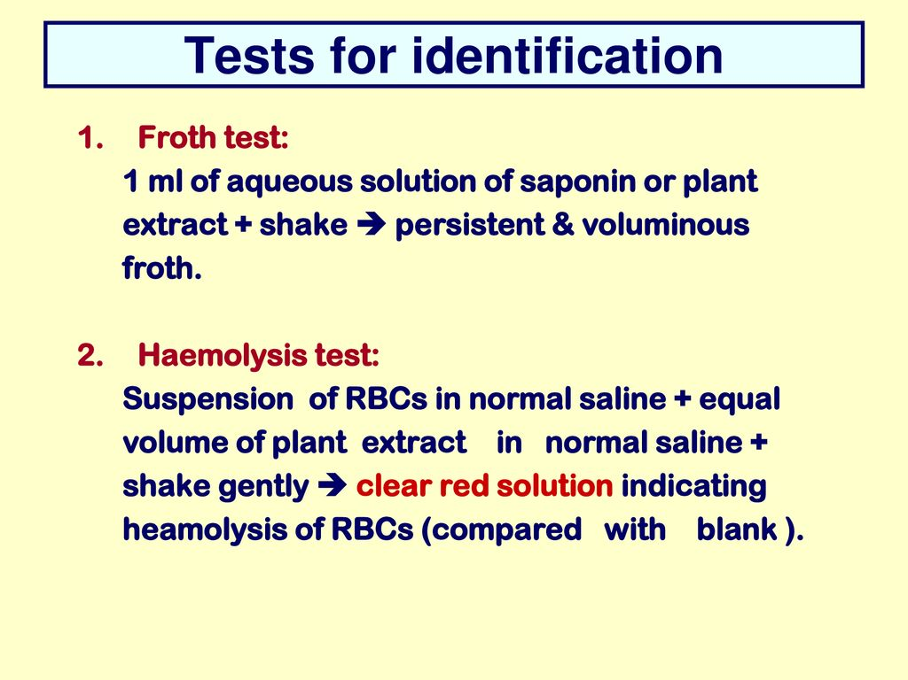
https://www.youtube.com/watch?v=1NsisPegdqQ

Slide 22





DETERMINATION OF TANNINS:-
Method:-
Sample + 150ml of water
Cool, transfer the mixture to a 250-ml volumetric flask and dilute to volume with water.
Allow the solid material to settle
Filter the liquid through a filter-paper, diameter 12cm Discarding the first 50ml of the filtrate.

Slide 23
Total amount of material powder,
that is extractable into water,
Evaporate 50.0ml of the plant material extract to dryness
dry,105⁰c,4hrs
Weigh %.

Slide 24



DETERMINATION OF SWELLING INDEX:-
The swelling index is the volume in ml taken up by the swelling of 1 g of plant material under specified conditions.
Method:-
1 g of plant material into 25 mL measuring cylinder +25mL water
Shake the mixture thoroughly every 10 minutes for 1 hour Allow to stand for 3 hours at room temperature, or as specified
Measure the volume in ml occupied by the plant material, including any sticky mucilage.

Slide 25




DETERMINATION OF FOAMING INDEX:-
Many medicinal plant materials contain saponins that can cause a persistent foam when an aqueous decoction is shaken.
https://www.youtube.com/watch?v=5w5qs78iZ7w&t=224s
1 g of the plant material + 100ml of water (500mL conical flask)
Cool and filter into a 100-ml volumetric flask
Pour the decoction into 10 stoppered test-tubes in successive portions Dilute to volume (10ml) with water.
Allow to stand for 15 minutes Measure the height of the foam.

Slide 26
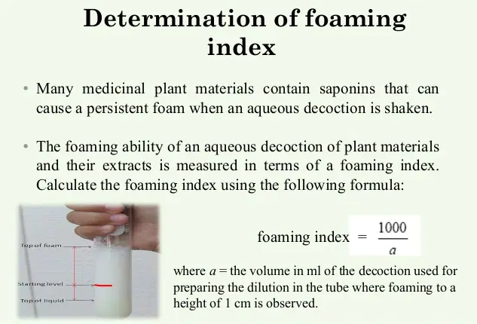

Slide 27
DETERMINATION OF PESTICIDE RESIDUES:-
Medicinal plant materials are liable to contain pesticide residues which
accumulate from agricultural practices, such as spraying, treatment of
soils during cultivation, and administration of fumigants during storage.
Maximum residue limit can be calculated by using following formula:-
ADL *W * E
MDI * (100 * Safety factor)
Maximum residue limit =
Where ADL= Acceptable daily limit W= body weight
MDI=Mean daily intake of drug E=Extraction factor

Slide 28
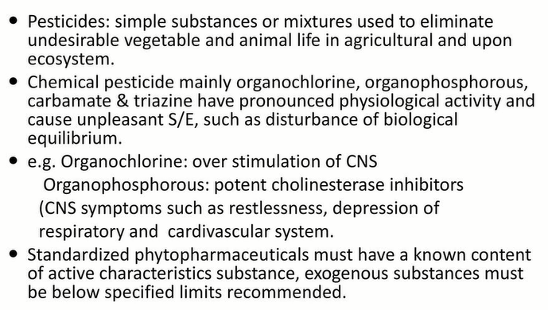

Slide 29
DETERMINATION OF ARSENIC AND HEAVY METALS
Contamination of medicinal plant materials with arsenic and heavy metals can be attributed to many causes including environmental pollution and traces of pesticides.
Limit test for arsenic:-
The amount of arsenic in the medicinal plant material is estimated by matching the depth of colour with that of a standard stain.
Limit test for cadmium and lead:-
The method of determination is left to the analyst. Nevertheless, the determination must be consistent and sensitive enough to allow comparison with a reference material.

Slide 30
DETERMINATION OF MICROORGANISMS:-
Medicinal plant materials normally carry a great number of bacteria and moulds, often originating in soil. While a large range of bacteria and fungi form the naturally occurring microflora of herbs, aerobic spore-forming bacteria frequently predominate.
Current practices of harvesting, handling and production may cause additional contamination and microbial growth.
The determination of Escherichia coli and moulds may indicate the quality of production and harvesting practices.

Slide 31



Method:-
Preparation of sample solution (plant extract)
Preparation of culture media Sample added to the culture media
Incubate for 24hrs to 48hrs at aseptic condition
Growth of microorganisms can be identified by turbidity/staining with suitable reagents

Slide 32
RADIOACTIVE CONTAMINATION:-
A certain amount of exposure to ionizing radiation cannot be avoided since there are many sources, including radionuclides occurring naturally in the ground and the atmosphere.
Method of measurement:-
Since radionuclides from accidental discharges vary with the type of facility
involved, a generalized method of measurement is so far not available. However, should such contamination be of concern, suspect samples can be analysed by a competent laboratory. Details of laboratory techniques are available from the International Atomic Energy Agency (IAEA).

Slide 33


