Slide 1

Course Name: Fabric Design and Analysis
Course Code: TE-323
Topic: Twill Weave and Different types of twill designs

Slide 2

Submitted To:
Engr. Fahmida Siddiqa
Assistant Professor
Department Of Textile Engineering
Daffodil International University
Submitted By:
Name ID
Sayem Chawdhury 191-23-5529
Md. Fayad Noor 191-23-5546
Sayed mahmudul Haque Anik 191-23-5604
Sharifur Rahman Ayon 191-23-5594
Section: C
Department Of Textile Engineering

Slide 3
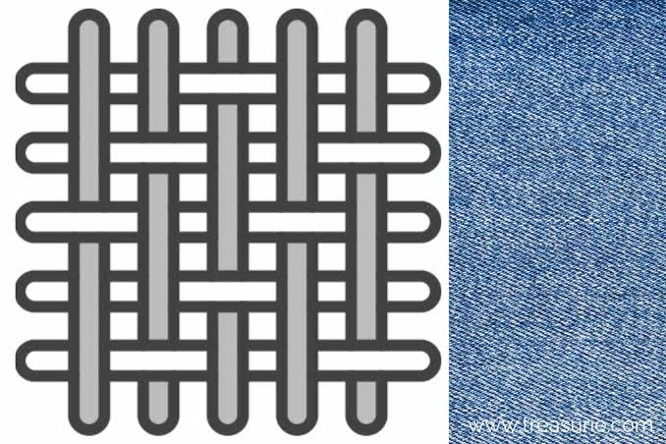
Basic of twill weave and it’s features
191-23-5604
Twill is a type of textile weave with a pattern of diagonal parallel ribs.

Slide 4
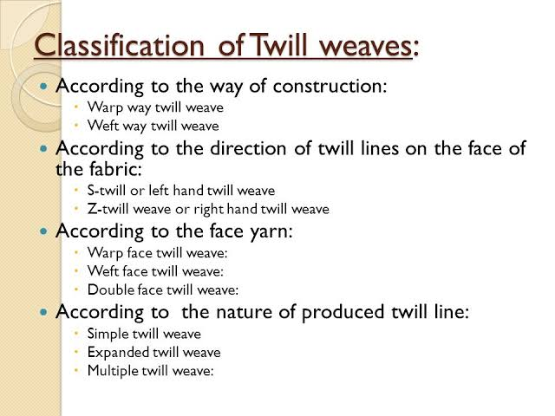
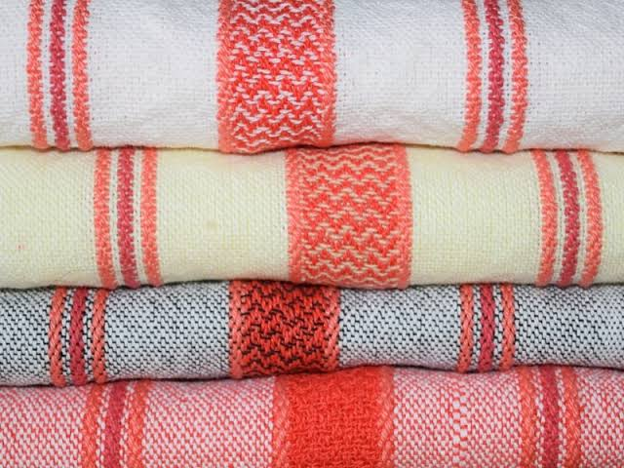
Classification of Twill weave
191-23-5604

Slide 5
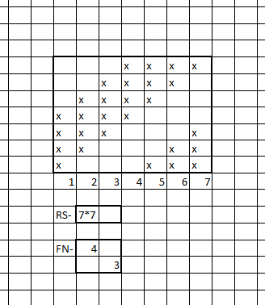
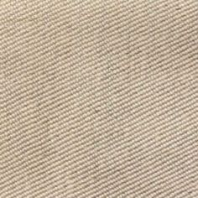
191-23-5529
Z Twill Weave
When the diagonal lines form the lower left corner to the upper right corner, the twill is known as right hand twill or Z-twill.

Slide 6
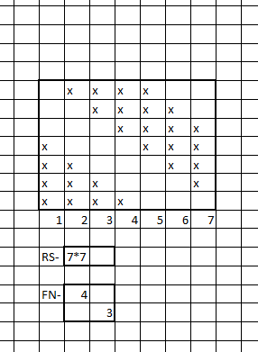
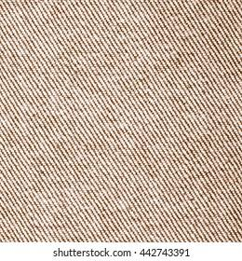
191-23-5529
S Twill Weave
The alignment of twill line is parallel to the middle portion of S. So it is called S-twill.

Slide 7

191-23-5546
Zigzag Twill & Its Classification
Features of Zigzag Twill:
Classification of Zigzag Twill:
Two types-
Horizontal Zigzag
Vertical Zigzag
achieved by reversing the direction at suitable intervals.
A point is created in reversing point.
referred to as Pointed Twill.
uses: Figured or ornamented design, Upholstery, Wall covering etc.

Slide 8
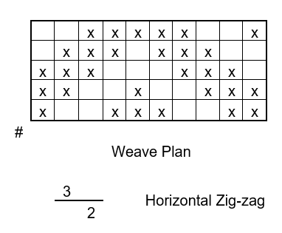
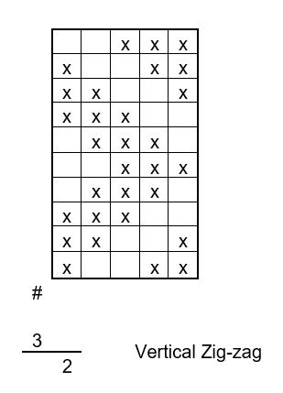
191-23-5546
Horizontal & Vertical Zigzag:
Features of Horizontal Zigzag:
warp yarn is double to the number of weft yarn.
Point draft
Features of Vertical Zigzag:
weft yarn is double to the number of warp yarn
Straight draft

Slide 9
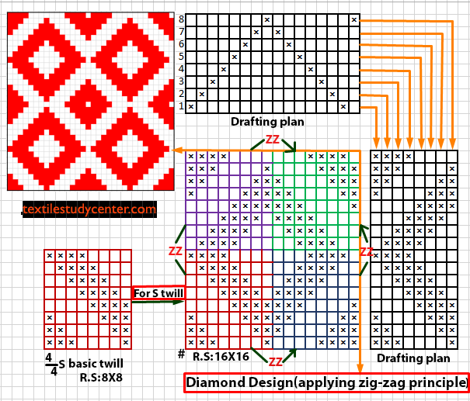
Diamond Weave
ID: 191-23-5594
Features
Uses

Slide 10
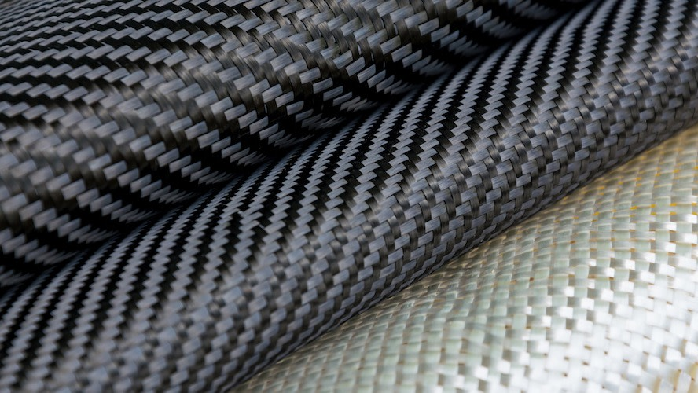
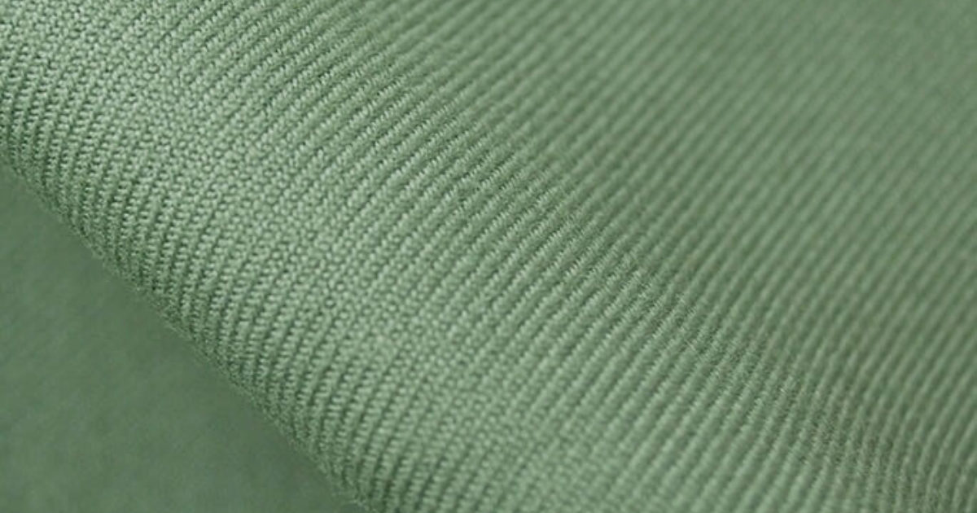
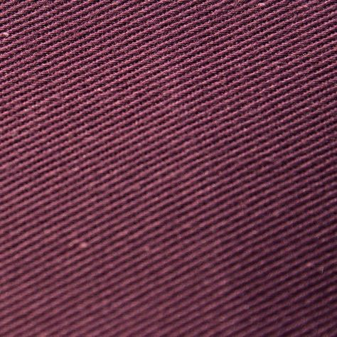
ID:191-23-5594
5 Benefits of Using Twill
Durable
Opaque
Shows few stains
Shows few wrinkle and creases
Drapes well

Slide 11


