Slide 1
Chapter 1: Vectors and Scalars

Slide 2
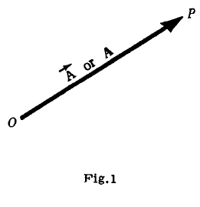
Definition
A VECTOR is a quantity having both magnitude and direction such as displacement, velocity, force and acceleration.
Graphically a vector is represented by an arrow $OP$ (Fig.1) defining the direction.
The magnitude of the vector being indicated by the length of the arrow.
The tail end $O$ of the arrow is called the origin or initial point of the vector, and the head $P$ is called the terminal point or terminus.

Slide 3
Analytically,
A vector is represented by a letter with an arrow over it, as $\vec{A}$ in Fig.1, and
Its magnitude is denoted by $|\vec{A}|$ or A.
In printed works, bold faced type, such as A, is used to indicate the vector $\vec{A}$ while $|\vec{A}|$ or A indicates its magnitude.
We shall use this bold faced notation for Lecture Work.
But while, writing, use arrow notation.

Slide 4
A SCALAR is a quantity having magnitude but no direction, e.g. mass, length, time, temperature, and any real number.
Scalars are indicated by letters in ordinary type as in elementary algebra.
Operations with scalars follow the same rules as in elementary algebra.

Slide 5
VECTOR ALGEBRA. The operations of addition, subtraction and multiplication familiar in the algebra of numbers or scalars are, with suitable definition, capable of extension to an algebra of vectors. The following definitions are fundamental.
1. Two vectors $A$ and $B$ are equal if they have the same magnitude and direction regardless of the position of their initial points. Thus $A= B$ in Fig.2.
2. A vector having direction opposite to that of vector $A$ but having the same magnitude is denoted by $−A$ (Fig.3).

Slide 6
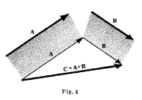
Addition of Two vectors
3. The sum or resultant of vectors $A$ and $B$ is a vector $C$ formed by placing the initial point of $B$ on the terminal point of $A$ and then joining the initial point of $A$ to the terminal point of $B$ (Fig.4).
This sum is written $A+B$, i.e. $C = A+B$.

Slide 7
Subtraction of two vectors
4. The difference of vectors $A$ and $B$, represented by $A −B$, is that vector $C$ which added to $B$ yields vector $A$. Equivalently, $A− B$ can be defined as the sum $A + (−B).$
If $A = B$, then $A−B$ is defined as the null or zero vector and is represented by the symbol $0$ or simply $0$.
It has zero magnitude and no specific direction.

Slide 8
Unit Vector
A UNIT VECTOR is a vector having unit magnitude, if $A$ is a vector with magnitude $|A|≠0$, then $\frac{A}{\left|A\right|}$ is a unit vector having the same direction as $A$.
Any vector $A$ can be represented by a unit vector $a$ in the direction of $A$ multiplied by the magnitude of $A$.
In symbols, $A = Aa$.

Slide 9
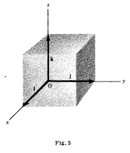
RECTANGULAR UNIT VECTORS
THE RECTANGULAR UNIT VECTORS $i, j, k$.
An important set of unit vectors are those having the directions of the positive $x, y,$and $z$ axes of a three dimensional rectangular coordinate system, and are denoted respectively by $i, j,$and $k$ (Fig.5).

Slide 10
COMPONENTS OF A VECTOR.
Any vector $A$ in 3 dimensions can a represented with initial point at the origin $0$ of a rec angular coordinate system (Fig.7).
Let $(A_{1}, A_{2}, A_{3})$be the rectangular coordinates of the terminal point of vector $A$ with initial point at $0$.

Slide 11
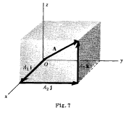
The vectors $A_{1}i, A_{2}j$, and $A_{3}k$ are called the rectangular component vectors or simply component vectors of $A$ in the $x, y$and $z$ directions respectively.
The sum or resultant of $A_{1}i, A_{2}j$, and $A_{3}k$ is the vector $A$ so that we can write
$A=A_{1}i+A_{2}j+A_{3}k$
The magnitude of $A$ is
$A=|A|=\sqrt{A_{1}^{2}+A_{2}^{2}+A_{3}^{2} }$

Slide 12
SCALAR FIELD.
If to each point $(x,y,z)$of a region $R$ in space there corresponds a number or scalar $φ(x,y,z)$ then $φ$ is called a scalar function of position or scalar point function and we say that a scalar field $φ$ has been defined in $R$.
Examples.
(1) The temperature at any point within or on the earth's surface at a certain time defines a scalar field.
(2) $φ(x,y,z) = x^{3}y − z^{2}$ defines a scalar field.
A scalar field which is independent of time is called a stationary or steady-state scalar field.

Slide 13
VECTOR FIELD.
If to each point $(x,y,z)$of a region $R$ in space there corresponds a vector $V(x,y,z)$, then $V$is called a vector function of position or vector point function and we say that a vector field $V$ has been defined in $R$.
Examples.
(1) If the velocity at any point $(x,y,z)$ within a moving fluid is known at a certain time, then a vector field is defined.
(2) $V(x,y,z) = xy^{2}i − 2yz^{3}j + x^{2}zk$defines a vector field.
A vector field which is independent of time is called a stationary or steady-state vector field.

Slide 14
Ex-1.

Slide 15
EX-2

Slide 16
EX-3

Slide 17
Exercise 1

