Slide 1
Vector Analysis
1. Product of multiple vectors

Slide 2
Basic concepts
Types of Quantity
Quantity with Magnitude only
Quantity with magnitude and direction
Scalar
Vector
Time
Displacement
Distance
Velocity
Mass
Acceleration
Volume
Momentum
Temperature
Force

Slide 3
Representation of vectors
Notation:
Represented by an arrow overhead or by boldface type.
$\vec{A}$ or $A$
Modulus or Magnitude:
Length of the vector
a real scalar value
denoted by $|\vec{A}|$ or $\left|A\right|$
Unit Vector:
Whose magnitude is unity
Unit vector of $A$ is denoted by $\hat{a}$
Unit vector of $A$ is defined by $\hat{a}=\frac{A}{|A|}$

Slide 4
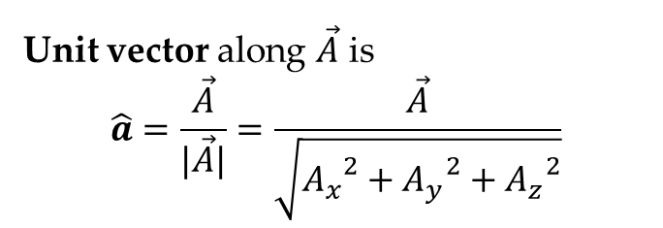
Vector in 3-dimension
If $\vec{A}$ is a vector in 3 dimension then $\vec{A}$ is represented by
$$z$$
$$\vec{A}=A_{x}\hat{i}+A_{y}\hat{j}+A_{z}\hat{k}$$
$A(A_{x}$, $A_{y},A_{z})$
$$A_{z}$$
Where$\hat{i},\hat{j},\hat{k}$are called the unit vectors along $x−$axis, $y−$axis and $z−$axis respectively.
$$\hat{k}$$
$$y$$
Magnitude of is
$A=\left|\vec{A}\right|=\sqrt{{A_{x}}^{2}+{A_{y}}^{2}+{A_{z}}^{2}}$
$$o$$
$$\hat{j}$$
$$A_{y}$$
$$\hat{i}$$
$$A_{x}$$
$${(A}_{x},A_{y})$$
Unit vector along $\vec{A}$ is
$$\hat{a}=\frac{\vec{A}}{|\vec{A}|}=\frac{\vec{A}}{\sqrt{{A_{x}}^{2}+{A_{y}}^{2}+{A_{z}}^{2}}}$$
$$x$$

Slide 5
Product of vectors
Types of Product
Scalar Product
Or
Dot(.) Product
Vector Product
Or
Cross (×) Product

Slide 6
Scaler Product of two vectors
If $\vec{A}=A_{x}\hat{i}+A_{y}\hat{j}+A_{z}\hat{k}$ and $\vec{B}=B_{x}\hat{i}+B_{y}\hat{j}+B_{z}\hat{k}$ are two vectors
Their scalar(dot) product is denoted by $\vec{A}∙\vec{B}$ and is defined by
$$y$$
$$\vec{B}$$
$$\vec{A}∙\vec{B}=\left|\vec{A}\right|\left|\vec{B}\right| cos θ=AB\cos{θ}$$
$$θ$$
$$O$$
$$\vec{A}$$
$$x$$
Where $θ$ is the angle between $\vec{A} and \vec{B}$
$$A=\left|\vec{A}\right|=\sqrt{{A_{x}}^{2}+{A_{y}}^{2}+{A_{z}}^{2}} ; B=\left|\vec{B}\right|=\sqrt{{B_{x}}^{2}+{B_{y}}^{2}+{B_{z}}^{2}}$$
Also $\vec{A}∙\vec{B}=\left(A_{x}\hat{i}+A_{y}\hat{j}+A_{z}\hat{k}\right)∙\left(B_{x}\hat{i}+B_{y}\hat{j}+B_{z}\hat{k}\right)=A_{x}B_{x}+A_{y}B_{y}+A_{z}B_{z}$
$$θ=\cos^{−1}\left(\frac{\vec{A}∙\vec{B}}{AB}\right)=\cos^{−1}\left(\frac{A_{x}B_{x}+A_{y}B_{y}+A_{z}B_{z} }{AB}\right)$$

Slide 7
Vector Product of two vectors
If $\vec{A}=A_{x}\hat{i}+A_{y}\hat{j}+A_{z}\hat{k}$ and $\vec{B}=B_{x}\hat{i}+B_{y}\hat{j}+B_{z}\hat{k}$ are two vectors
$$y$$
Their Vector(Cross) Product is denoted by $\vec{A}×\vec{B}$ and is defined by
$$\vec{B}$$
$$\hat{η}$$
$$θ$$
$$O$$
$$x$$
$$\vec{A}×\vec{B}=\left|\vec{A}\right|\left|\vec{B}\right| sin θ \hat{η}=AB\sin{θ}\hat{η}$$
$$\vec{A}$$
Where $θ$ is the angle between $\vec{A} and \vec{B}$ and $\hat{η}$ is a unit vector
Also $\vec{A}×\vec{B}=\left|\begin{matrix}\hat{i} & \hat{j} & \hat{k} \\ A_{x} & A_{y} & A_{z} \\ B_{x} & B_{y} & B_{z}\end{matrix}\right|=\hat{i}\left(A_{y}B_{z}−A_{z}B_{y}\right)−\hat{j}\left(A_{x}B_{z}−A_{z}B_{x}\right)+\hat{k}\left(A_{x}B_{y}−A_{y}B_{x}\right)$
$$θ=\sin^{−1}\left(\frac{\left|\vec{A}×\vec{B}\right|}{AB}\right)$$
$$\hat{η}=±\frac{\vec{A}×\vec{B}}{\left|\vec{A}×\vec{B}\right|}$$

Slide 8
Some problems
1. Find the angle between the vectors $\vec{A}=2\hat{i}+3\hat{j}+\hat{k}$ and $\vec{B}=3\hat{i}+\hat{j}−2\hat{k}$
2. Find the sine of the angle between the vectors $\vec{A}=\hat{i}+2\hat{j}+3\hat{k}$ and
$\vec{B}=3\hat{i}−4\hat{j}+2\hat{k}$
3. Find a unit vector perpendicular to the vectors $\vec{A}=\hat{i}+2\hat{j}+3\hat{k}$ and
$\vec{B}=3\hat{i}−4\hat{j}+2\hat{k}$

Slide 9
Solution
1. Find the angle between the vectors $\vec{A}=2\hat{i}+3\hat{j}+\hat{k}$ and $\vec{B}=3\hat{i}+\hat{j}−2\hat{k}$
Given vectors $\vec{A}=2\hat{i}+3\hat{j}+\hat{k}$ and $\vec{B}=3\hat{i}+\hat{j}−2\hat{k}$
$∴$ $A=\left|\vec{A}\right|=\sqrt{2^{2}+3^{2}+1^{2}}=\sqrt{14}$ and $B=\left|\vec{B}\right|=\sqrt{3^{2}+1^{2}+{(−2)}^{2}}=\sqrt{14}$
$\vec{A}∙\vec{B}=\left(2\hat{i}+3\hat{j}+\hat{k}\right)∙\left(3\hat{i}+\hat{j}−2\hat{k}\right)=\left(2\right)\left(3\right)+\left(3\right)\left(1\right)+\left(1\right)\left(−2\right)=7$
Let $θ$ the angle between them. Then
$$θ=\cos^{−1}\left(\frac{\vec{A}∙\vec{B}}{AB}\right)=\cos^{−1}\left(\frac{7 }{\sqrt{14}\sqrt{14}}\right)=\cos^{−1}\left(\frac{1 }{2}\right)={60}^{o}$$
Conclusion:
➢ Find magnitudes of the vectors
➢ Find dot product of the vectors
➢ Find angle by using the formula directly

Slide 10
Solution
2. Find the sine of the angle between the vectors $\vec{A}=\hat{i}+2\hat{j}+3\hat{k}$ and $\vec{B}=3\hat{i}−4\hat{j}+2\hat{k}$
Given vectors $\vec{A}=\hat{i}+2\hat{j}+3\hat{k}$ and $\vec{B}=3\hat{i}−4\hat{j}+2\hat{k}$
$∴$ $A=\left|\vec{A}\right|=\sqrt{1^{2}+2^{2}+3^{2}}=\sqrt{14}$ and $B=\left|\vec{B}\right|=\sqrt{3^{2}+{(−4)}^{2}+2^{2}}=\sqrt{29}$
Also $\vec{A}×\vec{B}=\left|\begin{matrix}\hat{i} & \hat{j} & \hat{k} \\ 1 & 2 & 3 \\ 3 & −4 & 2\end{matrix}\right|=\hat{i}\left(4+12\right)−\hat{j}\left(2−9\right)+\hat{k}\left(−4−6\right)=16\hat{i}+7\hat{j}−10\hat{k}$
$$∴\left|\vec{A}×\vec{B}\right|=\sqrt{{16}^{2}+7^{2}+{\left(−10\right)}^{2}}=\sqrt{405}$$
Let $θ$ the angle between them. Then
$$\sin{θ}=\left(\frac{\left|\vec{A}×\vec{B}\right|}{AB}\right)=\left(\frac{\sqrt{405}}{\sqrt{14}\sqrt{29}}\right)=\frac{9\sqrt{5}}{\sqrt{14}\sqrt{29}}$$
Conclusion:
➢ Find magnitudes of the vectors
➢ Find Cross Product of the vectors
➢ Find magnitude of the Cross Product
➢ Find angle by using the formula directly

Slide 11
Solution
3. Find a unit vector perpendicular to the vectors $\vec{A}=\hat{i}+2\hat{j}+3\hat{k}$ and $\vec{B}=3\hat{i}−4\hat{j}+2\hat{k}$
Given vectors $\vec{A}=\hat{i}+2\hat{j}+3\hat{k}$ and $\vec{B}=3\hat{i}−4\hat{j}+2\hat{k}$
Also $\vec{A}×\vec{B}=\left|\begin{matrix}\hat{i} & \hat{j} & \hat{k} \\ 1 & 2 & 3 \\ 3 & −4 & 2\end{matrix}\right|=\hat{i}\left(4+12\right)−\hat{j}\left(2−9\right)+\hat{k}\left(−4−6\right)=16\hat{i}+7\hat{j}−10\hat{k}$
$$∴\left|\vec{A}×\vec{B}\right|=\sqrt{{16}^{2}+7^{2}+{\left(−10\right)}^{2}}=\sqrt{405}$$
Let$\hat{η}$ be the unit vector. Then
$$\hat{η}=±\frac{\vec{A}×\vec{B}}{\left|\vec{A}×\vec{B}\right|}=±\frac{16\hat{i}+7\hat{j}−10\hat{k}}{\sqrt{405}}=±\left(\frac{16}{\sqrt{405}}\hat{i}+\frac{7}{\sqrt{405}}\hat{j}−\frac{10}{\sqrt{405}}\hat{k}\right)$$
Conclusion:
➢ Find Cross Product of the vectors
➢ Find magnitude of the Cross Product
Find unit vector by using the formula directly

Slide 12
Exercise-1
1. Find a unit vector perpendicular to the vectors $\vec{A}=2\hat{i}+\hat{j}−\hat{k}$ and
$\vec{B}=−6\hat{i}+3\hat{j}+5\hat{k}$. Find the sine of the angle between these vectors.
2. Find a unit vector perpendicular to the vectors $\vec{A}=\hat{i}+2\hat{j}+3\hat{k}$ and
$\vec{B}=5\hat{i}−\hat{j}+2\hat{k}$

Slide 13
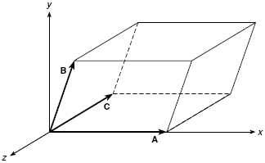
Multiple products
Scalar product of three vectors: $a∙\left(b×c\right)≡$ Volume of the Parallelopiped
$$V=a∙\left(b×c\right)=\left(b×c\right)∙a=−a∙\left(c×b\right)=−\left(c×b\right)∙a$$
* $\left[a b c\right]=a∙\left(b×c\right)$
Scalar product of four vectors:
$\left(a×b\right)∙\left(c×d\right)=\left(a∙c\right)\left(b∙d\right)−\left(a∙c\right)\left(b∙d\right)$

Slide 14
Vector Product Of Three Vectors:
$$a×\left(b×c\right)=\left(a∙c\right)b−\left(a∙b\right)c$$
$\left(a×b\right)×c=\left(a∙c\right)b−\left(b∙c\right)a$
Vector Product Of Four Vectors:
$\left(a×b\right)×\left(c×d\right)=\left[a b d\right]c−\left[a b c\right]d=\left[a c d\right]b−\left[b c d\right]a$
* $\left[x y z\right]=x∙\left(y×z\right)$

Slide 15
Basic problems (Question Numbers are not from BOOK)
1. Show that ${\left(a×b\right)}^{2}=a^{2}b^{2}−{\left(a∙b\right)}^{2}$. If $xa=b$ find $x$.
2. Show that $\left(a×b\right)×\left(b×c\right)∙\left(c×a\right)={\left[a b c\right]}^{2},$ and if
$\left|a+b\right|=\left|a−b\right|$ then $a$and $b$are perpendicular.
3. Prove that $\left[a×b b×c c×a\right]={\left[a b c\right]}^{2}=\left|\begin{matrix}a∙a & a∙a & a∙c \\ b∙a & b∙b & b∙c \\ c∙a & c∙b & c∙c\end{matrix}\right|$
4. Show that $\left[a+b b+c c+a\right]=2[a b c]$

Slide 16
Solution of previously mentioned problems
1. Show that ${\left(a×b\right)}^{2}=a^{2}b^{2}−{\left(a∙b\right)}^{2}$. If $xa=b$ find $x$.
Solution(1st Part): Let $θ$ be the angle between $a$ and $b$
Then, $a×b=ab\sin{θ} \hat{η}$ where $\hat{η}=\frac{a×b}{|a×b|}$
${⇒\left(a×b\right)}^{2}={\left(ab\sin{θ} \hat{η}\right)}^{2}=a^{2}b^{2}\sin^{2}{θ}=a^{2}b^{2}\left(1−\cos^{2}{θ}\right)$ [ ${\hat{η}}^{2}=1$ ]
$⇒{\left(a×b\right)}^{2}=a^{2}b^{2}−a^{2}b^{2}\cos^{2}{θ}=a^{2}b^{2}−{\left(a∙b\right)}^{2}$ $[a∙b=ab\cos{θ}]$
Solution(2nd Part):
We have, $xa=b$
$$⇒\left|xa\right|=\left|b\right|$$
$$⇒\left|x\right|\left|a\right|=\left|b\right|$$
$⇒x=\frac{\left|b\right|}{\left|a\right|}$

Slide 17
2. Show that $\left(a×b\right)×\left(b×c\right)∙\left(c×a\right)={\left[a b c\right]}^{2},$ and if
$\left|a+b\right|=\left|a−b\right|$ then $a$and $b$are perpendicular.
Solution(1st Part):
L.H.S. $=\left(a×b\right)×\left(b×c\right)∙(c×a)$
$=\left\{m×\left(b×c\right)\right\}.(c×a)$
$=\left\{\left(m∙c\right)b−\left(m∙b\right)c\right\}∙(c×a)$
$=\left\{\left(a×b∙c\right)b−\left(a×b∙b\right)c\right\}∙(c×a)$
$\left(\left[a b c\right]b−\left[a b b\right]c\right)∙(c×a)$
$=\left(\left[a b c\right]b−0 c\right)∙(c×a)$
$=\left[a b c\right]b∙(c×a)$
$=\left[a b c\right]\left[a b c\right]$
$={\left[a b c\right]}^{2}$
Solution(2nd Part):
We have, $\left|a+b\right|=\left|a−b\right|$
$⇒{\left|a+b\right|}^{2}={\left|a−b\right|}^{2}$
$⇒(a+b)(a+b)=(a−b)(a−b)$
$⇒a^{2}+ab+ba+b^{2}=a^{2}−ab−ba+b^{2}$
$$⇒4a∙b=0⇒a∙b=0$$
Therefore, $a$and $b$are perpendicular

Slide 18
3. Prove that $\left[a×b b×c c×a\right]={\left[a b c\right]}^{2}=\left|\begin{matrix}a∙a & a∙a & a∙c \\ b∙a & b∙b & b∙c \\ c∙a & c∙b & c∙c\end{matrix}\right|$
Solution(1st Part):
L.H.S. $=\left[a×b b×c c×a\right]$
$=\left(a×b\right)∙\left\{\left(b×c\right)×\left(c×a\right)\right\}$
$=\left(a×b\right)∙\left\{m×\left(c×a\right)\right\}$
Let $m=b×c$
$=(a×b)∙\left\{\left(m∙a\right)c−\left(m∙c\right)a\right\}$
$=(a×b)∙\left\{\left(\left(b×c\right)∙a\right)c−\left(\left(b×c\right)∙c\right)a\right\}$
$=(a×b)∙\left\{\left[a b c\right]c−\left[b c c\right]a\right\}$
$=(a×b)∙\left\{\left[a b c\right]c−0a\right\}$
$=\left[a b c\right](a×b)∙$ $c$
$=\left[a b c\right]\left[a b c\right]$
$={\left[a b c\right]}^{2}$

Slide 19
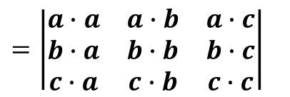
Solution(2nd Part):
Let $a=a_{1}\hat{i}+a_{2}\hat{j}+a_{3}\hat{k}$
$$\left[a b c\right]=a∙\left(b×c\right)=\left|\begin{matrix}a_{1} & a_{2} & a_{3} \\ b_{1} & b_{2} & b_{3} \\ c_{1} & c_{2} & c_{3}\end{matrix}\right|$$
$b=b_{1}\hat{i}+b_{2}\hat{j}+b_{3}\hat{k}$
$c=c_{1}\hat{i}+c_{2}\hat{j}+c_{3}\hat{k}$
$\left[a b c\right]\left[a b c\right]=\left|\begin{matrix}a_{1} & a_{2} & a_{3} \\ b_{1} & b_{2} & b_{3} \\ c_{1} & c_{2} & c_{3}\end{matrix}\right|\left|\begin{matrix}a_{1} & a_{2} & a_{3} \\ b_{1} & b_{2} & b_{3} \\ c_{1} & c_{2} & c_{3}\end{matrix}\right|$
$=\left|\begin{matrix}a_{1}a_{1}+a_{2}a_{2}+a_{3}a_{3} & a_{1}b_{1}+a_{2}b_{2}+a_{3}b_{3} & a_{1}c_{1}+a_{2}c_{2}+a_{3}c_{3} \\ b_{1}a_{1}+b_{2}a_{2}+b_{3}a_{3} & b_{1}b_{1}+b_{2}b_{2}+b_{3}b_{3} & b_{1}c_{1}+b_{2}c_{2}+b_{3}c_{3} \\ c_{1}a_{1}+c_{2}a_{2}+c_{3}a_{3} & c_{1}b_{1}+c_{2}b_{2}+c_{3}b_{3} & c_{1}c_{1}+c_{2}c_{2}+c_{3}c_{3}\end{matrix}\right|$
$=\left|\begin{matrix}a∙a & a∙b & a∙c \\ b∙a & b∙b & b∙c \\ c∙a & c∙b & c∙c\end{matrix}\right|$

Slide 20
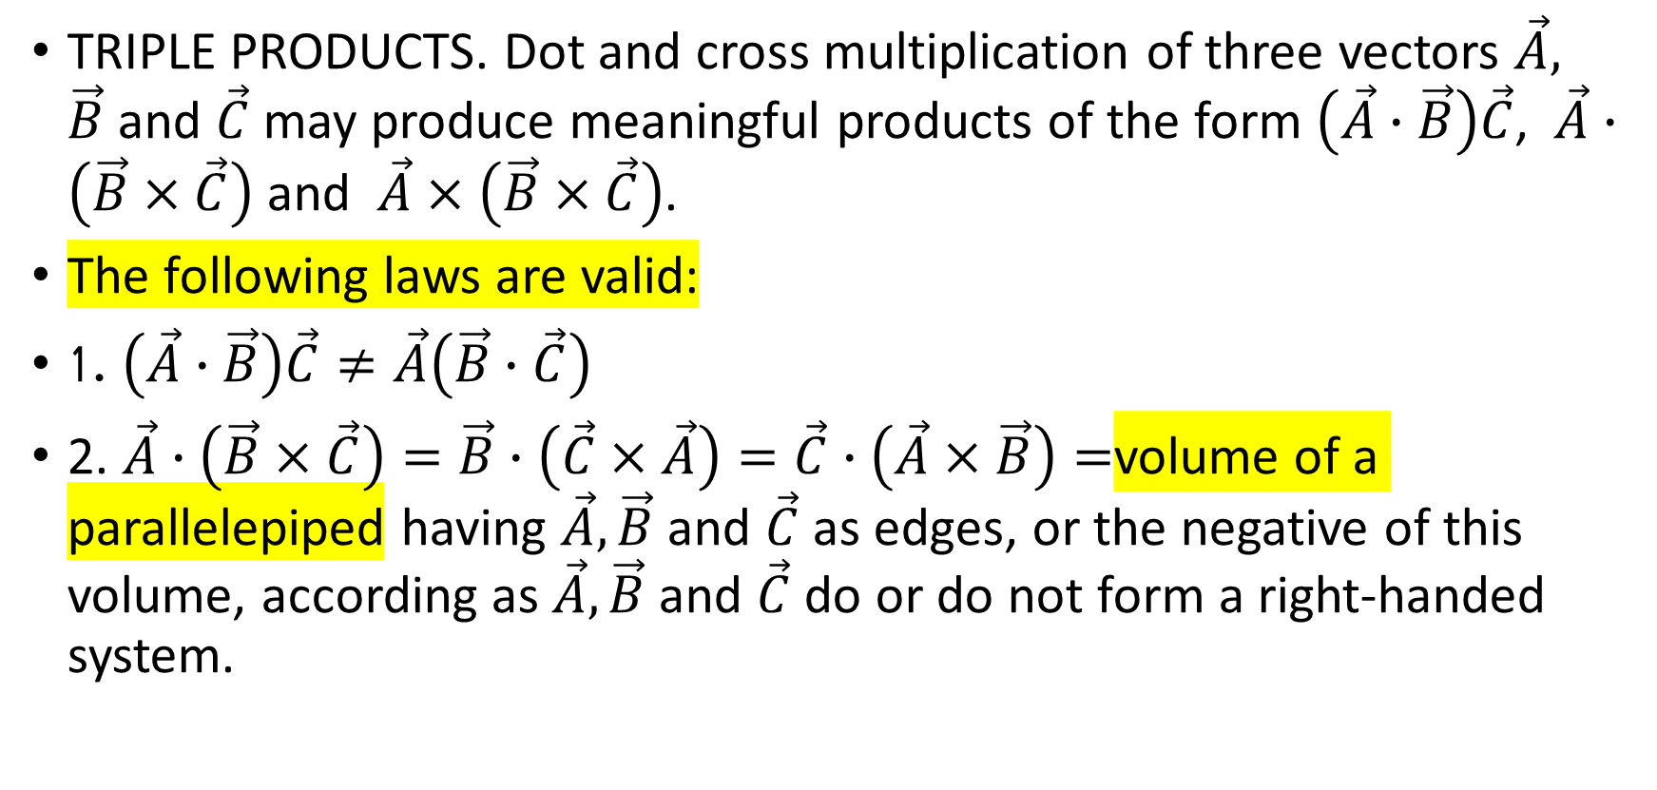
TRIPLE PRODUCTS.
TRIPLE PRODUCTS. Dot and cross multiplication of three vectors $\vec{A}, \vec{B}$and $\vec{C}$ may produce meaningful products of the form $\left(\vec{A}∙\vec{B}\right)\vec{C}$, $\vec{A}∙\left(\vec{B}×\vec{C}\right)$and $\vec{A}×\left(\vec{B}×\vec{C}\right)$.
The following laws are valid:
1. $\left(\vec{A}∙\vec{B}\right)\vec{C}≠\vec{A}\left(\vec{B}∙\vec{C}\right)$
2. $\vec{A}∙\left(\vec{B}×\vec{C}\right)=\vec{B}∙\left(\vec{C}×\vec{A}\right)=\vec{C}∙\left(\vec{A}×\vec{B}\right)=$volume of a parallelepiped having $\vec{A},\vec{B}$and $\vec{C}$ as edges, or the negative of this volume, according as $\vec{A},\vec{B}$and $\vec{C}$ do or do not form a right-handed system.

Slide 21
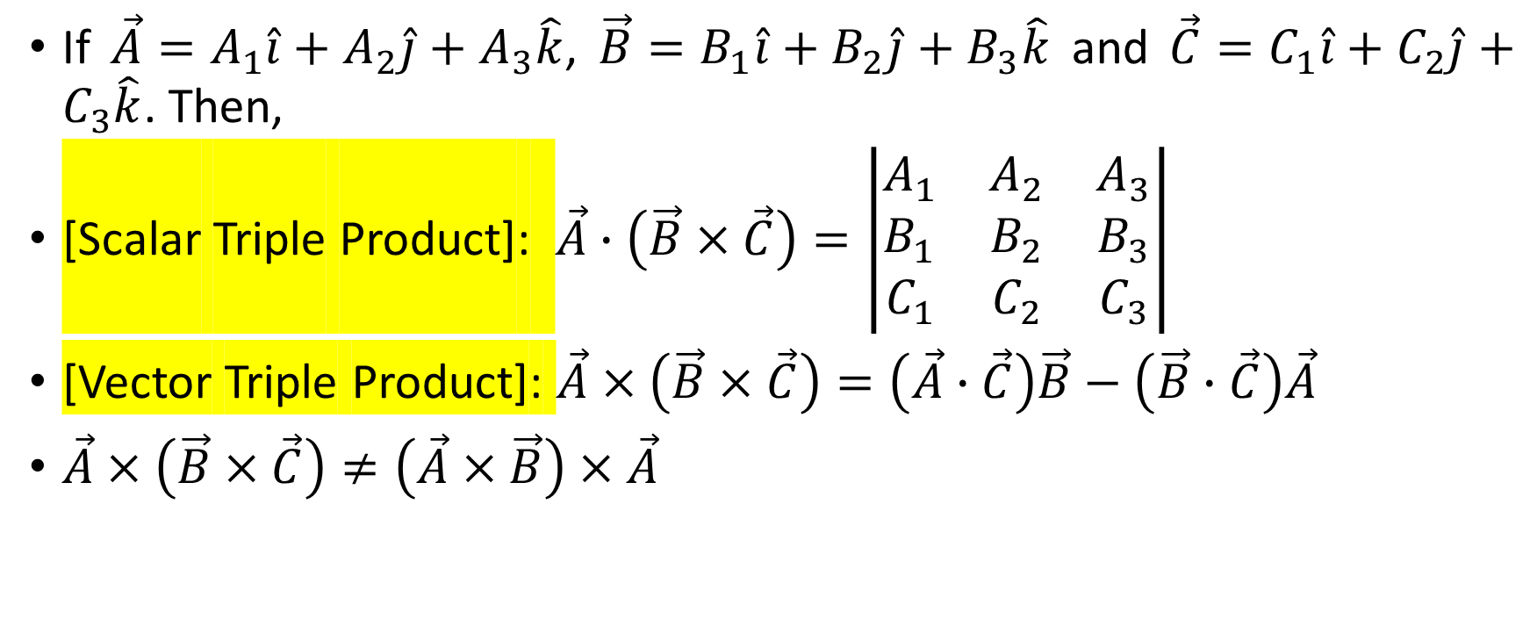
If $\vec{A}=A_{1}\hat{i}+A_{2}\hat{j}+A_{3}\hat{k}$, $\vec{B}=B_{1}\hat{i}+B_{2}\hat{j}+B_{3}\hat{k}$ and $\vec{C}=C_{1}\hat{i}+C_{2}\hat{j}+C_{3}\hat{k}$. Then,
[Scalar Triple Product]: $\vec{A}∙\left(\vec{B}×\vec{C}\right)=\left|\begin{matrix}A_{1} & A_{2} & A_{3} \\ B_{1} & B_{2} & B_{3} \\ C_{1} & C_{2} & C_{3}\end{matrix}\right|$
[Vector Triple Product]: $\vec{A}×\left(\vec{B}×\vec{C}\right)=\left(\vec{A}∙\vec{C}\right)\vec{B}−\left(\vec{B}∙\vec{C}\right)\vec{A}$
$\vec{A}×\left(\vec{B}×\vec{C}\right)≠\left(\vec{A}×\vec{B}\right)×\vec{A}$

Slide 23
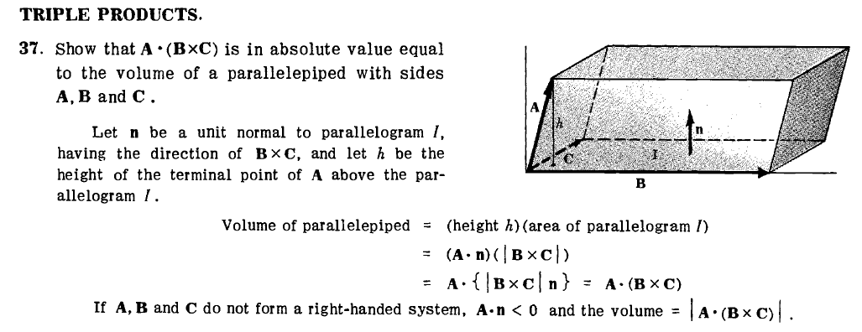

Slide 25
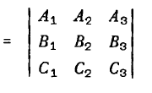
Prof:

Slide 26
Solution:

Slide 28
Please Try (b)

