Slide 1

Chapter 1: Introduction to Statistics(part 2):
Variable & Data

Slide 2


Learning Outcomes
After completing this chapter, you will be able to-
Understand about data.
Identify several types of variables with their levels to store data in.

Slide 3


Contents
From this lecture, you are going to learn…
Variable and types of variable
Data and types of data
Levels of measurements
Applications Of Statistics In Engineering

Slide 4


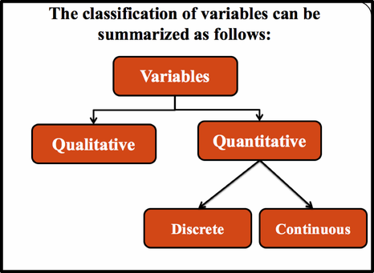

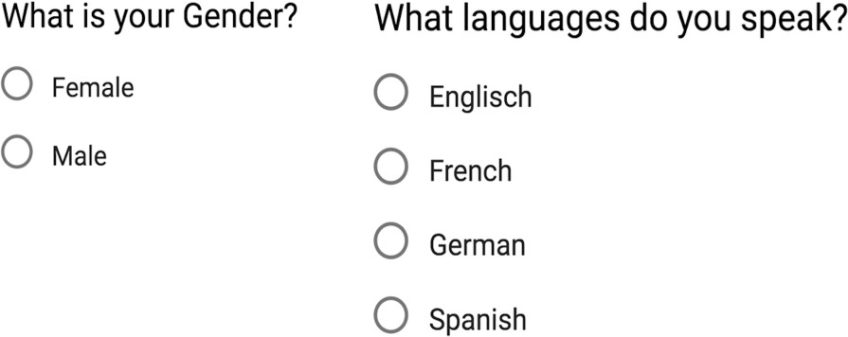
Variable & Types
Variable : Any characteristic which may vary either in magnitude or in quality is called variable.
Your height:?
No. of Family members: ?

Slide 5




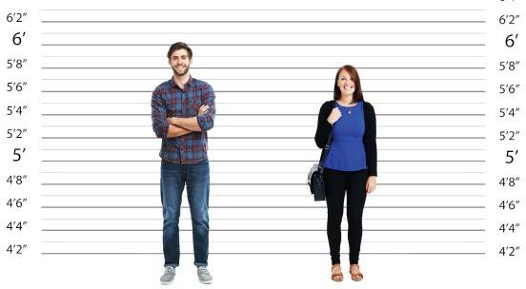


Types of Quantitative variable
Qualitative or attribute variable: Numerical measurement is not possible and may have several mutually exclusive categories.
Quantitative variable: Numerical measurement
is possible.
What is your Height?
No of cars passing a road per minutes.
Where is your Home District?
Your Religion?
Muslim
Hindu
Christian
Others

Slide 6


Types of Quantitative variable
Discrete variable: Assume isolated values
which are countable.
Continuous variable: Assume any value
within a specified range.
No. of sibling in your family
Your Blood Pressure
Example: The number of students in 20 classes, number of cars passing a certain road per minute (1, 2, 3, etc).
Example: The distance of students home from University, Temperature etc.

Slide 7

Data and Types
Data are numerical facts and figures collected from any field of investigation.
Obtained by Direct observation. Some methods to collect primary data are Observation method Interview method
Through questionnaires etc.
Primary Data
Data
Obtained from published or utilized data. Secondary data can be collected from publications newspapers, reports etc.
Secondary Data

Slide 8


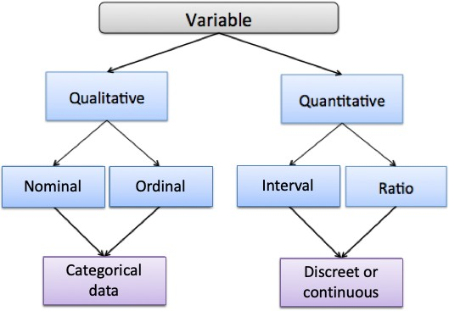


Types of variables with Level
So, there are four levels of measurements:
Nominal level data.
Ordinal level data
Interval level data
Ratio level data.
1. Categorical
Data
Discrete Data or
Continuous Data

Slide 9
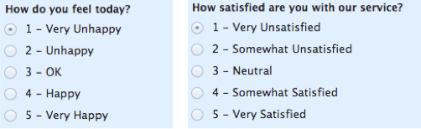


Types of variables with Level
Nominal level: data that is classified into categories and cannot be arranged in any Particular order.
Ordinal level: involves data arranged in some order, but the differences between data values cannot be determined or are meaningless.
Where is your Home District?
Your Religion?
Muslim
Hindu
Christian
Others
Phone no., Blood group etc
Exam Grade.
Position in a competition etc

Slide 10


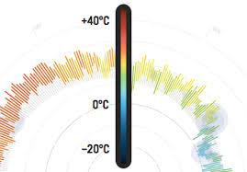

Types of variables with Level
Interval level: Numerical measurement is possible with meaningful amount of differences between data values. There is no natural zero point. (meaningless zero).
Ratio level: Numerical measurement is possible with meaningful amount of differences between data values and natural zero point. (meaningful zero).
Temperature
Required time to solve a math.

Slide 11


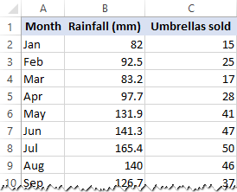
Data and Variables at a glance…
Qualitative or attribute variable (Nominal)
Quantitative variable (continuous) (Ratio)
Quantitative variable (Discrete) (Ratio)
Data

Slide 12
,,,,
(
\
\
: •,,, ... .\ .
I
\\
.^{•I} ;,,--
.•. •
-.--- -,(--..,:
·:.
1
·
... '
.
, _ :,._
. .
.. 1⁻ , . .:-·:....
' . ".,.-, '.
·.• .'/ ",\
) .
. -1

