Slide 1
Measures of central tendency

Slide 3
Example:
Solution:
Here, we can see that the number of observations is 20 so $n=20$
Now, two raised to the fifth power is 32
Therefore, we should have at least 5 Classes that is $k=5$
Now to determine the class interval or width we have,

Slide 4
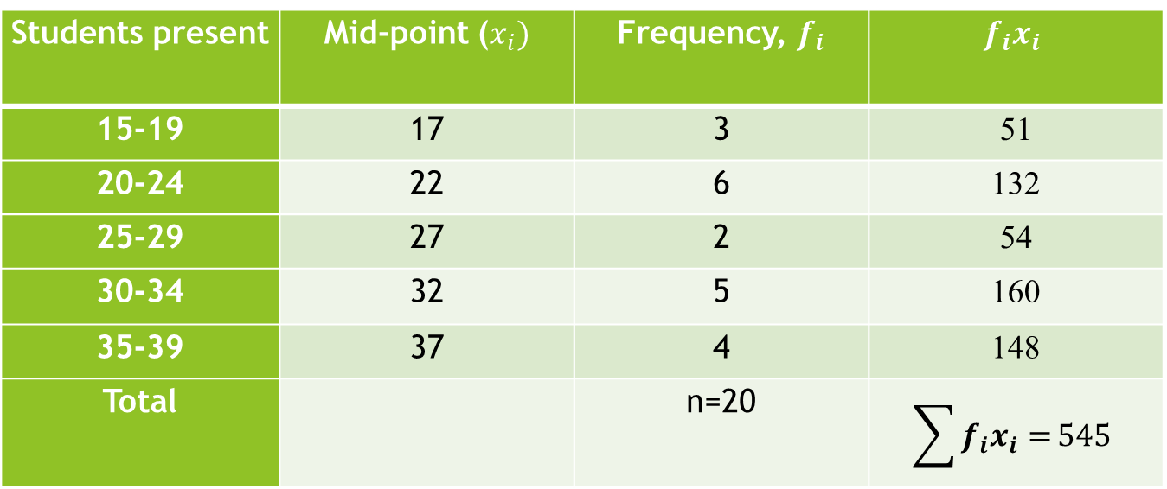
Table-1: Table of the number of students present in a class in 20 working days
Students present | Mid-point ($x_{i})$ | Frequency, $f_{i}$ | $$f_{i}x_{i}$$
15-19 | 17 | 3 | 51
20-24 | 22 | 6 | 132
25-29 | 27 | 2 | 54
30-34 | 32 | 5 | 160
35-39 | 37 | 4 | 148
Total |  | n=20 | $$\sum{f_{i}x_{i}=}545$$
We know that,
$$=\frac{545}{20}=27.25≈27$$

Slide 5
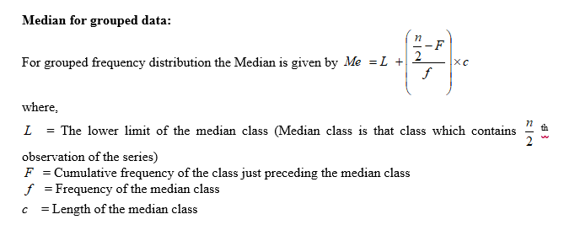

Slide 6
Example:
Students present | Frequency, f | Cumulative frequency
15-19 | 3 | 3
20-24 | 6 | 9
25-29 | 2 | 11
30-34 | 5 | 16
35-39 | 4 | 20
Total | n=20
Median=Size of n/2 th observation =20/2=10 ^{th} observation
Hence, the median lies in the class 25-29
Median, $M_{e}=L+\left(\frac{\frac{n}{2}−F}{f}\right)×c$
$$=25+\frac{10−9}{02}×5=25+2.5=27.5$$
Hence, the median is 27.50.

Slide 7
Students present | Frequency, f_{i}
15-19 | 3
20-24 | 6
25-29 | 2
30-34 | 5
35-39 | 4
Total | n=20

Slide 8
Example:
Calculate the mode from the following Data.
Students present | Frequency, f_{i}
15-19 | 3
20-24 | 6
25-29 | 2
30-34 | 5
35-39 | 4
Total | n=20
Since the maximum frequency 6 is in the class 25-29, therefore 25-29 is the modal class
We know that,

