Slide 1

Fundamentals of Management
Chapter 7

Slide 2
What is Management?
Management is the application of planning, organizing, staffing, directing and controlling functions in the most efficient manner possible to accomplish objectives.

Slide 3
Types of Objectives
Objective- Specific results or targets to be achieved by a certain time.
Organizational Objectives
Departmental Objectives
Subunit Objectives
Individual Objectives

Slide 4
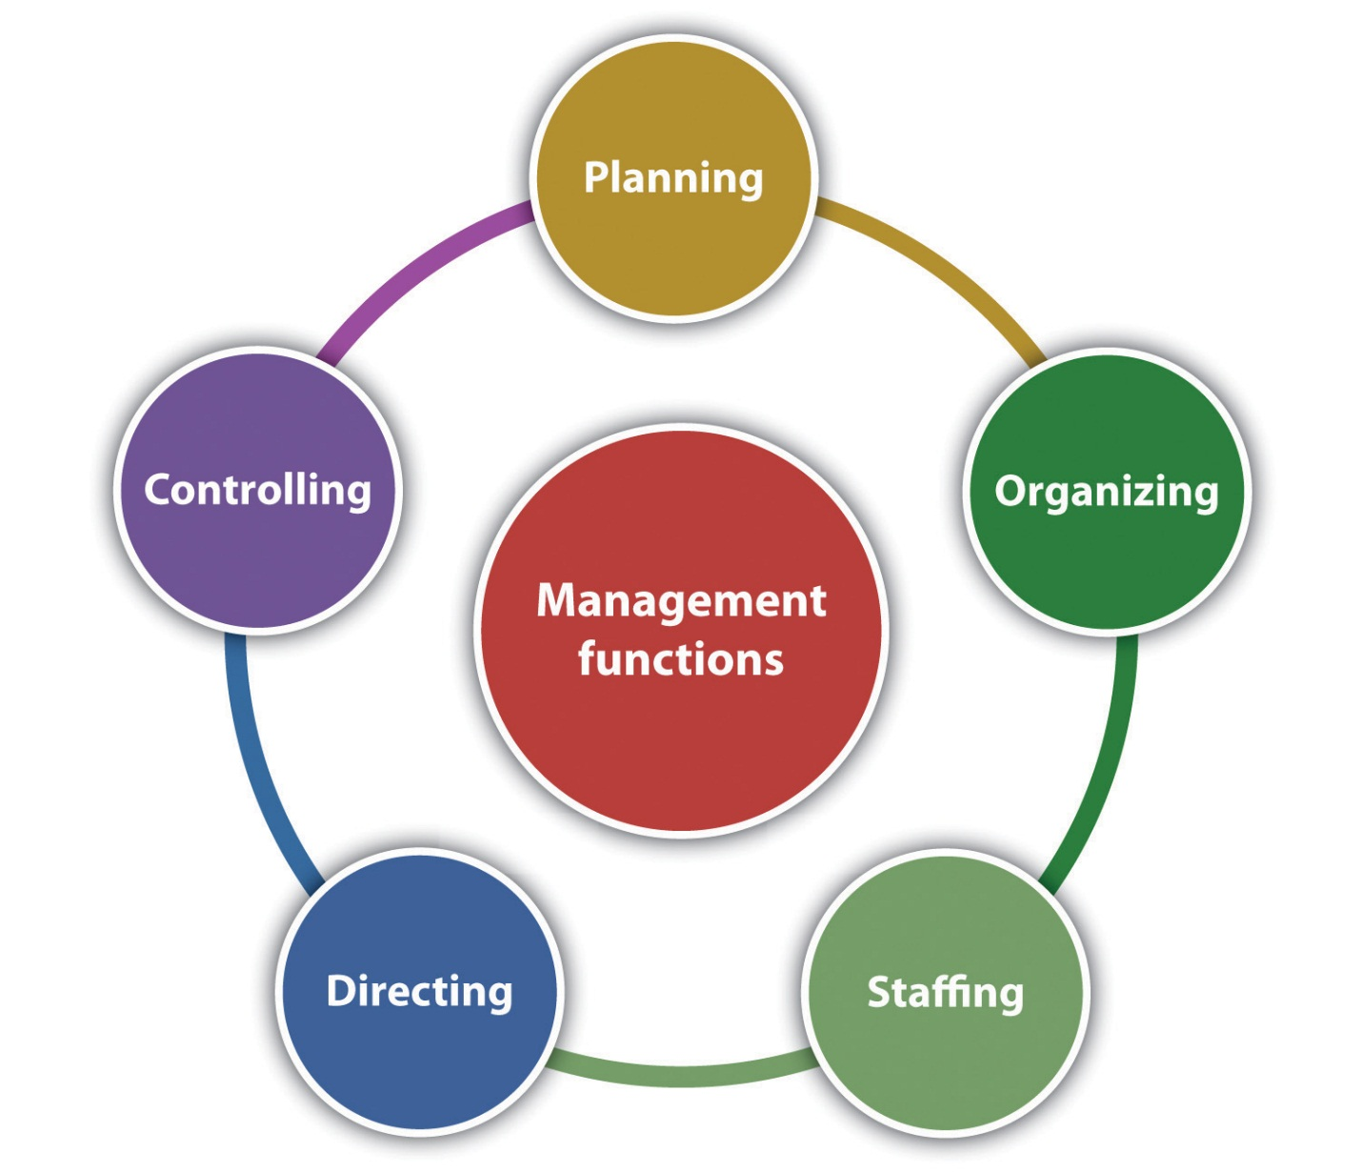
Functions of Management?

Slide 5
Functions of Management?
Planning
Planning is determination of courses of action to achieve desired goals. Thus, planning is a systematic thinking about ways & means for accomplishment of pre-determined goals. Planning is necessary to ensure proper utilization of human & non-human resources.
Organizing
It is the process of bringing together physical, financial and human resources and developing productive relationship amongst them for achievement of organizational goals.

Slide 6
Functions of Management?
Staffing
Staffing has assumed greater importance in the recent years due to advancement of technology, increase in size of business, complexity of human behavior etc. The main purpose o staffing is to put right man on right job.
Directing
It is that part of managerial function which actuates the organizational methods to work efficiently for achievement of organizational purposes.
Controlling
It implies measurement of accomplishment against the standards and correction of deviation if any to ensure achievement of organizational goals. The purpose of controlling is to ensure that everything occurs in conformities with the standards.

Slide 7
Levels of Management
Executive
Middle
First Line
(Operating Employees)
Core Decision Making
Coordination and Execution
Execution of Decisions

Slide 8
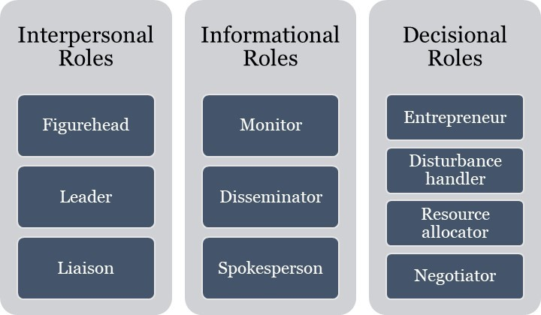
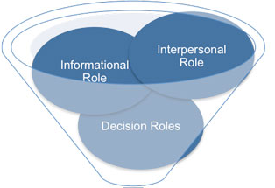
Management Roles

Slide 9
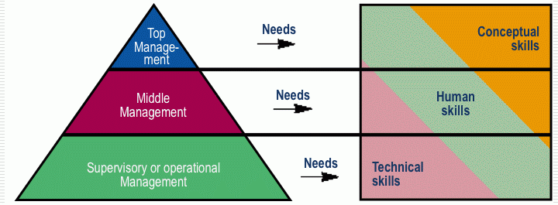
Management Skills
Executive
Middle
First Line
(Operating Employees)

Slide 10
Management Skills
Technical: Hard Skills - engineer, doctor, pilot, mechanic, computer programmer, army etc.
Human/ Interpersonal: Soft Skills- communication, coordination, support, motivation, leading, balancing etc.
Conceptual: Soft Skills- envision, deeming, managing, communicating, controlling, leading.

