Slide 1

Topics: Copyright
Juwel Rana
Lecturer
Dept. of Nutrition & Food Engineering
Daffodil International University

Slide 2
Definition of Copyright
Copyright is a legal concept, enacted by most governments.
A copyright is a law that gives the owner of a written document, musical composition, book, picture, or other creative work, the right to decide what other people can do with it.
Copyright laws make it easier for authors to make money by selling their works.
Because of copyright, a work can only be copied if the owner of the copyright gives permission.

Slide 3
Copy rights is related with four kinds of works
Literary, dramatic and musical works
Artistic works
Cinematographic works
Record and broadcast.

Slide 4
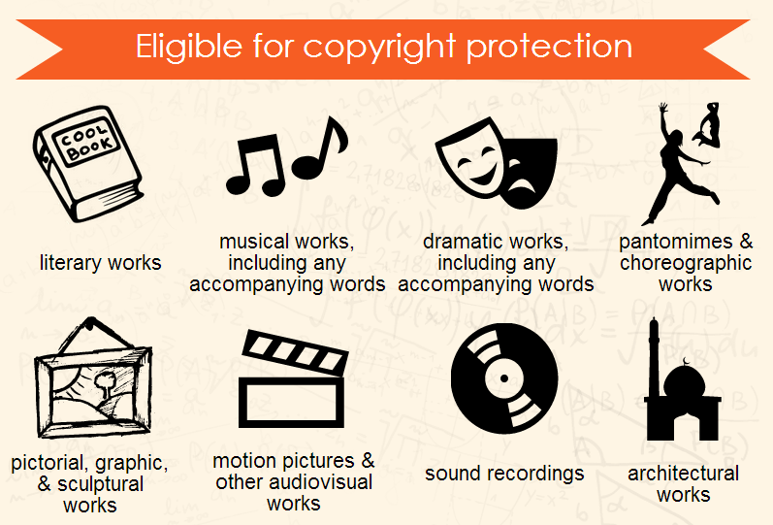

Slide 5
Literary, dramatical & musical works
Literary work means literature of every kind and includes works on humanity, religion, social science etc.
Dramatic works means drama, recitation, choreographic work, entertainment in dumb show, scenic arrangement etc.
Musical work means any combination of melody or harmony or either printed, reduced to writing or produce or reproduce.

Slide 6
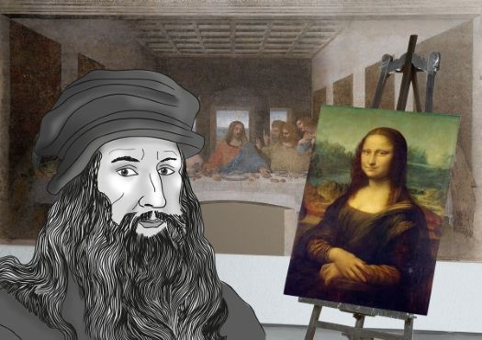
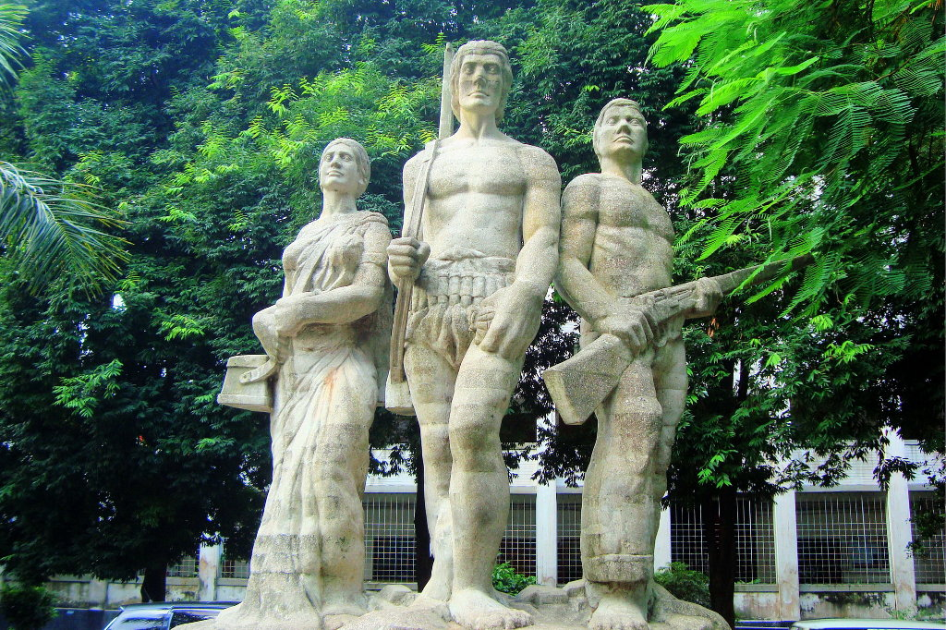
Artistic work
a. Painting, sculpture, drawing, engraving on a photograph
b. An architectural work or art
c. Any other work of artistic craftsmanship

Slide 7


Cinematographic works
It means any sequence of visual images fixed on materials of any description.

Slide 8

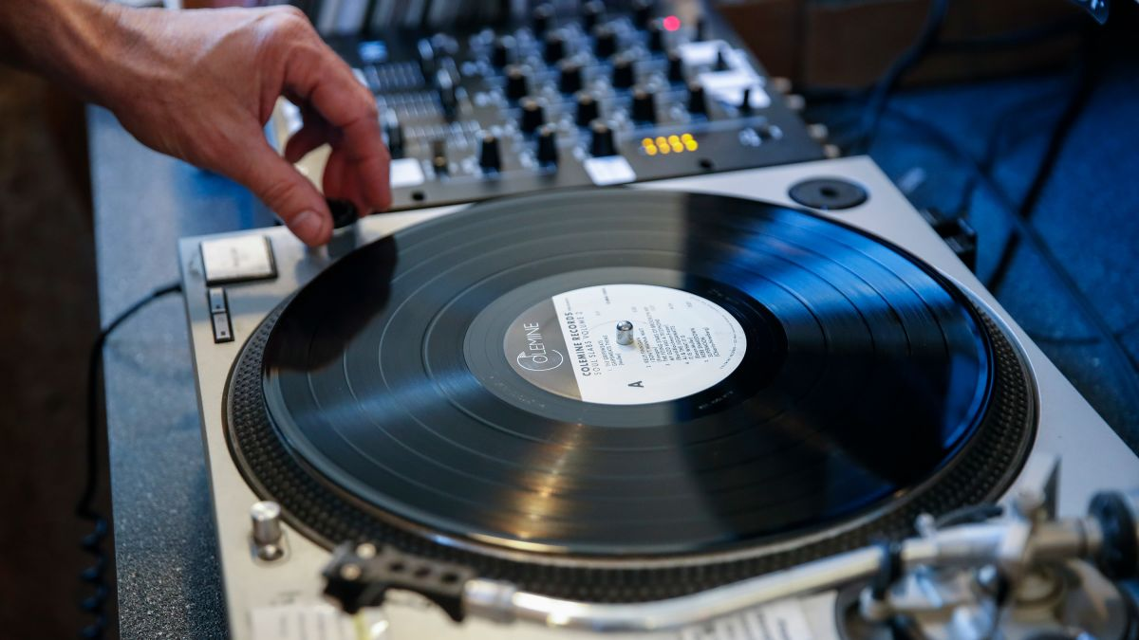
Record
It means disc, tape or other device in which sounds are embodied, so as to the capable of being reproduced their form.

Slide 9
Nature & Scope of Protection
To accord copyright, following factors are taken into consideration-
The work must not be copied from another work but must originate from the author.
Two authors independently producing an identical work will be entitled for copyright in their respective works.
The emphasis is more on the labor, skill judgment and capital expended in producing the work.

Slide 10
Bangladesh Copyright Law
The present copyright law enforce in Bangladesh has its roots in the British Copyright Act 1911 which was implemented in British India in the year 1914 to protect creative works.
The creative works in Bangladesh (former East Pakistan) was protected by a Copyright Ordinance (1962), superseding the British Indian Copyright Laws of 1914. The Copyright Ordinance was further amended in 1967 (27th February) by the government of the day
In 1974 the ordinance has been amended and approved ( Act no. LIV of 1974)
The previous act was cancelled and Bangladesh copyright ordinance-2000 has been passed on 18th July, 2000.
Bangladesh copyright ordinance-2000 has been amended in 18th may 2005 & published as “Copyright (amendments) Act 2005.”

Slide 11


Duration of Copyright?

Slide 12
Duration of Copyright
Duration of copyright for literature, music, drama & arts: The copyright will be valid during the lifetime + 60 years of the owners.
Cinema: Release year +60years.
Sound recording: The year of recording+ 60 years.
Photograph: Published year + 60 years.
Anonymous writing: published year + 60 years. During this time if the identity of the writer is known then the time of the copyright will be the dearth year + 60 years.
Computer related works: the published year + 60 years.
Broadcasting: the published year + 25 years of broadcasting and reproduction.

Slide 13
Copyright registration in Bangladesh
In Bangladesh, Copyright Office is responsible for maintaining the register of copyrighted works. Any application for registration, transfer, abandonment, modification of register should be made to the Registrar.
REGISTRATION: An application for copyright should be supported by the following documents:
1. A completed application form
2. Treasury chalan
3. Copies of the work to be registered
4. Transfer deed of work in stamp paper (if applicable)
5. Legal paper (Okalat nama) (if a lawyer submits the application form on behalf of the author)

Slide 14
Once the Registrar received any application for copyright, s/he shall serve notice of the concerned application to every person who has any interest in the subject matter of that application. If the Registrar receives any objection s/he may after holding such inquiry as s/he deems fit, enter such particulars of work in the register of copyright, which s/he considers proper.
After registration, the Registrar shall sends copies of the entries made in the register to the parties concerned.
Continue…

Slide 15
Copyright registration in Bangladesh
Please visit the following link
  https://supremeip.com/copyright/
  http://www.copyrightoffice.gov.bd/

Slide 16
The works which will considered as violence of copyright
Literature used for commercial purpose without permission.
Transformation or reproduction of arts without permission.
Any kind of editing in dramatic works without permission.
Used of clippings of newspaper, television, drama & arts without permission.
Used or reproduction of creative, research works or any informative works without permission.
Use every intellectual works for profit without permission.

Slide 17
The works which will not considered as violence of copyright
If any parts of literature, music, drama & arts is used for personal purpose with reference.
Any criticism of literature, music, drama & arts .
Clippings of newspaper, television, drama & arts can be used with reference.
Judicial report & report related with literature, music, drama & arts can be reproduced.
The reproduction of literature, music, drama & arts for the use in parliament.
The citation of the published literature, drama in public place.
If the clippings drama & literature is used for providing education.

Slide 18
Crime & Punishment
In case of cinema piracy the accused person and the helping person will be punished one to five years imprisonment along with one to five lac taka.
If any computer program is pirated then and the accused person will be punished 6 month to 4 years imprisonment along with one to four lac taka.
Besides these, any kind of piracy like: music, audio, video, photograph is punishable according to Bangladesh copyright ordinance- 2005.
16

Slide 19
Discussion forum activity?
What are the differences between copyright and patent?

Slide 20

THANK YOU

