Slide 1
industrial design
Juwel Rana
Lecturer
Dept. of Nutrition & Food Engineering
Daffodil International University

Slide 2
What is industrial design?
Industrial Design (ID) is the professional practice of designing products, devices, objects and services.
Industrial Designs refers to the shape, configuration, pattern or ornament or composition of lines or colour or combination.
An industrial design constitutes the ornamental or aesthetic aspect of an article or product.
An industrial design may consist of three-dimensional features, such as the shape of an article, or two-dimensional features, such as patterns, lines or colour.
In principle, the owner of a registered industrial design or of a design patent has the right to prevent third parties from making, selling or importing articles or product bearing or embodying a design, which is a copy, or substantially a copy, of the protected design, when such acts are undertaken for commercial purposes.

Slide 3
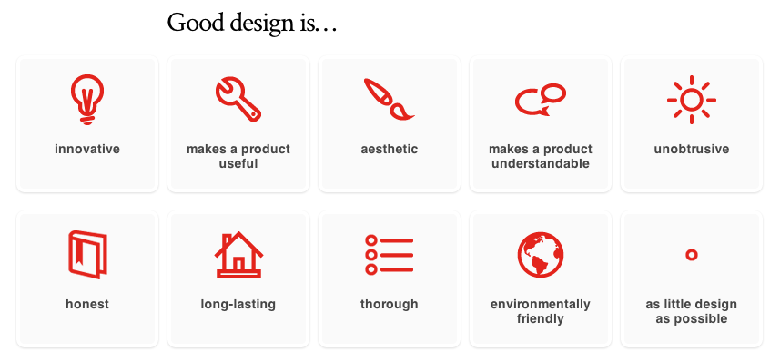
Attributes of Good Design

Slide 4
Why Register?
To have exclusive right
Ban others from copying
Certificate of ownership
Design registration can be used in Court
A better license position
Design registration gives a broader protection than copyright

Slide 5
Who can apply for Industrial Design registration in Bangladesh?
Any person whether national or foreigner claiming to be the proprietor of a new or an original industrial design may apply
Apply to the Registrar of the Department of Patent, design, and Trademarks for the registration of the design in Bangladesh with the documents.
In the case of the foreign application, the application will be submitted through a local agent/Lawyer.

Slide 6
Rights of the Owner of Industrial Design
1) Right on design’s exploitation at the discretion of the right owner;
2) Exclusive right to permit the design’s exploitation;
3) Exclusive right to prevent the unlawful design’s exploitation, including the right to forbid such an exploitation;
4) Other intellectual property rights as stipulated by the laws.

Slide 7
Industrial design Act, Bangladesh
Under the Patents and Designs Act. 1911, ……………….
  the protection of an industrial design shall apply to a new design and not any scandalous design on any design contrary to morality or public order or which is likely to offend the religious or racial susceptibilities of any community.
A design is defined as any composition or lines or colours or any three dimensional form, whether or not associate with lines or colours, that gives a special appearance to a products of industry of handicraft and escapable of serving as a pattern for a products of industries or handicraft.

Slide 8
Requirements for Registration
An industrial design can be registered if it is:
Novel as the design must not have been disclosed to the public by any means whether by written or oral means before applying for registration.
Original as the design should appropriately differ from other design.
Industrially applicable as the design should be applicable to an article which is functional and useful.
Legal as it does not contradict with public order or morals which then can not be registered

Slide 9
Cont..
Additional Conditions:
Visibility: Must be visible, cognizable, and judged by the sense of sight in its normal.
Special appearance: Use of lines, colors, shapes or patterns article can more appealing to the eye which must add an ornamental and special effect to the article.
Non-functionality: Industrial design’s only concern is the visible appearance of a product and not the technical or functional features.

Slide 10
Industrial Design Registration Process in Bangladesh
1) Name and Address of the applicant
2) Representation:
Application on the prescribed form shall be accompanied by exactly similar four copies of representation of the article clearly showing the features of the design by different views and stating names of the views.
The representation may contain drawing or photographs or specimens of the design where applicable.

Slide 11
Cont..
3) Statement of Novelty: The applicant should endorse the application and each of the representations a brief statement of the novelty for which he/she seeks protection. This may be done when he/she files the application or at any time before registration is finally effectuated.
4) Endorsement of disclaimers: Statement of the novelty will contain a disclaimer to the effect that no right is claimed over the use of Trademarks, any mechanism, letters, words, numbers etc.

Slide 12
Cont..
5) Classification of Goods: For purpose of registration of industrial design, goods to which the design is to be applied are divided into fourteen class.
6) Original POA (Power of Authority by Applicant) Original copy of POA must be filed within 1 months of filing of Application in Bangladesh.

Slide 13
Cont..
7) Duration of Registration of Design: The registration of industrial design is valid for 5 years from the date of application. The period may be extended by two further periods each of 5 years on application before the expiry of the copyright.
Ten years is the maximum time period for which your industrial design can be protected.
A government maintenance fee must be paid five years after registration (or within six months after that upon payment of an additional late maintenance fee) in order to keep the registration valid.

Slide 14
Cont..
8) Filing Cost
Ordinary Industrial Design Application
1) Official Fee: $36 with included
2) POA: $15
3) Attorney Fee
Convention Industrial Design Application
1) Official Fee: $144 VAT included
2) POA: $15
3) Attorney Fee
9) Timeline
In Bangladesh, it takes around 1-2 years approximately for a Design to be registered

Slide 15
Stages of Registration Process
Stage-1: Application Filed U/R-35 (1)
Tyeps of Appicaltion:
(1) Ordinary Paten Application
An ordinary application is an application without claiming priority.
(2) Convention Application (Priority)
Convention application (claiming priority from a convention country)is an application that is made in Bangladesh within 6 months from the date of an application made in a convention country.

Slide 16
Cont…
Stage-2: Examination
In Bangladesh an examination for (a) Formlaties check and (b) Novelty check of a design application is carried out automatically without a formal request being made.
Stage-3: Proceed for Registration Certificate
If there is no office action or if the determination is in favor of the applicant of a design the Registrar is obliged to issue a Certificate of Registration for the Design.

Slide 17
Punishment
If anyone pirate of registered design then according to THE PATENTS AND DESIGNS ACT, 1911 (ACT NO. II OF 1911) will applicable to him/her
The act provides couple of civil remedies such as compensation, damages and injunction for an act of infringement of the copyright of a registered design. Suits for infringement of industrial design are instituted before the district court.

Slide 18
Why protect industrial designs?
Industrial designs make an article attractive and appealing and they add to the commercial value of a product and increase its marketability.
It helps to ensure a fair return on investment to the owner in his/her design
It enhance export potential of national products.
It encourage creativity in the industrial and manufacturing sector and lead to more aesthetically attractive and diversified products.

Slide 19
Difference between Geographical indication
&
Industrial design
Geographical indication is a sign of quality products having a specific geographical origin and Industrial design means only the features of shape, configuration, pattern or ornament applied to any article by any industrial process
Geographical indication is a logo but Industrial design is descriptive article.
Geographical indication has long term reputation but Industrial design is totally new concept of a person.
Geographical indication is unique to a particular region or area, and are originated from there but Industrial design consist of three-dimensional features, such as the shape or surface of an article, or of two-dimensional features, such as patterns, lines or color applied to a wide variety of products of industry and handicraft and many more.

Slide 20

Patent VD Industrial Design

Slide 21
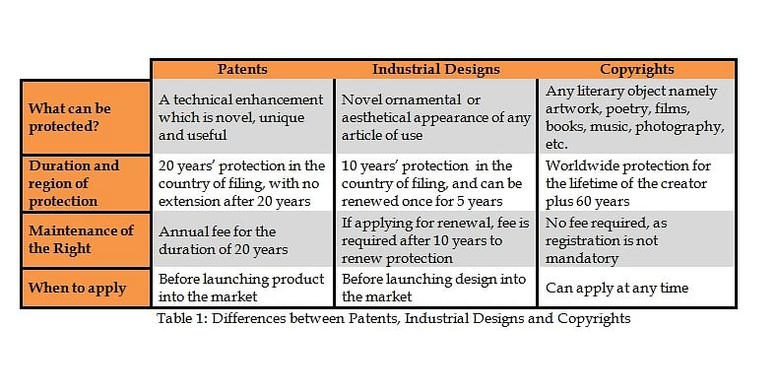
Note: kindly check all the information related to BD Act.

Slide 22
Patent | Industrial Designs
patents are an “exclusive right granted for an invention, which is a product or a process that provides, in general, a new way of doing something, or offers a new technical solution to a problem.” | Industrial Designs refers to the shape, configuration, pattern or ornament or composition of lines or colour or combination thereof applied to any article whether two dimensional or three dimensional, by any industrial process or means, whether manual, mechanical or chemical, separate or combined, which in the finished article appeal to and are judged solely by the eye.

Slide 23

Any Question

Slide 24


