Slide 1
Food security
Dr. M. Burhan Uddin
Professor
Dept. of Food Technology and Rural Industries
Bangladesh Agricultural Industries
Mymensingh-2202
E-mail: burhan992003@yahoo.com
Cell: 01711 110509

Slide 2
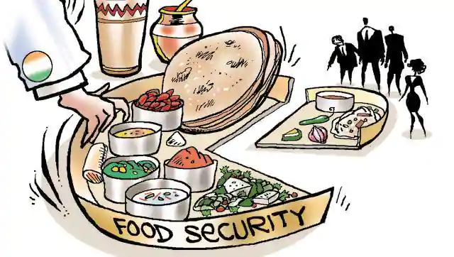
What is food security?
"when all people at all times have access to sufficient, safe, nutritious food to maintain a healthy and active life".
Commonly, the concept of food security is defined as including both physical and economic access to food that meets people's dietary needs as well as their food preferences. Household food security exists when all members, at all times, have access to enough food for an active, healthy life
.

Slide 3
Community & household Food Security
"Community food security exists when all citizens obtain a safe, personally acceptable, nutritious diet through a sustainable food system that maximizes healthy choices, community self reliance and equal access for everyone." - Public Health Association of British Columbia (PHABC)
A household is food secure when it has access to the food needed for a healthy life for all its members (adequate in terms of quality, quantity, and safety and culturally acceptable) and when it is not at undue risk of losing such access.

Slide 4
Main component/ dimensions of food security
Component
access
stability
utilization
availability

Slide 5
Food availability
Food availability addresses supply side of the food security and expects sufficient quantities of quality food from domestic agriculture production or import. This is simple mathematical calculation weather the food available in certain territory/country is enough to feed the total population in that particular territory and calculated from the level of local agriculture production at that territory, stock levels and net import/export.
This dimension of food security at different levels can be assessed by precipitation record, food balance sheet, food market survey, agricultural production planet etc.

Slide 6
Food access
Having sufficient food at national level or at certain territory cannot be taken as the proof that all the household or individuals in the country/territory have enough food to eat.
Food access is another dimension of food security which encompasses income, expenditure and buying capacity of households or individuals. Food access addresses whether the households or individuals have enough resources to acquire appropriate quantity of quality foods.
Some of the indicators of this dimension at different levels are food price, wage rate, per capita food consumption, meal frequency, employment rate etc.

Slide 7
Food utilization
Food utilization is another component of food security which addresses not only how much food the people eat but also what and how they eat.
It also covers the food preparation, intra-household food distribution, water and sanitation and health care practices. The nutritional outcome of the food eaten by an individual will be appropriate and optimum only when food is prepared/cooked properly, there is adequate diversity of the diet and proper feeding and caring practices are practiced.

Slide 8
Food utilization
Some of the indicators of this dimension Stunting rate, wasting rate, prevention of diarrhoeal diseases, latrine usage, weight-for-age, goitre, anaemia, night blindness etc which can be assessed by demographic and health survey, immunization chart etc.

Slide 9
Stability
This dimension addresses the stability of the other three dimensions over time. People cannot be considered food secure until they feel so and they do not feel food secure until there is stability of availability, accessibility and proper utilization condition.
Instability of market price of staple food and inadequate risk baring capacity of the people in the case of adverse condition (e.g. natural disaster, unexpected weather etc), political instability and unemployment are the major factors affecting stability of the dimensions of food security.

Slide 10
Stability
This dimension of food security can be assessed by Global Information Early Warning System, Anthropometric survey, weighing chart of pregnant women ,food price fluctuation, women's BMI, migration etc.

Slide 12
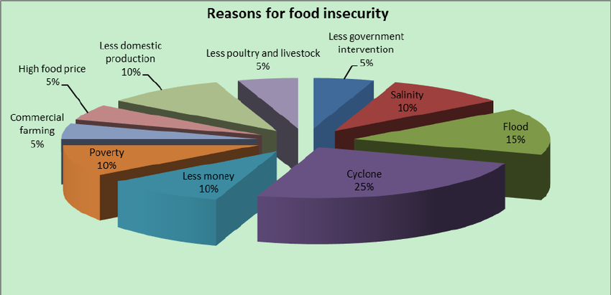
Food insecurity
The U.S. Department of Agriculture (USDA) defines food insecurity as a lack of consistent access to enough food for an active, healthy life.

Slide 13
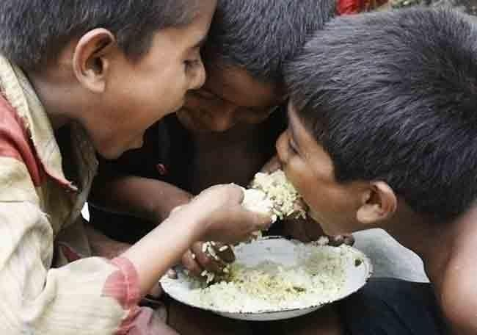
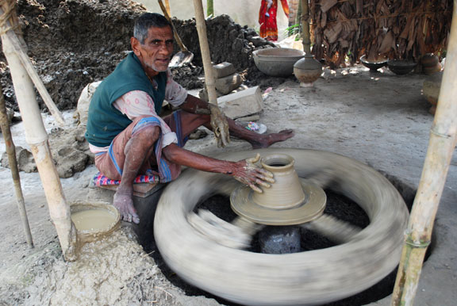
Who are food insecure?
Landless people with little or no land to depend upon
Traditional artisans ,providers of traditional service
Petty self employed
Workers and destitute includes beggars .in the urban areas

Slide 14
Types of Food Insecurity
Chronic Food Insecurity
Lack of minimum requirement of food to the people for a sustained period of time due to extended periods of poverty, lack of assets and inadequate access to productive or financial resources can be called as Chronic Food Insecurity.
Acute or Transitory Food Insecurity
Sudden lack of food or reduction in the ability to produce or access minimum requirement of food due to short-term shocks and fluctuations in food availability and food access, including year-to-year variations in domestic food production, food prices and household incomes can be defied as Acute or Transitory Food Insecurity.

Slide 15
Causes and factors affecting food insecurity
Population Increase:
In Bangladesh, high population growth, frequency of natural disasters, and low productivity are traditionally considered to be causes of food insecurity.
According to a World Food Program (WFP) report (2012), 65.3 million people are food insecure in Bangladesh (45 percent of the population).
This gap between production and distribution requires deeper understanding of the causes of food insecurity with specific focus on institutional weakness (both political and economic institutions).

Slide 16
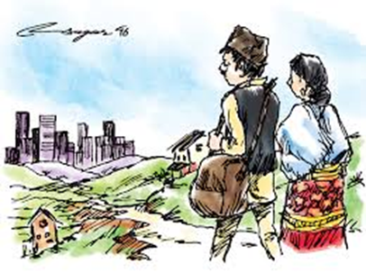
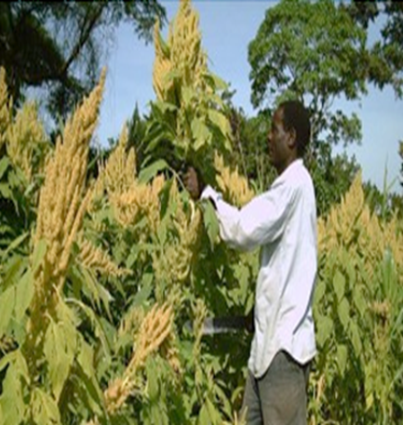
Causes and factors affecting food insecurity (cont..)
Urbanization:
By 2050 it is expected that more than 65% of the population will be living in urban areas. This trend of urbanization will occur mainly in low-income countries and will be
placing increased demand on food supply chains.
Natural resources:
This is collectively considered under a combination of urbanization, poor water management and poor soil conditions, all of which are major factors contributing to soil becoming unfit for agriculture

Slide 17
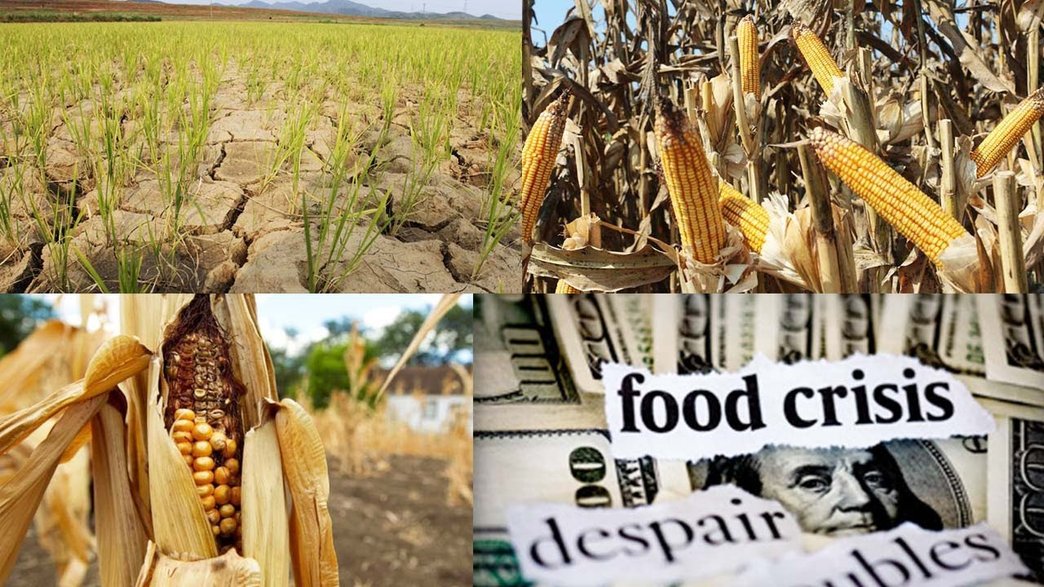
Causes and factors affecting food insecurity
Climate change: It is of common knowledge that local climate variations are exploited to promote cultivation of certain products. Climate shifts and changes in weather patterns have drastic effects on the productivity and economic
This in turn has a significantly negative effect on food security from a both a supply and demand.
Lack of access to farming land: Land is needed to produce food and generate income. But many people simply do not have the resources or opportunity to own land. Land ownership can strengthen cultural identity and empower people by bringing participation in decision-making.

Slide 18
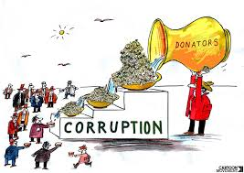
Causes and factors affecting food insecurity [Cont.]
Political corruption and instability
In many areas , the presence of corrupt political regimes, along with an unstable political climate means that food aid doesn’t always reach those in need as it was intended.

Slide 19
Government Initiative:
The Government of Bangladesh had taken several steps for arresting rise in food prices and safeguarding the poor.
Fair price shops had been opened under special management while open market sales (OMS) have also been geared-up.
During 2007-08 about 0.25 million metric tons of grain have been sold so far under Open Market Sale (OMS). Other safety- net programs such as. Vulnerable Group Development (VGD) and Vulnerable Group Feeding (VGF) have continued with allocation of 0.22 and 0.19 million metric tons respectively.

Slide 20
Government Initiative:
The Government is implementing a programme to increase production up to 25 percent of major crops during July 2007 to June 2010.
Government has taken steps to prepare Upazila (sub-district) wise crop production plan for the coming crop seasons aiming at increase of different crops through input management, intensive extension, technology transfer and monitoring.
Government has taken strategy for horizontal expansion by using fallow agricultural land in coastal and hilly

Slide 21
Thank you….

