Slide 1
Dry Washing Process, 1
Sand Blasting:
→Popular dry process.
→A mechanical process.
→Aluminum oxide (Al₂0₃) used which looks like SAND.
→Sand blasting is performed with combine the wash like normal Wash, Stone-enzyme, Enzyme, Bleach wash etc.

Slide 2
Washing Process of Sand Blasting
Al₂o₃ is very fine & very hard/Sharp.
Aluminum oxides (Al₂0₃) through by GUN with dry air to perform blasting action.
The Gun has a switch to start & stop the flow.
The garments to be sand blasting are placed on the bed of a close chamber. Garments are faded by frictional affect of Al₂o_{3.}
Al₂o₃ flow is done at 10^{ө}-20^{ө} angles.
Operators should have protective masks, gloves, Helmet, earflap, uniform.
After mechanical fading, chemicals treatment are required.
Limitations??????????????

Slide 3
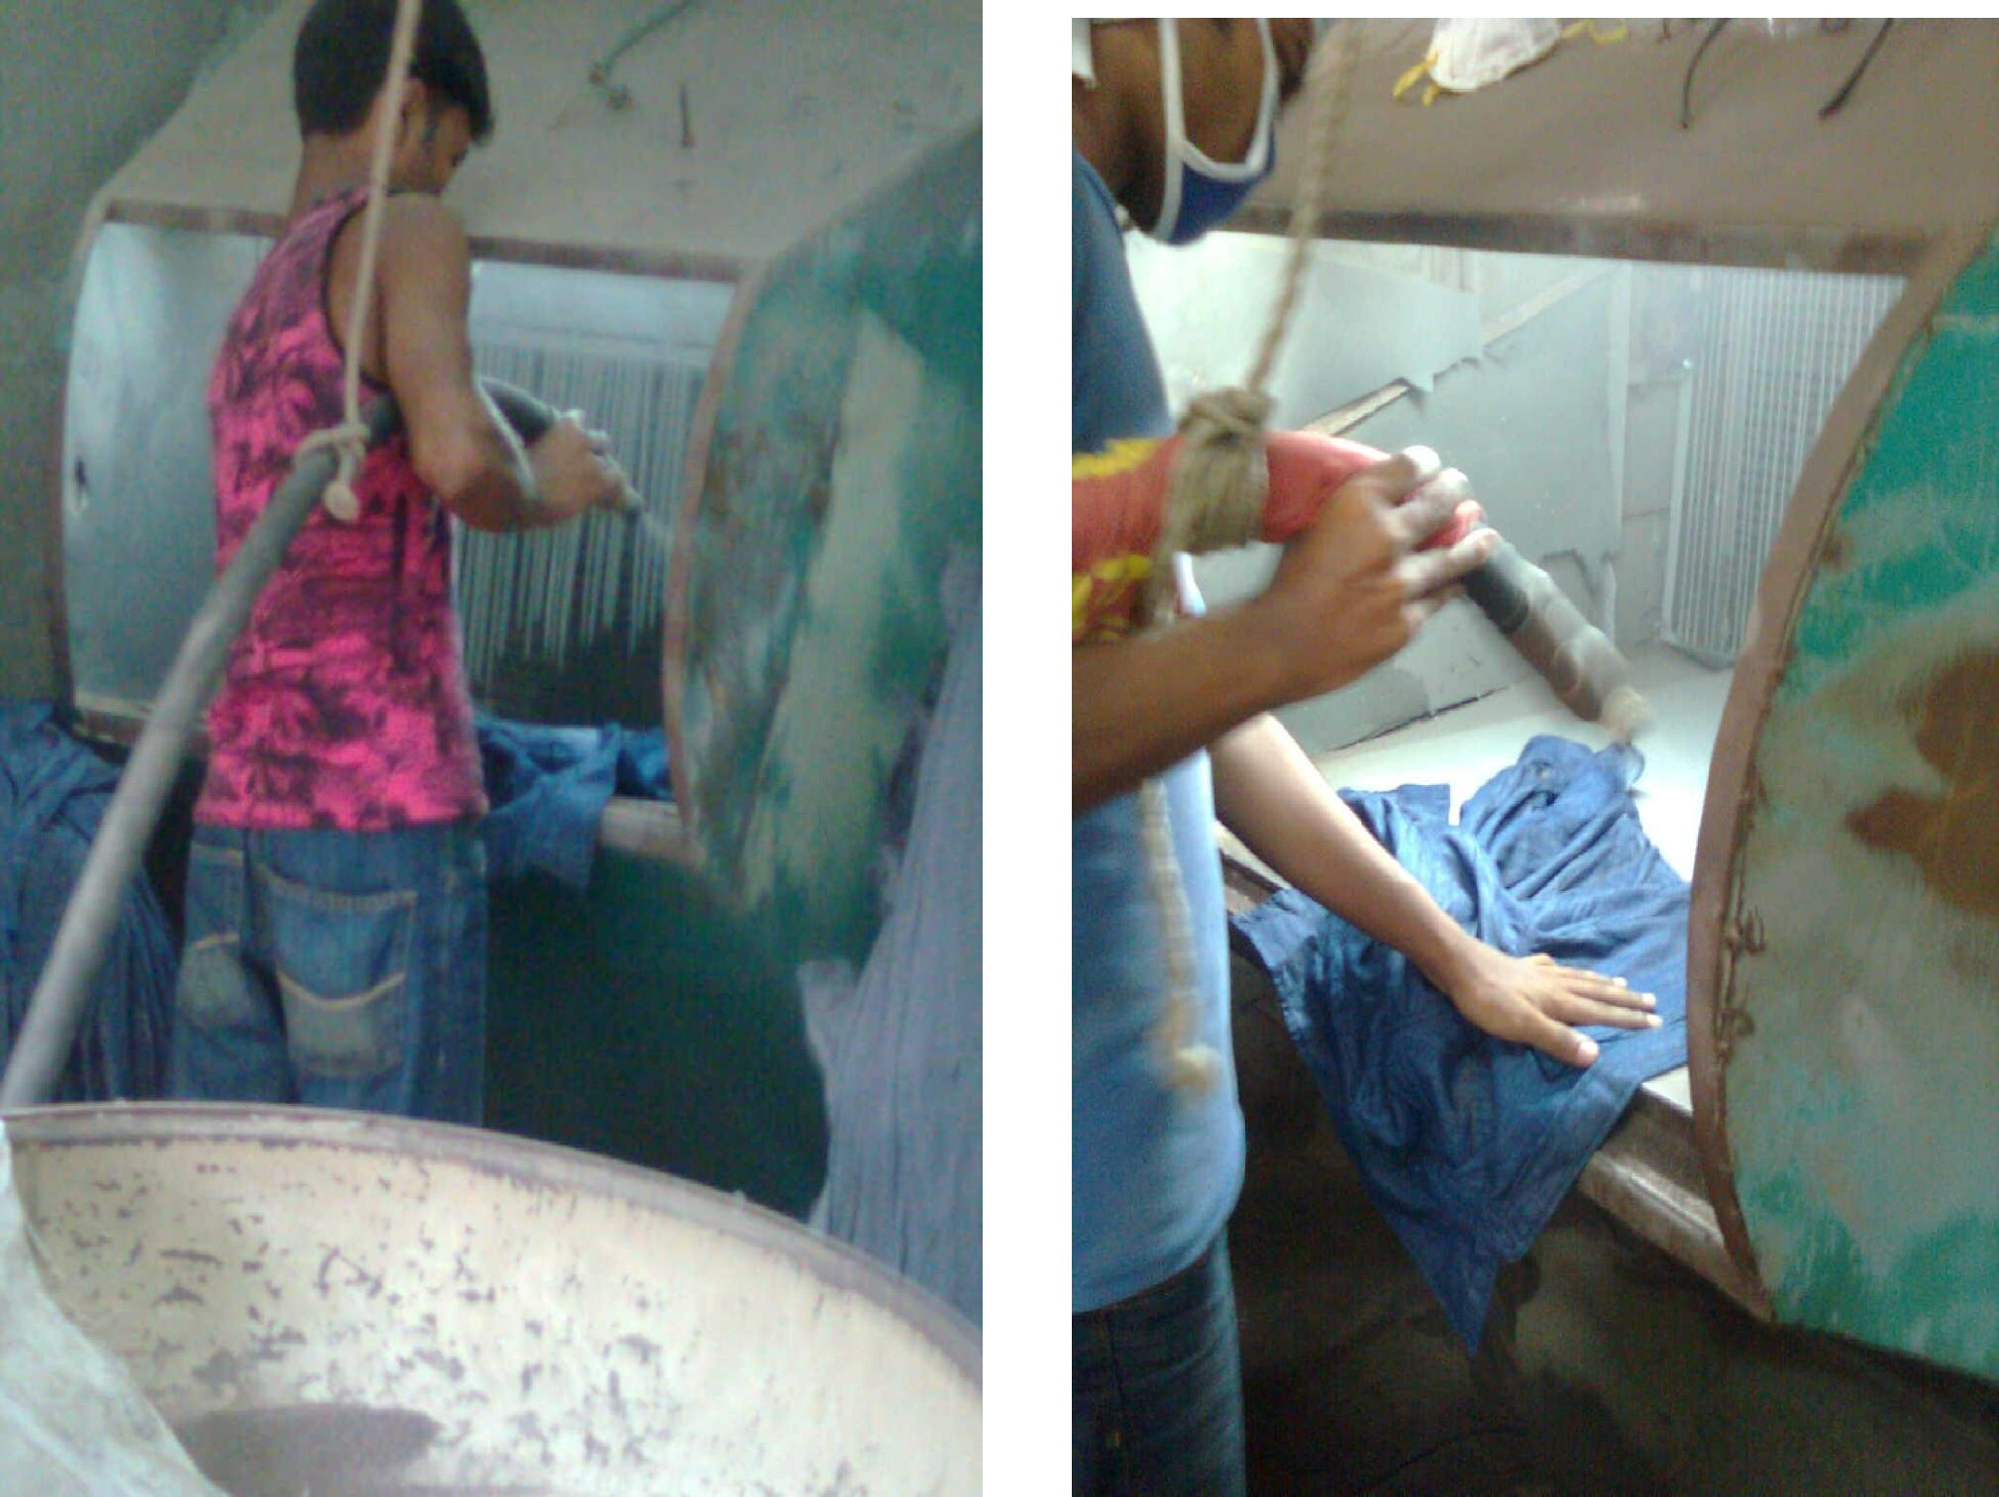
Sand Blasting

Slide 4
Whisker
To make whisker first, Buyer’s given design is plotted on a tracing paper. Then from the tracing paper the design is transferred to the ply-wood or gas kit.
The next step is to place foam rubber according to the design on ply wood with the help of solution gum.
Finally, the upper surface of the rubber is grinded to a slope or spherical shape and the whisker pattern is prepared.
Now this pattern is entered through the front opening of the pant and rubbing is done by emery paper at 320 ppm to 500 ppm. Thus the effect produced on the pant is called whisker.
It may require more or less than 3 efforts to make whisker pattern to make buyer’s design accurately.

Slide 5
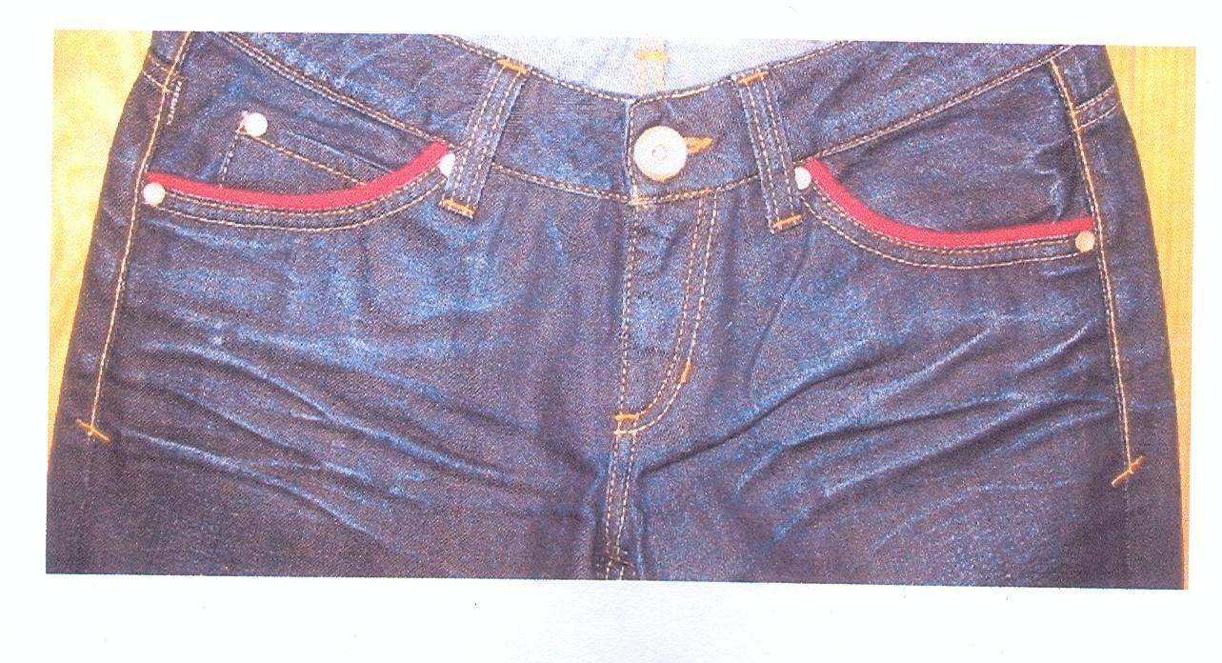
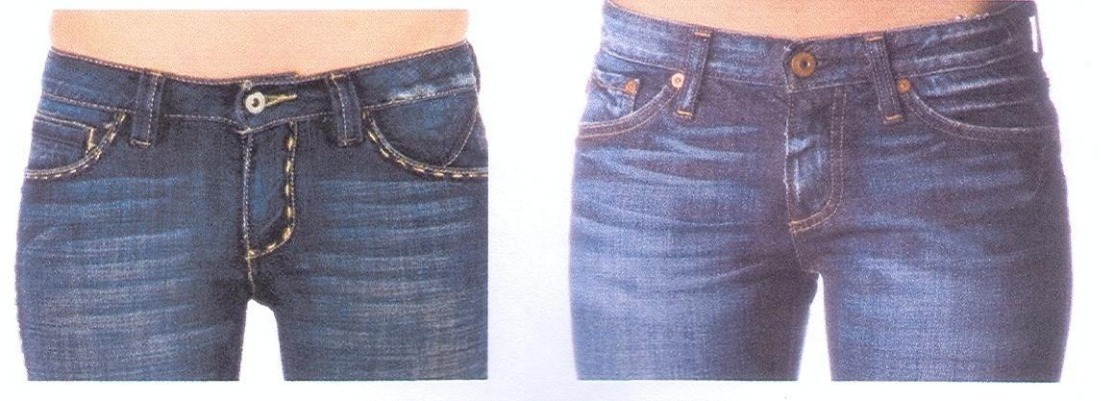
Whisker (3D and 2D)
Limitations???????

Slide 6
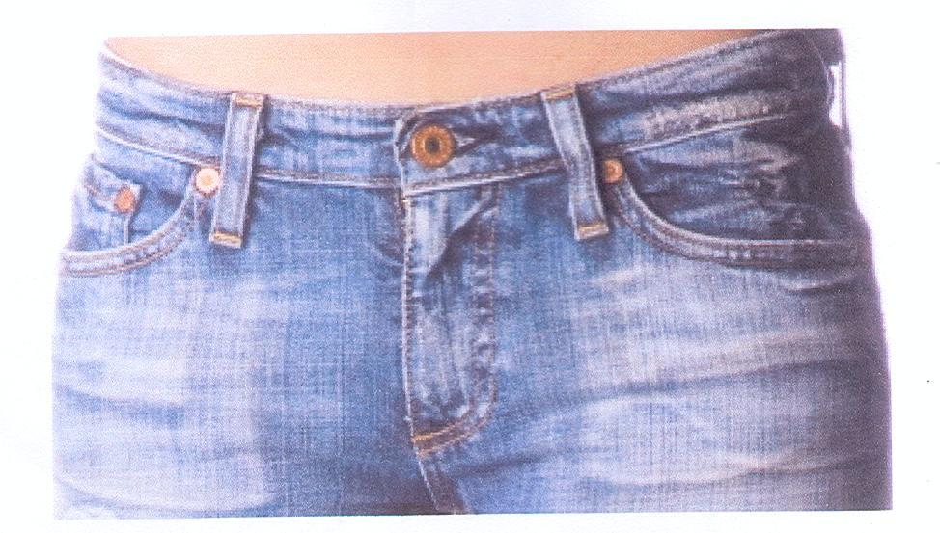
Hand Scrapping
To create the impression or visibility of pocketing fabric or any inside materials visibility to the face of the jeans pants with the help of emery paper scrapping is called hand scraping. It is used as the alternatives of sand blasting in some cases.

