Slide 1
PP Spray (KMnO4: Potassium per Manganate Spray)
10 g KMnO4 in 1 litre
0r + Lubricant 1% and 5 g KMnO4 in 1 litre
For pp spray, the garments are placed in a cabinet. Then KMnO4 solution is sprayed according to the requirement.
After spraying the garments look grayish brown.
Then it is neutralized with oxalic acid (COOH-COOH). Finally, faded (white) effect is produced.
Cautions:
-The worker must put on mask and hand gloves.
-There must have back glass fountain system to avoid spreading of KMnO4 in air.
-It is never done on grey garments. The garments must be desized before spraying.

Slide 2
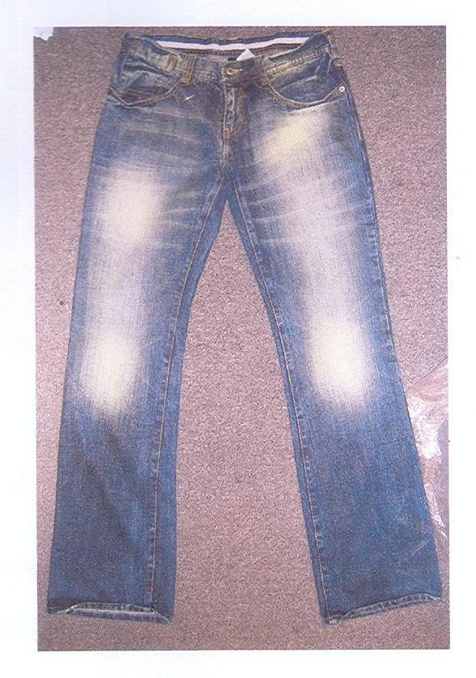
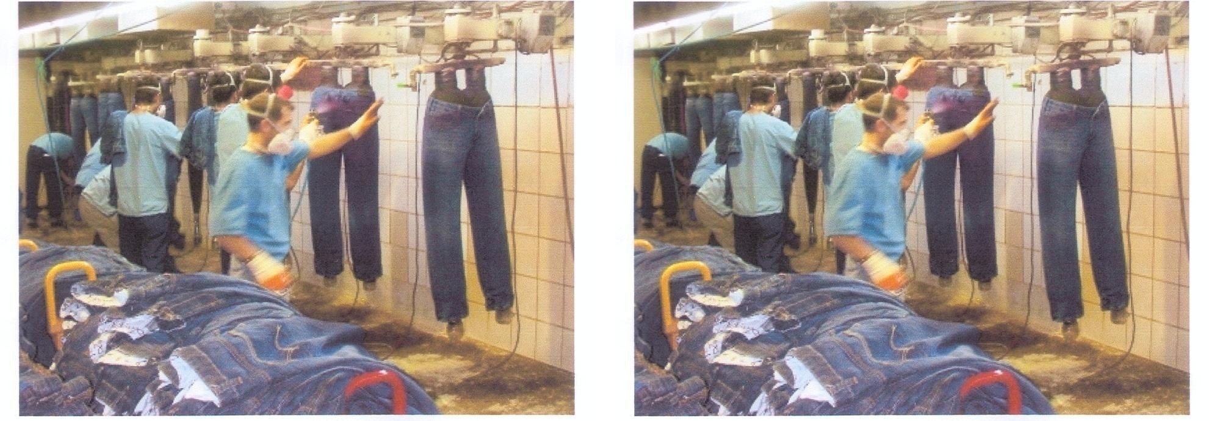
PP-Spray

Slide 3
P.P Sponging
To import fading effect in specific areas (thigh, bum, knee) of garments as buyer recommended. P.P sponging is doing in Denim, Twill, Poplin, corduroy generally middle of wash i.e. after enzyme wash, stone enzyme wash. If need some area more white then we are doing P.P. sponging.
Tools & Equipment: P.P. sponging operator must be used Hand gloves, Helmet, Mask, Ear plug &uniform for their safety.

Slide 4
Process:
We should take a rubber board on table.
Place the rubbing board in side the leg panel.
If need some particular area more white then we are doing P.P sponging.
After P.P. sponging sodium metabisulphite is used to neutralize the garments.
Standard stock solution for P.P. sponging is 0.4% i.e. 100 liter water 400 grams potassium permanganate.
P.P sponging is done manually.
By foam/ fabric pieces wet in p.p.stock solution and rubbing particular area of garments as result fading affects on garments.
Application: The purpose of P.P sponging is also to create more fading affect on particular area of garments.

Slide 5
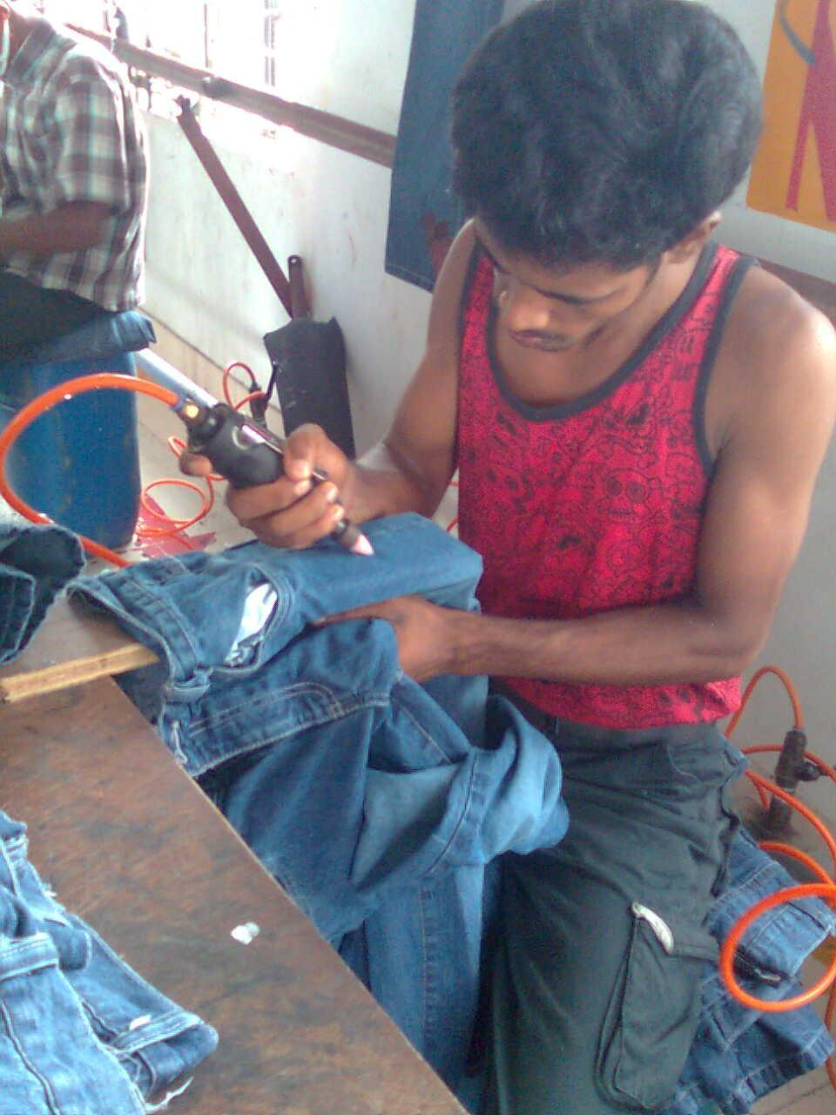
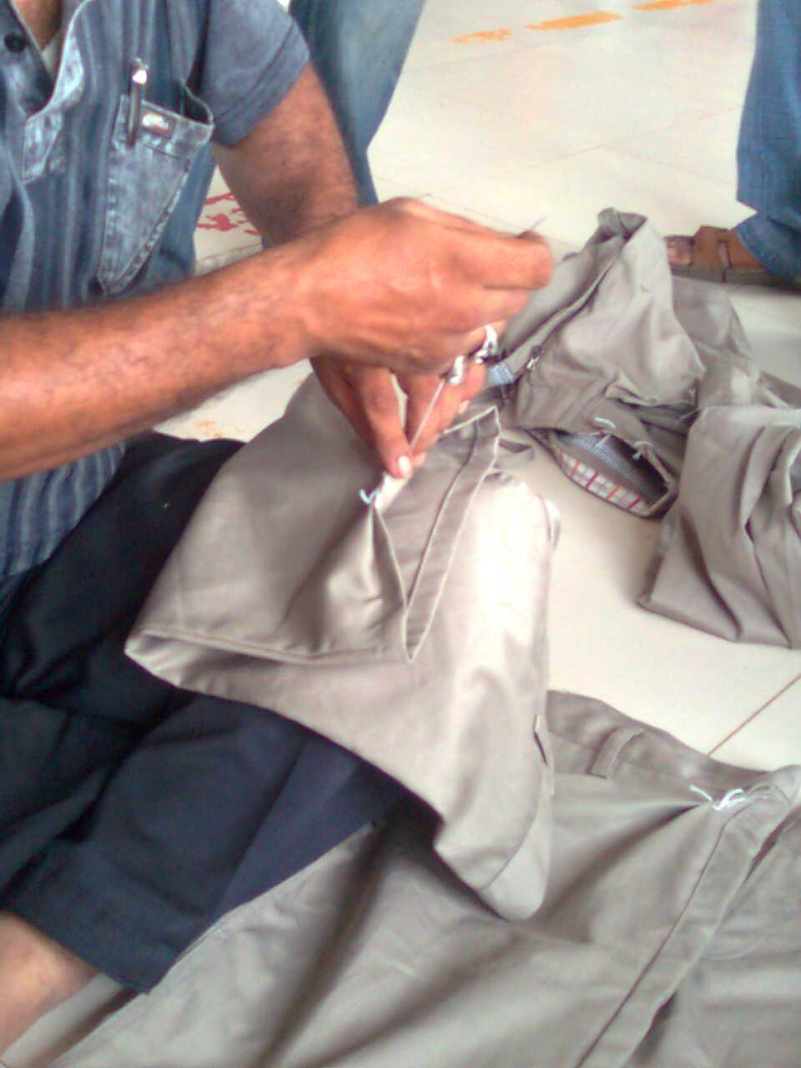
Tagging

Slide 7
Destroy
Destroy is newly fashion on garments.
Destroy is doing by manually.
Different types of machine used for destroy the garments.
When destroy is done one garment, it seems to be long time used effect.
Grinding machine, emery cloth, hacksaw blade, knife etc. is used to destroy

Slide 8
Procedure:
We should take a pant on dummy.
Direct apply knife/hacksaw blade, grinding machine.
Needle is used when needed.
As a result destroyed apparel will be produce.
After this process wet process is needed.
Application: This process is apply on normally bottom, pocket, opening in garments. Its produce fashionable garments.

