Slide 1
Wrinkle
A wrinkle, also known as a rhytide, is a fold, ridge or crease in the cloth or garments. Wrinkle is a particular type of pressure in the finished fabric or garments. It is produced during finishing operations.
Wrinkle resistance in a fabric is a desirable attribute, but it is not easily measured quantitatively.
There are two types of wrinkle process:
a) Permanent Wrinkle
b) Overall Wrinkle

Slide 2
Permanent Wrinkle Process
Permanent wrinkle is done after all types of wet process in dry position.
Done on Denim, Twill, Canvas, Poplin, Corduroy, Knit & Polyester etc.
Resin is sprayed on garments in specific area by nozzle.
Recipe: 20% resin & 80% water.
After spray, fold by buyer demand and clip attached in the fold area.
Hang the garment in hanger trolley (80-100 pcs).
Put inside the Industrial oven.
Set temperature 140°c to 160°c, Time 20-40 minutes (depends on fold).
After setting time machine is automatically off.
Then hanger will stay 10 minutes for cold in oven.
Open the door and unload garments from oven.
Open the clip from garment and go to quality section for quality checking & delivery.

Slide 3
Overall Wrinkle Process
Differences with permanent wrinkle regarding steps:
Tie the whole garment in tight position by thread.
For overall wrinkle, we use resin in washing machine with water and run tied garments for 5 to 10 minutes at 50°c temperature.
Unload the garments for hydro extracting
Open the tie or cut the thread.
Time required in oven 50-70 minutes.

Slide 4
Wrinkle Free
This process is one kind of resin finishing process. In this process of applying resins on the textile material that they cross linked with the amorphous block the free (-OH) that prevent the hydrogen bond formation and thus improve the wrinkle free finishing.
Mainly it is applied on twill fabrics, single jersey, and Denim fabric.
Some advantages:
Improve resistance and recovery to creasing by wrinkle free process.
Good water repellency and moderately soil repellency and remove of soil by washing can be achieved by wrinkle free process.
Resin improves resilience, handle and draping properties of fabric.
Improve wet and dye fastness.
Recipe:
Wetting agent: 0.5 % on the weight of the fabric.
resin: 6-10 %
Softener: 3-5 %
Then make 60-80 liter liquor put in the machine tank.

Slide 5
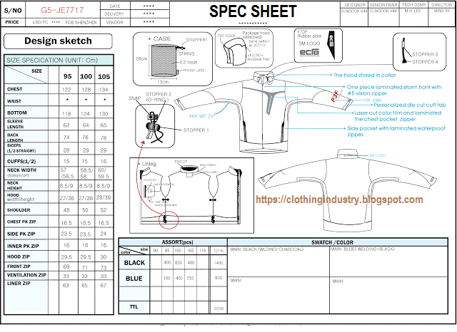
Product Package
It is also known as Technical package and Merchandisers Detailed sheet.
It contains:
Style number of the garments.
Item description of the garments.
Design/Specifications of the garments.
Measurement list of the garment.
Color of the garments.
Color combination of the garments.
Size of the garments.
Packing Instruction of the garments.
Folding instruction of the garment.
Types of sewing thread used.
Instruction for care label.
Types of the fabric used and weight of that fabric.
Composition and contribution of that fabric.

