Slide 1
Nano Finish
Nano process of applying resin and fluro-carbons. It is also a permanent chemical process.
Advantages:
1.Water, oil and alcohol repellency but air permeability.
2. The crease resistance feature keep clothing neat.
3. Dye fastness can be improved and wet increases.
4. It also helps to improve resilience, handle and drapping properties of the fabric.
Recipe:
Wetting agent: 0.5-1 % on the wt of the goods.
Resin: 4-6 % owf
Softener: 2-3 % owf (non ionic)
Fluoro carbon: 4-6 %

Slide 2
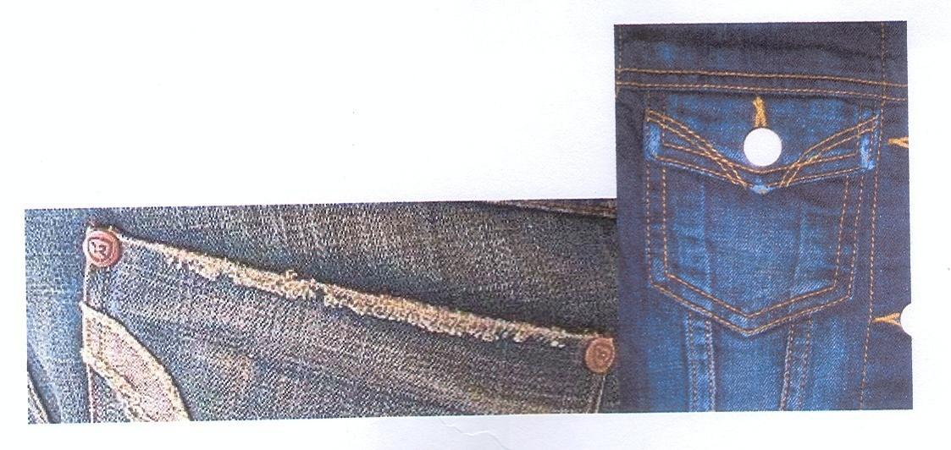
Grinding
It is usually done in the edge side of the pocket, legs etc

Slide 3
Ph Requirements of Buyers
American Eagle: 6.8-8.0
V.F.A: 5.5-8.0
LEVIS: 5.0-9.0
SEARS: 6.0-8.0
J.C.P: 5.0-9.0
H&M: 4.5-7.5
AMC: 6.0-8.0
GAP: 6.0-8.0
Why Required??????

Slide 4
Some Washing Effects on Denim

Slide 5
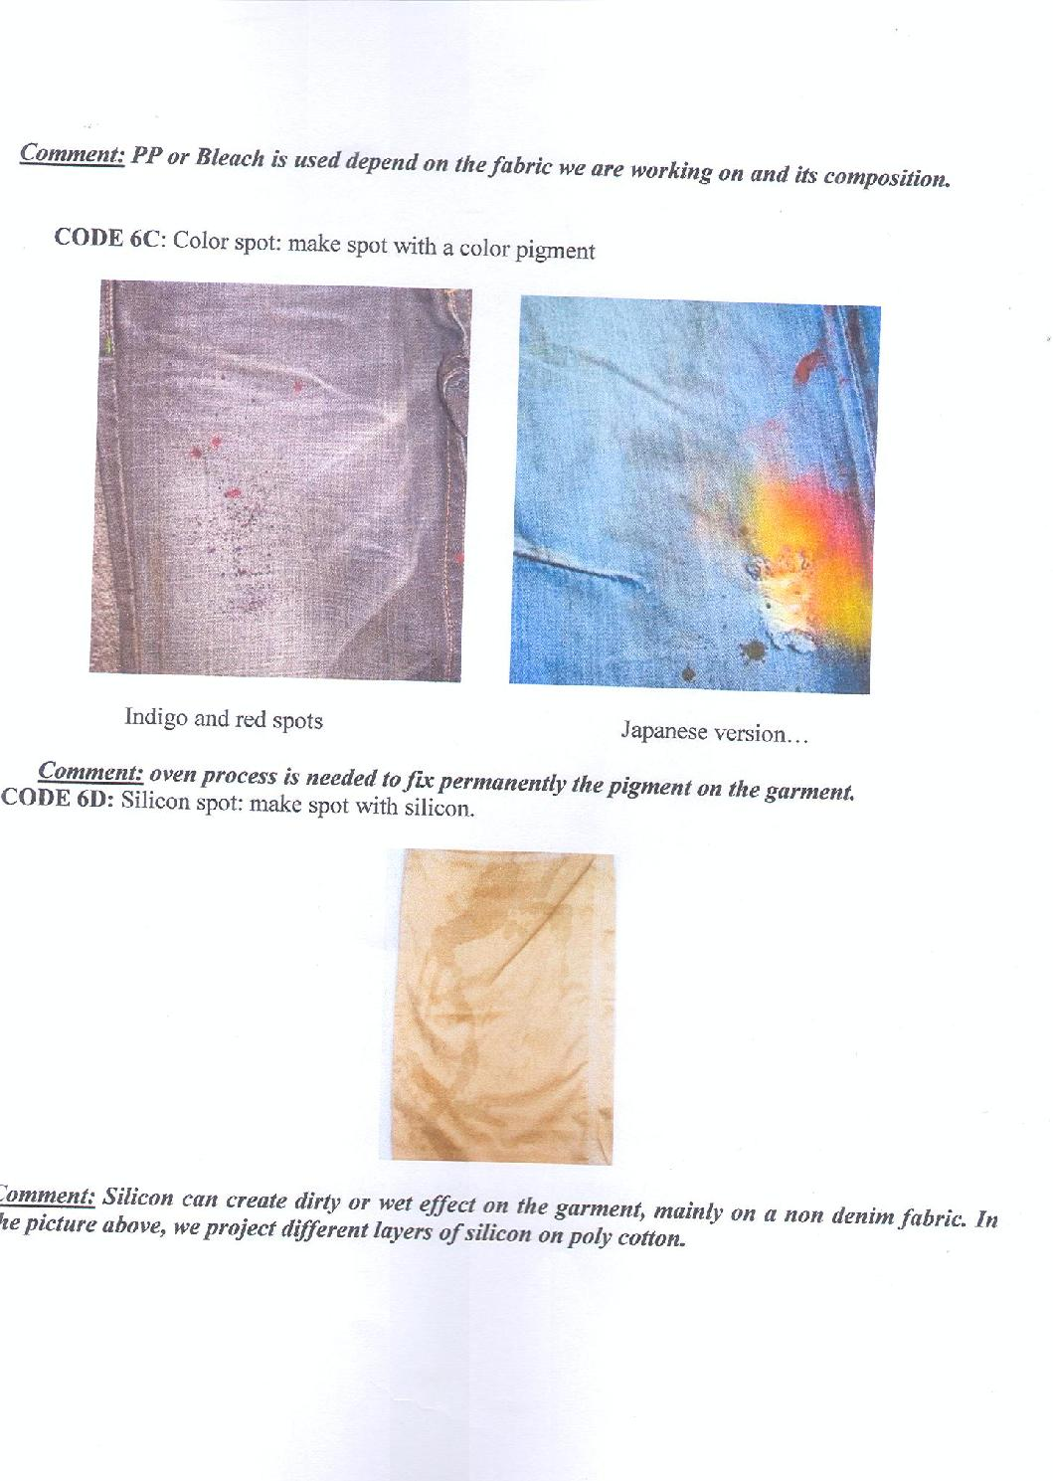
Some Washing Effects on Denim

Slide 6
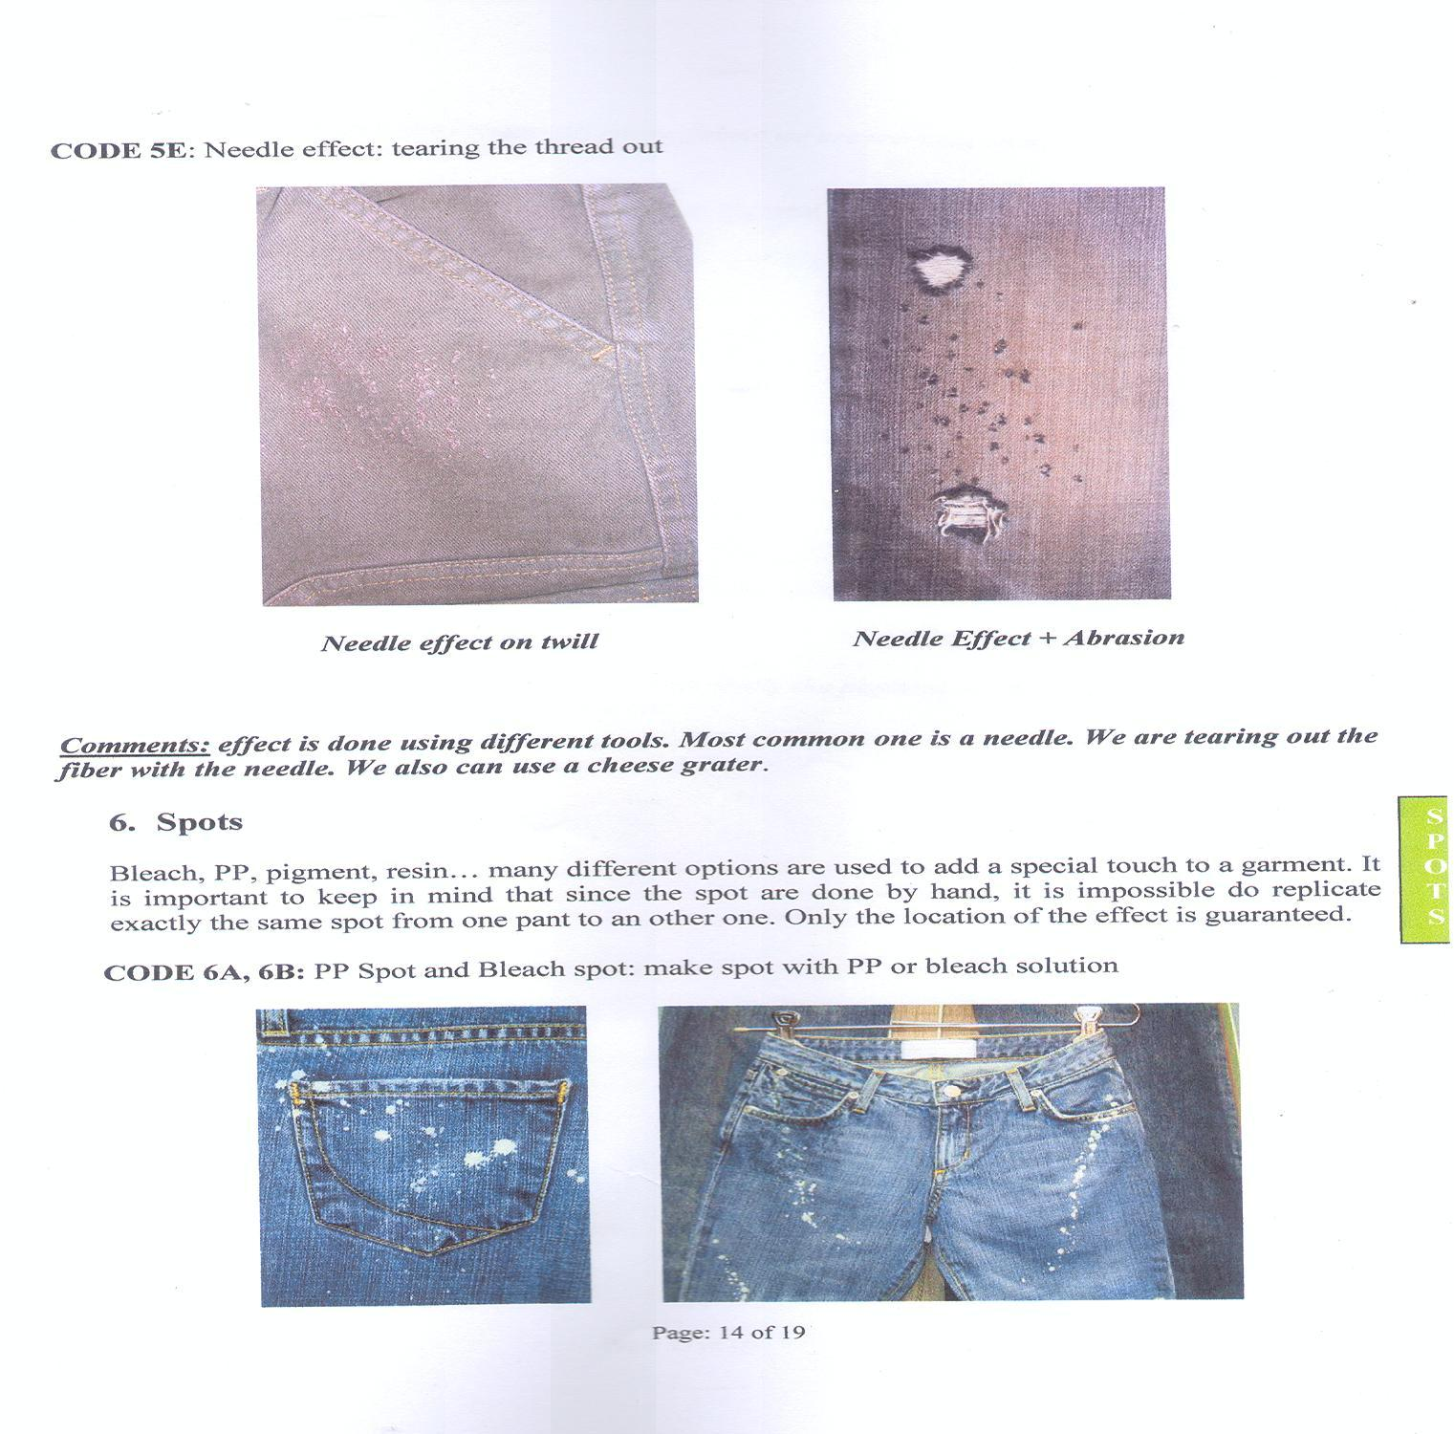
Some Washing Effects on Denim

Slide 7
Some Washing Effects on Denim

Slide 8
Some Washing Effects on Denim

Slide 9
Some Washing Effects on Denim

Slide 10
APPROX. RATE FOR DIFFERENT TYPES OF WASHING (Varies)
NORMAL WASH / GARMENT WASH
Kids / Boy's item - us$ 0.70 - $ 1.25 / DOZ
Adult item - us$ 1.00 - $ 1.50 / DOZ
PIGMENT WASH / CAUSTIC WASH
Kids / Boy's item - us$ 1.00 - $ 1.50 / DOZ
Adult item - us$ 1.25 - $ 2.00 / DOZ
SILICON WASH
Kids / Boy's item - us$ 1.25 - $ 1.75 / DOZ
Adult item - us$ 1.50 - $ 2.00 / DOZ
ENZYME WASH (TWILL/CANVAS/POPLIN/CORDREY/T.SHIRT)
Kids / Boy's item - us$ 1.80 - $ 2.25 / DOZ
Adult item - us$ 2.25 - $ 2.75 / DOZ
ENZYME WASH (DENIM)
Kids / Boy's item - us$ 3.00 - $ 4.00 / DOZ
Adult item - us$ 3.50 - $ 5.00 / DOZ
STONE ENZYME WASH (TWILL/CANVAS/POPLIN/CORDREY)
Kids / Boy's item - us$ 2.00 - $ 2.50 / DOZ
Adult item - us$ 2.50 - $ 3.00 / DOZ

Slide 11
Continued……
STONE ENZYME WASH (DENIM)
Kids / Boy's item - us$ 3.50 - $ 4.50 / DOZ
Adult item - us$ 4.00 - $ 6.00 / DOZ
ACID WASH
Boy's item (Woven/Knit) - us$ 5.00 - $ 5.50 / DOZ
Adult item- us$ 6.00 - $ 7.00 / DOZ
Sweeter item - us$ 7.00 - $ 8.00 / DOZ
STONE ENZYME + SAND BLASTING
Boy's item (Twill/Canvas etc.) - us$ 5.00 - $ 6.00 / DOZ
Boy's item (Denim) - us$ 5.50 - $ 6.50 / DOZ
Adult item (Twill/Canvas etc.) - us$ 6.00 - $ 7.00 / DOZ
Adult item (Denim) - us$ 7.00 - $ 8.00 / DOZ
STONE ENZYME + SAND BLASTING + TINTING
Boy's item (Twill/Canvas/Denim etc.) - us$ 7.00 - $ 9.00 / DOZ
Adult item (Twill/Canvas/Denim etc.) - us$ 8.50 - $ 10.00 / DOZ
STONE ENZYME + SAND BLASTING + GRINDDING
Boy's item- us$ 7.00 - $ 9.00 / DOZ
Adult item- us$ 8.00 - $ 10.00 / DOZ

Slide 12
Continued……
STONE ENZYME + SAND BLASTING + GRINDDING
Boy's item- us$ 7.00 - $ 9.00 / DOZ
Adult item- us$ 8.00 - $ 10.00 / DOZ
STONE ENZYME + SAND BLASTING + TAGGING + GRINDING
Boy's item- us$ 8.00 - $ 10.00 / DOZ
Adult item- us$ 9.00 - $ 12.00 / DOZ
STONE ENZYME + SAND BLASTING + WHICKERING
Boy's item- us$ 7.00 - $ 9.00 / DOZ
Adult item- us$ 8.00 - $ 10.00 / DOZ
STONE ENZYME + WHICKERING + PERMANENT CRINKLE
Boy's item- us$ 10.00 - $ 12.00 / DOZ
Adult item- us$ 12.00 - $ 13.00 / DOZ
STONE ENZYME + TAGGING + GRINDING
Boy's item- us$ 7.00 - $ 8.00 / DOZ
Adult item- us$ 8.00 - $ 9.00 / DOZ

