Slide 1
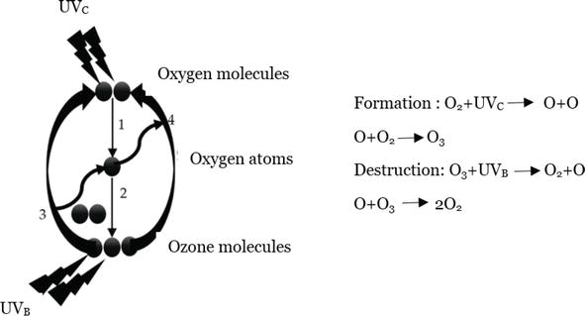
Ozone
Ozone is a strong oxidant agent, which can be produced synthetically, as well as naturally available in the atmosphere.
Ozone layer behaves like a shield against ultraviolet radiation. Because it absorbs UV-B and UV-C light during the cycle of formation and destruction of ozone in the atmosphere.

Slide 2
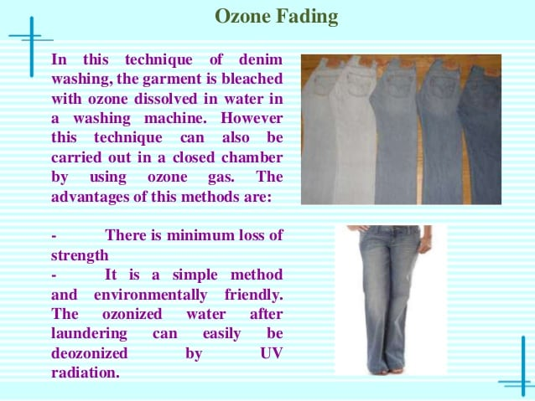

Slide 3
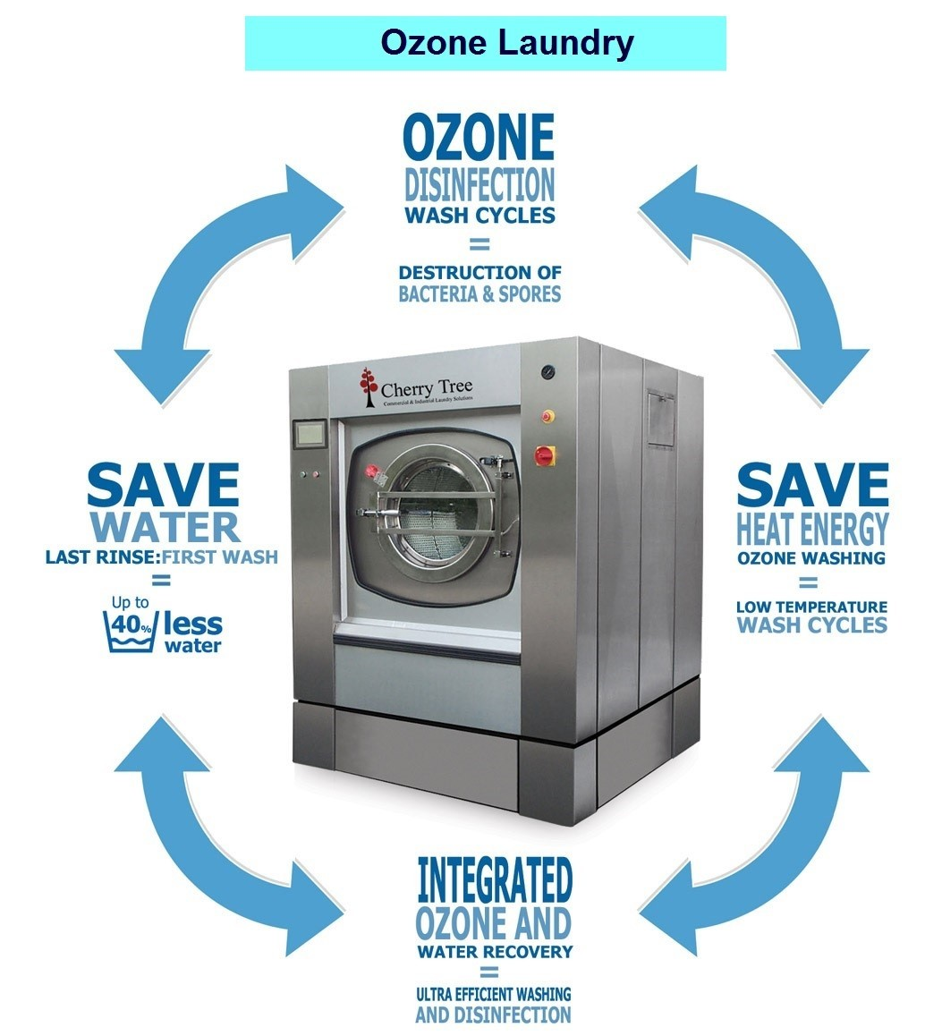

Slide 4
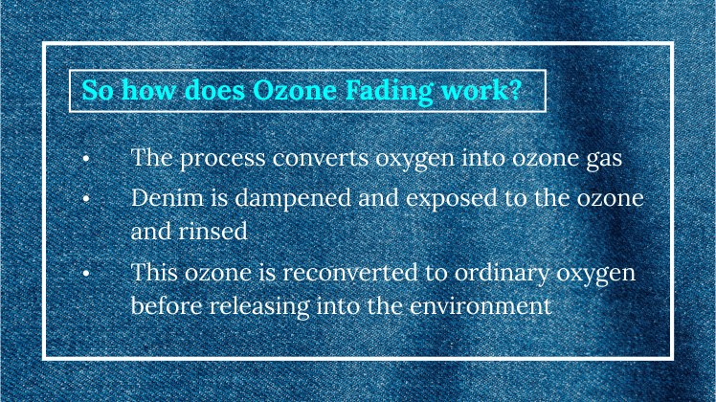

Slide 5
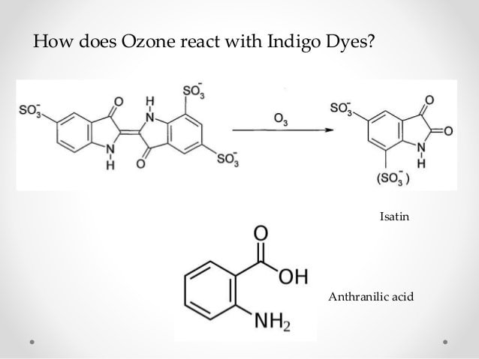
OZONE FADING

Slide 6
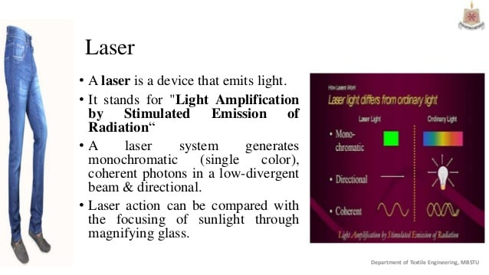

Slide 7
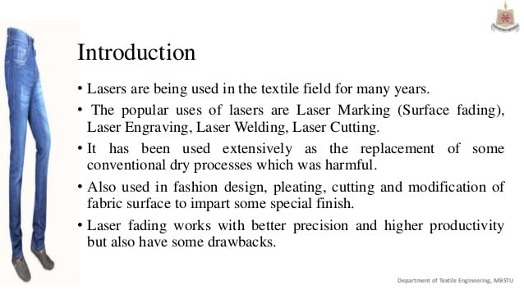
Laser technology

Slide 8
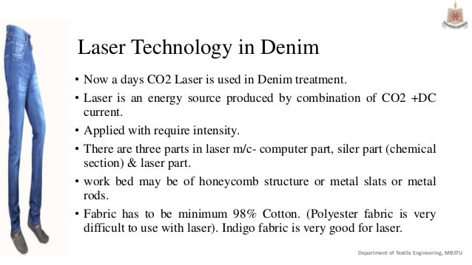

Slide 9
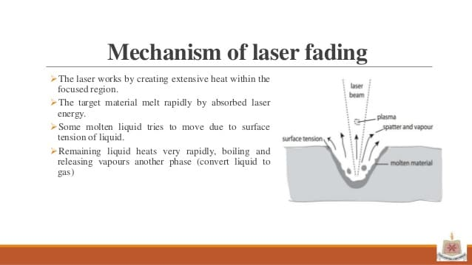
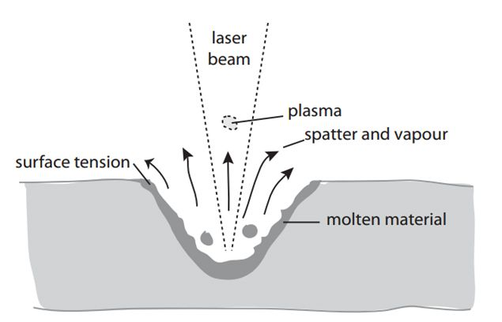

Slide 10
Work sequence
Create design pattern: Creation of a design pattern and development of pattern from captured photo or design made by computer software.
Convert into, bmp format: Conversion into grey scale .bmp format (bitmap image format).
Input the design into Laser system: Putting the design file into the computer attached with laser m/c
Set the pixel time: Set the luminance of light that will placed on the garments.
Placing the garments: Placing the garments on honey comb table
Location identification: Marketing a red light on the garments where laser light fall to make sure garments in placed properly.
Start: run the m/c.

Slide 11
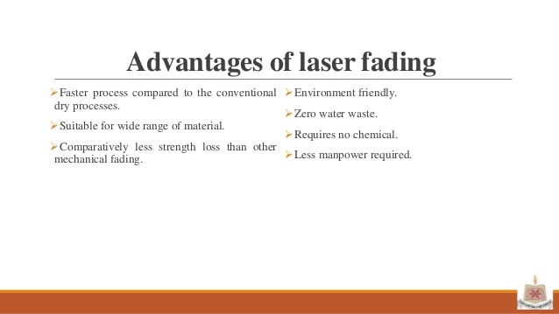
Disadvantages of laser fading:
Initial investment is very high.
Skilled operator is needed.
Producing natural effect is difficult and often requires some manual touch.
The laser beam itself and the produced fumes are health hazardous.
Maintenance and servicing of the laser system may be troublesome in some cases.

Slide 12
Some general Features
Effect quality finer than manual.
Hand feel finer than manual.
Less hairiness.
Higher production cost
Less working space
Design consistency higher
Higher tearing strength (vary in stretch denim)
Rejection rate 0% (5% in Manual)
Less manpower [Laser: Manual= 1:3 (Approx)]
Higher power requirement (approx. 7.5 KWH)
Harmful laser beam (if contact to skin or eyes)

Slide 13
VIDEO: SUSTAINABLE WASH (LASER AOP+OZONE)

