Slide 1
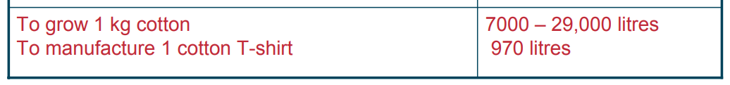
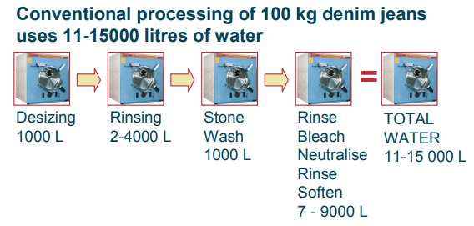
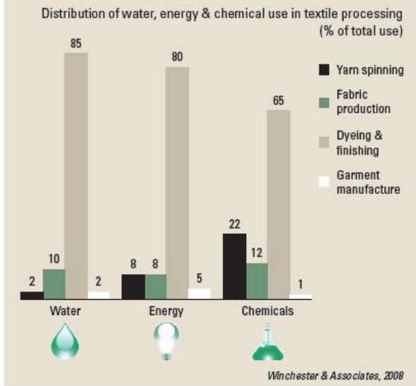
Few FACTS……Think!!!!!!

Slide 2
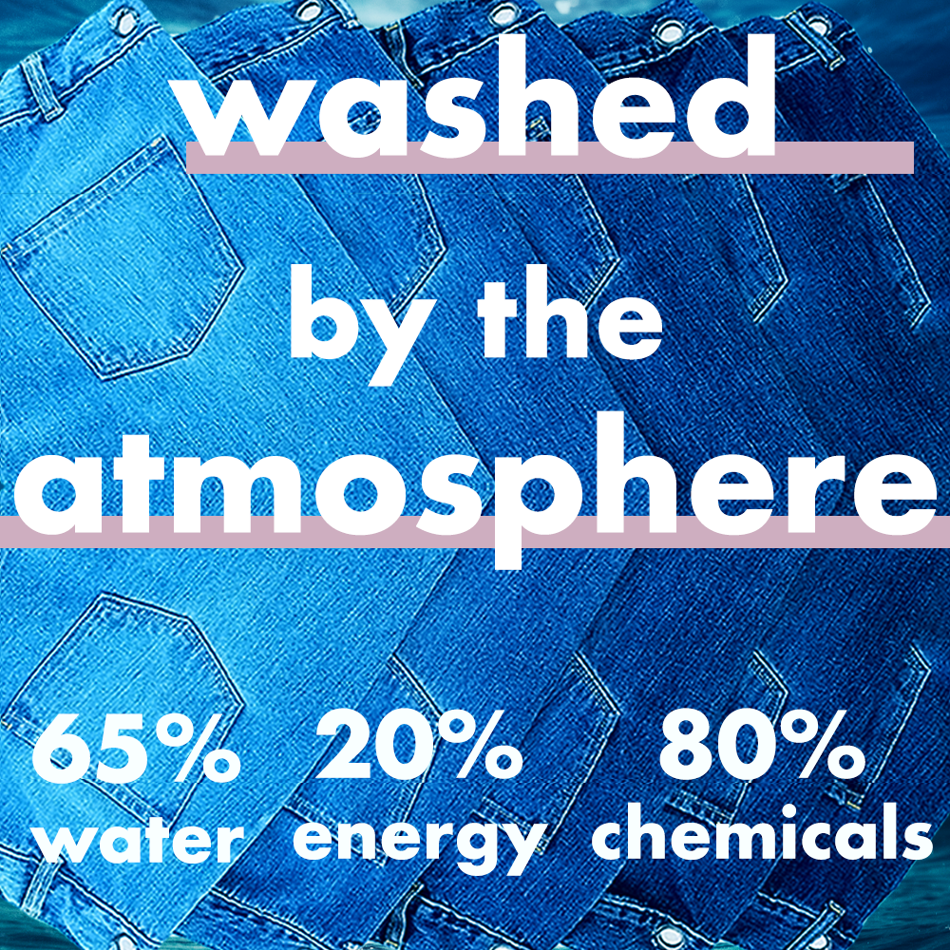

Slide 3
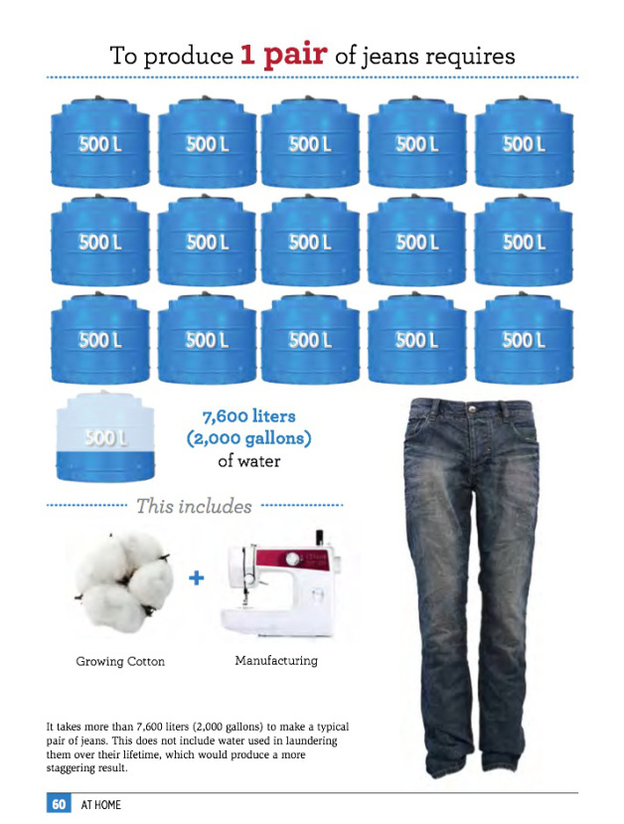

Slide 4
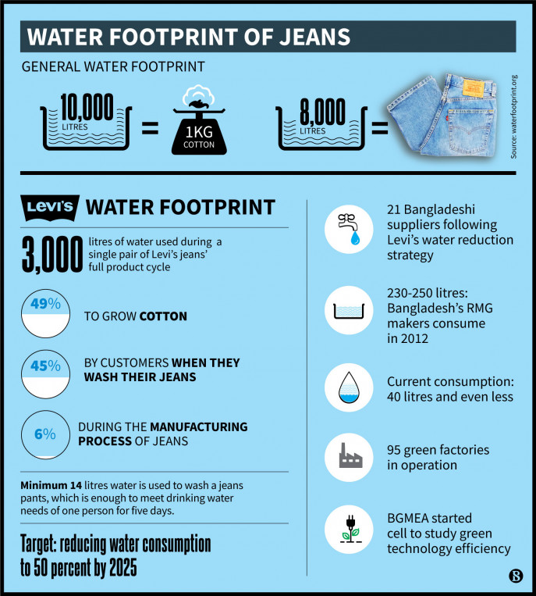

Slide 5
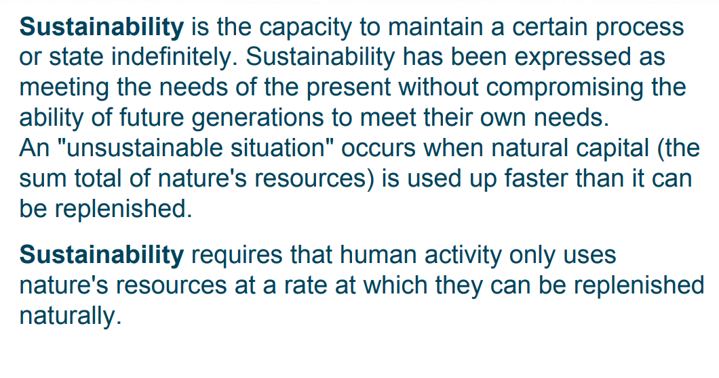
sustainability

Slide 6
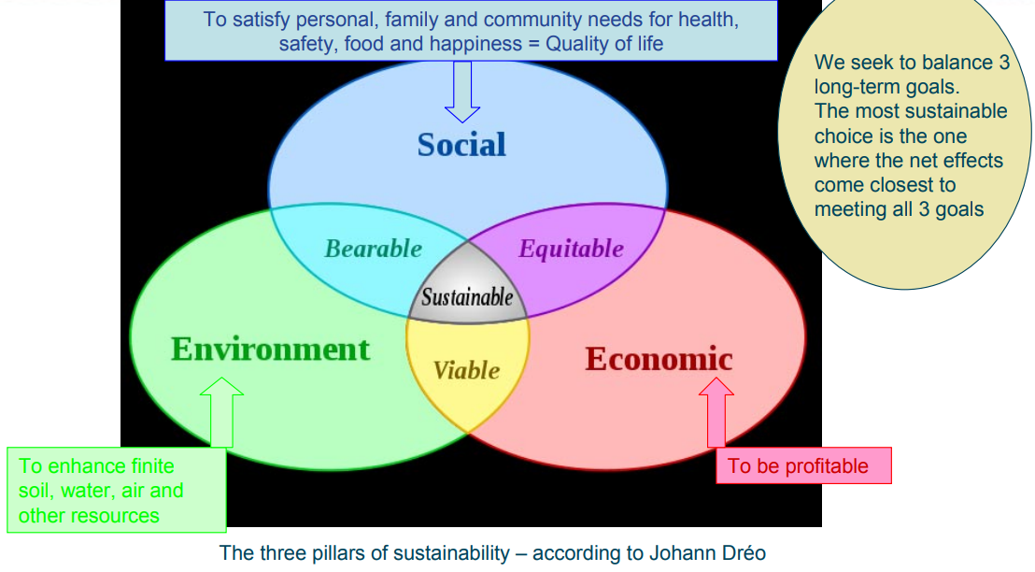
Three Spheres of Sustainability

Slide 7
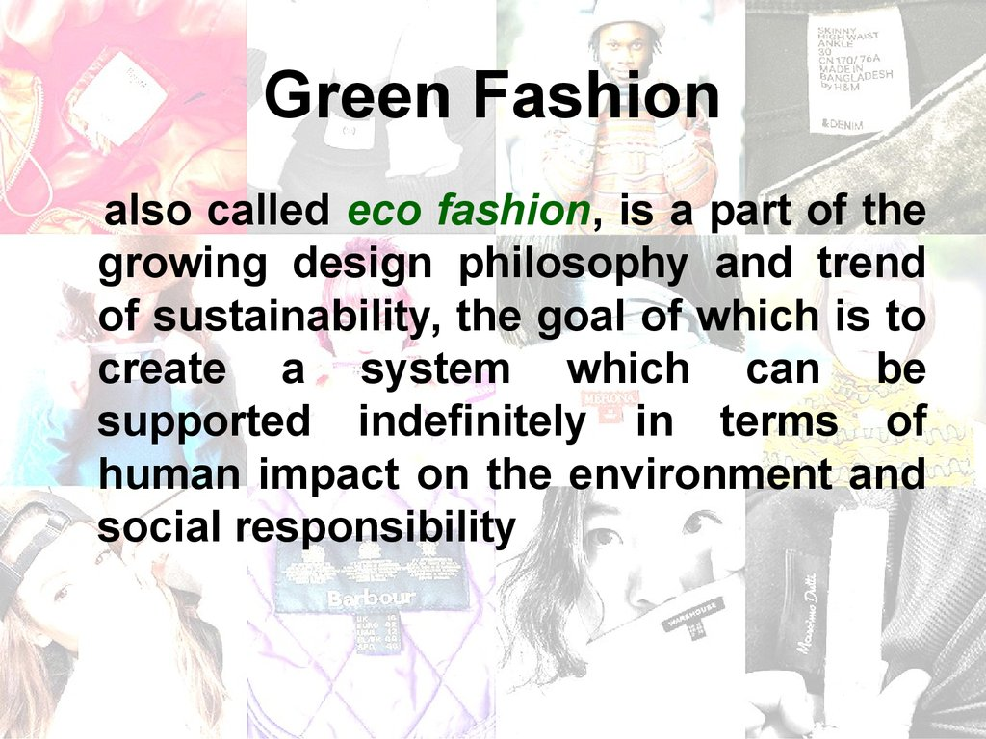

Slide 8
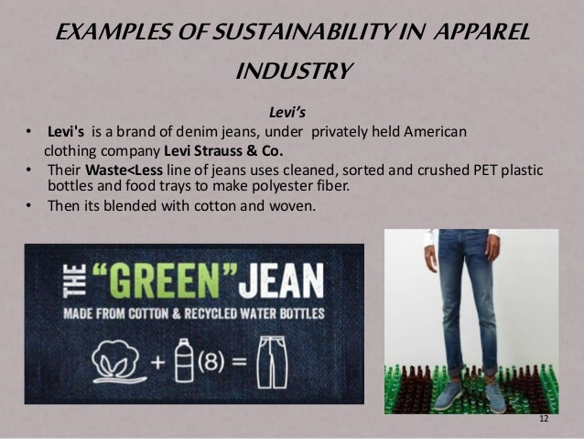

Slide 9

CATEGORIES OF Sustainability issues in denim washing
Less water consumption.
Elimination of wastewater.
Reuse of water.
Less chemicals for sustainable future.
Use of environmentally friendly chemicals and materials.
Less energy for efficient manufacturing.
The protection of human health.
Shorter process.
Process optimization in terms of time, temperatures and raw materials.
Quality improvement.
Increasing productivity.
Longevity of washing equipment.

Slide 10
SUSTAINABLE DENIM WASH: FULL PROCESS

