Slide 1
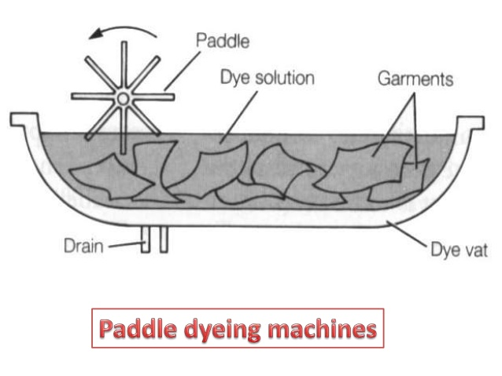
Garments Dyeing Machines
Garments dyeing machines are classified into two groups:
a) Pedal dyeing machine
b) Rotary dyeing machine
Pedal dyeing machine:
First and oldest type machine.
Two types that is overhead pedal type and side pedal type.
Generally used for woolen knit wear.
Dyeing cost is higher due to manual operation, higher labor load, manual loading-unloading, chemical feeding.
Not used in Bangladesh.

Slide 2
Continued….
b) Rotary dyeing machine:
Modified version of pedal type.
Classified into two types:
(i) Normal atmospheric pressure type (Less than 100 degrees)
(ii)High temperature type (more than 100 degrees dyeing temperature).

Slide 3
Continued……
Atmospheric Pressure Rotary Garments Dyeing Machine:
Widely used in Bangladesh.
Made of stainless steel. There are two stainless steel cylinders one inside the other.
Outer cylinder is solid and has two sliding doors like microbus at the upper middle half position of the cylinder.
The cylinder is fixed on the machine frame and the machine frame is fixed on the floor to avoid jerking during operation.
Also two chemical dosing doors on the sliding doors for further chemical addition.
Inner stainless steel cylinder is perforated having two stainless steel side shafts.
The side shafts are fixed with the machine frame through ball bearing.
Two machine pulley is fixed on the two side of the side shafts.

Slide 4
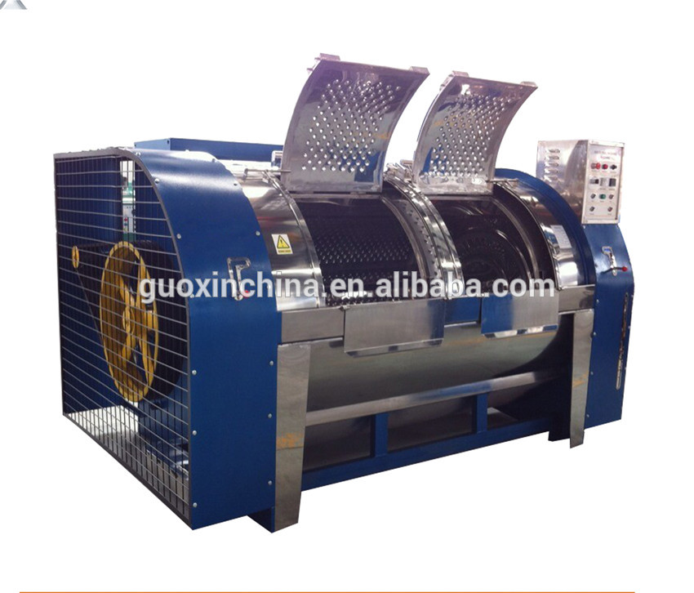
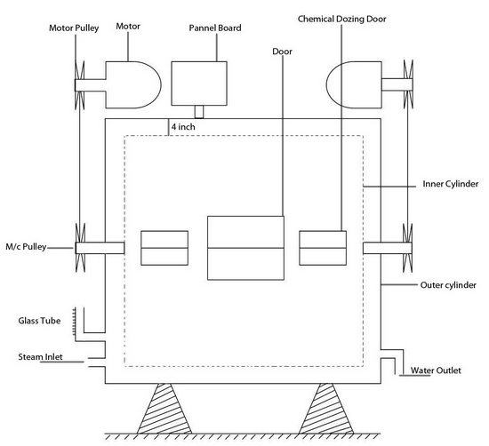
Continued….

Slide 5
Continued….
By the help of two big high power motor & motor pulley, the machine pulley is rotated.
As a result the inner perforated cylinder can rotate freely inside outer cylinder.
Inner cylinder has two spring loaded doors. The doors of both cylinder is aligned to the same position to load and unload garments.
The inner cylinder can be rotated at 5 to 35 rpm through control panel.
The rotation of the inner cylinder is controlled for clock-wise and anti-clockwise direction by reversal driving unit .
The dual direction movement is used to avoid roping affect of the garments.

Slide 6
Continued……
There are three to four inches gap between the inner and outer cylinder. A solid steam pipe is situated between the gap.
Dyeing temperature is controlled by a dial & indicator.
Garments movement is for three triangular shape bars in inner cylinder.
From water tank a water pipe is connected in bottom of outer cylinder.
It automatically stops after time with alarm sound to attract the attention.
The capacity of the dyeing machine is 60 kg to 500 kg.

Slide 7
Continued……
High Temperature Rotary Garments Dyeing Machine:
Modified and latest version of normal atmospheric pressure type.
Controlled by microprocessor which is presently used in Bangladesh.
Very big central door facilitates for materials loading and unloading mechanically.
Light machine structure facilitates high speed running with safe balance.
Simple A/C drive and A/C converter facilitate 5 to 35 rpm.
Additional two chemical tanks may be attached for auto dozing of dyes and chemicals.
Separate liquor circulating pump, heater and filter facilitates additional liquor circulation and hence better quality of dyeing.
Available built in form hence less risk of installation and running problem.
Fully programmable up to 200 dyeing program can be saved & reused.

Slide 8
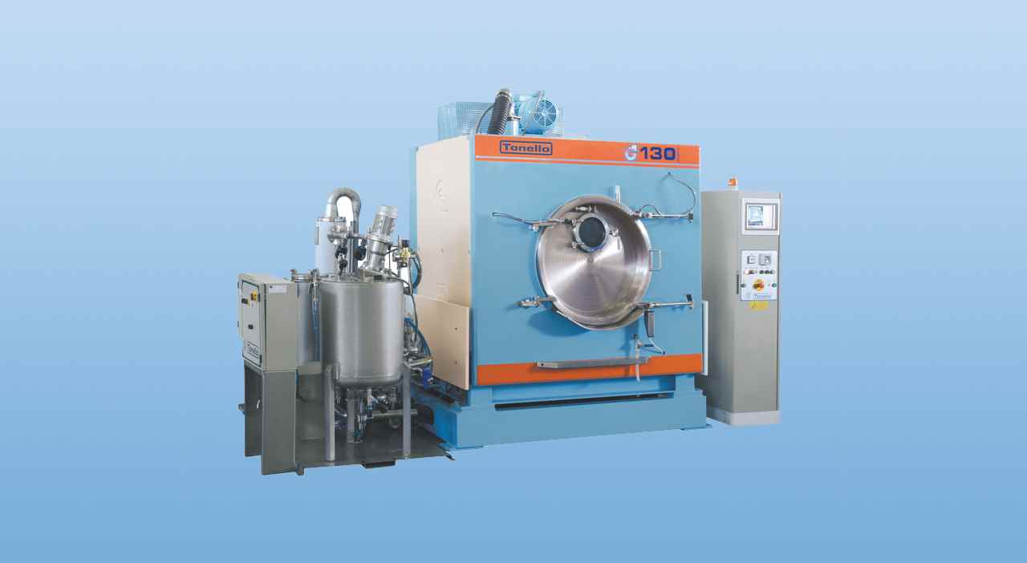
Continued….

Slide 9
Basic principle of garments dyeing with hot brand reactive dyes
At first load hot water and add salt, lubricant, sequestering agent and maintain ph at 7.
Then load garments and start machine.
Raise the temperature of the dye bath to 80°c with in 30mins.
After 5 mins at 80°c, add dye within 15 mins time.
Continue dyeing for 30 mins.
Add alkali to the dye liquor slowly within 15 mins.
Continue dyeing process for 30-60 mins.
Reduce liquor temperature to 70°c and then drop the liquor.
Washed thoroughly at 40°c to 45°c for 5 mins to remove the unfixed.
Then drop the liquor, again wash with normal water for 5 mins.
Then softener may be applied on the garments to improve the softness properties.

