Slide 1
Special chemicals for garments dyeing
Pretreatments: Good pretreatment means half dyeing. During pre- treatments use of nonionic wetting agent in the bath improves desizing effect.
Impurities Re-deposit: After pretreatments impurities are removed, they may redeposit (if insoluble and suspended) on the garments resulting color spot. To avoid this we can use Sandopan LFW or sirrix A.K. liquid may be used.
Metal Compound: Copper, iron can destroy the bleaching performance. Aluminum may be damaged by alkali. To avoid this Sandoclear 8160 or Sandopan SF liquid may be used.
Crease Marks: Lubricant (Imacol) may be used.
Irregular dyeing: Leveling agent (Drimagen E2R of clariant) can be used.

Slide 2
Cotton Garments Dyeing Process
Lot Size: 100 Kg garments
De-sizing:
M:L= 1:5…..500L water
Machine starts running
Desizing agent (Pc 90) @ 2g/L = 2kg
Lenosil SR (WA) @ 0.5g/ = 0.5kg
Temperature = 90°C
Time at 90°C = 15 min
Drop
Rinsing:
M:L= 1:5…..500L water
Wash of 5 min at 60°C to clean
Drop

Slide 3
Continued……
Scouring and Bleaching:
M:L= 1:5…..500L water
Start the machine
Caustic soda @ 12% = 12kg
H2O2 @6% =6 L
Stabilizer @2% =2L
Wetting agent @0.5% =0.6L
Temperature =95°C
Time at 95°C =1.5 hrs
Drop
Rinsing:
M:L= 1:5…..500L water
Temperature 60°C
Add Calgon-T @ 1g/l to clean for 5 mins.
Drop
Neutralization:
M:L= 1:5…..500L water
Add acetic acid @ 2ml/L and continue for 10 min to neutralize
Drop

Slide 4
Continued…….
Dyeing:
M:L= 1:10…..1000L water
Machine Start
Salt @ 40% =40kg
Lubricant @ 1/kg =1kg
Sequestering agent @1g/kg =1kg
Continue for 10 min and raise temperature to 80°C.
Add dyes within 15 min and continue for 20-30 mins.
Add sodium bicarbonate @ 5% for pH 9.5 within 15 mins.
Continue dyeing for 30-60 mins to improve level dyeing.
After shade matching, drop the liquor.

Slide 5
Continued……
Rinsing:
M:L= 1:5…..500L water
Add detergent @ 2g/L and raise temperature to 60 °C.
Continue washing for 10 -15 min to remove unfixed dyes.
Drop
Softening:
M:L= 1:5…..500L water
Add softener @1g/L and continue for 10-15 min at 40°C to 50°C.
Drop
Unload the garments
Hydro-extraction:
Drying
Quality checking and Delivery:

Slide 6
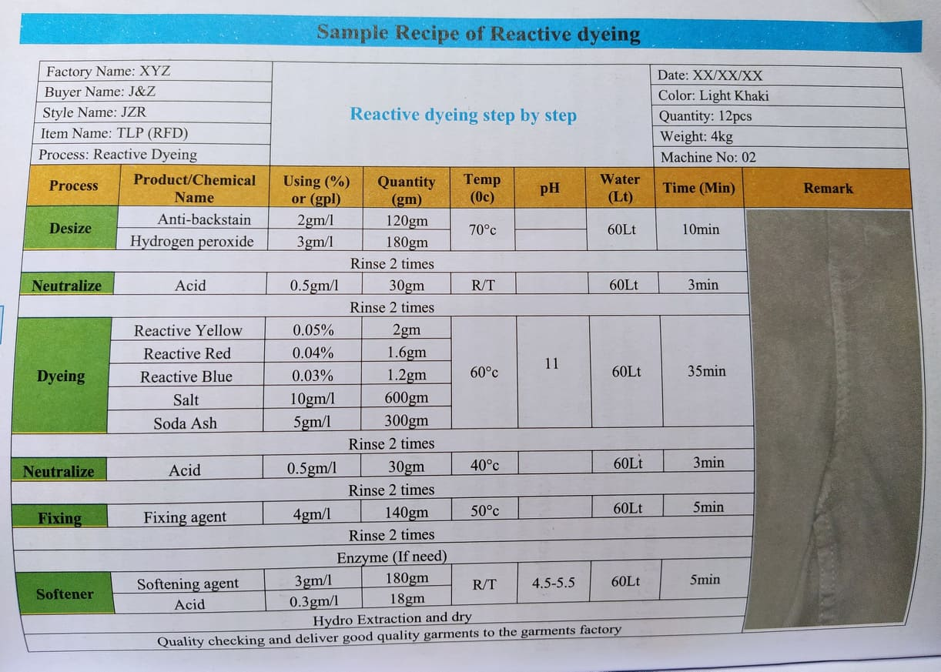
OR

Slide 7
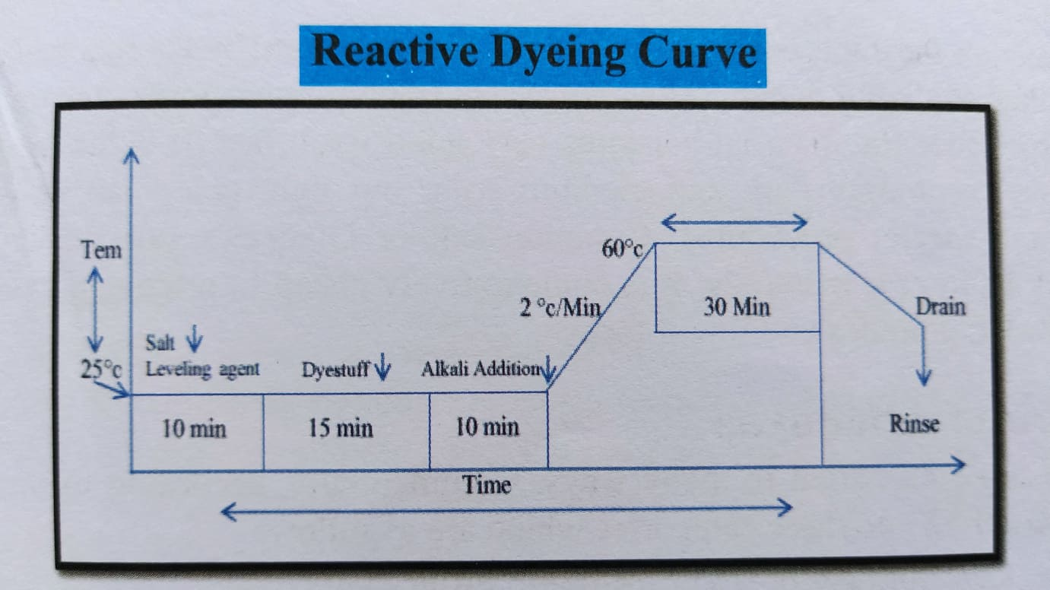

Slide 8
Cotton Sweater Dyeing with pigments
Sweater produced with cotton yarn is commonly dyed with pigment. Dyeing process does not require desizing as there is no starch materials present in the fabric.
Batch: 100 kg.
Scouring and bleaching:
Liquor ratio of 1:25…..2500 L water
Start machine running and steam supply
Detergent @ 0.5 g/L
Soda ash @ 2 g/L
Caustic soda @ 3g/L
H2O2 @ 3ml/L
Stabilizer @ 1ml/L
Temperature 90-70°C
Time 40 mins
Drop
Rinsing:
M:L= 1:10 …..1000L water
Continue washing for 5min at 50°C to clean
Drop

Slide 9
Continued…….
Neutralization:
M:L= 1:5…..500L water
Add acetic acid @1g/l and continue for 5 min without temp to neutralize
Drop
Enzyme Treatment:
M:L= 1:10 ….1000L water
Start machine
Cellulase enzyme @ 1ml/L 1g
Acetic Acid to maintain pH=4.5
Temperature 55°C
Processing time 30 min
Rinsing:
M:L= 1:10 …..1000L water
Raise the temperature to 60°C and continue washing for 5 min
Drop the liquor.

Slide 10
Continued……
Dyeing:
M:L= 1:25….2500L water
Cationic agent @ 1g/L
Soda ash to maintain pH =8.5
Add 0.5% that is 500 g Pigment Red H3BD.
Continue treatment for 10 min at normal temp and then raise the temp of the liquor to 70°C within 15 min.
Continue the operation for 20 min at 70°C
Drop
Binder Exhaustion:
M:L= 1:10 …..1000L water
Add binder @ 1ml/L and continue treatment for 5 min.

Slide 11
Continued….
Rinsing:
M:L= 1:10 ….1000L water
Continue washing for 5 min
Softening:
M:L= 1:10 …..1000L water
Add 0.5g/L softener and acetic acid to maintain pH 5.5 and continue treatment 5 min
Drop
Hydro-extraction:
Drying:
Quality checking and Delivery:

Slide 12
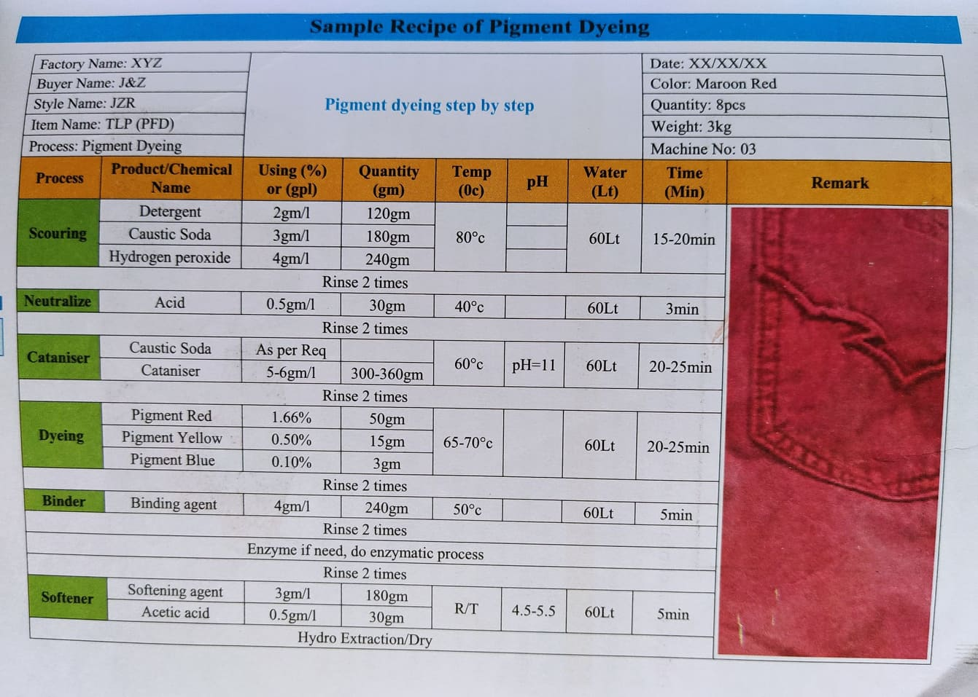
OR

Slide 13
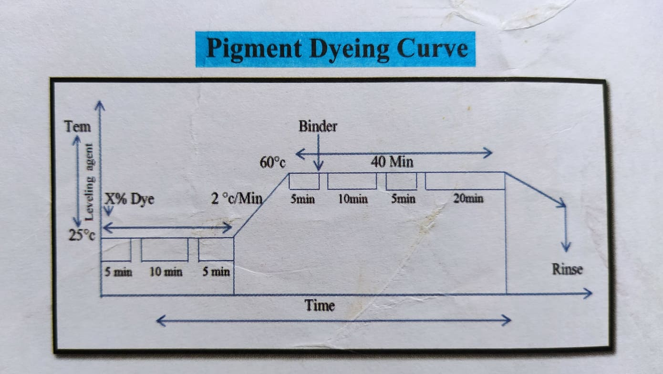

Slide 14
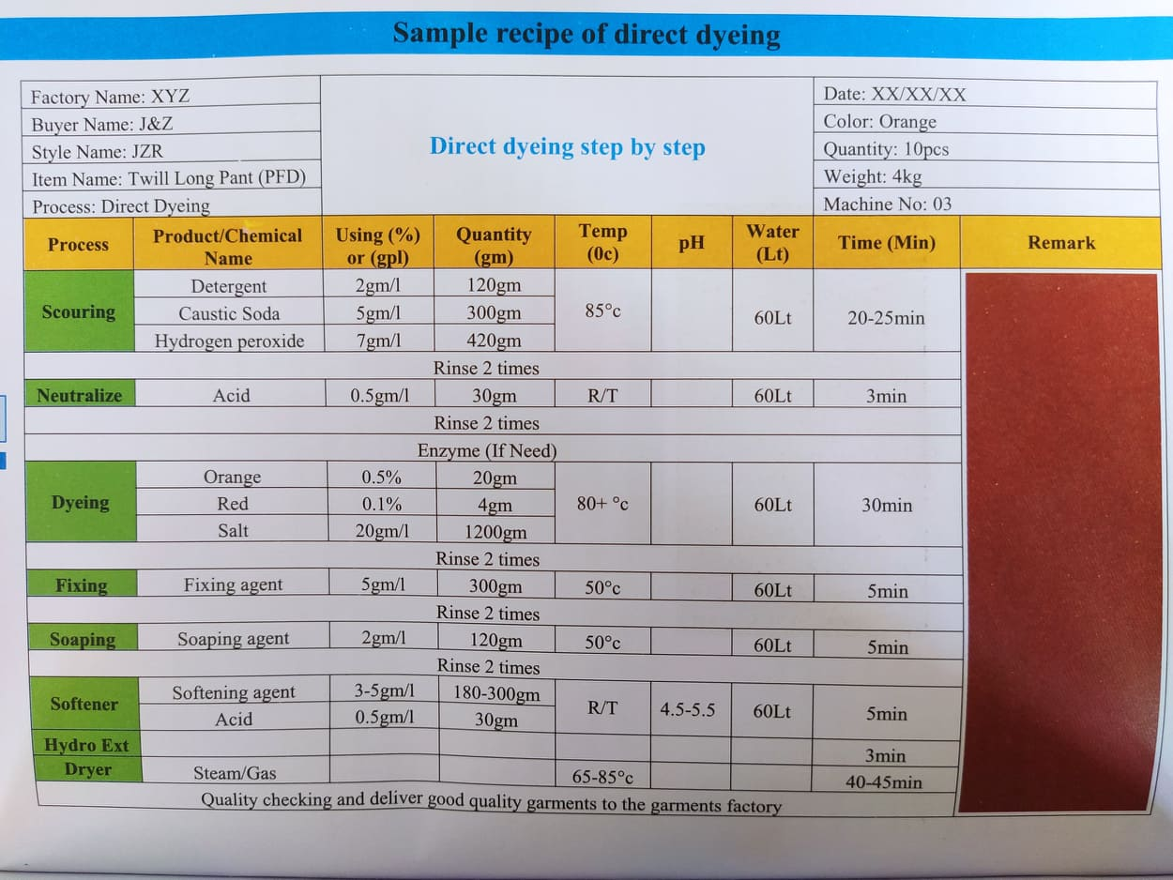

Slide 15
