Slide 1
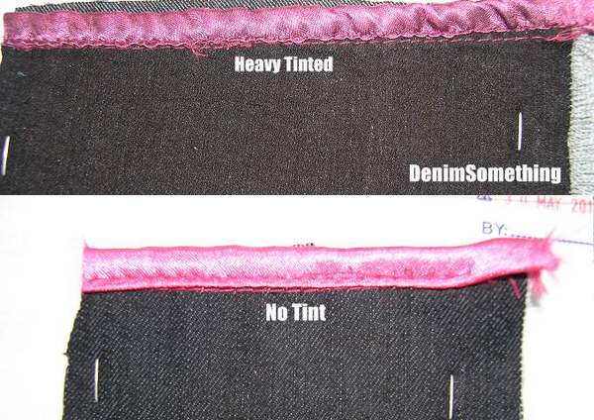
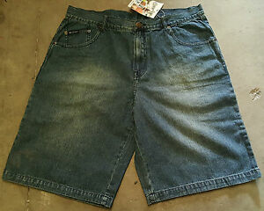
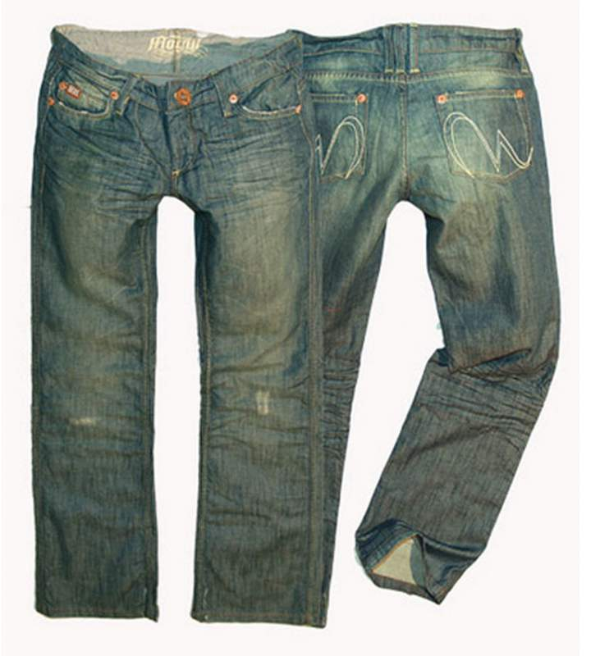
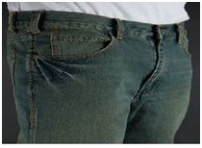
Are only washed or…?????

Slide 2
Tinting
Tinting is a process done after washing but before softening. Normally after acid wash, stone wash with bleach or enzyme, stone wash, sand blasting, etc, tinting and over dyeing is done. The faded area is normally over dyed with orange (bright color), yellow or similar hue and stone.
Normally denim garments are of blue color. When orange or yellow color is placed is placed on the faded area, the garments look like dirty but actually the garment is clean and new. Another color is again reused in the faded portion, this is called tinting dyeing.

Slide 3
Continued…..
Precautions to be taken in tinting:
During fabric sewing low and high thread tension required. Otherwise irregular dyeing effect happen but low tension more preferable.
Selection of interlining before garments tinting.
The main recipe of tinting is given below:
L:R: 1:7
Dye: .01-.05 % (Direct/Reactive)
Leveling agent: .05%
salt: 15-20 g/l
Soda ash: 10-15 g/l
Temp: 50°C- 70°C
Time: 1-2 hrs

Slide 4
Process of enzyme bleach wash with tinting
Step 1: Desizing: Batch size: 60pcs
Water is added
Garments are loaded
Machine started
500 gm Soda ash added
500 gm Caustic soda added
200 gm Bio. D added
Steam temp: 60°C
Process time: 25 minutes
Drop liquor
Two time wash
Step 2: Enzyme wash:
Water added 400 liters
Machine running
200 ml liquid, 400 gm powder type enzyme added
150 ml Acetic acid added
200 gm Anti Back staining agent added
10 kg Pumice stone added
Temp: 50°C
Process time: 60 minutes
Drop liquor

Slide 5
Continued……
Step 3: Neutral wash
Water is added: 400 liters
Machine running
500 gm Hypo sulphide added
Steam temp: 45°C
Process time: 10 minutes
Drop liquor
Step 4: Tinting
Water is added (400 liters)
Machine running
0.02% Direct Brown GTL and 0.01% Direct Black V-200 added
4kg salt is added
Steam temp: 70°C
Process time: 20 minutes
Check shade
Drop the liquor
Step 5: Softening
Step 6: Hydro-Extraction
Step 7: Drying
Step 8: Quality Checking and Delivery

