Slide 1
Torsional Properties
Chapter 03

Slide 2
Torsional Properties
The behaviors shown by textile fibre, when it is subjected to twisting is known as torsional properties.

Slide 3
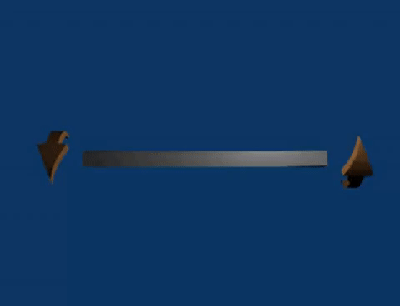
Torsional rigidity
Torsional rigidity is the resistance of a textile fibre against twisting. The unit of torsional rigidity is N-mm², N-m² etc.
Mathematically, Flexural rigidity, Rt = $\frac{\text{η}\text{Е}\text{T}\text{2} }{\text{ρ}}$
Where,
η = Shape factor
Е = Specific shear modulus (in N/tex)
T = Linear density (in tex)
ρ = Density (in gram/cm³)

Slide 4
Specific torsional rigidity
The specific torsional rigidity is the torsional rigidity of a textile fibre of unit linear density.
Specific torsional rigidity is usually expressed as N-mm²/tex, N-m²/tex etc.
Mathematically, Flexural rigidity, Rt = $\frac{\text{η}\text{Е(1)2 }}{\text{ρ}}$
Where,
η = Shape factor
Е = Specific shear modulus (in N/tex)
T = Linear density (in tex)
ρ = Density (in gram/cm³)

Slide 5
Specific torsional rigidity of different fibres
Fibre | Specific torsional rigidity (mN-mm²/tex)
Cotton | 0.16
Wool | 0.12
Silk | 0.16
Viscose | 0.085
Nylon-6.6 | 0.06
Polyester | 0.067

Slide 6
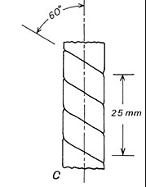
Breaking twist
Breaking twist is the twist for which a textile fibre will break. Breaking twist can also be defined as the number of turns or twists required to break a fibre.
Breaking twist depends upon the diameter of fibre and is inversely proportional to the diameter.
So, Breaking twist, Tb ∞ $\frac{1}{d}$ [d = fibre diameter]

Slide 7
Breaking twist angle
The angle through which the outer layers of fibres are sheared at breaking is known as breaking twist angle. Breaking twist angle is usually expressed as α.
Mathematically, Breaking twist angle, α = tan⁻¹ (∏ d Tb)
Where, d = Fibre diameter &
Tb = Breaking twist per unit length of fibre

Slide 8
Breaking twist angle of different fibres
Fibre | Breaking twist angle (α) | Fibre | Breaking twist angle (α)
Cotton | 35⁰ | Wool | 40⁰
Viscose | 33⁰ | Silk | 39⁰
Polyester | 50⁰ | Glass | 4⁰

Slide 9
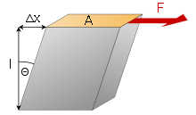
Shear modulus
Shear modulus can be defined as the ratio between shear stress and shear strain.
So, Shear modulus = $\frac{\text{Shear} \text{stress}}{\text{Shear} \text{strain} }$
Shear strain is usually measured in radian. Shear modulus of a fibre is expressed as kN/mm². For example, shear modulus of wool is 1.3 kN/mm².

Slide 10
Thank You

