Slide 1
Optical Properties of Textile Fibres
Chapter 08

Slide 2
Lecture 01

Slide 3
Optical Properties of Textile Fibres
The behaviors shown by a textile fibre when light falls on it are called as optical properties.
The optical properties of a fibre include birefringence (basis on light refraction or transmission), dichorism (basis on light absorption) and luster (basis on light reflection).

Slide 4
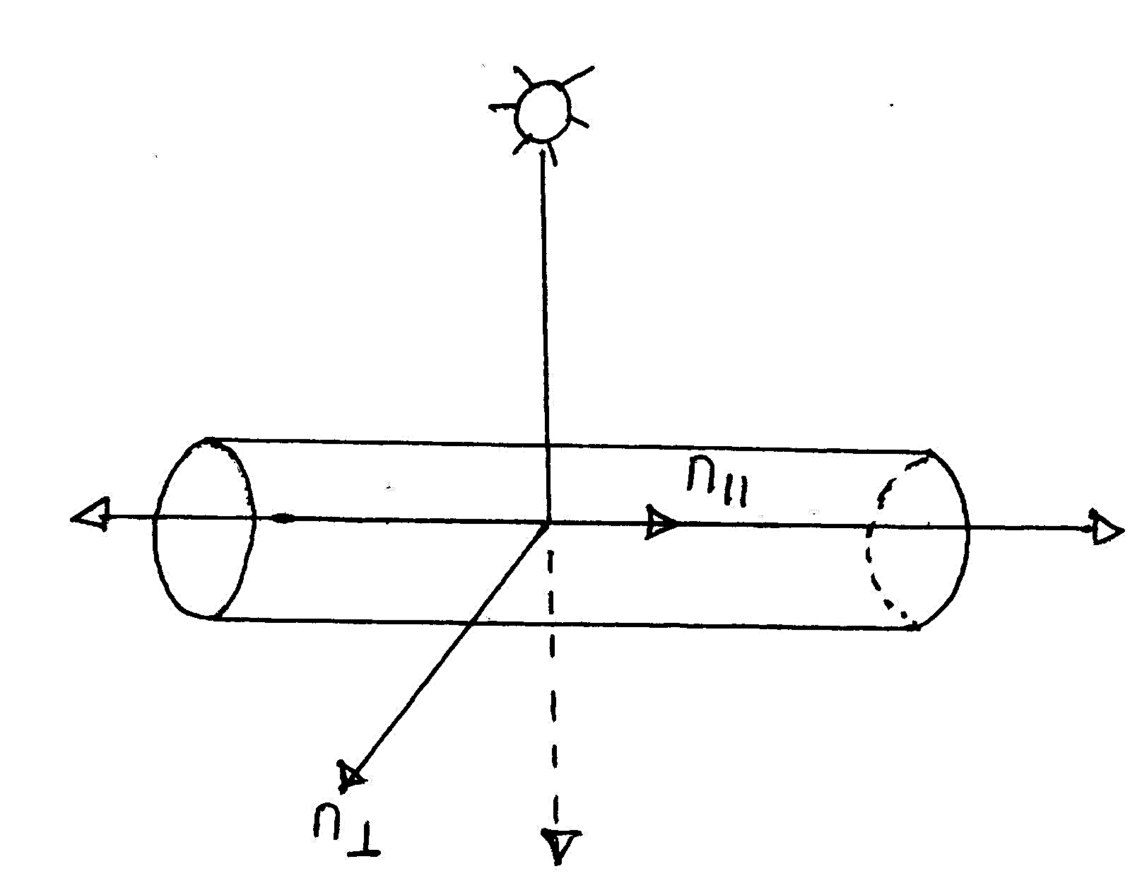
1. Birefringence
When a beam of light falling on a textile fibre, it splits up into two refracted beams, one polarized parallel to the fibre axis and other polarized perpendicular to the fibre axis.
The difference between the refractive index for light, polarized parallel to the fibre axis and the refractive index for light, polarized perpendicular to the fibre axis is called as birefringence value of fibre.

Slide 5
1. Birefringence
Birefringence can be formalized by assigning two different refractive indices to the fibre for different polarizations. The birefringence magnitude is thus defined by-
Δ η = η|| - η┴
Where η|| and η┴ are the refractive indices for light, polarized parallel and perpendicular to the fibre axis respectively.
The birefringence of a fibre is due to the orientation of the crystal axis in the crystalline regions and of the individual molecules in the non-crystalline regions. Greater the value of birefringence indicate the most of molecules are lined up parallel to the fibre axis and it will be zero if they are randomly directed.

Slide 6
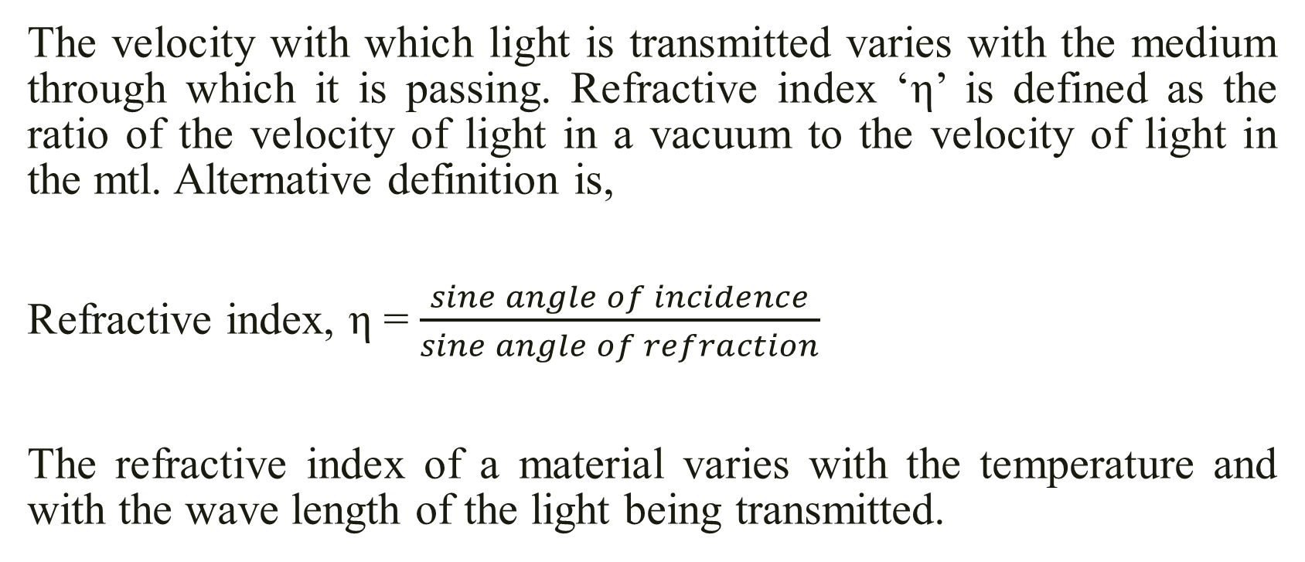
Refractive Index
The velocity with which light is transmitted varies with the medium through which it is passing. Refractive index ‘η’ is defined as the ratio of the velocity of light in a vacuum to the velocity of light in the mtl. Alternative definition is,
Refractive index, η = $\frac{sine angle of incidence}{sine angle of refraction}$
The refractive index of a material varies with the temperature and with the wave length of the light being transmitted.

Slide 7
Factors affecting the birefringence of textile fibres
The birefringence value of textile fibres depend on-
The degree of orientation and
The degree of asymmetric of the molecular chain (straight/zigzag/with side groups)
Highly oriented fibres will have high Birefringence value. Ideally oriented fibres have different birefringence value. The magnitude of birefringence which ranges from -0.005 for Triacetate to 0.188 for Terylene.

Slide 8
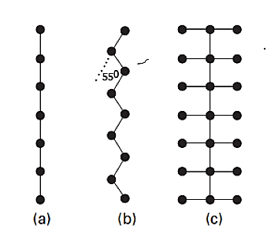
Factors affecting the birefringence of textile fibres
Fig: (a) Straight chain, (b) Zigzag chain & (c) Chain with side group

Slide 9
Birefringence property depends on the following factors
As you know earlier the magnitude of the birefringence depends on two factors:
The degree of orientation of the molecules and
The degree of asymmetry of the molecules themselves.
If all the atoms in a molecule are arranged in a straight chain Fig. (a), the bond polarisabilities are greatest along the line joining the atoms, then a high birefringence will be expected.
However, the actual molecules in fibers do not have this form and their birefringence will be reduced for two reasons.

Slide 10
Two Reasons
⦿ Firstly, most main chains have a zigzag form Fig. (b) provided that the bonds diverge from the main axis by less than about 55°, this still gives a positive birefringence. Example, the value of the birefringence of polyester fiber is 0.188.
⦿ Secondly, there will be side groups attached to the main chain, as in Fig. (c), and these will have the effect of providing atomic bonds at right angles to the main axis. This will increase the value of n⊥ and reduce the birefringence. In triacetate and acrylic fibers, the side groups have a greater effect than the main chain, and the birefringence is negative. Example, the value of the birefringence of triacetate fiber is -0.005.

Slide 11
Thank You

Slide 12
Lecture 02

Slide 13
2. Dichorism
The variation in the absorption of radiation by a colored fabric with the direction of polarization of light is called as dichorism, which may result in the difference of depth of shade or even in the actual color. For dyed fibre exhibiting dichorism, its magnitude is used as a measure of orientation of the molecules in the fibre. So, we get-
φ = k₁/k₂
Where, φ = Dichroic/dichroitic constant
K₁ = Absorption co-efficient of light polarized parallel to the fibre axis
K₂ = Absorption co-efficient of light polarized perpendicular to the fibre axis

Slide 14
Requirements of Dichroism
The dye molecule must be asymmetrical so that its absorption of radiation varies with the direction of the electric field exciting the characteristics vibration.
The dye molecule must be absorbed on to the fibre molecule in a particular direction so that all the dye molecules make the same angle (or a limited range of angles) with the axis of the chain molecules.
The chain molecules must be preferentially oriented.

Slide 15
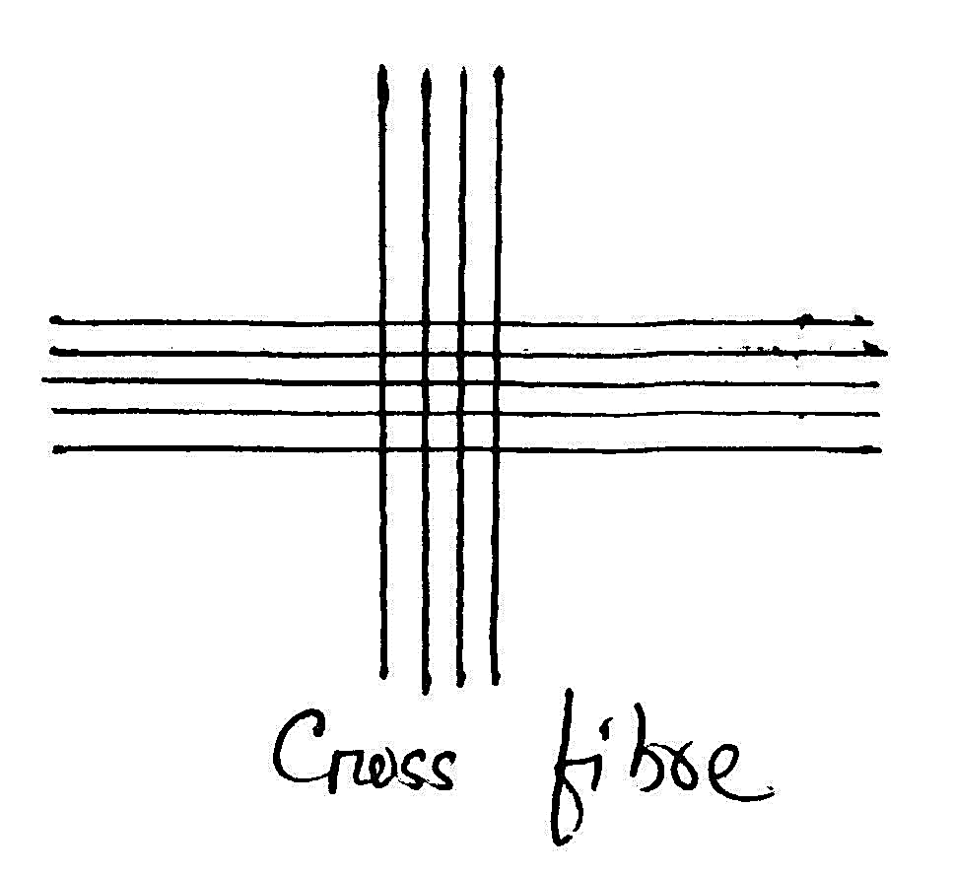
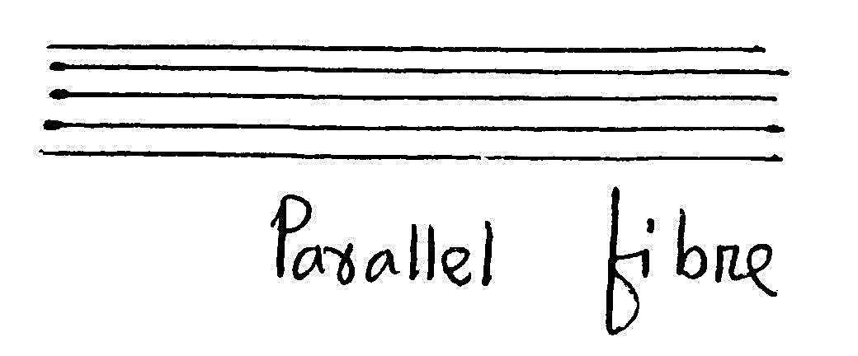
Cross fibres absorb more radiation than parallel fibre
When light passes through the two dichroic fibres, there is a greater total absorption if they are crossed than there is if they are parallel.
This is because, if the fibres are crossed, the first fibre absorbs a large part of one component and the second fibre absorbs a large part of the perpendicular component.
But if the fibres are parallel, the same component is transmitted through both little absorption.

Slide 16
3. Lustre
Lustre is an important property of textile fibres. When a beam of light falls onto a fibre surface, it may be reflected along the angle of reflection.
The reflection may vary with the angle of incidence, with the color and polarization of light.
Lustre of textile fibres will be increased with the increase of regular light reflection.

Slide 17
Factors affecting the lustre of textile fibres
Falling of light on fibre (across the fibre or along the fibre)
Incidence angle of the light
Fibre fineness
Irregularities of fibre surface
Cross-sectional shape of fibre
Amount of small particles (TiO₂) present in fibre
Maturity of fibre

Slide 18
Fibre without (a) and with (2) small particles-TiO₂

Slide 19
Immature and matured fibre

Slide 20
Thank You

