Slide 1
Basic Economics
Chapter 02

Slide 2
Terms and definitions
Three Questions of an Economic Organization or Three Fundamental Problem
Economic System
Microeconomics and Macroeconomics
Three Questions of an Economic Organization
Goods and Services
Cost Concept

Slide 3
Lecture 01

Slide 4
Three Questions/Fundamental Problems of economic Organization
Every society must have to determine what goods are produced, how these goods are made, and for whom these goods are produced. These three fundamental questions of economic organization- what, how and for whom are as crucial now a days.
What goods are produced and in what quantities?
How are goods produced?
For whom are goods produced?

Slide 5
What goods are produced and in what quantities?
A society must determine
  how much of each of the many possible goods and services it will make, and
  when they will be produced.
Will we produce rice or jute in our fields? A few high breed rice or much local rice will produce?
Will we use scarce (Rare) resources to produce many consumption goods?
Will we produce fewer consumption goods and more investment goods(eg:-machine, factory, equipment etc)?
Every society has to face this type of question or problem, We may call this problem as Problem of choice.

Slide 6
How are goods produced?
A society must determine
who will do the production, with what resources, and
what production techniques they will use.
Is electricity generated from natural gas, coal, solar or nuclear power?

Slide 7
For whom are goods produced?
One key task for a society is to decide
Who gets to eat the fruit of the economic efforts or
How is the national product divided among different households?
Are many people poor or rich?
Do high incomes go to teacher, Doctor, Businessman or landlords?
These type of problem is called to be Problem of distribution.

Slide 8
Economic System
Different type of economic system succeeds in different countries of the world. They are -
1. Market Economy
2. Command Economy
3. Mixed Economy.

Slide 9
Market Economy
A market economy is one in which individuals and private firms make the major decision about production and consumption.
In this market consumer are independent.
  What: Firms produce the commodity that yield the highest profit. From here you can get answer of the question What.
  How: Firms use the techniques of production which are least costly. From here you can get answer of the question How.
  Whom: Consumption is determined by individual decisions about how to spend the wages and property ownership. We get the answer of question for whom.
  Example: - In the united states of America most economic question are solved by the market so their economic system can be treated as Market Economy.

Slide 10
Command Economy
A command economy is one in which the government makes all decisions about production and distribution.
Government also owns and directs the operations of enterprise in most industries.
Government is the employer of most workers and tells them how to do their jobs.
In a command economy, government
  decides how the output of the society is to be divided among different goods and services.
  answers the major economic questions through its ownership of resources and its power to enforce decisions.
Example: During the most of the 20th century Soviet Union is operated by Command Economy.

Slide 11
Mixed Economy
In modern society, the rules of market economy or command economy, both are followed and practiced simultaneously.
  Like market economy, here will be private ownership of property, earning of profit and individual initiatives.
  Like command economy, here government has control over the economic activities at the private level.
  Large scale and basic industries and important commercial venture are run in the public sector
Example: Mixed Economy exits in Bangladesh where both market and government plays role simultaneously in production, distribution, consumption etc.

Slide 12
Thank You

Slide 13
Lecture 02

Slide 14
Economic Terms: Micro Vs Macro
Economic analysis is divided into two main branches:
Microeconomics and
Macroeconomics.
Factors that affect a individual, are studied in Microeconomics
and
factors that generally affect everyone in the economy are studied under Macroeconomics.

Slide 15
Microeconomics
Greek word Micro means ‘small’.
Microeconomics is the study of
  The choices and decisions that individuals and businesses make(like an individual firm or an individual consumer),
  The way these choices and decisions interact, and
  The influence, regulation and taxes that governments apply on these choices.
  The goal of microeconomics is to explain the prices and quantities of individual goods and services.

Slide 16
Microeconomics
According to these units, we may see these examples:
Firms(e.g. Cement Factory):
  Demand and Supply of commodities & determination of price by a firm
  Study of costs of producing a good by a firm
  Study of revenue of a firm
  Determining producer's equilibrium (cost & revenue)
Consumers:
  Utility of a consumer : satisfaction from consumption
  Consumer's Equilibrium

Slide 17
Macroeconomics
Macro means Big.
Macroeconomics is the study of total effects on the national economy and the global economy of the choices that individuals, businesses, and governments make.
The goal of macroeconomics is to explain general price level, national income, Employment, Production. Macroeconomics also studies the effect of Government actions-taxes, spending and the defect on total incomes and price level.
Example: Macroeconomic studies the forces that the average cost of living, the total value of production in a country.

Slide 18
Macroeconomics
According to these units, we may see these examples:
Calculation of National Income : GDP(Gross Domestic Product), NNP(Net national product ), GNP(Gross national product ), PPP(Purchasing power parity) etc. Because it includes income of all the residents of a country, not just one individual.
Determination of equilibrium level of output and employment :
  Aggregate Demand and Aggregate Supply analysis.
  Inflation, deflation and controlling the situation
  Employment and unemployment

Slide 19
Macroeconomics
Monetary Policy :
  Money supply
  Interest rates
Fiscal Policy
  Government budget : expenditure and income.
  Taxes and subsidies.
Balance of Payment situation.

Slide 20
Goods and Services
There is a major difference between goods and services.
Goods are basically objects or products which have to be manufactured, stored, transported, market and sold.
  Example: Square Pharmaceutical, BMW, Addidas are some companies manufacturing goods.
Services are output of individuals and they can be collective of individualistic actions or performance by an individual.
  Example: a barber or a chartered accountant is giving individual services.
  A airlines have airplanes which are a product/good but travelling by airplanes is a service (airlines are one of the most competitive service sectors today).

Slide 21
Comparison between Goods & Services
Basis For Comparison | GOODS | SERVICES
Meaning | Goods are the material items that can be seen, touched or felt and are ready for sale to the customers. | Services are amenities, facilities, benefits or help provided by other people.
Nature | Tangible | Intangible
Transfer of ownership | Yes | No
Evaluation | Very simple and easy | Complicated

Slide 22
Return | Goods can be returned. | Services cannot be returned back once they are provided.
Separable | Goods can be separated from the seller | Services cannot be separated from the service provider.
Variability | Identical | Diversified
Storage | Goods can be stored for use in future or multiple use. | Services cannot be stored.
Production and Consumption | There is a time lag between production and consumption of goods. | Production and Consumption of services occurs simultaneously.

Slide 23
Thank You

Slide 24
Lecture 03

Slide 25
Types of Goods
Normal Goods are goods for which demand goes up when income is higher and for which demand goes down when income is lower.
Inferior(Low grade) Goods are goods for which demand falls when income rises.
Substitutes are goods that can serve as replacements for one another; when the price of one increases, demand for the other goes up. Perfect substitutes are identical products. Example: tea and coffee.
Complements are goods that “go together”; a decrease in the price of one results in an increase in demand for the other, and vice versa.

Slide 26

Types of Goods
Some examples of complementary goods are:
Cars and Petrol.
Shoes and Polish.
Computer Hardware and Computer Software.

Slide 27
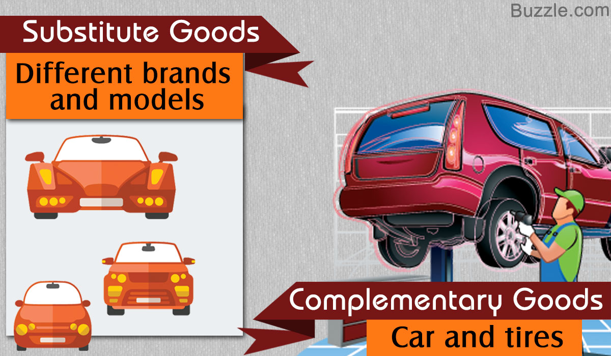
Substitutes & Complements

Slide 28
Consumer Goods & Producer Goods
CONSUMER GOODS: Consumer goods are tangible goods that are purchased for direct consumption to satisfy a human need or want.
Clothing is a purchase of good to satisfy a human need – the need to be clothed.
PRODUCER GOODS/CAPITAL GOODS: Producer goods are (also called intermediate goods in economics) goods manufactured and used in further manufacturing processing or resale. Producer goods either become part of the final product or used in the manufacturing process stream.

Slide 29
Consumer Goods & Producer Goods
The goods used as inputs at the beginning of the production line are capital or producer goods which may include cloth, plastic, or other materials. The good that is produced at the end of production line (the clothing line) is a consumer good. It’s a final end product made for a buyer to consume.
Some goods are both consumer and producer goods. For example, cars are bought by individuals as well as firms, and fuel is used both privately and commercially.

Slide 30
Types of Consumer Goods
  Durable goods and
  Non – durable goods

Slide 31
Durable goods
The goods which tend to have a long useful life. According to the Economics and Statistics Administration, a durable good is expected to last three years.
Example: Furniture, jewelry and cars, large appliance such as stoves and washing machines are durable goods. The category also includes defense and commercial procurement of heavy equipment and assets like aircrafts, trucks and ships.

Slide 32
Non-durable goods
Goods that are consumed in a short time or that have useful lives of less than three years are classified as non- durable.
Example: Food, medicines and other consumable, as well as products that last a limited lifetime such as clothing, shoes and small electronic devices.

Slide 33
Thank You

Slide 34
Lecture 04

Slide 35
Cost Concept
Fixed costs: Fixed cost are that part of the total cost of the firm which does not change with output. Expenditures on depreciation, rent of land and buildings, property taxes, advertising, insurance and office supplies and interest on bonds are example of fixed costs.
A cost that does not change with an increase or decrease in the amount of goods or services produced. Fixed costs are expenses that have to be paid by a company, independent of any business activity.

Slide 36
Cost Concept
Variable Cost: Variable cost is the cost that changes with changes in output. Examples of variable costs are wages and expenses on raw material.
Variable costs are those costs that vary depending on a company's production volume; they rise as production increases and fall as production decreases.

Slide 37
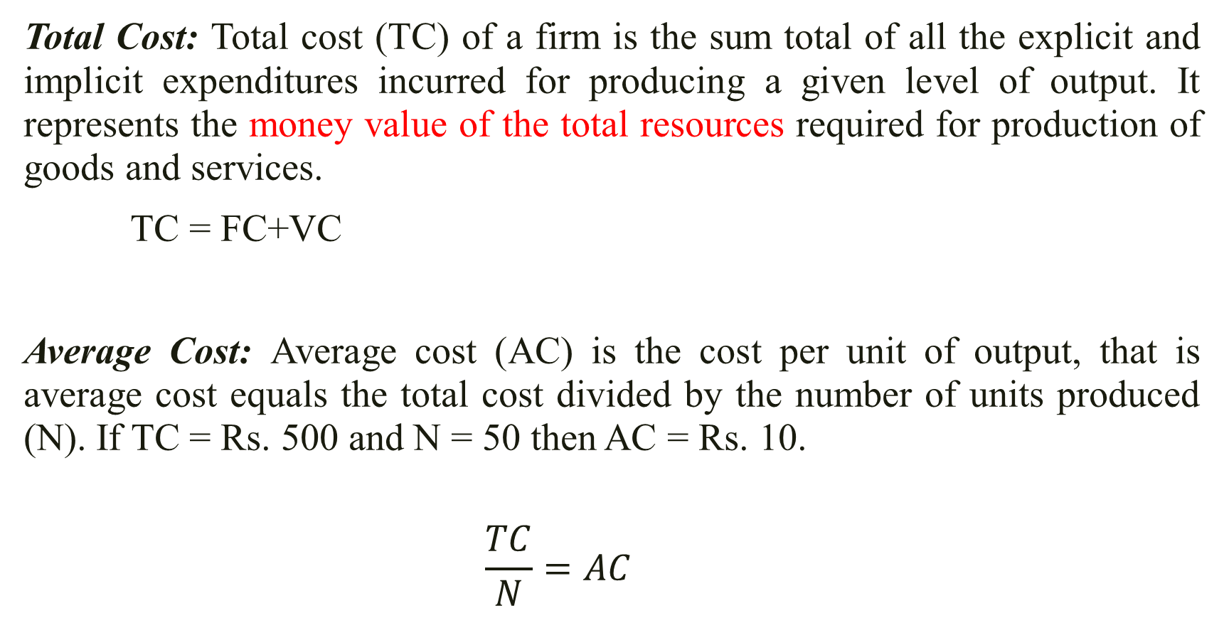
Cost Concept
Total Cost: Total cost (TC) of a firm is the sum total of all the explicit and implicit expenditures incurred for producing a given level of output. It represents the money value of the total resources required for production of goods and services.
TC = FC+VC
Average Cost: Average cost (AC) is the cost per unit of output, that is average cost equals the total cost divided by the number of units produced (N). If TC = Rs. 500 and N = 50 then AC = Rs. 10.
    $$\frac{TC}{N}=AC$$

Slide 38
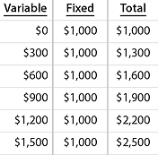
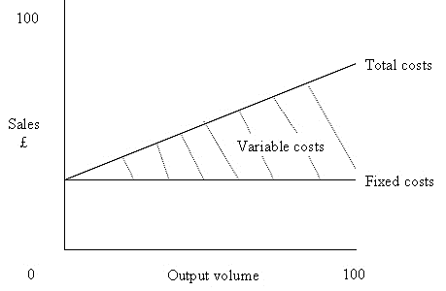
Graphical representation of fixed,variable and total cost

Slide 39
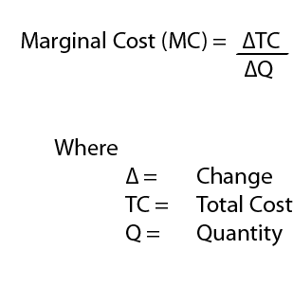
Cost Concept
Marginal Cost: Marginal cost (MC) is the extra cost of producing one additional unit. At a given level of output, one examines the additional cost being incurred in producing one extra unit and this yields the marginal cost.
For example, if TC of producing 100 units is Rs. 10,000 and the TC of producing 101 units is Rs. 10,050, then MC at N = 101 equals Rs. 50. Marginal cost refers to the change in total cost associated with a one-unit change in output.

Slide 40
Cost Concept
Actual Costs: The cost a company pays or is paid for a good or service. The actual cost may be more or less than the estimated cost.
For example, a car shop may estimate that repairs will cost $700, but the actual cost may in fact be $800.
Explicit Cost: An explicit cost is a cost that occurs, is easily identified, and is accounted for in business documents or financial statements.
Examples of explicit costs would be items such as wage expenses, rent, or lease costs. If the company spends $100,000 on employee wages, $50,000 on equipment purchases and $20,000 on inventory, the total explicit costs or accounting costs are $170,000 for the year.

Slide 41
Cost Concept
Implicit Costs: Implicit costs are associated with resources that are provided to the company with no price tag.
For example, if a company operates out of a building it owns, it experiences an implicit cost from the rent it could earn from leasing the building to another company. The building could earn $3,000 a month from a commercial renter, so the company has an implicit cost of $3,000 to add to its economic costs.
Both the explicit and implicit costs of a company are calculated for a fiscal year.

Slide 42
Thank You

