Slide 1
Role of spirituality in public health and/or medical care

Slide 2
Learning objectives
What is spirituality? How spirituality and adaptive coping are linked?
What is spiritual care? What are the ethical and professional boundaries for nurses?
What is religious healing? What are the key types of religious healing practicing in rural Bangladesh?

Slide 3
Religion/Spirituality & Health Beliefs
90% of Americans believe in a higher power; 58% view religion as very important in their lives (Princeton Religion Research Center Report, 1996)
Prayer was second only to medication use among hospitalized adults coping with moderate to high pain (76% vs. 82%) (McNeill et al., 1998)
94% of patients regard spiritual & physical health as equally important
79% believe faith can help people recover (McNichol, 1996)
72% “pray often” for the health of a family member; 52% pray for world peace; 27% for success in careers (Newsweek, 2003)

Slide 4
Definitions
Spirituality : Spirituality refers to a belief in a higher power, an awareness of life and its meaning, the centering of a person with purpose in life. It involves relationships with a higher being, with self, and with the world around the individual.. Spirituality implies living with moral standards.
The spirit of a human is his essence, that part of him or her that is not visible. The part that does not die but is immortal. Webster defines spirit as “ a life giving force” and as the “active presence of God in human life
(National Center of Continuing Education, Inc. Death and Dying, pg. 23)

Slide 5
Definitions conti..
Spirituality is recognized as a factor that contributes to health in many persons. The concept of spirituality is found in all cultures and societies. It is expressed in an individual’s search for ultimate meaning through participation in religion and / or belief in God, family, naturalism, rationalism, humanism and the arts. All these factors can influence how patients and health care professionals perceive health and illness and how they interact with one another.
(National Center of Continuing Education, Inc. Death and Dying, pg. 23)

Slide 6
Religion
Religion is an organized and public belief system of worship and practices that generally has a focus on a god or supernatural power. It generally offers an arrangement of symbols and rituals that are meaningful and understood by it’s followers.
Religion is primarily a set of beliefs, a collection of prayers, or rituals. Religion is first and foremost a way of seeing. It can’t change the facts about the world we live in, but it can change the ways we see those facts, and that in itself can often make a difference.” (Harold Kushner)

Slide 7
Does Religion Make a Difference?
Well-being
Depression
Suicide
Anxiety
Substance abuse

Slide 8
Spirituality
Spirituality fulfills specific needs
Meaning to life, illness, crises, and death
Sense of security for present and future
Guides daily habits
elicits acceptance or rejection of other people
Provides psychosocial support of like-minded people
Strength when facing life’s crises
Healing strength and support

Slide 9
Spirituality
Spiritual Care
Practice of compassionate presence
Listening to patient’s fears, hopes, pain, dreams
Obtaining a spiritual history
Attentiveness to all dimensions of patient & his family: body, mind &spirit
Incorporation of spiritual practices as appropriate
Involve chaplains as members of the interdisciplinary healthcare team

Slide 10
What is spiritual care mean ?
Spiritual care is recognizing and responding to the multifaceted expressions of spirituality we encounter in our patients and their families. The purpose is to determine the nature of a person’s relationship to God and other people, and to give the person the opportunity to accept spiritual support. Themes such as the search for meaning, feelings of connection or isolation, hope or hopelessness, and fear of dying are all clues that a person is struggling with spiritual issues. (Chaplain Loyal Ward)

Slide 11
Current Trends
How prominent is Religion/Spirituality (R/S) in daily lives of general population?
How common is it to connect R/S and perceptions of health and recovery?
What are the relationships between R/S and physical/mental health?
Should R/S be addressed in medical care setting?
How spiritual Healing works?

Slide 12
How spiritual Healing works?
In spiritual healing practice, people are said to be
cured by the communication of human media with
diverse sacred spirits and pious ancestors; often they
are offered torturous treatments, along with incantations to drive away the imaginary evil spirits or effects of sorcery or avaricious and malicious characters. Spiritual healers are locally called Boiddya.
The spiritual healers offer services
for all spiritual problems, such as embodiment of evil entities, black magic or effect of sorcery, complexity
in going abroad, infertility, resolving family disputes or village conflicts. They even often treat the chronic and
complex diseases of patients, who returned from modern
medical centers with treatment failure.

Slide 13
How spiritual Healing works?
In most cases spiritual healers are women. The healers in this system also first tried to diagnose the disorders in meditation, uttering some words/rhymes in Hindi tunefully, and begged assistance from ‘Ma’ (particular sacred spirits calling them as ‘Mother’) and other pious ancestral spirits to diagnose the problem and cure a person.
The healers tunefully ask the patient’s name, context
of the problems, and then diagnosed the types of difficulties
and the necessary background at time of meditation.
These healers offered their healing services Saturday and Tuesday only. Although the diagnosis and consultation fee is small, the spiritual healing required a list of treatment instruments, which make the treatment implicitly expensive, sometimes even more expensive than the modern diagnosis and treatment procedures.

Slide 14
How spiritual Healing works?
Majority of the patients in spiritual healing are also
women. Although the healers in this system work usually
with the assistance of spirits and gods, they showed
their charisma to the patient, perceiving his/her personality.
If most of the descriptions of the disorder were
similar with the patient’s reality, he/she delightedly say,
‘yes, yes’, ‘Boiddya is right’.
Spiritual healers believed that not everyone may get such a supernatural power without having some human attribution, and a person would never be eligible to assimilate the spiritual power
of healing if the gods or other pious ancestral sprits did
not like him/her.

Slide 15
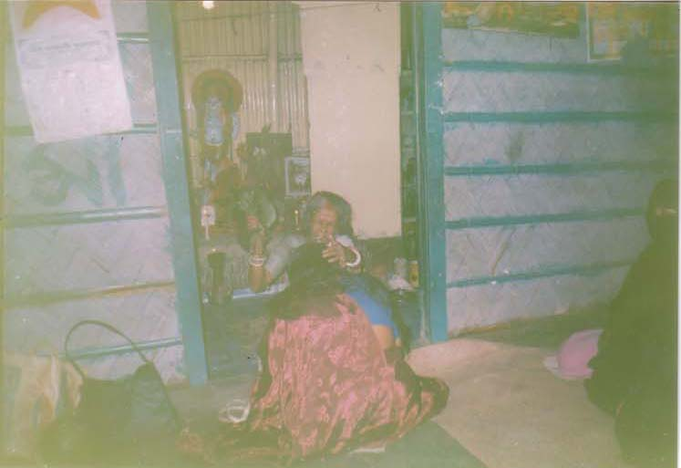
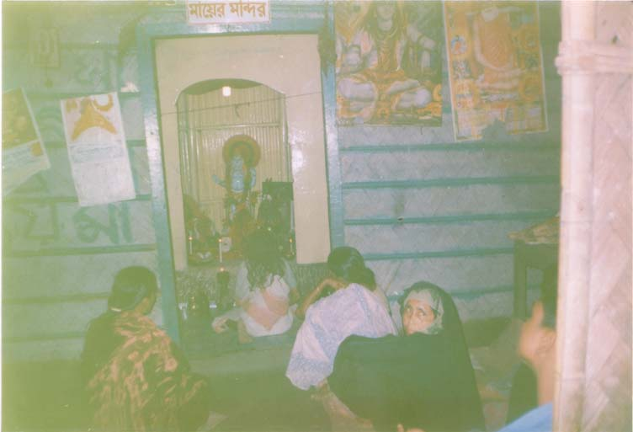
How spiritual Healing works?
Even though the spiritual
healing system is a bit expensive to pursue in the rural context, a good number of people are found to come to the spiritual healers on healing days (Saturdays and
Tuesdays). Candidates for spiritual healing considered this practice to be fruitful based on unquestionable faith.
For more:
(https://www.researchgate.net/publication/323213960_Traditional_healing_practices_in_rural_Bangladesh_A_qualitative_investigation)

Slide 16
Religious beliefs and practices:
Religious beliefs and practices are associated with;
Lower suicide rates
Less anxiety
Less substance abuse
Less depression and faster recovery from depression
Greater well-being, hope, and optimism
More purpose and meaning in life
Higher social support
Greater marital satisfaction and stability
Featured CME Topic: Spirituality Religion, Spirituality, and Medicine: Research Findings and Implications for Clinical Practice Harold G. Koenig, MD

Slide 17
The Meaning of Illness
Illness can create an existential crisis (Why?)
Raises questions about meaning, values, relationships
Illness disrupts routines, forces change (financial, geographical, interpersonal)
Many/most rely on religious or spiritual beliefs
Framework to understand and respond
Hope through rituals
Integration of caring relationships, higher meaning

Slide 18
Link of Spirituality & Adaptive Coping
Provides emotional comfort
Finding strength in the face of ongoing pain
Linking individuals to caring communities that provide social roles and intimacy
Activities result in calming, relaxing response
Encourages/facilitates better self-care
Connecting with a higher power offers unique physical & mental benefits (Keefe et al., J of Pain, 2001)

Slide 19
Research in Spirituality and Health
• Pain questionnaire by American Pain Society to hospitalized patients
Personal Prayer is the most commonly used non-drug method for pain management:
- Pain Pills 82%
- Prayer 76%
- Pain IV med 66%
- Pain injections 62%
- Relaxation 33%
- Touch 19%
- Massage 9%
McNeil, JA et al. J of Pain and Symptom Management. 1998: 16(1) 29-40

Slide 20
Reassurances that gave comfort
89% Believing that you will be in the loving presence of God or a higher power
87% Believing that death is not the end but a passage
87% Believing that part of you will live on through your children and descendants
85% Feeling that you are reconciled with those you have hurt or who have hurt you (George H. Gallup International Institute. “Spiritual Belief and the Dying Process)
.
Gallup survey key findings:

Slide 21
US have faith on healing power and prayer.
82%: believe in the healing power of prayer
64%: feel MDs should pray with those patients who request it
63%: want MDs to discuss matters of faith
99% of MDs say religious beliefs can make a positive contribution to the healing process
Scientists are realizing that a personal spiritual relationship helps us make sense out of illness. It gives hope
It changes healthy behavior and reduces the risk of disease

Slide 22
Article: Religious and Spiritual Beliefs & Practices in Medicine: An Evaluation in a Tertiary Care Hospital in Malaysia Authors: RM Yousuf, ARM Fauzi, SFU Akter, SMS Azarisman, OA Marzuki)

Slide 23
Abstract
Back ground: In recent years there has been growing awareness regarding the role of religion and spirituality (R/S) in the practice of clinical medicine. Despite hundreds of articles in professional journals on the subject, little is known about physician beliefs regarding the influence of religion on health
Objectives: The study aim to assess the beliefs and observations of physicians regarding the role of R/S and patient’s health and whether they address such issues in their clinical practice. Concomitantly, we aim to assess the beliefs of our patients and whether they like to address such issues

Slide 24
Abstract
Methods: Questionnaire was based on a cross sectional survey among hospitalized patients and their treating physicians.
Result: Nearly all patients and physicians reported a high prevalence of religiosity. Patients also acknowledged that their R/S was respected by the staff, and that physicians inquired R/S about half of the time. R/S was described as beneficial as it enabled patients to cope better with their illness and gave them a positive state of mind.
Conclusion: Religion is important to many patients and physicians, but half of the physicians ignore it in their clinical practice. Physicians need to be attentive to patients R/S issues and address them in specific clinical situations.

Slide 25
Spiritual Needs
• May be dynamic in patient understanding of illness
• Religious convictions / beliefs may affect healthcare decision-making
• May be a patient need
• May be important in patient coping
• Integral to whole patient care

Slide 26
Five basic spiritual needs of every person:
A meaningful philosophy of life (values & moral sense).
A sense of the transcendent (outside of self, view of God and something beyond the immediate life, having hope.)
A trusting relationship with God (faith).
A relatedness to nature & people (friendship), experiencing love & forgiveness.
A sense of life meaning.

Slide 27
The nurse’s role in spirituality
Define your own philosophy of life and death. What do you believe? What does human life mean to you? What does death mean? Is there life beyond? Is there a God? Is there a Heaven and a Hell?
You must be comfortable and confident in what you believe in order to help others. Or you will be threatened and fearful when confronting death and dying in your patients.
Identify your emotional and physical limitations.

Slide 28
Ethical & professional boundaries for the nurses
Spiritual History: patient-centered
Recognition of pastoral care professionals as experts
More in-depth spiritual counseling should be under direction spiritual leaders
Praying with patients

Slide 29
8 Dimensions of patient assessment
Illness / treatment summary
Physical /Psychological
Decision making
Communication
Social
Spiritual
Practical
Anticipatory planning for death

Slide 30
A Spiritual Inventory might include questions about:
The patient’s perception of what is going on.
What gives meaning and purpose to life?
How, or whether belief and faith enter in.
Love: By whom do you feel loved-accepted?
Forgiveness--need it? Do you need to grant it to others?
Prayer--What do you pray for?
Quiet and meditation--What helps get you on center?

Slide 31
Spiritual assessment
Spiritual assessment should, at a minimum, determine the patient’s denomination, beliefs, and what spiritual practices are important to the patient
This information assists in determining the impact of spirituality, on the care and services being provide, and will identify if further assessment or services are needed
An integral part of a patient’s initial assessment should include data about the patient’s spiritual and religious beliefs
Several tools exist for spiritual assessment
Spiritual care needs to be individualized, with the patient given the opportunity to participate

Slide 32
Spiritual History
Taken at initial visit as part of the social history, and at follow-up visits as appropriate
Recognition of cases to refer to chaplains
Opens the door to conversation about values and beliefs
Uncovers coping mechanism and support systems
Reveals positive and negative spiritual coping
Opportunity for compassionate care

Slide 33
Spirituality and medical care in Bangladesh
Name of Diseases | Patterns of traditional healing | Key actors

Slide 34
Religion, Spirituality, and Medicine: Research Findings and Implications for Clinical Practice
Abstract: A growing body of scientific research suggests connections between religion, spirituality, and both mental and physical health
The findings are particularly strong in patients with severe or chronic illnesses who are having stressful psychological and social changes, as well as exist struggles related to meaning and purpose
Recent studies indicate that religious beliefs influence medical decisions, such as the use of chemotherapy and other life-saving treatments, and at times may conflict with medical care.
This article addresses the ways physicians can use such information. Spirituality is an area that makes many physicians uncomfortable, since training in medical schools and continuing medical education programs are limited.

Slide 35
Religion, Spirituality, and Medicine con..
Not only do most physicians lack the necessary training, they worry about spending additional time with patients and overstepping ethical boundaries.
While these concerns are valid, each can be addressed in a sensible way. Taking a spiritual history, supporting the patient’s beliefs, and orchestrating the fulfillment of spiritual needs are among the topics this article will address.
The goal is to help physicians provide medical care that is sensitive to the way many patients understand and cope with medical illness.

Slide 36
Thanks!

