Slide 1

Globalization and Health
Dr Sanjana Zaman, MBBS, Ph.D (Japan)

Slide 2
Globalization - broader definition
Globalization can be defined as processes that are changing the ways in which people interact across boundaries, notably physical (such as the nation-state), temporal (such as instantaneous communication via email), and cognitive (such as cultural identity). The result is a redefining of human societies across many spheres, economic, political, cultural, technological and so on.
As such, globalization affects the health of different people in very different ways. How good or bad globalization happens to be for you will be influenced by socioeconomic status, sex, education, age, geographical location, and other factors.
Lee, K et al. BMJ 2002;324:44 ( 5 January )
»

Slide 3
What is globalisation?
A couple of deﬁnitions:
‘the flow of information, goods, capital and people across political and economic boundaries’ (Daulaire 1999)
‘the process of closer interaction of human activity across a range of spheres, including the economic, social, political and cultural, experienced along three dimensions: spatial, temporal and cognitive (Lee, K 2002)

Slide 4
Effect of Globalization
This point brings us to the final issue of major debate on globalization—whether the resultant changes are having positive or negative impacts on human societies and the natural world.
Globalization is having diverse effects on a wide range of social spheres, including the economic, political, cultural, technological, and environmental realms.
These effects are creating both positive and negative impacts. Individually, each of us gains and loses from specific aspects of globalization. The Information Revolution has given us 24-hour access to news, entertainment, and personal messages, but at the expense of our ability to switch off and enjoy down time.

Slide 5
Effect of Globalization
The globalization of the food industry has potentially diversified our diets by, for example, offering access to fresh fruits and vegetables throughout the year.
In contrast, for the relatively disadvantaged in terms of socioeconomic status, education, geographical location, race, and gender, the net balance between gains and losses from globalization can tip more toward the negative. As well as being less able to enjoy its benefits, they shoulder a relatively heavier burden of its costs. Lower wages, greater insecurity sometimes evolved with it.

Slide 6
Globalization
Positives
  Offers exciting opportunities for entrepreneurs and all citizens
Negatives
  Could lead to domestic job loss, exploitation of workers in the third world nations, and environmental problems.
We will be exploring the wonders that globalization does in the Healthcare industry.

Slide 7
What is Global Health?
Health problems that transcend national boundaries, that may be influenced by circumstances or experiences in other countries, and that are best addressed by cooperative actions, and solutions whether they occur in developing countries, countries in advanced transition or industrialized countries“ (UNC-CH, 2007, p.3)
Global Health issues:
  Health Disparities: mortality &morbidity of poor
  Infectious Diseases More effective health care Systems
  Tobacco addiction
  Q What other issues can you identify?

Slide 8
Global Health Inﬂuences
Changing Conditions
Increased Travel
Climate Change
Transmission of infectious diseases
Common Needs
Interdependency
Health impact of conﬂict
Epidemiological Transition

Slide 9
Public health & Globalisation
Public health in globalising world
Domestic action alone insufficient
Health achievements critical to international development goals

Slide 10
Public health & Globalisation
      Public Health
      Definition: the organized local and global efforts to prevent death, disease and injury, and promote the health of populations.
      Goals: Improve population health;
Reduce health inequalities.

Slide 11
The health impact of Globalization
Globalization, in its economic, temporal, communicative and cultural forms can have an inﬂuence on the social context that inﬂuences health status.
Improvements in communication, travel and the opening up of economic markets inﬂuences local and regional political relations.
Here are a few examples of health related changes linked to globalization

Slide 12
Globalisation and health
Openness
Cross border
flows technology
National Policies
Regional/global rules
and institutions
Level and
Education
Health
Health
distribution
Water
risks
systems
of
Energy
household
Transport
income
Other sectors
GCP/HSD June 2000
Health
Outcomes

Slide 13
The Growing Impact of Globalization for Health and Public Health Practice
In recent decades, public health policy and practice have been increasingly challenged by globalization, even as global financing for health has increased dramatically
The globalization and its health challenges from a vantage of political science, emphasizing increased global flows (of pathogens, information, trade, finance, and people) as driving, and driven by, global market integration
Several globalization-related pathways to health exist i.e globalized diseases and economic vulnerabilities

Slide 14
Globalization is associated with a no of flows that have direct and indirect effects on health
Increased pathogen flows: Whether it is the risk of drug-resistant tuberculosis or pandemic influenza, the movement of people means the transport of pathogens. SARS was a wake-up call to a somnambulant public health community and the spark for new International Health Regulations and multilateral health collaborations. Global trade, another ancient vector of disease, poses other health risks, from the spread of pests to that of pestilence:

Slide 15
Globalisation & Public health
Global risks for health
  Exclusion from global markets
  Private ownership of knowledge
  Migration of health professionals
  Cross border transmission of disease
  Environmental degradation
  Conflict
Global opportunities for health
  Inclusion/ connection
  New market incentives for R&D
  New resources for effective interventions
  Knowledge dissemination
  New rules to control cross border risks

Slide 16
Globalisation & Public health
Public health crisis in developing countries
  Poverty (2.5 billion), debt,
  Inequalities in health and welfare
  Population growth (80 million)
  Double burden of disease: HIV/AIDS; TB Malaria
  Weak public health infrastructure
  Public Health sector reform
WHO’s response
  Strategic directions
  Priority for: diseases of the poor; tobacco
  Support for national health systems
  New: Partnerships and relationships;
  Resources;
  Rules;
  Optimism.

Slide 17
Public health & Globalisation
Without doubt, globalization poses risks to global health, but it also provides benefits. The extraordinary improvements in information technology have dramatically increased the speed and ease of data flow, thereby facilitating the sharing of information
Medical discoveries made in one country can be made nearly instantaneously available to patients in other countries
Although many non-governmental organizations (NGOs) decry the negative effects of increasing globalization, they have also clearly benefited from it to improve healthcare delivery and health policy in many developing countries

Slide 18
Medical Attention: People Are Seeking
Cosmetic surgery
Cardiac surgery
Dental procedures
Bariatric surgery
Assisted reproductive
Technology
Ophthalmologic care
Orthopedic surgery
Organ and cellular transplantation
Gender reassignment procedures
Executive health evaluations

Slide 19
Public health & Globalisation
Globalization has also brought about improvements in research methodology, and some argue that clinical research has become more sophisticated as a result .
Other benefits of globalization include cross-border use of health services that benefit patients and provide much needed resources .
As the major international agency dealing with global public health issues, the WHO—together with other international organizations—has an important role in mitigating the health risks posed by globalization.

Slide 20
Public health & Globalisation
Globalisation, trade and health
A policy, research and training programme
Develop knowledge and skills
Promote policy coherence
Contribute to: global public goods for health, global health funds, international rules for health

Slide 21
Public health & Globalisation
One major problem is the increasing internationalization of health risks.
Although increasing trade is certainly good for economies, it also leads to a globalization of health risks. Important examples of such risks include:
tobacco, alcohol, global epidemics of non-communicable diseases;
trade in health services like marketizing different family planning methods in developing countries;
medical consultation via internet but often misled by wrong information;
patients’ travelling abroad to receive health care;
The international movement of health personnel across borders.

Slide 22
Public health & Globalisation
The developing countries are at particular risk, as industrialized countries increasingly ban cigarette advertisements and tobacco companies intensively target people in poorer nations as potential customers.
However, unlike tobacco use, the impact of alcohol consumption on health is much more complex. Still target group is poorer population. There is a strong relationship between alcohol consumption and liver cirrhosis, some cancers, and most causes of injuries and violence.

Slide 23
Public health & Globalisation
People in the developing countries are rapidly being habituated with fast food
Due to effect of advertising of food products like:
Convenience foods are
easy, fast, and, well,
convenient!
Obesity and health related problems are commonly appeared

Slide 24
Public health & Globalisation
Like Dr Dolittle’s “push-me-pull-you”, it is unclear at present in which
direction globalization will lead us.

Slide 25
Winners and Losers
Winners
Transnational Corporations
Wealthy Developed Countries
Countries with large low paid workforce (China, India)
Losers
Geographically Isolated Poor Countries
Low paid workers
Developing Countries
Politically Isolated Countries

Slide 26
Public health & Globalisation
71% of Americans agreed that culture diversity was a major reason for America’s success.
US culture is now penetrating every continent (Free Higher Education for Public)
Pollution of the Environment. E.g cars, factories, Aerospace industry, where USA found always number # 1 in carbon remission among all the countries in the world.
Migration of people and companies due to high costs of labor contribute to spread differed diseases

Slide 27
Aspects of Globalization that may effect Health
General effect on health from changes in national economic growth–link between ‘health and wealth’
Environmental degradation (e.g. air, water pollution)
Improved access to knowledge and technology
Marketing of harmful products & unhealthy behaviours
Conflict & security
Cross-border transmission of disease

Slide 28

Globalization Of Health From Below
“Massive poverty and obscene inequality are social evils, like slavery and apartheid”
- Mandela, 2005

Slide 29
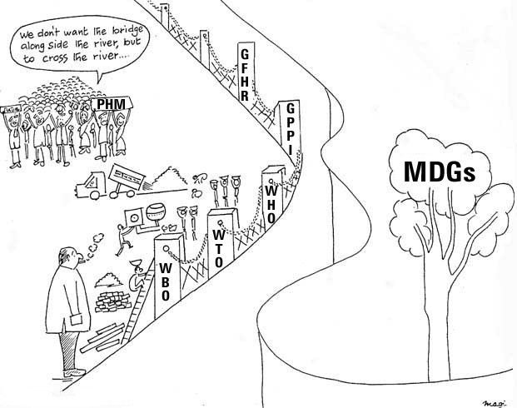
Globalization Of Health From Below
Increasing Poverty and inequality ….. The greatest obstacle to Health for All and the Millennium Development Goals
Poverty / Inequality

Slide 30
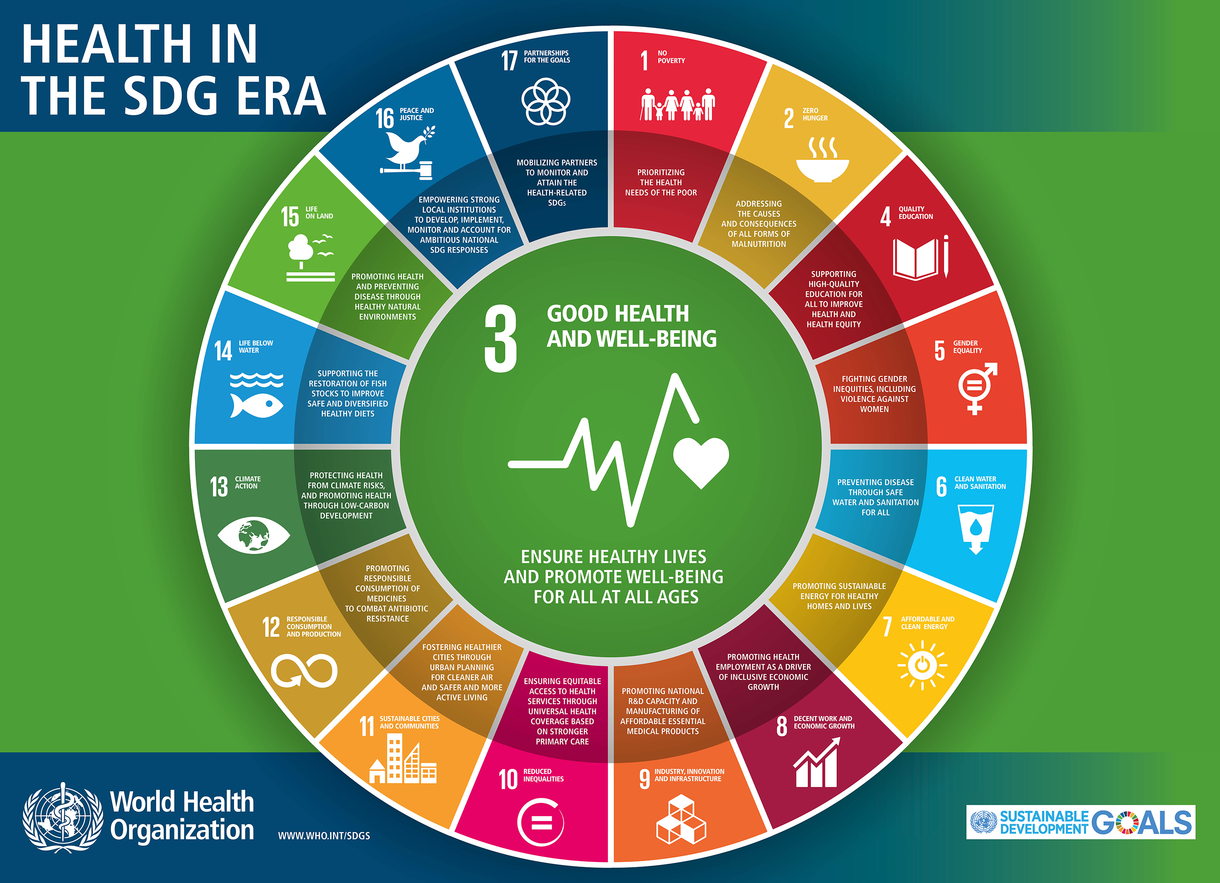
Globalization and SDGs (by 2030)
https://www.who.int/sdg/en/

Slide 31
Globalization Of Health From Below
Conceptual significance of PHM – globalization of health from below
“Development requires the removal of major sources of unfreedom; poverty as well as tyranny, poor economic opportunities as well as systematic social deprivation, neglect of public facilities as well as intolerance or over activity of repressive states .. The contemporary world denies elementary freedoms to vast numbers of people – perhaps even the majority of people.”
- Amartya Sen, 1999

Slide 32
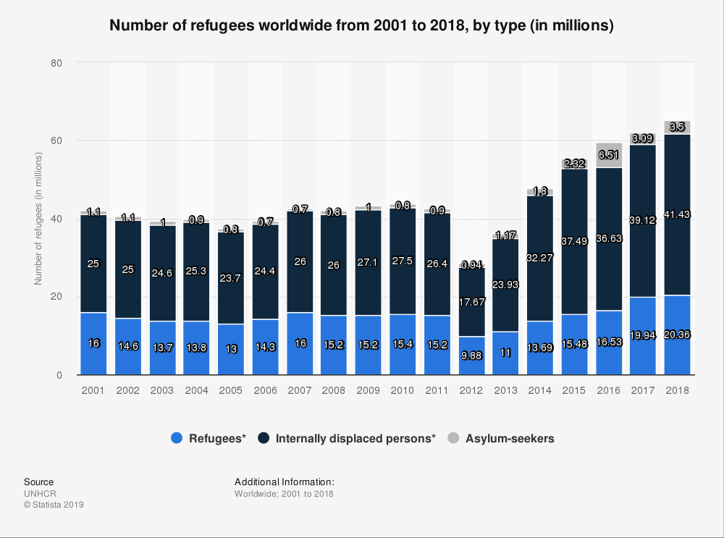
Growth in the Number of Refugees
30

Slide 33
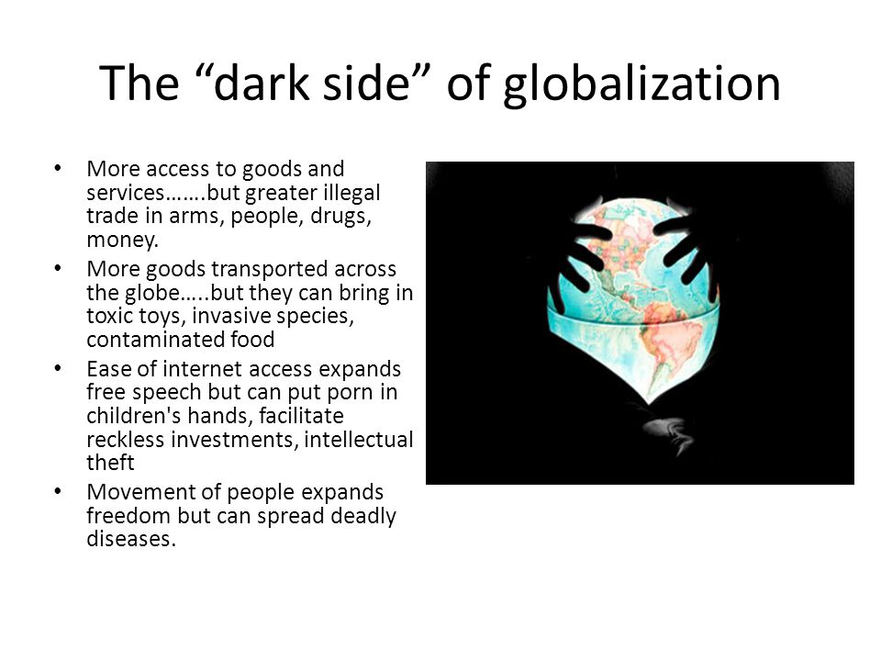

Slide 34
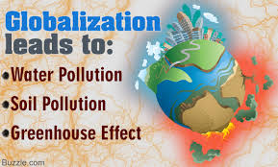
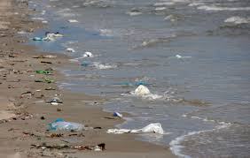

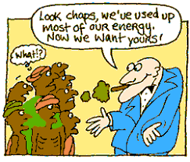

Slide 35
Burden of Disease (DALY’s)
1990 | 2020
Lower respiratory infections | Ischaemic heart disease
Diarrhoeal Diseases | Depression
Perinatal conditions | Road Trafﬁc Accidents
Depression | Cerbero-Vascular Disease
Ischaemic Heart Disease | Chronic Obstructive Pulmonary Disease
Cerebro-Vascular disease | Lower Respiratory Infections
TB | War
Measles | Diarrhoeal Diseases
Road trafﬁc accidents | HIV
Congenital Abnormalities | Perinatal conditions

Slide 36
References
Daulaire N (1999) Globalization and Health Development 42: 4;22 – 24
Lee K (2000) Globalization and health policy: a review of the literature and proposed research and policy agenda In: Health Development in the New Global Economy PAHO: Washington
WHO www.who.int/topics/global_burden_of_disease/en/

Slide 37

Health in All, Now !
https://www.who.int/healthpromotion/frameworkforcountryaction/en/
JOIN US THANK YOU

