Slide 1
Health systems and financing in a global perspective
Dr Sanjana Zaman, MBBS, Ph.D (Japan)

Slide 2
Outline of the Session
Definition of health system
Conceptual frameworks that help think
about health systems as basis for action
Financing in health system

Slide 4
Health System
Health
Beyond sickness
Physical, mental and social wellbeing
Beyond the individual
all agents promoting health & wellbeing
domestic/national & international factors
A system is
Any collection of related
parts (infrastructure, organizations, materials and people) that interact in an organized way for a purpose

Slide 6
Health System Definition
This definition includes the full range of players engaged in the provision and financing of health services including the public, nonprofit, and for-profit private sectors, as well as international and bilateral donors, foundations, and voluntary organizations involved in funding or implementing health activities.
Health systems encompass all levels:
central, regional, district, community, and household. Health sector projects engage with all levels and elements of the health system and frequently encounter constraints that limit their effectiveness.

Slide 7
Basic health system framework
INPUTS & PROCESSES
Governance
OUTPUTS
Service delivery
efficiency
access
availability
affordability
acceptability
quality
safety
IMPACTS
Finances
Improved
OUTCOMES
survival
nutrition
equity
Human resources
Increased
effective coverage
responsiveness
Medicines,
technologies & infrastructure
Reduced
morbidity
impoverishment due to health expenditures
Information
OTHER DETERMINANTS OF HEALTH
(Economic, Social, Political, Environmental)
Modified from: WHO Everybody’s business, 2007 & Health Metrics Network Framework, 2008

Slide 8
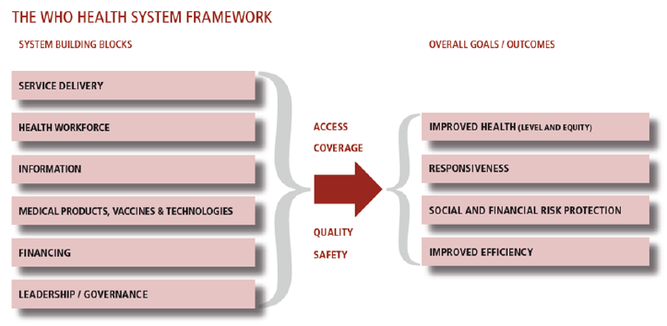
WHO’s Health system framework

Slide 9
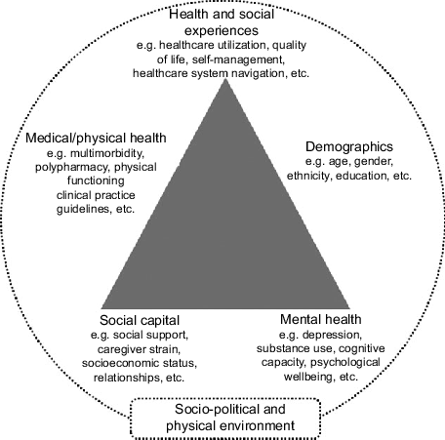
Understanding the Complexity of Health System
The Complexity of any health system Framework:
It includes five health dimensions

Slide 10
Characteristics of all complex systems
And ….
nest sub-systems within them
but are part of larger systems

Slide 11
Self-organising &
Constantly
changing

Slide 12
Tightly linked
Medicines & Technologies building block – Tanzania 2007
ESSENTIAL MEDICINES | ARVs |  | MALARIA |  | TB |  | OI |  | ARVs Ped
REAGENT Blood safety (+ HIV test) |  | VACCINES |  | CONDOMS |  | ONTRACEPTIVES | MEDICAL SUPPLIES
C
GOVERNMENT
BILATERAL DONOR
MULTILATERA L DONOR
NGO/PRIVATE
C S N C S W I O I S H D R D C O A A A
D
U N I T
H A V A R D
P
C L I N
A P
X F
I I O Z
S E
R
J I C A
C D C
C
A B B O T T
G A V I
C U A M M
U N I C E F
U S A I D
W B
E
GLOBAL
FUND
L U M B I A
Source Of Funds
P
GOVERNMENT
F
I D
A
O N
R
Procurement
TEC
& CCT
C L I N T O N
H A V A R D
MEDICAL
STORE
C R S
S C M S
E G P A F
MOH
& SW
A X I O S
U N I C E F
J I C A
C O L U M B I A
A B B O T T
G A V I
C U A M M
CROWN
U S A I D
T M A P
Agent/Body
C D C
AGENTS
Point of 1st
TEC
&CC T
HOSPITAL
CRS IMA
MEDICAL STORE
AXIOS HEALTH FACILITY COLUMBIA
HOSPITAL
CUAMM
warehousing
Point of 2nd
TEC
&CC T
REGIONAL/DISTRI CT
VACCINE STORE
ZONAL MEDICAL STORE
HEALTH FACILITY
HOSPITAL
warehousing
Point of Distribution
TEC
&CC T
ZONAL BLOOD
DISTRICT STORE HEALTH FACILITY PRIMARY HEALTH CARE FACILITY
HOSPITAL
SAFETY CENTRE
PATIENT

Slide 13
Health System is Dynamic and Interconnected with People
‘It is the multiple relationships and interactions among the building blocks ... that convert these blocks into a system’
Source: de Savigny and Adam (2009)

Slide 15
Functions of health financing systems

Slide 16
Health Care Financing
Financing is the most critical of all determinants of a health system:
WHO – “function of a health system concerned with the mobilization, accumulation and allocation of money to cover the health needs of the people, individually and collectively, in the health system”
To ensure that all individuals have access to effective public health and personal health care

Slide 17
Functions: Health Care Financing
The functions of health care financing are to ensure that:
- resources are mobilized or collected
- they are pooled and managed in a risk-sharing perspective
- health care services are purchased by the relevant organisms, individuals or health care centers
These 3 functions can be carried out by a single organization but most of the time, they are shared among several organizations:
- the State
- social security systems
- optional private insurance schemes

Slide 18
Functions: Health Care Financing (Contd..)
The financing of health care systems consists of a range of instruments to achieve certain goals:
Improve the health of the majority
Allow health care production adapted to needs
Further equity in funding and access to health care
Improve quality
Control costs
Contribute to the allocative and technical efficiency of the system

Slide 19
Principles of a health financing system
Revenue collection
Have to be collected equitably
and efficiently
Pooling
costs of health care are shared by
all and not borne by individuals
Used to buy or provide health interventions that are allocatively and technically efficient
Purchasing

Slide 20
Action 1: Establishing the vision
Action 7: Monitoring and Evaluation
Action 2: Situational analysis
Decision Process of Health Financing
Action 6: Implement ation
Action 3: Financial assessment
Action 5: Strategy for change
Action 4: Constraint assessment
Source: Health systems financing-The path to universal coverage - WHO

Slide 21
Sources of health care financing
The tax-based public sector
Out of Pocket Expenditure
Insurance- social, community- based, private
External financing

Slide 22
Different financing methods available
and organization of the financing systems
Financing Systems
Methods of public financing
Methods of private financing
External financing
“Aid”
Internal financing
User
payments
For-profit
or
Non-profit private insurance
Medical savings voluntary
or compulsory
Social contributions employers employees
Social insurance systems (illness)
Public systems of health services
Unified System
Fragmented System

Slide 23
Later in the Course:
Budgeting in Health Care System and Health Care Financing

Slide 24
Source: Health Systems Financing- Toolkit on monitoring health systems strengthening, WHO

Slide 25
Conclusion
Countries should move forward and faster to develop equitable and efficient institutional structures, revenue- raising mechanisms and spending prioritizations
To become more efficient and equitable in the use of resources
Need for constant re-evaluation and adjustment

Slide 26
References
Balwar R, Vaidya R, Tilak R, Guptha RK, Kunte R. Textbook of Public Health and Community Medicine. 1st ed. Department of community medicine, AFMC, Pune in collaboration with WHO India office.New Delhi (India); 2009. p.
Schieber G, Baeza C, Kress D, and Maier M. Financing Health Systems in the 21st Century [online] 2006 [Cited on 2016 Jun 2]
];Available from:URL:
http://www.ncbi.nlm.nih.gov/books/NBK11772
Health Systems Financing - Toolkit on monitoring health systems strengthening. World Health Organisation [Online] 2008 [Cited on 2016 Jun 4];Available from:URL:http://www.who.int/healthinfo/statistics/toolkit_hss/EN
_PDF_Toolkit_HSS_Financing.p₆d_{/2}f_{0/2016}

