Slide 1
Gender and Global Health (Violence & Injuries)
Dr Sanjana Zaman, MBBS, Ph.D (Japan)

Slide 2
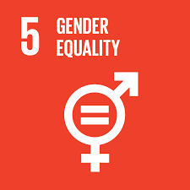
Class outline
Definition of Sex and Gender
Definition of violence
Gender based violence and why is GBV/VAW a global issue
Health impact of violence.
Types of cost for gender based violence

Slide 3
Gender Inequality - Facts
Globally, 750 million women and girls were married before the age of 18
At least 200 million women and girls in 30 countries have undergone FGM.
The rates of girls between 15-19 who are subjected to FGM (female genital mutilation) in the 30 countries. In some African countries nearly 100% of women and girls have undergone some forms of FGM. Djibouti 97%, Somalia 98%
1 in 5 women and girls, including 19% of women and girls aged 15 to 49, have experienced physical and/or sexual violence by an intimate partner within in a year.

Slide 4
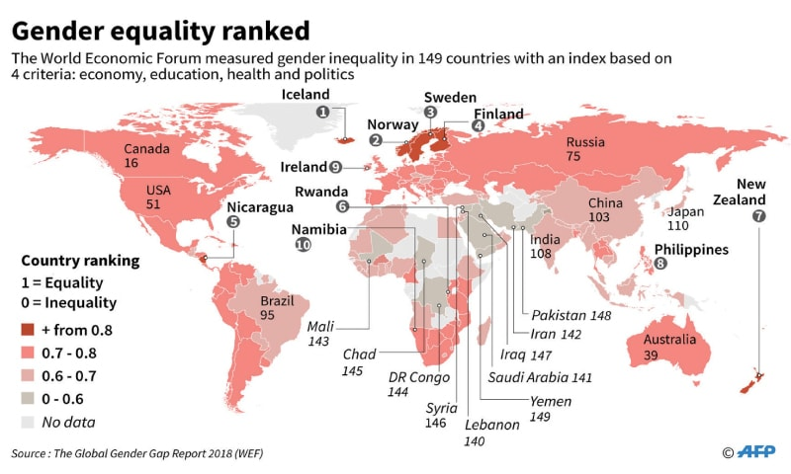

Slide 5
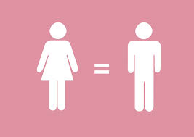
Definition
Gender: A social term that refers to different roles, responsibilities, perspective, behaviors and status of women and men that are determined by the society and culture. This role may vary from country to country or within countries, can also change over time
Sex: Biological differences between women and men which are unchangeable (without considerable surgery)

Slide 7
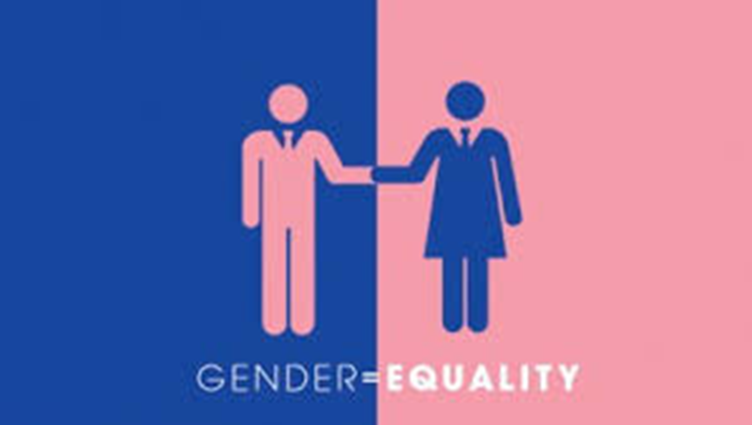
Definition
Gender equality means that women & men and girls & boys enjoy the same rights, resources, opportunities and protections. (Education, employment, health, political participation, safety and justice). Its also fundamental human rights

Slide 8
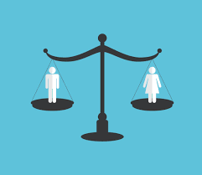
Definition
Gender Equity is the process of allocating resources, programs and decision making fairly to both males and females without any discrimination on the basis of sex. It also addressing any imbalances in the benefits available to men and women.
To address the equality often requires women-specific needs projects and programs to end existing inequities

Slide 9
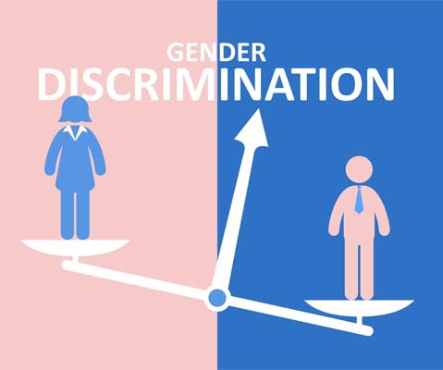
Gender Discrimination
Gender discrimination refers to any distinction, exclusion or restriction made on the basis of socially constructed roles and norms which prevents a person from enjoying full human rights.

Slide 10
What are the challenges
The goal of achieving equality between women and men is based on principles of human rights and social justice.
Empowerment of women is more over a prerequisite for achieving people centered development
The abolition of poverty can not be achieved until men and women have equal access to the resources and services necessary to achieve their individual potential and fulfil their obligations to household, community and, more broadly society.

Slide 11
Gender issues in health
Access to healthcare facilities
Cultural norms and practices (Lower status/social value in the hh)
Son preference
Violence and abuse
Poverty
Female Genital Mutilation (FGM)
Lower education and awareness or access to information
Discrimination in the health facilities
Public health issues like violence, alcoholism, smoking

Slide 12
What is violence
Violence is the use of physical force to injure people or property. Violence may cause physical pain to those who experience it directly, as well as emotional distress to those who either experience or witness it. Individuals, families, schools, workplaces, communities, society, and environment all are harmed by violence
Violence is defined by the World Health Organization as "the intentional use of physical force or power, threatened or actual, against oneself, another person, or against a group or community, which either results in or has a high likelihood of resulting in injury, death, psychological harm, mal-development, or deprivation", but acknowledges that the inclusion of "the use of power" in its definition expands on the conventional meaning of the word

Slide 13
Gender-based violence (GBV)
Gender-based violence (GBV) is violence that is directed against a person on the basis of gender. It constitutes a breach of the fundamental right to life, liberty, security, dignity, equality between women and men, non-discrimination, physical and mental integrity
Gender-based violence reflects and reinforces inequalities between men and women
Gender-based violence and violence against women are often used interchangeably as most gender-based violence is inflicted by men on women and girls. It is estimated that 20 to 25% of women in Europe have suffered physical violence. The no. of women who suffered from other forms of gender-based violence is much higher

Slide 14
What is violence against women?
Any act of gender-based violence that results in, or is likely to result in, physical, sexual or psychological harm or suffering to women, including threats of such acts, coercion, or arbitrary deprivations of liberty, whether occurring in public or private life
(Article 1, United Nations Declaration for the Elimination of Violence against Women)
Violence against women (VAW) is, collectively, violent acts that are primarily or exclusively committed against women. Sometimes considered a hate crime, this type of violence targets a specific group with the victim's gender as a primary motive. (Wikipedia)

Slide 15
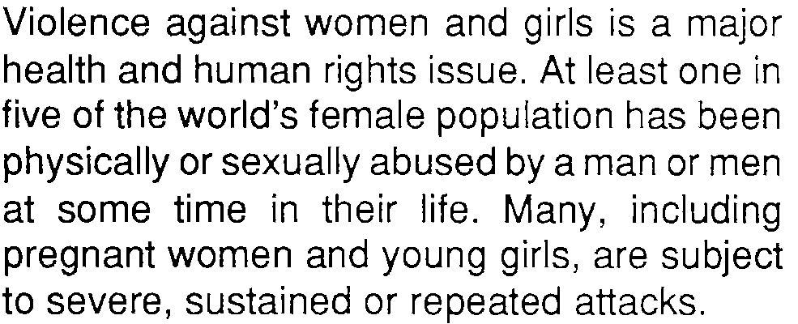
WHO statement

Slide 16
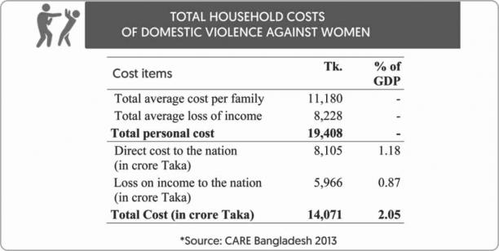
Violence against women: Cost of violence

Slide 17
