Slide 1

Global Maternal and Child Health
Dr Sanjana Zaman, MBBS, Ph.D (Japan)

Slide 2
Global Maternal & Child Mortality: How to save

Slide 3
Global scenario of Maternal Mortality
WHO in 2015 reported—
Every day around 830 women died from problems in pregnancy and childbirth
99% (825/830) of all maternal deaths occur in developing countries
Maternal mortality is higher in women living in rural areas and among poorer communities
Young adolescents face a higher risk of complications and death as a result of pregnancy than other women

Slide 4
Global scenario of maternal mortality
Between 1990 and 2015, maternal mortality worldwide dropped by about 44%
In sub-Saharan Africa, a number of countries halved their levels of maternal mortality since 1990
In other regions, including Asia and North Africa, even greater headway was made
Between 2016 and 2030, as part of the SDGs, the target is to reduce the global maternal mortality ratio to less than 70 per 100 000 live births.

Slide 5
What is Morbidity & Mortality?
Mortality is the state of being mortals. Mortality rate refers proportion of death that occurred in the population during a period of time
Mortality rate is the measure of the number of deaths (in general, or due to a specific cause) in a particular population, scaled to the size of that population, per unit of time., a mortality rate of 9.5 (out of 1,000) in a population of 1,000 would mean 9.5 deaths per year in that entire population, or 0.95% out of the total
Both concepts can be applied at the individual level or across a population. For example, a morbidity rate looks at the incidence of a disease across a population and/or geographic location during a single year. The two are often used together to calculate the prevalence of a disease — e.g., measles

Slide 6
Mortality Definition
Maternal Death (WHO)
The death of a woman while pregnant or within 42 days of termination of pregnancy, irrespective of the duration and site of the pregnancy, from any cause related to or aggravated by pregnancy or its management but not from accidental or incidental causes.

Slide 7
Maternal Morbidity & Mortality
Importance of Studying Maternal Morbidity:
Represents a huge burden of disease on the woman and her family
Can strengthen the study of maternal death
      Focuses research on the nature of how a morbid condition can lead to death, recognizing that death is the last stop on a continuum of adverse events

Slide 8
Where & why do maternal deaths occur?
The high number of maternal deaths in some areas of the world reflects inequities in access to health services, and highlights the gap between rich & poor
Almost all maternal deaths (99%) occur in developing countries
More than half of these deaths occur in sub-Saharan Africa and almost one-third occur in South Asia
More than half of maternal deaths occur in fragile and humanitarian settings

Slide 9
Where & why do maternal deaths occur?
The maternal mortality ratio in developing countries in 2015 is 239 per 100 000 live births versus 12 per 100 000 live births in developed countries
There are large disparities between countries, but also within countries, and between women with high & low income and women living in rural versus urban areas
The risk of maternal mortality is highest for adolescent girls <15 years old and complications in pregnancy & childbirth is a leading cause of death among adolescent girls in developing countries

Slide 10
Where do maternal deaths occur?
Women in developing countries have, on average, many more pregnancies than women in developed countries, and their lifetime risk of death due to pregnancy is higher.
A woman’s lifetime risk of maternal death – the probability that a 15 year old woman will eventually die from a maternal cause – is 1 in 4900 in developed countries, versus 1 in 180 in developing countries. In countries designated as fragile states showing the consequences from breakdowns in health systems.

Slide 11
How can women’s lives be saved?
Most maternal deaths are preventable, as the health-care solutions to prevent or manage complications are well known.
All women need access to antenatal care in pregnancy, skilled care during childbirth, and care and support in the weeks after childbirth.
Maternal health and newborn health are closely linked. It was estimated that approximately 2.7 million newborn babies died in 2015, and an additional 2.6 million are stillborn for maternal complications.

Slide 12
How can women’s lives be saved?
It is particularly important that all births are attended by skilled health professionals, as timely management and treatment can make the difference between life and death for both the mother and the baby
Severe bleeding after birth can kill a healthy woman within hours if she is unattended. Injecting oxytocin immediately after childbirth effectively reduces the risk of bleeding
Infection after childbirth can be eliminated if good hygiene is practiced and if early signs of infection are recognized and treated in a timely manner

Slide 13
How can women’s lives be saved?
Pre-eclampsia should be detected and appropriately managed before the onset of convulsions (eclampsia) and other life-threatening complications
Administering drugs such as magnesium sulfate for pre-eclampsia can lower a woman’s risk of developing eclampsia
To avoid maternal deaths, it is also vital to prevent unwanted and too-early pregnancies
All women, including adolescents, need access to contraception, safe abortion services to the full extent of the law, and quality post-abortion care

Slide 14
Why women don’t get the care they need?
Poor women in remote areas are the least likely to receive adequate health care
This is especially true for regions with low numbers of skilled health workers, such as sub-Saharan Africa and South Asia
Globally in 2015, births attended by skilled health personnel was 89 % for riches and only 43% for poor
This means that millions of births are not assisted by a midwife, a doctor or a trained nurse

Slide 15
Why women don’t get the care they need?
In HICs, virtually all women have at least four antenatal care visits, are attended by a skilled health worker during childbirth and receive postpartum care
In 2015, only 40% of all pregnant women in LICs had the recommended antenatal care visits
Other factors that prevent women from receiving or seeking care during pregnancy and childbirth are:
- poverty -distance -lack of information
- inadequate services -cultural practices

Slide 16
Causes of Maternal Morbidity
Women giving birth commonly supporting from:
      Hemorrhage
      Eclampsia
      Septic abortion
      obstetric trauma (Obstructed labor)
      Infection (especially post-partum)
      gestational diabetes
      preexisting medical conditions
Other conditions were also present with lower rate including severe conditions of complications occur

Slide 17
Disparities in Maternal Morbidity
Morbidity is greatest among socio-economically disadvantaged groups
Among socio-economically disadvantaged groups, racial & ethnic differences were sometimes greatly reduced
African-American women at higher risk of morbidity compared to white women

Slide 18
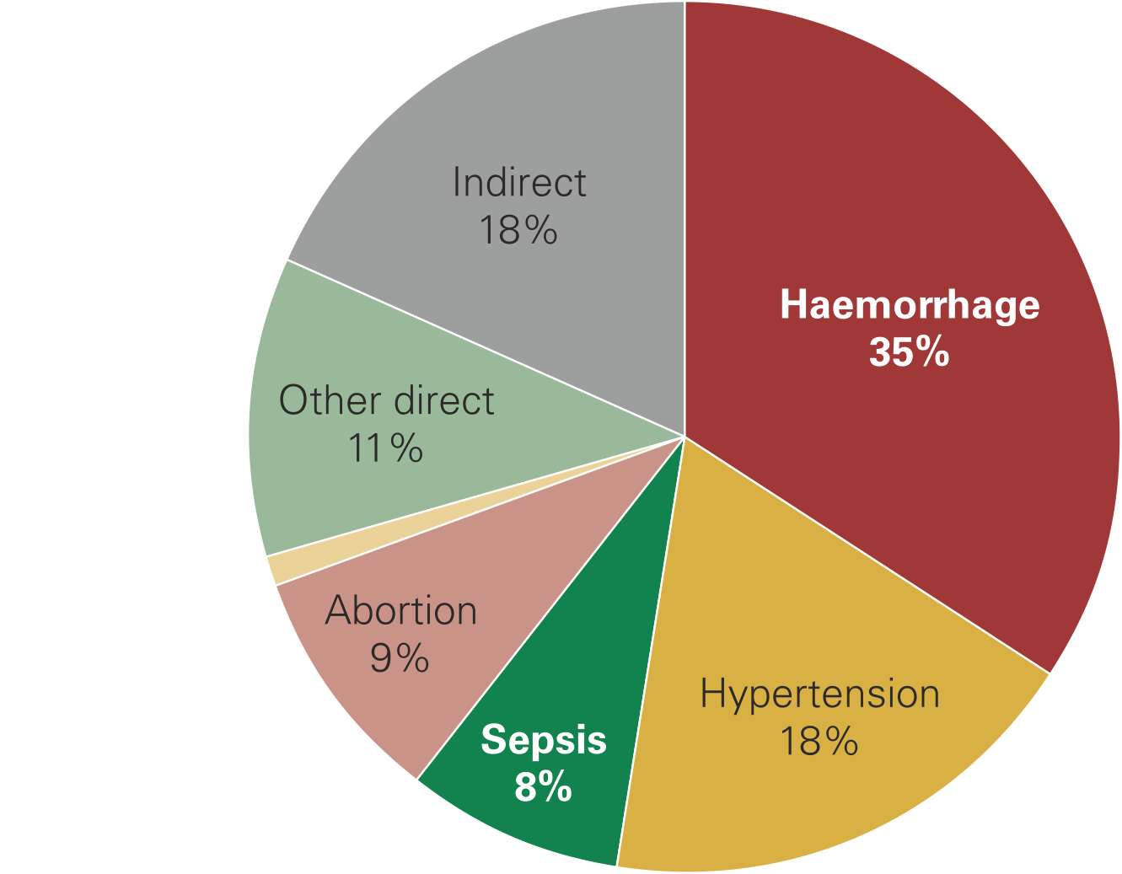
Causes of Maternal Deaths Worldwide
MDG 5a

Slide 19
Maternal Mortality Ratio:
Bangladesh Target (MGD-5)
Indicators | Base Year 1990 | Target starts 2000 | Target 2015

Slide 20
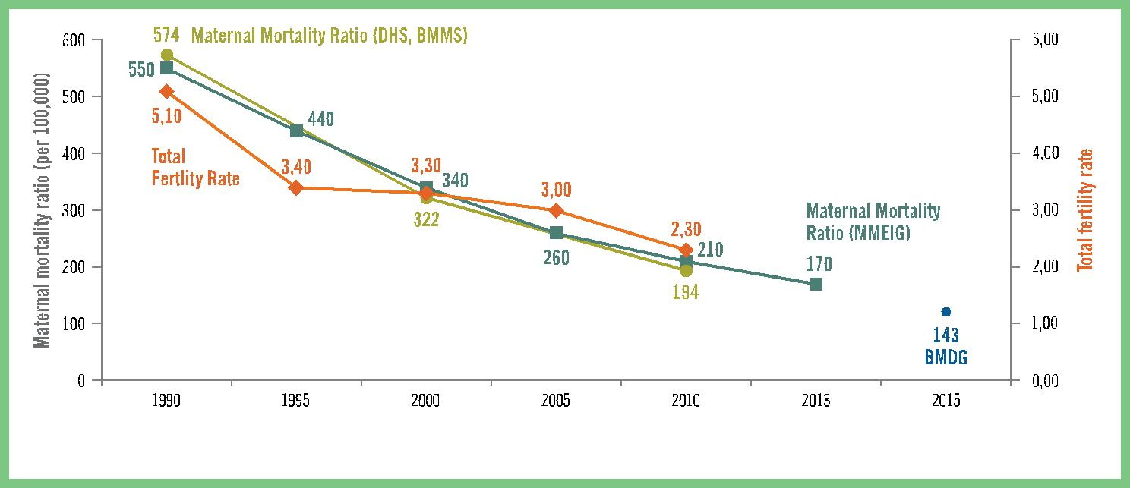
Trends in Maternal Mortality and Fertility 1990-2013
Sources: Maternal Mortality: Inter-Agency Group (MMEIG) estimates (1990-2013), BDHS (1990), BMMS (2001, 2010); TFR: BFS (1989), BDHS (1993/4, 1999/00. 2004, 2011).
BMDG: 2015 Millennium Development Goal Target for MM.

Slide 21
Maternal Mortality in the 20th Century

Slide 22
Estimated Measures
Maternal Mortality Ratio (MMR): Ratio of maternal deaths in a period to live births (proxy for risky events) in the same period (x 100,000)
Number of maternal deaths
PMDF: Proportion of maternal among female deaths 15-49

Slide 24
Practice
In a Upazilla, the total population was 285000 , where the number of maternal death occurred, was 36, leaving the live birth 3302. What will be the MMR? With the same data find IMR/CMR?

Slide 25
Sources of Data
Civil registration systems with cause of death assigned by attending physician
Household surveys with sibling histories
Sample vital registration systems
Reproductive Age Mortality Surveys (RAMOS): not very common
Population censuses with questions on household deaths
Hospital- or facility-based studies
Other

Slide 26
Data available in the Region
Country | Group
Afghanistan | B
Bangladesh | B
Bhutan | B
Cambodia | B
China | B
Indonesia | B
Iran | B
Mongolia | C
Myanmar | B
Nepal | B
Pakistan | B
Philippines | B
Thailand | B
Papua New Guinea | C
Civil registration characterized as complete, with good attribution of cause of death
Countries lacking good complete registration data but where other types of data are available
No national data on maternal mortality

Slide 27
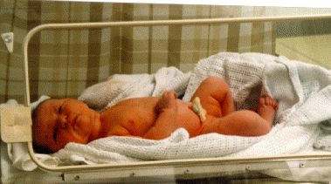
Global Child mortality

Slide 28
Child mortality: Global key facts
Neonatal mortality: death < 28 days after birth
About 37% of all child deaths are neonatal!
Highest rates in sub-Saharan Africa
Africa: > 1 million neonatal deaths every year and 38% die of infections
Neonatal death/ 1000 LBs in Bangladesh 24.20 (WB,2013)
U5 deaths
U5 deaths
Neonatal deaths

Slide 29
Child mortality: Global key facts
6.9 million under five year children died in 2011 globally
More than 50% child deaths are due to conditions that could be prevented or treated
93% of the <five deaths are in six countries of the Western Pacific Region (Cambodia, China, Papua New Guinea, Philippines and Viet Nam)
Almost 65% of these under-five deaths occur in China alone, partly because of its large population

Slide 30
Child mortality: Global key facts
Together with India, Nigeria, Congo, Pakistan, China contributes to about half of under-five deaths worldwide
Conditions that cause the highest mortality are preventable and treatable through simple, affordable interventions
Strengthening health systems to provide such interventions to all children will save many young lives

Slide 31
Child mortality: Global key facts
Leading causes of death in <5 children are pneumonia, preterm birth complications, diarrhoea, birth asphyxia and malaria
About 1/3 of all child deaths are linked to malnutrition
Variations in mortality are due to maternal education, rural or urban residence, birth interval, and wealth
Children in LMICs are nearly 18 times more likely to die before the age of 5 than children in HICs
Skilled care before, during and after childbirth can save the lives of women and newborn babies
http://www.wpro.who.int/china/mediacentre/factsheets/mch/en/

Slide 32
Major causes of U5 mortality globally
Major causes of U5 mortality, WHO 2008

Slide 33
Background…Cont’d
Causes of Neonatal Deaths, WHO 2008

Slide 34
Background…Cont’d
325,000 deaths from sepsis & pneumonia in Africa
Simple preventive measures can save most!
Existing interventions can prevent 35-55% neonatal deaths worldwide
These interventions include:
      Treating pregnant women
      Treating newborns

Slide 35
WHO Essential Interventions
Essential interventions” identified by the WHO as having the greatest potential to reduce newborn mortality
    Interventions for Mothers
    Interventions for Newborns

Slide 36
Essential Newborn Care (ENC)
Majority of babies born healthy and at term
Care during first hours, days and weeks of life determine whether they remain healthy
Basic care to support survival and wellbeing is called ENC
It includes immediate care at birth, care during the first day and up to 28 days
Notes:
5 mark

Slide 37

The
1st 24 hours of Life
The first 24 hours of life is a very significant and a highly vulnerable time due to critical transition from intrauterine to extra-uterine life

Slide 38
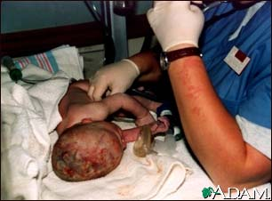
Immediate
Care of the Newborn
Airway
Breathing
Temperature

Slide 39
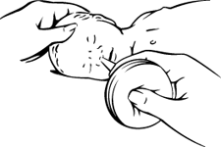
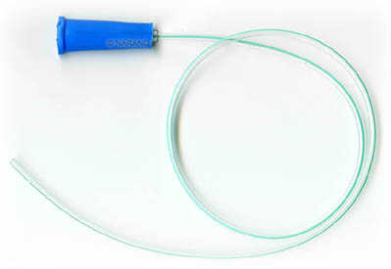

Airway & Breathing
Suction gently & quickly using bulb syringe or suction catheter
Starts in the mouth then, the nose to prevent aspiration

Slide 40
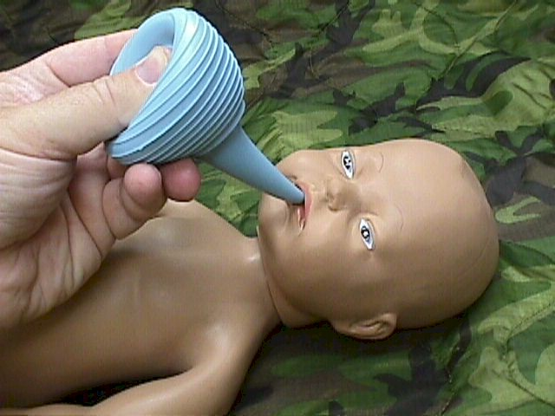
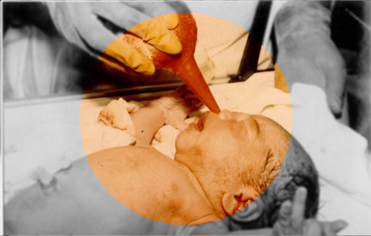
Preparing for Suction
Suction first from the mouth
Then from the nose

Slide 41


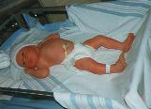
Airway & Breathing
Stimulate crying by rubbing
Position properly- side lying / modified t-berg
Provide oxygen when necessary

Slide 42

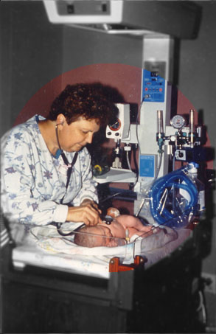

Temperature
Dry immediately
Place in infant warmer or use droplight
Wrap warmly

Slide 43


