Slide 1

ADR UNDER VILLAGE COURT ACT-2006
Presented by
Mohammad Badruzzaman
Assistant Professor,
Department of Law
Daffodil International University

Slide 2
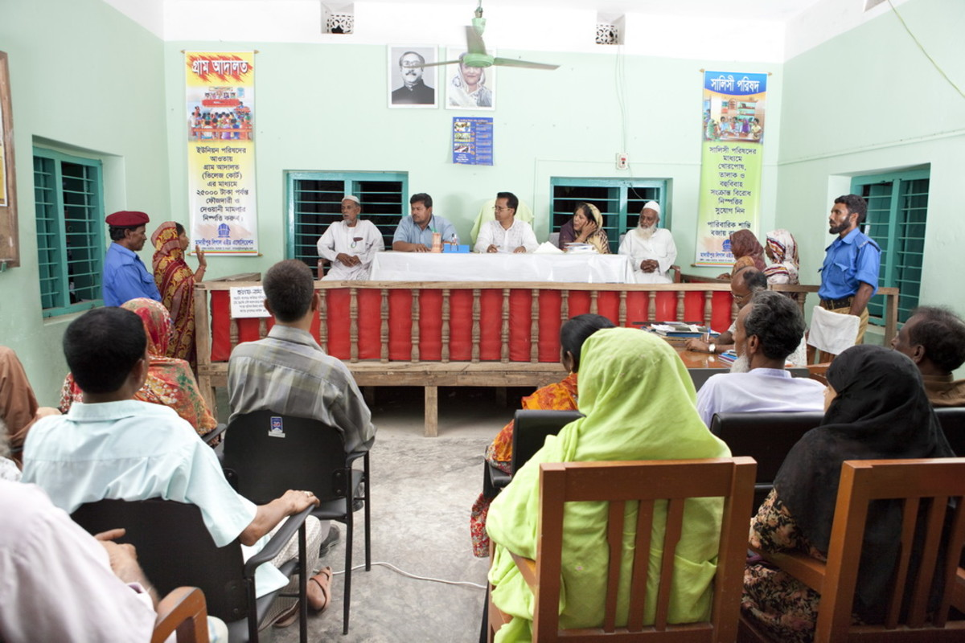
Village Court in image

Slide 3
Origin of village court
The Village Chaukidari Act, 1870
▼
The Bengal Village Self-government Act, 1919
▼
The Basic Democracies Order, 1959
▼
The Conciliation Courts Ordinance ,1961
▼
The Village Courts Ordinance, 1976
▼
The Village Courts Act, 2006

Slide 4
Structure of the Village Court
The “Village Court” is composed with five juries headed by the UP Chairman. Four members are nominated by the two parties- one from the local community and the other must be a local elected UP member .
If there is a reason where the involvement of Chairman is challenged by any party to the dispute, any reliable member of the Union Parishad other than those mentioned under Section-5(1) can be appointed (by UNO) in the prescribed manner, shall be the Chairman of the Village Court.
If the cases/complaints (for criminal matters) are relevant to child and, or women, the relevant party should appoint a woman as representative of the Village Court. If parties fail to nominate members within time then Chairman gives a certificate for filing case.

Slide 5
Jurisdictions of the Village Court
The basic legal jurisdictions of the village court refer to the Village Courts Act, 2006 and its amendment in In addition, the village court may follow the provisions of the Village Courts Rules, 1976.
Place of occurrence of offence or where the cause of action arises have to take for fixing jurisdiction. The village courts have authority to deal with both civil and criminal matters. The Village Courts Act, 2006 contains a Schedule with two parts, which specifies the nature of cases and disputes a Village Court can deal with.
No other court have jurisdiction to try the cases described in the schedule.

Slide 6
Jurisdiction (criminal cases)
1. Sections 143 and 147 of the Penal Code read with the Third or the Fourth clause of section 141 of the Code, when the common object of the unlawful assembly is to commit an offence under sec. 323 or 426 or 447 of that Code, and when not more than ten persons are involved in the unlawful assembly.
2. Sections 160, 334, 341, 342, 352, 358, 504, 506 (first part), 508,509 and 510 of the Penal Code
3. Sections 379, 380 and 381 of the Penal Code when the crime against the cattle and the value involves does not exceed seventy five thousand taka.
4. Sections 379, 380 and 381 of the Penal Code when the crime against any other property other than the cattle and the value of property involved does not exceed fifty thousand taka.

Slide 7
Jurisdictions (Criminal case)
5. Sections 403, 406, 417 and 420 of the penal Code when the amount in respect of which the offence is committed does not exceed seventy five thousand taka.
6. Section 427 of the Penal Code when the value of the property involved does not exceed seventy five thousand taka.
7. Sections 428 and 429 of the Penal Code when the value of the animal does not exceed seventy five thousand taka.
8. Attempts to commit or the abetment of the commission of any of the above offences.

Slide 8
Jurisdictions (Civil Matters)
1. Suit for the recovery of money on due contracts, receipts or other documents.
2. Suit for the recovery of movable property, or for the value thereof.
3. Suit for the recovery of possession of immovable property within one year of dispossession.
4. Suit for compensation for wrongfully taking or damaging movable property.
5. Suit for damages by cattle trespass.
6. Suit for payable wages of the farmer and recovery of compensation.

Slide 9
Relevant Provisions of other Relevant Laws
7. Cattle-trespass Act, 1871(Act no. I of 1871)
U/S. 24.Penalty for forcibly opposing the seizure of cattle or rescuing the same
U/S. 26. Penalty for damage caused to land or crops or public roads by pigs
U/S. 27. Penalty on pound-keeper failing to perform duties Oaths Act, 1873 (Act no. X of 1873)
8. Power of Court to tender certain oaths
9.Court may ask party or witness whether he will make oath proposed by opposite party
10.Administration of oath if accepted

Slide 10
Relevant Provisions of other Relevant Laws
11.Evidence conclusive as against person offering to be bound Agricultural Labour (Minimum Wages) Ordinance, 1984 (Ordinance NO. XVII of 1984)
U/S. 3. Minimum wages for agricultural labour
U/S. 5.Payment of minimum wages
U/S. 6.Compensation and recovery procedure
U/S. 7.Protection of minimum wage

Slide 11
village courts can not try
1. Shall not try a case relating to an offence specified in Part l of the Schedule if the accused had previously been convicted of by village court or of a cognizable offence from any other court or a case relating to any matter specified in Part II of the Schedule if–- The interest of a minor is involved in the case;- Provision for arbitration has been made in a contract between the parties to the dispute;- The Government or a local authority or a public servant acting in the discharge of his duty is a party to the dispute
2. Shall not apply to a suit or proceeding to establish a title to any immovable property in respect of which an order for delivery of possession has been made by a Village Court or to recover possession thereof;
3. Cannot inflict any sentence of imprisonment or impose any fine as provided in the sections of the Penal Code, 1860 or the Cattle Trespass Act, 1871 except imposing fine for defiance of summons and contempt of Village Court.

Slide 12
Proceedings of Village Courts
The proceedings of Village Courts has seven steps:
Step 1: Application
Step 2: Chairman's Scrutiny of the Jurisdiction
Step 3: Issue of Summons
Step 4: Formation of the Village Court
Step 5: Hearing of the Case/complaints
Step 6: Decision Making
Step 7: Appeal against the Decision

Slide 14
Time frame for application
For criminal matter within 30 days after occurrence of crime For civil 60 days Within 15 days first meeting After framing issue within 30 days resolve If not resolve than within 15 days hearing After first hearing 90 days time If not then 30 days for valid reason Suit in the court after 60 days of failure of village court.

Slide 15
Pre Trial Provisions
A party to the dispute should apply to the Chairman An application shall be in writing and shall be signed by the petitioner and shall be presented to the Chairman of the UP (Rule 3 of The VC Rules, 1976);
An application shall be accompanied by a fee of Taka 2 for criminal case and taka 4 for civil case(Rule 3);
If the application is rejected the aggrieved person may prefer a revision before the Assistant Judge within the period of 30 days from the date of rejection (section 4 and rule 5);
If the order passed by the Chairman is found mala fide or substantially unjust the Assistant Judge shall return the application to the petitioner together with the order to admit the application (Rule 6);

Slide 16
Pre Trial Provisions
The application shall be registered on admission (Rule 7);
Summons to be issued for the appearance of the respondent before the UP Chairman on the date and time fixed therein ( Rule 8);
When the respondent appears and admits the claim or dispute and satisfies the claim, no VC shall be constituted(Rule 33)On Service of Summons the Chairman of the UP shall ask the parties to nominate their members within seven days and on getting nomination the Chairman shall constitute the VC( Rule 10) ;
After constitution of the VC the Chairman shall ask the respondent to submit the WO within a period of three days and fix the day, time and place where the VC shall sit and may direct the parties to produce necessary evidence

Slide 17
Trial Provisions
The VC shall try the case on the day fixed under rule 13 and may adjourn the hearing from time to time for a period not exceeding seven days at a time. The application shall be dismissed in case of non appearance of the applicant due to his negligence (Rule 15);
The case shall be heard and decided ex parte if the respondent fails to appear due to his negligence (Rule 16);
The decision of the VC shall be recorded by the Chairman of the VC in the register in form no. I and every such decision shall indicate whether the decision is unanimous , and if not , the ratio of the majority (Rule 17;
Every decision of the VC shall be pronounced in open court by the Chairman of the VC (Rule 18);
After the decision of every case a decree shall be drawn in Form IV which shall be signed by the Chairman of the VC

Slide 18
Post Trial Provisions
The decision, which is made unanimously or (4:1) majority or out of four members appeared 3:1 majority then the decision of the Court, is binding upon the parties. For decision by a majority of three to two (3:2) appeal lies to the Magistrate of first class in criminal matter and to the Assistant Judge in civil matter (Section 8 and Rule 19);
The Magistrate or the Assistant Judge in case of failure of justice may set aside or modify the decision of the VC or refer back the dispute to the VC for reconsideration

Slide 19
Execution of decision
If the Village Court awards any decree it must be recorded in the specific registers, and when the decision imposes any compensation or fine to any party it also has to be registered. For recovery of the pending imposed compensation or fine, the Chairman of the Village Court as Chairman of the UPs will use the provisions of the Local Government (UP) Act, 2009 in line with section-9 (3) of the Village Court Act. Then, the Chairman of the UPs will provide the recovered compensation or fine to the affected party. If claim can be satisfied otherwise than compensation it should be presented to the assistant judge court and the court execute the decree accordingly.

Slide 20
Some important topics
Filing false case 5000 tk
Contempt of village court-1000 tk
No lawyer involved Representation in case of disability of parties Transfer of cases Investigation by police

Slide 21
Questions Session

