Slide 1


Number System
MAT111

Slide 2
Topic-1
Number, Real, complex, Rational, Irrational, Fraction, Integer, Classification
Factor, Divisor and Multiple, Find prime factorization & all factor of a number
LCM, HCF/GCD, Find LCM & HCF/GCD of Integers or Fractions
Complex number, Modulus, Argument and its various forms

Slide 3
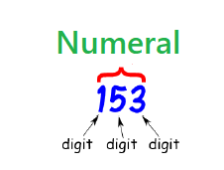
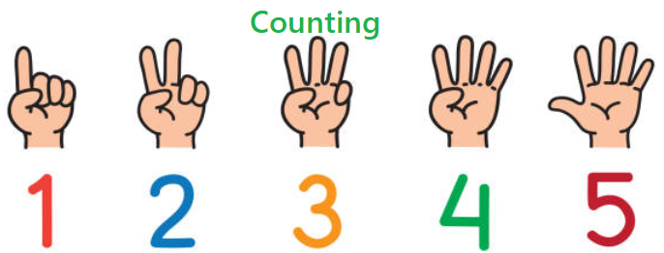

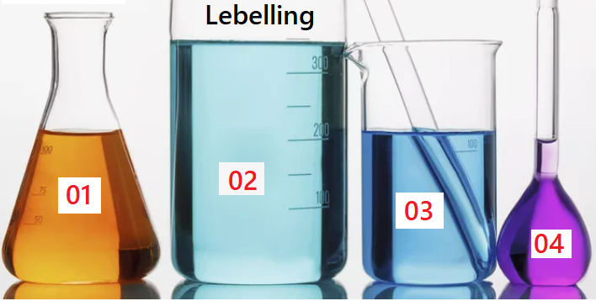
Number:
A number is a numeral which represents a quantity and also used for counting, measurement & labelling.
For example: The weight of a man is 153 kg

Slide 4




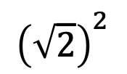




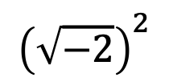

Real Number :
$${\left(\sqrt{2}\right)}^{2}$$
$$=2$$
Non-negative
A number is said to be real if the square of it is non-negative otherwise imaginary.
$${\left(\sqrt{−2}\right)}^{2}$$
Negative
$$=−2$$
A real number geometrically represents a point on X-axis.
$−3$
$−2$
$−1$
$$0$$
$1$
$2$
$3$

Slide 5









Complex Number :
A complex number $z$ is the linear combination of two real numbers $x$&$y$ with a special sign $i$.
$$z = x+ iy$$
where: $x$ and $y$ real number &
$$(±i )² = −1$$
$$y(imaginary)$$
A complex number geometrically represents a point on Complex plane or Argand plane.
$$.$$
$$(x,y)$$
$0$
$$x(real)$$

Slide 6
Rational Number:
A number of the form $\frac{p}{q}, q≠0$ where $p$ and $q$ are integers.
For example:
Recurrence decimal number /Infinite decimal point number
01
Integer / Whole number
03
02
Terminating decimal number
04
Fraction

Slide 7
Irrational Number:
A number which is not expressible as $\frac{p}{q}, q≠0$ where $p$ and $q$ are integers.
For example:
01
Inexpressible as fraction
02
Non-terminating decimal number/Infinite nonrepeating decimal number

Slide 8
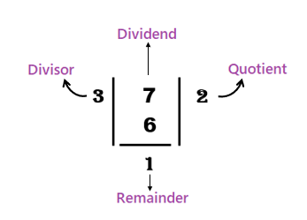
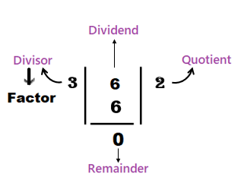
Division
Try it: What are the factors of the number 6 ?

Slide 9








Factor:
Factors of a number are all those numbers which can exactly divide the given number.
For example: $1, 2 and 4$ are the factors of $4$.
Multiple:
Multiples of a number are those numbers which are exactly divisible by the given number.
For example: The multiples of $4$ are $4, 8, 12, 16, 20,…$
Factors
Multiples
$$5$$
$$1$$
$$5$$
$$6$$
$$1$$
$$2$$
$$3$$
$$6$$
$$7$$
$$1$$
$$7$$
$$8$$
$$1$$
$$2$$
$$4$$
$$8$$
$$5$$
$$5$$
$$10$$
$$15$$
$$20$$
$$25$$
$$.$$
$$.$$
$$.$$
$$6$$
$$6$$
$$12$$
$$18$$
$$24$$
$$30$$
$$.$$
$$.$$
$$.$$
$$7$$
$$7$$
$$14$$
$$21$$
$$28$$
$$35$$
$$.$$
$$.$$
$$.$$
$$8$$
$$8$$
$$16$$
$$24$$
$$32$$
$$40$$
$$.$$
$$.$$
$$.$$

Slide 10
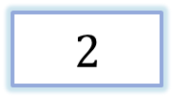
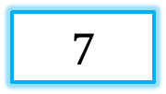
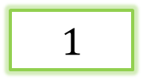
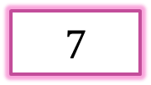
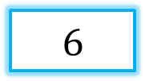


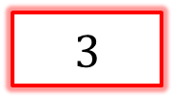
Prime Number :
A prime number is a natural number greater than 1, that has exactly two factors 1(one) and itself.
$$7$$
$$1$$
$$7$$
Composite Number :
$$6$$
A composite number is a natural number greater than 1, that has more than 2 factors.
$$1$$
$$2$$
$$3$$
$$6$$

Slide 11
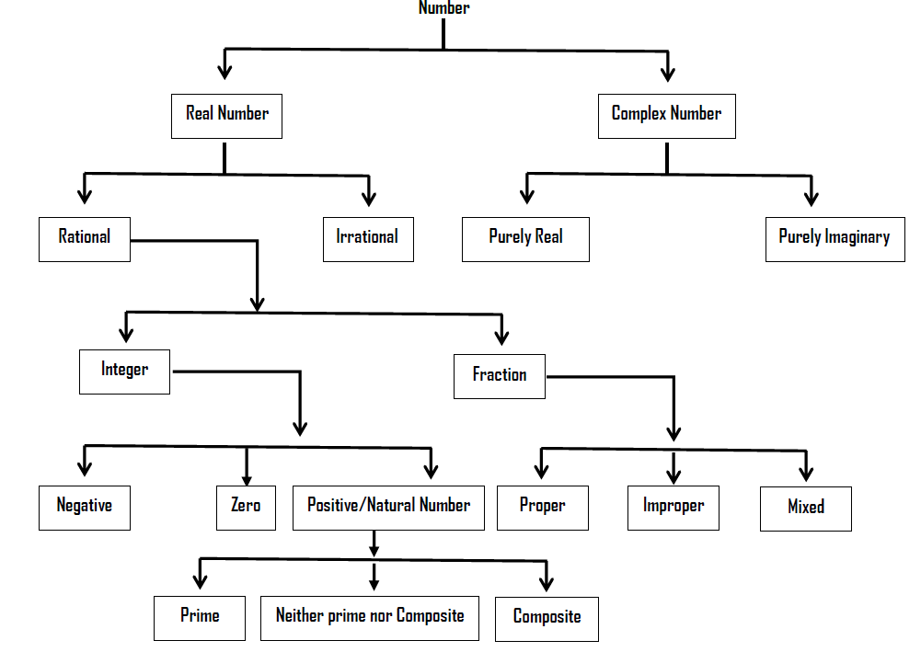
Classification:

Slide 12
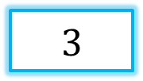
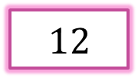
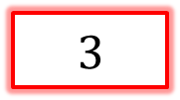
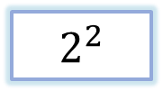
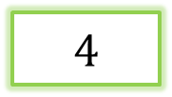
Prime Factorization
$$12$$
Prime factorization of a number is the representation of the number by its prime factors.
$$4$$
$$3$$
$$2^{2}$$
$$3$$

Slide 13
Problem 01: Find the Prime Factorization of 1600.
Division method:
Tree Diagram:
Multiplication Method :
1600
2
800
2
400
2
200
2
100
2
50
2
25
5
5
Therefore ,the prime factorization of 1600 is

Slide 14
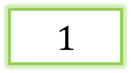

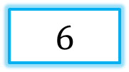



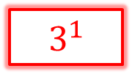


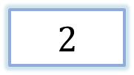
Formula:
$$6$$
$$Q=p^{l}q^{m}r^{n}$$
$$1$$
$$2$$
$$3$$
$$6$$
Number of factors
$$2^{1}$$
$$3^{1}$$
$$(l+1)(m+1)(n+1)$$
$$\left(1+1\right)\left(1+1\right)=4$$
Try it. How many factors of 520?

Slide 15

Problem 02: Find the all factors of 1600.
Calculation for all factors
Therefore ,the prime factorization of 1600 is
The factors of 1600 are
1, 2, 4, 5, 8, 10, 16, 20, 25, 32, 40, 50, 64, 80, 100, 160, 200, 320, 400, 800 & 1600.
So ,the total number of factors of 1600 is
$\left(6+1\right)\left(2+1\right)=7⋅3=21$

Slide 16
Exercise :
1. Find the prime factorization of 1240 using three different methods.
2. Find the all factors of 1240 using tree diagram.
3. Find the all prime factors of 1240.
4. Find the all composite factors of 1240.

Slide 17
LCM = Least Common Multiple
LCM is a smallest number which is divisible by that numbers.
HCF / GCD = Highest Common Factor / Greatest Common Divisor
GCD is a biggest number that divides those numbers.

Slide 18



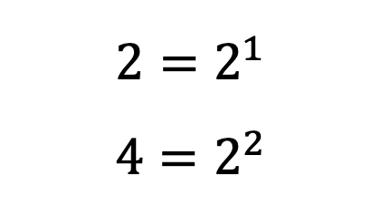
Calculation of LCM and GCD by using Prime Factorization.
Problem 03: Find the LCM & GCD of the numbers 2 & 4.
Solution:
Given numbers are $2 \& 4$
LCM = Common/Uncommon factors
Therefore, the prime factorization of $2 \& 4$are
GCD = Common factors
$$2=2^{1}$$
$$4=2^{2}$$
$$LCM (2,4)=2^{2}=4 \& GCD (2,4)=2^{1}=2$$

Slide 19

Problem 04 : Find the LCM and HCF of $50 , 140 \& 240.$
Solution:
Given numbers are $50 , 140 \& 240$.

Slide 20
LCM & HCF of Fractions

Slide 21
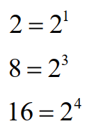
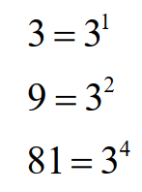




Calculation for Numerators
Calculation for Denominators
$$LCM (2, 8, 16)=24=16$$
$$LCM (3, 9, 81)=34=81$$
$$HCF\left(2, 8, 16\right)=2^{1}=2$$
$$HCF \left(3, 9, 81\right)=3^{1}=3$$

Slide 22



Exercise:
Find the H.C.F & L.C.M of $42, 63 \& 140$
Find the H.C.F & L.C.M of $\frac{2}{3},\frac{8}{9},\frac{16}{81} \&\frac{10}{27}$

Slide 23


