Slide 1


Complex Number

Slide 2
Complex number
Definition
Different forms
Modulus
Argument

Slide 3

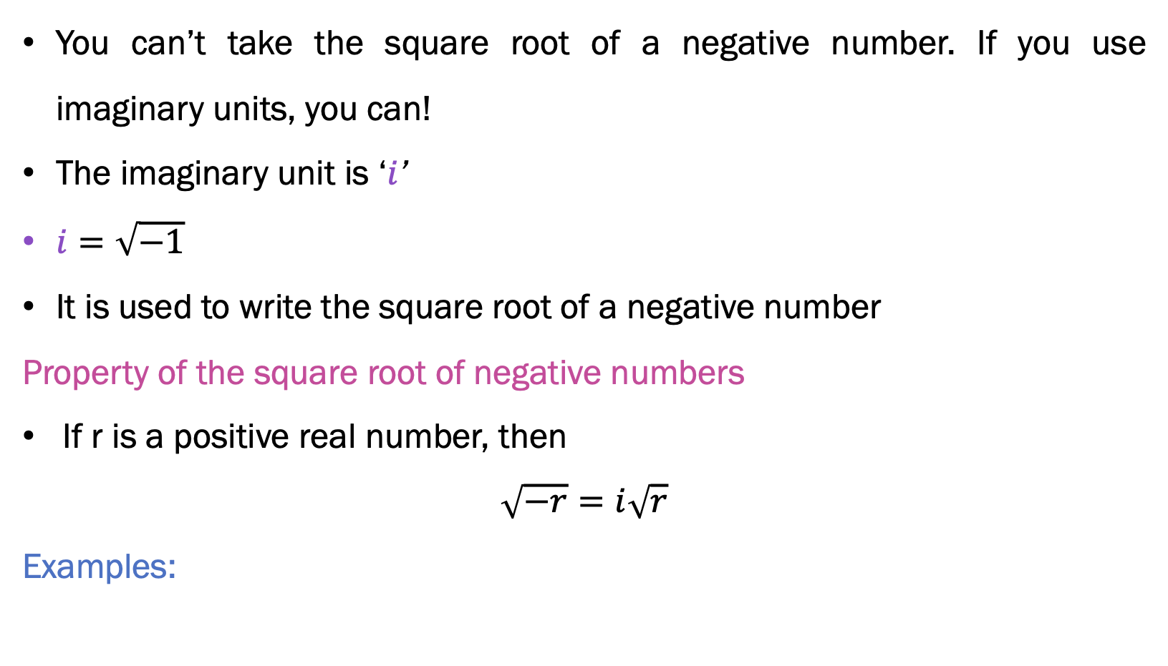
Imaginary Unit
You can’t take the square root of a negative number. If you use imaginary units, you can!
The imaginary unit is ‘$i$’
$i=\sqrt{−1}$
It is used to write the square root of a negative number
Property of the square root of negative numbers
If r is a positive real number, then
$$\sqrt{−r}=i\sqrt{r}$$
Examples:
$\sqrt{−2}=i\sqrt{2}$$\sqrt{−9}=i\sqrt{9}=3i$

Slide 4
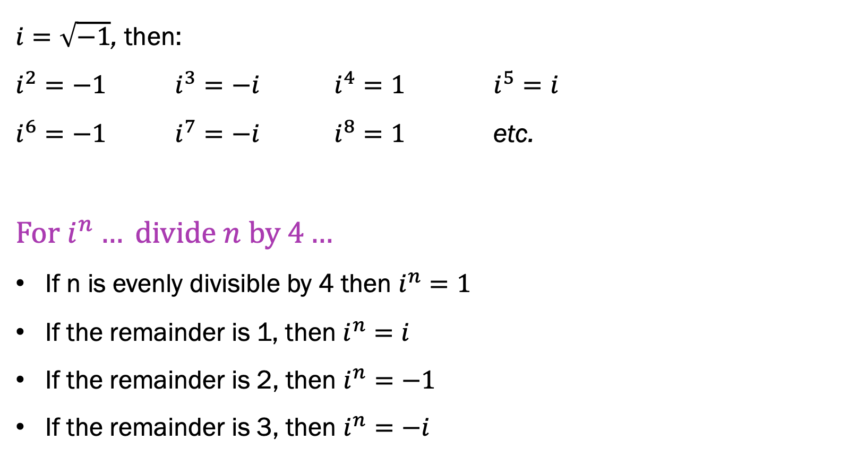
The powers of $i$
$i=\sqrt{−1}$, then:
$i^{2}=−1$$i^{3}=−i$$i^{4}=1$$i^{5}=i$
$i^{6}=−1$$i^{7}=−i$$i^{8}=1$etc.
$$For i^{n}… divide n by 4…$$
If n is evenly divisible by 4 then $i^{n}=1$
If the remainder is 1, then $i^{n}=i$
If the remainder is 2, then $i^{n}=−1$
If the remainder is 3, then $i^{n}=−i$

Slide 5
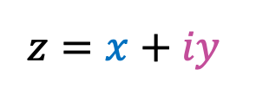
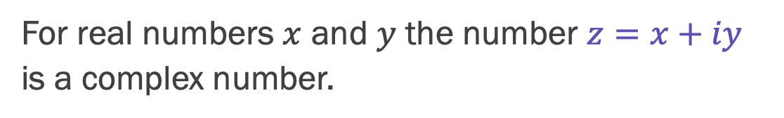


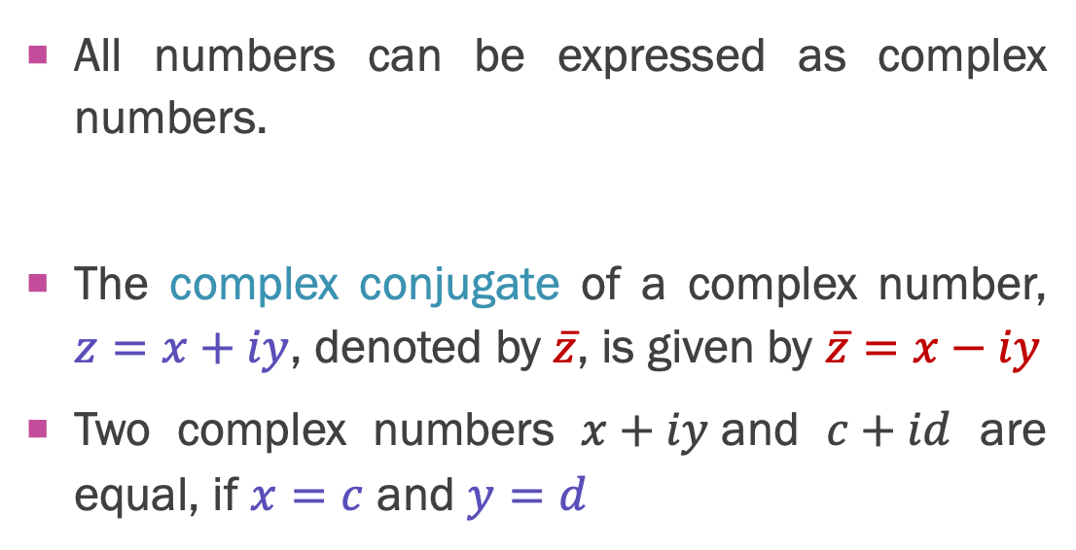
Definition
For real numbers $x$ and $y$ the number $z=x+iy$is a complex number.
C-numbers
$$z=x+iy$$
Real –numbers
Real part
Imaginary part
Rational numbers
All numbers can be expressed as complex numbers.
The complex conjugate of a complex number, $z=x+iy$, denoted by $\overline{z}$, is given by $\overline{z}=x−iy$
Two complex numbers $x+iy$and $c+id$ are equal, if $x=c$and $y=d$
Integers
$$3=3+i⋅0$$
$$−6i=0+i⋅(−6)$$

Slide 6
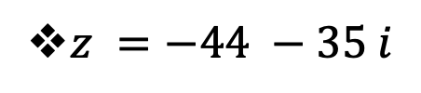

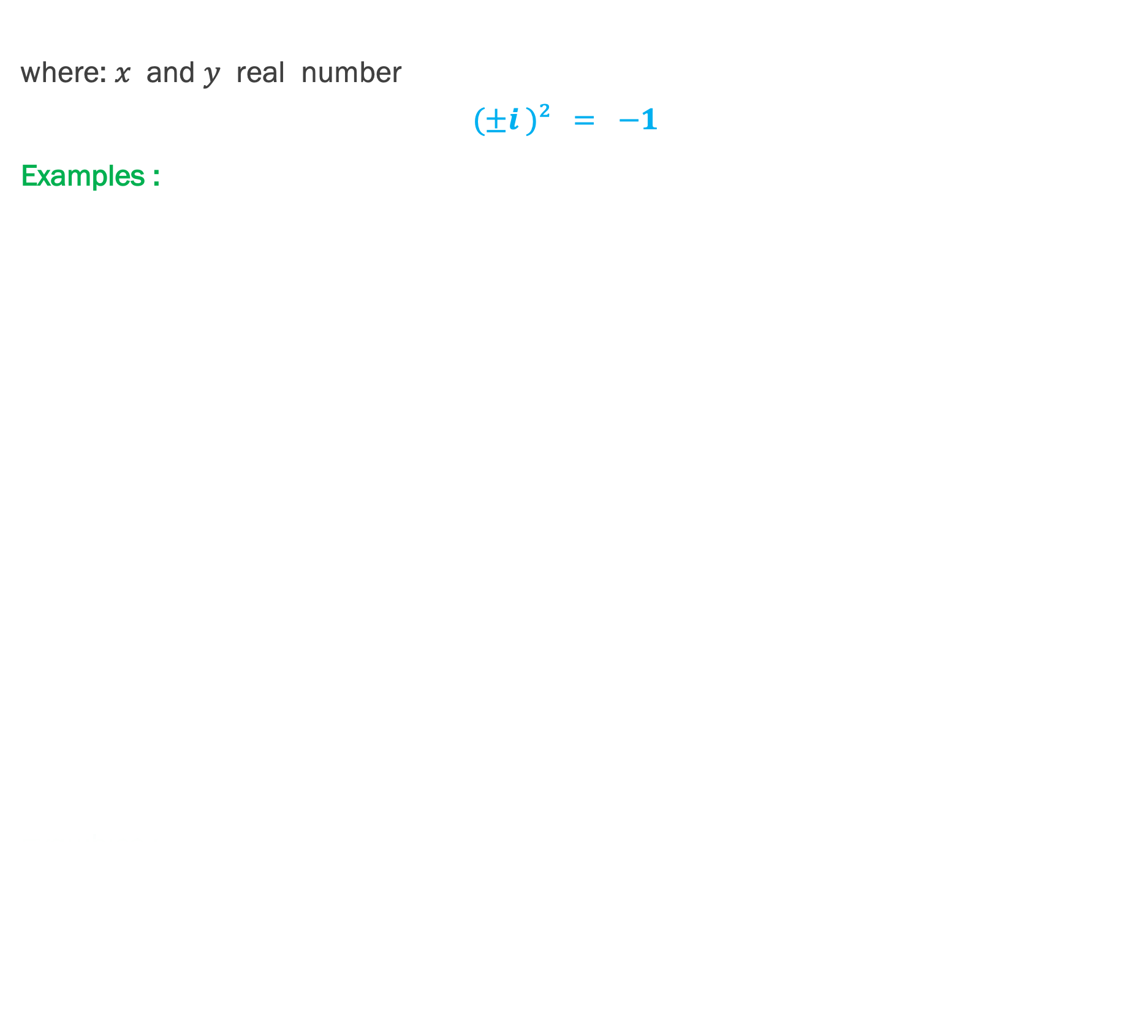
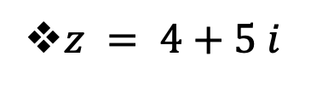
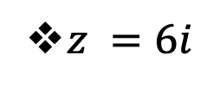


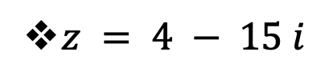

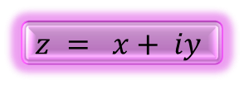

Algebraic form of $z$
where: $x$ and $y$ real number
$$(±i )² = −1$$
Examples :
$$z = x+ iy$$
$z = 4+5 i$
$z = 4 − 15 i$
$$= 4+(− 15 )i$$
$z =−44 −35 i$
$$=−44+(−35 )i$$
$z = 4$
$$= 4+(0)i$$
$z =6i$
$$=0+6i$$

Slide 7



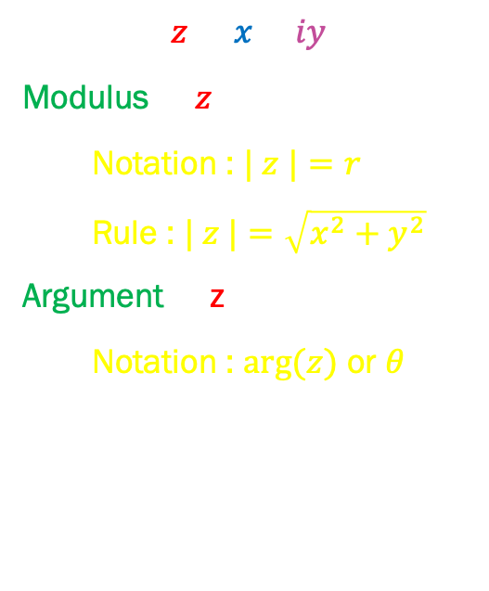



2 important concepts
$$y(imaginary)$$
$$z=x+iy$$
Modulus of $z$ :
  Notation : $| z |=r$
  Rule : $| z |=\sqrt{x^{2}+y^{2}}$
Argument of z :
  Notation : $arg⁡(z)$ or $θ$
$$∙$$
$$(x,y)$$
$$r$$
$$θ$$
(0, 0)
$$x(real)$$

Slide 8




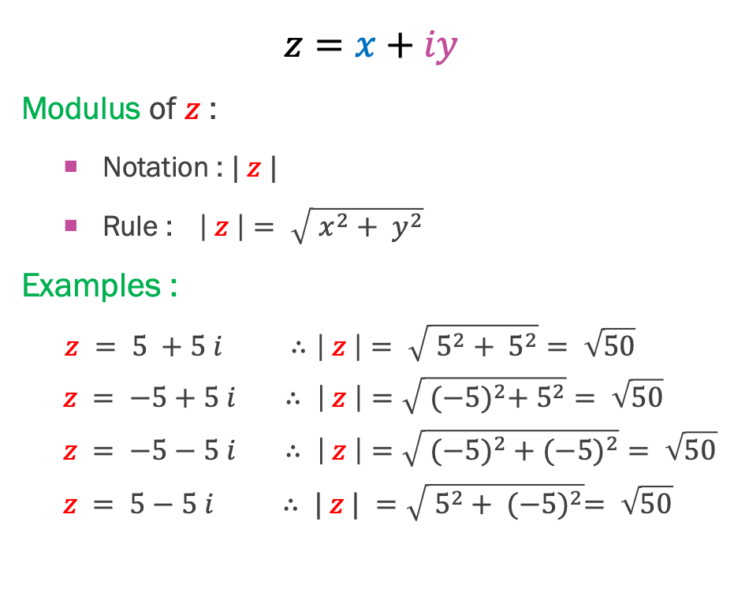






Finding Modulus of z
$$y(imaginary)$$
$$z=x+iy$$
Modulus of $z$ :
  Notation : $| z |$
  Rule : $\left| z \right|= \sqrt{ x^{2}+ y^{2}}$
Examples :
  $$z = 5 +5 i ∴\left| z \right|= \sqrt{ 5^{2}+ 5^{2}}= \sqrt{50}$$
  $$z = −5+5 i ∴ \left| z \right|=\sqrt{ {(−5)}^{2}+ 5^{2}}= \sqrt{50}$$
  $$z = −5−5 i ∴ \left| z \right|=\sqrt{ (−{5)}^{2}+(−{5)}^{2}}= \sqrt{50}$$
  $$z = 5−5 i ∴ | z | =\sqrt{ 5^{2}+ {(−5)}^{2}}= \sqrt{50}$$
$$(−x,y)$$
$$∙$$
$$(x,y)$$
$$r$$
$$y$$
(0, 0)
$$x(real)$$
$$x$$
$$(−x,−y)$$
$$(x,−y)$$

Slide 9

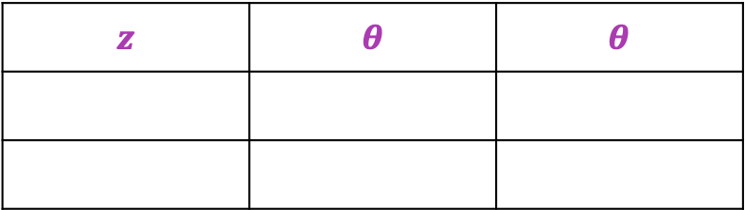

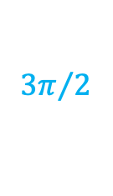





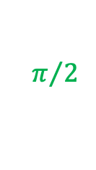















Argument of z
$$y (imaginary)$$
$$(0,5)$$
$$θ={90}^{0}$$
$$(−5,0)$$
$$θ={180}^{0}$$
$$θ=0^{0}$$
$$(5,0)$$
$$(0, 0)$$
$$x (real)$$
$$θ={270}^{0}$$
$$(0,−5)$$
$$z$$ | $$θ$$ | $$θ$$
$$z$$ | $$θ$$ | $$θ$$
$$(5,0)$$
$$0^{0}$$
$$0$$
$$(0,5)$$
$${90}^{0}$$
$$π/2$$
$$(−5,0)$$
$${180}^{0}$$
$$π$$
$$(0,−5)$$
$${270}^{0}$$
$${3π}/2$$

Slide 10







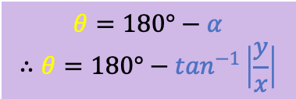








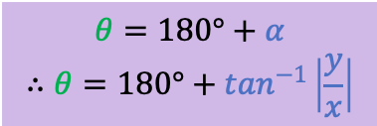















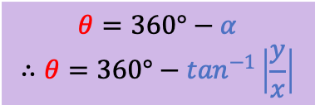








$$z =x+iy$$
$$z =−x+iy$$
$$z =−x−iy$$
$$z =x−iy$$
$$y(imaginary)$$
$$y(imaginary)$$
$$y(imaginary)$$
$$y(imaginary)$$
$$(x,y)$$
$$(−x,y)$$
$$∙$$
$$∙$$
$$θ$$
$$θ$$
$$x$$
$$θ$$
$$x$$
$$θ$$
$$y$$
$$y$$
$$180°$$
$$360°$$
$$α$$
$$180°$$
(0, 0)
$$x(real)$$
(0, 0)
$$x(real)$$
$$α$$
(0, 0)
$$x(real)$$
(0, 0)
$$α$$
$$x(real)$$
$$x$$
$$x$$
$$y$$
$$y$$
$$∙$$
$$∙$$
$$(−x,−y)$$
$$(x,−y)$$
$$θ=\tan^{−1}\left|\frac{y}{x}\right|$$
$$θ=180°−α$$
$$∴θ=180°−\tan^{−1}\left|\frac{y}{x}\right|$$
$$θ=180°+α$$
$$∴θ=180°+\tan^{−1}\left|\frac{y}{x}\right|$$
$$θ=360°−α$$
$$∴θ=360°−\tan^{−1}\left|\frac{y}{x}\right|$$

Slide 11

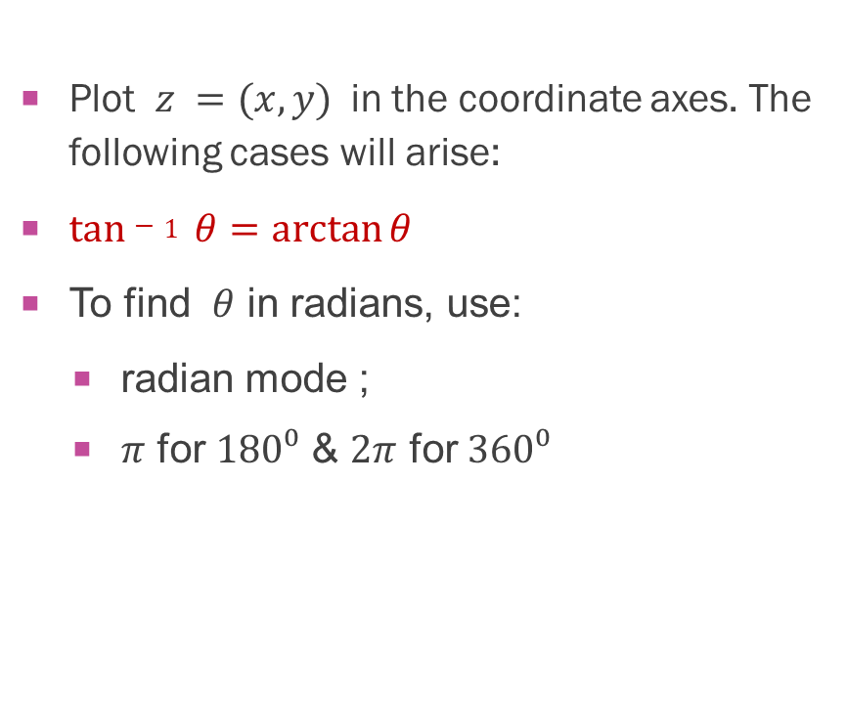
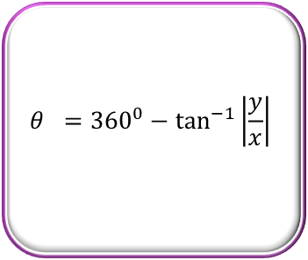
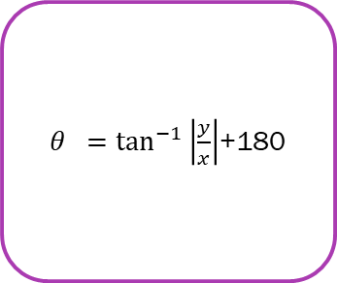


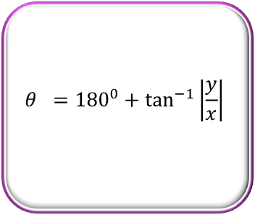
$$θ=?$$
Plot $z =(x,y)$in the coordinate axes. The following cases will arise:
$tan−1 θ=\arctan{θ}$
To find $θ$ in radians, use:
  radian mode ;
  $π$ for $180⁰$&$2π$ for $360⁰$
$$θ ={180}^{0}−\tan^{−1}\left|\frac{y}{x}\right|$$
$$θ = \tan^{−1}\left|\frac{y}{x}\right|+{180}^{0}$$
$$θ =\tan^{−1}\left|\frac{y}{x}\right|$$
$$θ ={180}^{0}+\tan^{−1}\left|\frac{y}{x}\right|$$
$θ =\tan^{−1}\left|\frac{y}{x}\right|$+180
$$θ ={360}^{0}−\tan^{−1}\left|\frac{y}{x}\right|$$

Slide 12

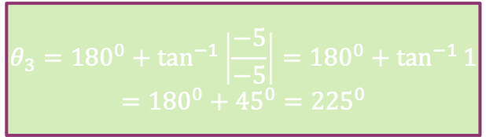












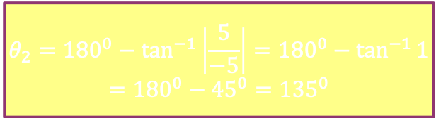


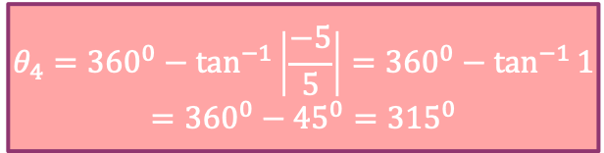

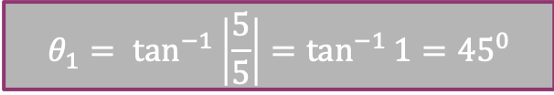




$$θ=?$$
$$y(imaginary)$$
$$z_{1}= 5 +5 i$$
$$θ_{1}= \tan^{−1}\left|\frac{5}{5}\right|=\tan^{−1}{1}={45}^{0}$$
$$z_{2}=−5 +5 i$$
$$(−5,5)$$
$$(5,5)$$
$$∙$$
$$∙$$
$$θ_{2}={180}^{0}−\tan^{−1}\left|\frac{5}{−5}\right|={180}^{0}−\tan^{−1}{1}$$
$$={{180}^{0}−45}^{0}={135}^{0}$$
$${135}^{0}$$
$$5$$
$${45}^{0}$$
$$z_{3}=−5 −5 i$$
$${225}^{0}$$
(0, 0)
$$x(real)$$
$$θ_{3}={180}^{0}+\tan^{−1}\left|\frac{−5}{−5}\right|={180}^{0}+\tan^{−1}{1}$$
$$={{180}^{0}+45}^{0}={225}^{0}$$
$$5$$
$$∙$$
$${315}^{0}$$
$$∙$$
$$(−5,−5)$$
$$(5,−5)$$
$$z_{4}= 5 −5 i$$
$$θ_{4}={360}^{0}−\tan^{−1}\left|\frac{−5}{5}\right|={360}^{0}−\tan^{−1}{1}$$
$$={{360}^{0}−45}^{0}={315}^{0}$$

Slide 13


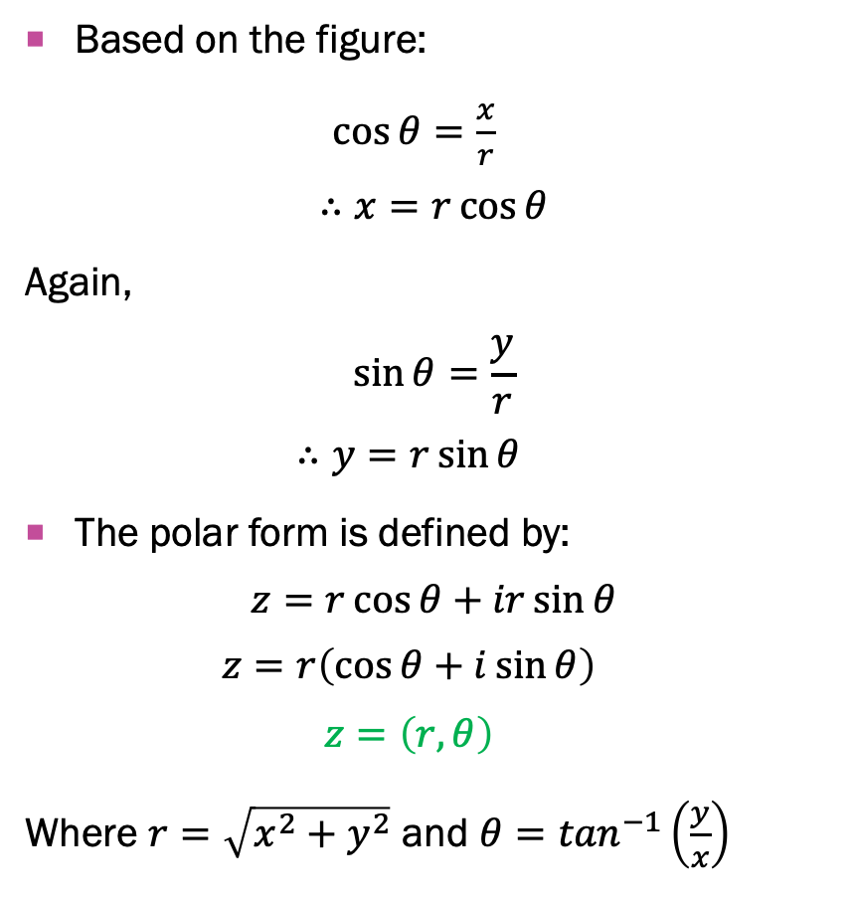



Polar Form of Complex Number
$$z=x+iy$$
Based on the figure:
$\cos{θ}=\frac{x}{r}$
$$∴x=r\cos{θ}$$
Again,
$$\sin{θ}=\frac{y}{r}$$
$$∴y=r\sin{θ}$$
The polar form is defined by:
$$z=r\cos{θ}+ir\sin{θ}$$
$$z=r\left(\cos{θ}+i\sin{θ}\right)$$
$$z=\left(r,θ\right)$$
Where $r=\sqrt{x^{2}+y^{2}}$ and $θ=\tan^{−1}\left(\frac{y}{x}\right)$
$$y(imaginary)$$
$$∙$$
$$(x,y)$$
$$r$$
$$y$$
$$θ$$
(0, 0)
$$x(real)$$
$$x$$

Slide 14




Exponential Form of $z$
$z = re^{iθ}$
where, $r = \left|z\right|$
$$θ=arg⁡(z)$$
$θ$ must be in radian.

