Slide 1

Radicals and Exponents
Masuma Parvin
Senior Lecturer
Department of GED
Daffodil International University

Slide 2



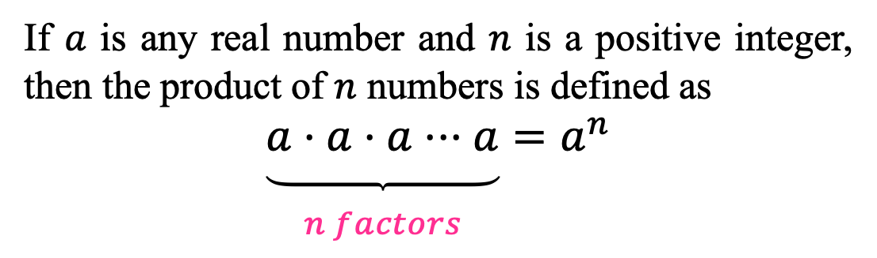
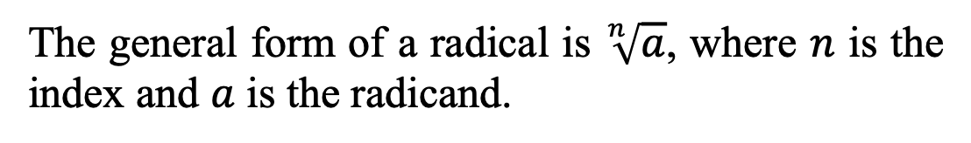
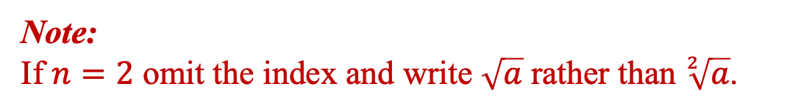
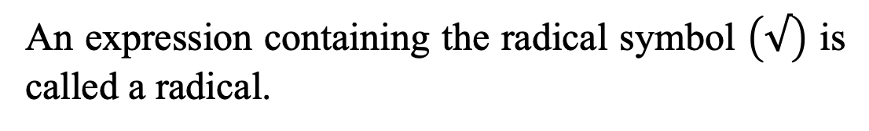
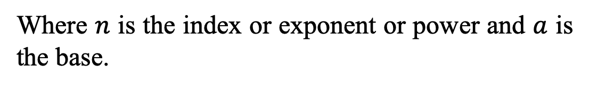
Definition
Exponent
If $a$ is any real number and $n$ is a positive integer, then the product of $n$numbers is defined as
$$\underset{\begin{aligned} \\ n factors\end{aligned}}{\underbrace{a⋅a⋅a⋅⋅⋅a}}=a^{n}$$
Exponent
(integer)
Base
(real number)
$$a^{n}$$
Where $n$ is the index or exponent or power and $a$ is the base.
Radical
Index
An expression containing the radical symbol $\left(√\right)$ is called a radical.
Radical Sign
$$\sqrt[n]{a}$$
The general form of a radical is $\sqrt[n]{a}$, where $n$ is the index and $a$ is the radicand.
Radicand
Note:﻿
If $n=2$ omit the index and write $\sqrt{a}$ rather than $\sqrt[2]{a}$.

Slide 3
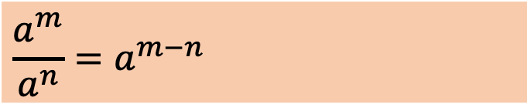
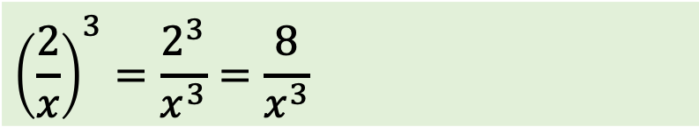

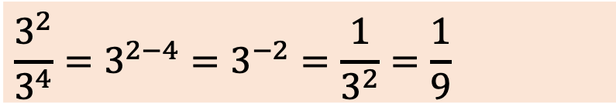
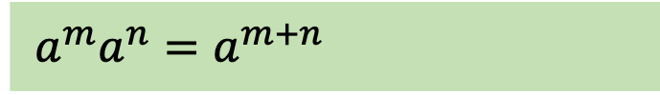

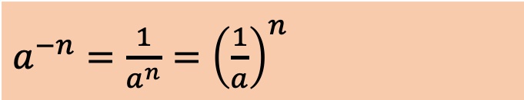
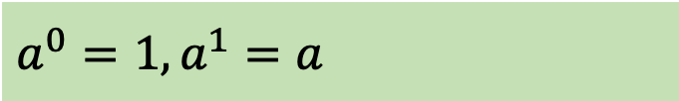

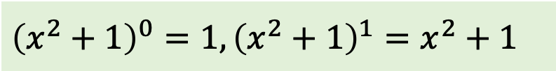
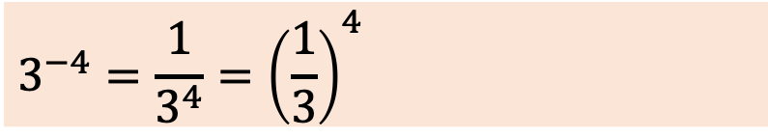
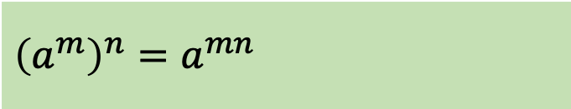
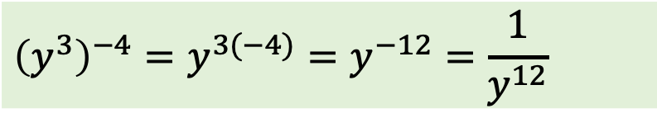
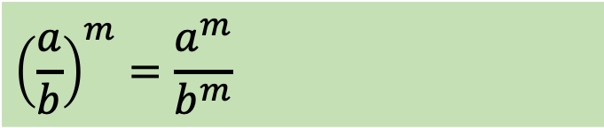
Properties of Exponents
Let $a$ and $b$ be real numbers, variables, or algebraic expressions and let $m$ and $n$ be integers (All denominators and bases are nonzero).
Property
Example
1.
$$a^{0}=1, a^{1}=a$$
$${\left(x^{2}+1\right)}^{0}=1,{\left(x^{2}+1\right)}^{1}=x^{2}+1$$
2.
$a^{−n}=\frac{1}{a^{n}}={\left(\frac{1}{a}\right)}^{n}$
$$3^{−4}=\frac{1}{3^{4}}={\left(\frac{1}{3}\right)}^{4}$$
3.
$$a^{m}a^{n}=a^{m+n}$$
$$3^{2}3^{4}=3^{2+4}=3^{6}=729$$
4.
$$\frac{a^{m}}{a^{n}}=a^{m−n}$$
$$\frac{3^{2}}{3^{4}}=3^{2−4}=3^{−2}=\frac{1}{3^{2}}=\frac{1}{9}$$
5.
$${\left(a^{m}\right)}^{n}=a^{mn}$$
$${\left(y^{3}\right)}^{−4}=y^{3(−4)}=y^{−12}=\frac{1}{y^{12}}$$
6.
$${\left(ab\right)}^{m}=a^{m}b^{m}$$
$${\left(5x\right)}^{3}=5^{3}x^{3}=125x^{3}$$
7.
$${\left(\frac{a}{b}\right)}^{m}=\frac{a^{m}}{b^{m}}$$
$${\left(\frac{2}{x}\right)}^{3}=\frac{2^{3}}{x^{3}}=\frac{8}{x^{3}}$$

Slide 4
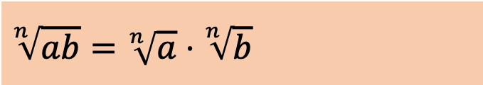
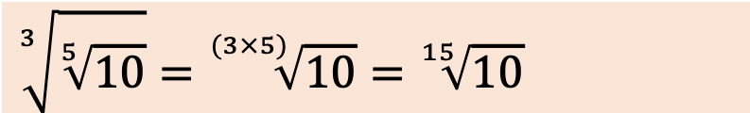
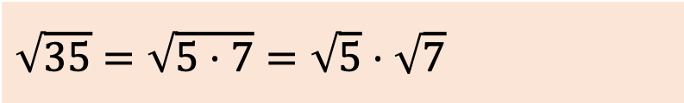
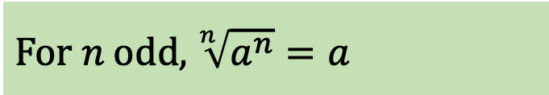
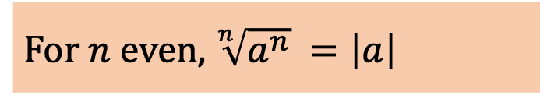
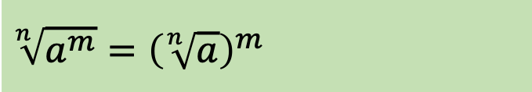
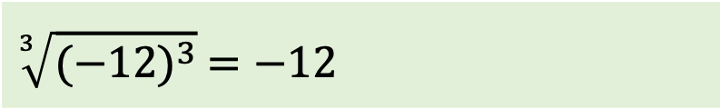
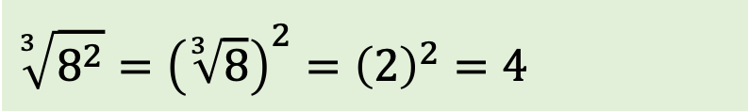
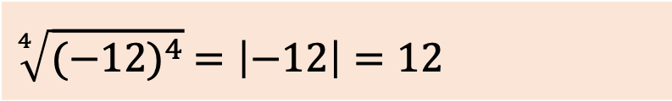
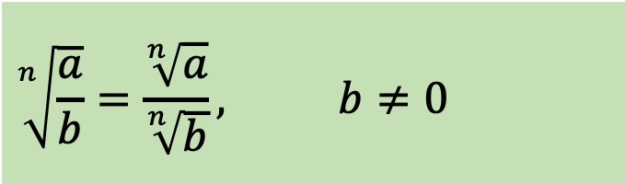
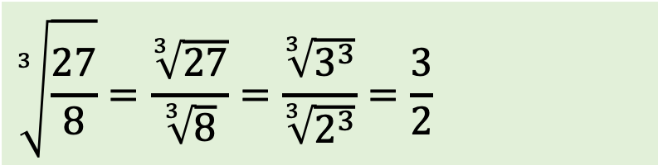
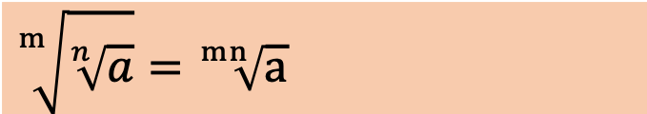
Properties of Radicals
Let $a$ and $b$ be real numbers, variables, or algebraic expressions such that the indicated roots are real numbers, and let $m$ and $n$ be positive integers.
Property
Example
1.
$$\sqrt[n]{a^{m}}={\left(\sqrt[n]{a}\right)}^{m}$$
$$\sqrt[3]{8^{2}}={\left(\sqrt[3]{8}\right)}^{2}={\left(2\right)}^{2}=4$$
2.
For$n$even, $\sqrt[n]{a^{n}} =\left|a\right|$
$$\sqrt[4]{{(−12)}^{4}} =\left|−12\right|=12$$
3.
$$\text{For} n \text{odd}\text{,} \sqrt[n]{a^{n}}=a$$
$$\sqrt[3]{{(−12)}^{3}} =−12$$
4.
$$\sqrt[n]{ab}=\sqrt[n]{a}⋅\sqrt[n]{b}$$
$$\sqrt{35}=\sqrt{5⋅7}=\sqrt{5}⋅\sqrt{7}$$
5.
$$\sqrt[n]{\frac{a}{b}}=\frac{\sqrt[n]{a}}{\sqrt[n]{b}}, b≠0$$
$$\sqrt[3]{\frac{27}{8}}=\frac{\sqrt[3]{27}}{\sqrt[3]{8}}=\frac{\sqrt[3]{3^{3}}}{\sqrt[3]{2^{3}}}=\frac{3}{2}$$
6.
$$\sqrt[m]{\sqrt[n]{a}}=\sqrt[mn]{a}$$
$$\sqrt[3]{\sqrt[5]{10}}=\sqrt[(3×5)]{10}=\sqrt[15]{10}$$

Slide 5
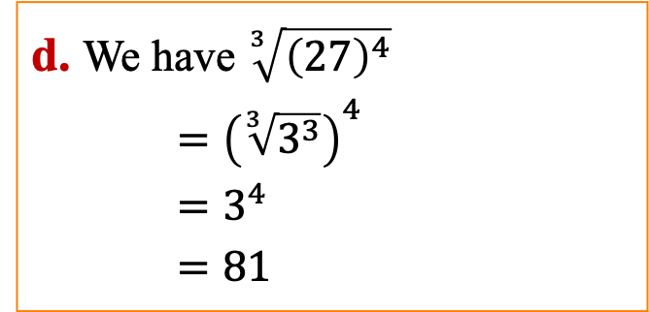
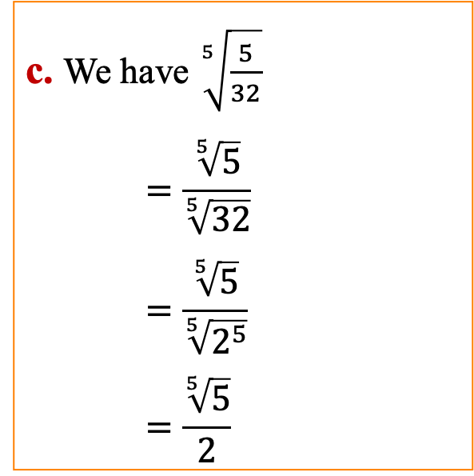
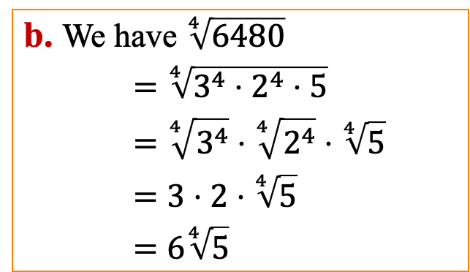
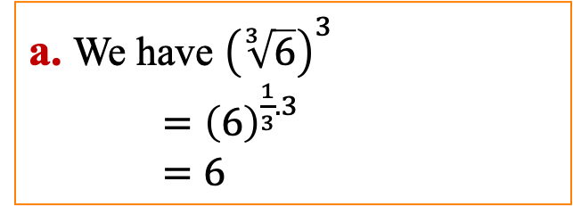
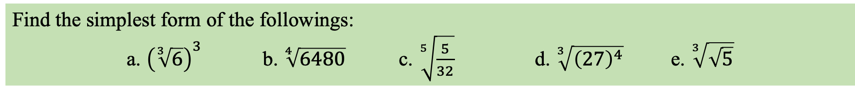
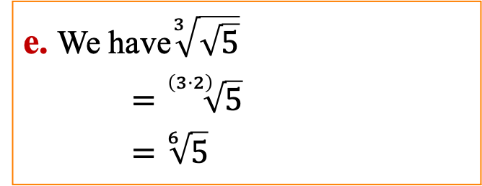
Simplification of Radicals
An expression involving radicals can be simplified by,
    by removing the perfect nth powers of the radicand.
    by reducing the index of the radical
    by rationalizing of the denominator of the radicand.
Find the simplest form of the followings:
a. ${\left(\sqrt[3]{6}\right)}^{3}$ b. $\sqrt[4]{6480}$ c. $\sqrt[5]{\frac{5}{32}}$ d. $\sqrt[3]{{\left(27\right)}^{4}}$ e. $\sqrt[3]{\sqrt{5}}$
a. We have ${\left(\sqrt[3]{6}\right)}^{3}$
$={\left(6\right)}^{\frac{1}{3}.3}$
$=6$
c. We have $\sqrt[5]{\frac{5}{32}}$
    $$=\frac{\sqrt[5]{5}}{\sqrt[5]{32}}$$
    $$=\frac{\sqrt[5]{5}}{\sqrt[5]{2^{5}}}$$
    $$=\frac{\sqrt[5]{5}}{2}$$
d. We have $\sqrt[3]{{\left(27\right)}^{4}}$
$={\left(\sqrt[3]{3^{3}}\right)}^{4}$
    $$=3^{4}$$
    $$=81$$
Property 3
Property 5
Property 1
b. We have $\sqrt[4]{6480}$
$=\sqrt[4]{3^{4}⋅2^{4}⋅5}$
    $$=\sqrt[4]{3^{4}}⋅\sqrt[4]{2^{4}}⋅\sqrt[4]{5}$$
    $$=3⋅2⋅\sqrt[4]{5}$$
    $$=6\sqrt[4]{5}$$
Property 4
e. We have$\sqrt[3]{\sqrt{5}}$
$=\sqrt[\left(3⋅2\right)]{5}$
    $$=\sqrt[6]{5}$$
Property 6

Slide 6



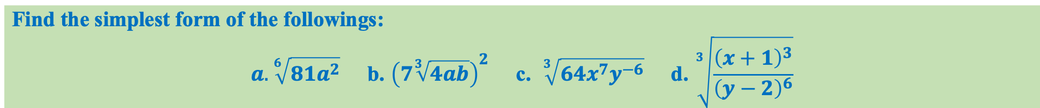



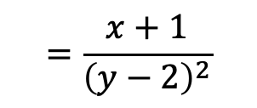











Find the simplest form of the followings:
$$a. \sqrt[6]{81a^{2}} \text{b}\text{. }{\left(7\sqrt[3]{4ab}\right)}^{2} \text{c}\text{. } \sqrt[3]{64x^{7}y^{−6}} \text{d}\text{. }\sqrt[3]{\frac{{\left(x+1\right)}^{3}}{{\left(y−2\right)}^{6}}}$$
a.
We have, $\sqrt[6]{81a^{2}}$
$$=\sqrt[6]{9^{2}a^{2}}$$
c.
We have,
$$=\sqrt[6]{{\left(9a\right)}^{2}}$$
d.
We have,
$$\sqrt[3]{64x^{7}y^{−6}}$$
$$\sqrt[3]{\frac{{\left(x+1\right)}^{3}}{{\left(y−2\right)}^{6}}}$$
$$={\left({\left(9a\right)}^{2}\right)}^{\frac{1}{6}}$$
$$=\sqrt[3]{4^{3}⋅x^{6}⋅x⋅y^{−6}}$$
$$={\left(9a\right)}^{\frac{1}{3}}=\sqrt[3]{9a}$$
$$=\sqrt[3]{4^{3}}⋅\sqrt[3]{{\left(x^{2}\right)}^{3}}⋅\sqrt[3]{x}⋅\sqrt[3]{y^{−6}}$$
$$=\frac{\sqrt[3]{{\left(x+1\right)}^{3}}}{\sqrt[3]{{\left(y−2\right)}^{6}}}$$
b.
We have,
$${\left(7 \sqrt[3]{4ab}\right)}^{2}$$
$$=4⋅x^{2}⋅\sqrt[3]{x}⋅y^{−2}$$
$$=\frac{x+1}{{\left(y−2\right)}^{2}}$$
$$=49⋅{\left(\sqrt[3]{4ab}\right)}^{2}$$
$$=\frac{4x^{2}}{y^{2}}\sqrt[3]{x}$$
$$=49⋅\sqrt[3]{{\left(4ab\right)}^{2}}$$
$$=49⋅\sqrt[3]{2^{3}.2a^{2}b^{2}}$$
$$=98⋅\sqrt[3]{2a^{2}b^{2}}$$

Slide 7









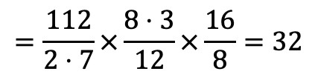
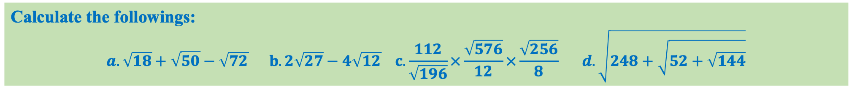
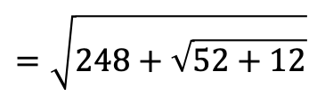



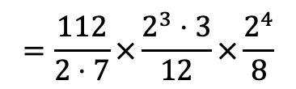

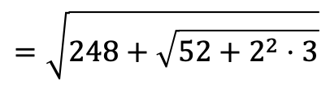







Calculate the followings:
$$a. \sqrt{18}+\sqrt{50}−\sqrt{72} b.2\sqrt{27}−4\sqrt{12} c.\frac{112}{\sqrt{196}}×\frac{\sqrt{576}}{12}×\frac{\sqrt{256}}{8} d.\sqrt{248+\sqrt{52+\sqrt{144}}}$$
$$\sqrt{18}+\sqrt{50}−\sqrt{72}$$
$$\sqrt{248+\sqrt{52+\sqrt{144}}}$$
a.
d.
$$=\sqrt{2⋅3^{2}}+\sqrt{2⋅5^{2}}−\sqrt{2^{3}⋅3^{2}}$$
c.
$$\frac{112}{\sqrt{196}}×\frac{\sqrt{576}}{12}×\frac{\sqrt{256}}{8}$$
$$=\sqrt{248+\sqrt{52+\sqrt{2^{4}⋅3^{2}}}}$$
$$=3\sqrt{2}+5\sqrt{2}−3\sqrt{2^{2}⋅2}$$
$$=3\sqrt{2}+5\sqrt{2}−6\sqrt{2}$$
$$=\frac{112}{\sqrt{2^{2}⋅7^{2}}}×\frac{\sqrt{2^{6}⋅3^{2}}}{12}×\frac{\sqrt{2^{8}}}{8}$$
$$=\sqrt{248+\sqrt{52+2^{2}⋅3}}$$
$$=2\sqrt{2}$$
$$=\sqrt{248+\sqrt{52+12}}$$
$$=\frac{112}{2⋅7}×\frac{2^{3}⋅3}{12}×\frac{2^{4}}{8}$$
b.
$$2\sqrt{27}−4\sqrt{12}$$
$$=\sqrt{248+\sqrt{64}}$$
$$=2\sqrt{3^{2}⋅3}−4\sqrt{2^{2}⋅3}$$
$$=\frac{112}{2⋅7}×\frac{8⋅3}{12}×\frac{16}{8}=32$$
$$=\sqrt{248+\sqrt{2^{6}}}$$
$$=2⋅3\sqrt{3}−4⋅2\sqrt{3}$$
$$=6\sqrt{3}−8\sqrt{3}$$
$$=32$$
$$=\sqrt{248+2^{3}}$$
$$=\sqrt{248+8}$$
$$=−2\sqrt{3}$$
$$=\sqrt{2^{8}}=2^{4}=16$$

Slide 8







Show that $3+\frac{1}{\sqrt{3}}+\frac{1}{3+\sqrt{3}}−\frac{1}{3−\sqrt{3}}=3$
$$\text{L}\text{.}\text{H}\text{.}\text{S} =3+\frac{1}{\sqrt{3}}+\frac{1}{3+\sqrt{3}}−\frac{1}{3−\sqrt{3}}$$
$$=3+\frac{\sqrt{3}}{\left(\sqrt{3}\right)\left(\sqrt{3}\right)}+\frac{\left(3−\sqrt{3}\right)}{\left(3+\sqrt{3}\right)\left(3−\sqrt{3}\right)}−\frac{\left(3+\sqrt{3}\right)}{\left(3−\sqrt{3}\right)\left(3+\sqrt{3}\right)}$$
$$=3+\frac{\sqrt{3}}{3}+\frac{\left(3−\sqrt{3}\right)}{3^{2}−{\left(\sqrt{3}\right)}^{2}}−\frac{\left(3+\sqrt{3}\right)}{3^{2}−{\left(\sqrt{3}\right)}^{2}}$$
$$L.H.S.=\frac{18+2\sqrt{3}+3−\sqrt{3}−3−\sqrt{3}}{6}$$
$$=3+\frac{\sqrt{3}}{3}+\frac{\left(3−\sqrt{3}\right)}{9−3}−\frac{\left(3+\sqrt{3}\right)}{9−3}$$
$$=\frac{18}{6}=3$$
$$=3+\frac{\sqrt{3}}{3}+\frac{\left(3−\sqrt{3}\right)}{6}−\frac{\left(3+\sqrt{3}\right)}{6}$$

Slide 9








Find the value of $a$&$b$ if $a+b\sqrt{6}=\frac{7\sqrt{3}+5\sqrt{2}}{\sqrt{48}−\sqrt{18}}$
Given that,
$$a+b\sqrt{6}=\frac{7\sqrt{3}+5\sqrt{2}}{\sqrt{48}−\sqrt{18}}$$
$$=\frac{114+41\sqrt{6}}{30}$$
$$=\frac{7\sqrt{3}+5\sqrt{2}}{4\sqrt{3}−3\sqrt{2}}$$
$$or, a+b\sqrt{6}=\frac{114}{30}+\frac{41}{30}\sqrt{6}$$
$$=\frac{\left(7\sqrt{3}+5\sqrt{2}\right)\left(4\sqrt{3}+3\sqrt{2}\right)}{\left(4\sqrt{3}−3\sqrt{2}\right)\left(4\sqrt{3}+3\sqrt{2}\right)}$$
$$∴a=\frac{114}{30}=\frac{19}{5} \text{and} b=\frac{41}{30}$$
$$=\frac{28×3+21\sqrt{2}\sqrt{3}+20\sqrt{2}\sqrt{3}+15×2}{48−18}$$
$$=\frac{84+21\sqrt{6}+20\sqrt{6}+30}{30}$$

Slide 10










What will be come in the place of question mark $\sqrt{86.49}+\sqrt{5+\left(?\right)}=12.3 ?$
Let the required value is $x$
According to the question we can write,
$$\sqrt{86.49}+\sqrt{5+\left(x\right)}=12.3$$
$$\text{or}\text{, } x={\left(\frac{123}{10}−\frac{93}{10}\right)}^{2}−5$$
$$o\text{r}\text{,} \sqrt{5+\left(x\right)}=12.3−\sqrt{86.49}$$
$$\text{or}\text{, }x={\left(\frac{30}{10}\right)}^{2}−5$$
$$\text{or}\text{, }5+x={\left(\frac{123}{10}−\sqrt{\frac{8649}{100}}\right)}^{2}$$
$$\text{or}\text{, } x={\left(3\right)}^{2}−5$$
$$\text{or}\text{, } x=9−5$$
$$\text{or}\text{, }x={\left(\frac{123}{10}−\frac{\sqrt{8649}}{\sqrt{100}}\right)}^{2}−5$$
$$\text{or}\text{, } x=4$$

Slide 11






What will be come in the place of question mark ${\left(?\right)}^{\frac{1}{4}}=\frac{48}{{\left(?\right)}^{\frac{3}{4}}} ?$
Let the required value is $x$
According to the question we can write,
$${\left(x\right)}^{\frac{1}{4}}=\frac{48}{{\left(x\right)}^{\frac{3}{4}}}$$
$$o\text{r}\text{,} {\left(x\right)}^{\frac{1}{4}}{\left(x\right)}^{\frac{3}{4}}=48$$
$$o\text{r}\text{,} {\left(x\right)}^{\frac{1}{4}+\frac{3}{4}}=48$$
$$o\text{r}\text{,} {\left(x\right)}^{\frac{4}{4}}=48$$
$$∴ x=48$$

Slide 12







If $\sqrt{841}=29$ then find the value of $\sqrt{841}+\sqrt{8.41}+\sqrt{0.0841}+\sqrt{0.000841}$
Given that, $\sqrt{841}=29$
Now,
$$\sqrt{841}+\sqrt{8.41}+\sqrt{0.0841}+\sqrt{0.000841}$$
$$=\sqrt{841}+\sqrt{\frac{841}{100}}+\sqrt{\frac{841}{10000}}+\sqrt{\frac{841}{1000000}}$$
$$=\sqrt{841}+\frac{\sqrt{841}}{\sqrt{100}}+\frac{\sqrt{841}}{\sqrt{10000}}+\frac{\sqrt{841}}{\sqrt{1000000}}$$
$$=29+\frac{29}{10}+\frac{29}{100}+\frac{29}{1000}$$
$$=\frac{29000+2900+290+29}{1000}$$
$$=\frac{32219}{1000}$$
$$=32.219$$

Slide 13






If$\sqrt{1+\frac{x}{144}}=\frac{13}{12}$, then find the value of $x$
We have,
$$\sqrt{1+\frac{x}{144}}=\frac{13}{12}$$
$$\text{or}\text{, }1+\frac{x}{144}={\left(\frac{13}{12}\right)}^{2}$$
$$\text{or}\text{, }\frac{x}{144}=\frac{169}{144}−1$$
$$\text{or}\text{, }\frac{x}{144}=\frac{169−144}{144}$$
$$\text{or}\text{, }\frac{x}{144}=\frac{25}{144}$$
$$∴ x=25$$

Slide 14








Find the value of $\frac{{\left(243\right)}^{\frac{n}{5}}×3^{2n+1}}{9^{n}×3^{n−1}}$
$$\frac{{\left(243\right)}^{\frac{n}{5}}×3^{2n+1}}{9^{n}×3^{n−1}}$$
We have,
$$=\frac{{\left(3\right)}^{5⋅\frac{n}{5}}{×3}^{2n+1}}{3^{2n}×3^{n−1}}$$
$$=\frac{3^{n}×3^{2n+1}}{3^{2n+n−1}}$$
$$=\frac{3^{n+2n+1}}{3^{2n+n−1}}$$
$$=\frac{3^{3n+1}}{3^{3n−1}}$$
$$=3^{3n+1−3n+1}$$
$$=3^{2}$$
$$=9$$

Slide 15
















If $2^{x}+2^{1−x}=3$, then find the value of $x$
Given that,
$$2^{x}+2^{1−x}=3$$
$$\text{or}\text{, }2^{x}+2^{1}⋅2^{−x}=3$$
$$\text{or}\text{, }2^{x}+2⋅\frac{1}{2^{x}}=3$$
$$\text{or}\text{, }a+2⋅\frac{1}{a}=3$$
$$\text{Let} 2^{x}=a$$
$$\text{or}\text{, }a^{2}+2=3a$$
$$\text{or}\text{, }a^{2}−3a+2=0$$
$$\text{or}\text{, }a^{2}−2a−a+2=0$$
$$\text{or}\text{, }a\left(a−2\right)−1\left(a−2\right)=0$$
$$\text{or}\text{, }\left(a−1\right)\left(a−2\right)=0$$
$$\text{Therefore} a−1=0 and a−2=0$$
$$⇒ a=1$$
$$⇒ a=2$$
$$⇒ 2^{x}=2^{0}$$
$$⇒2^{x}=2^{1}$$
$$⇒ x=0$$
$$⇒x=1$$

Slide 16















If $8^{x}.2^{y}=512$ and $3^{3x+2y}=9^{6}$, then what is the value of $x$ and $y$?
Given that,
$$8^{x}.2^{y}=512$$
Subtracting equation $(i)$ from equation $(ii)$we get,
$$\text{or}\text{, }{(2^{3})}^{x}.2^{y}=2^{9}$$
$$y=3$$
$$\text{or}\text{, }2^{3x}.2^{y}=2^{9}$$
Putting the value of $y$ in equation $(i)$we get,
$$\text{or}\text{, }2^{3x+y}=2^{9}$$
$$3x+3=9$$
$$∴ 3x+y=9………(i)$$
$$\text{or}\text{,} 3x=9−3=6$$
Again,
$$3^{3x+2y}=9^{6}$$
$$∴ x=2$$
$$\text{or}\text{,} 3^{3x+2y}={(3^{2})}^{6}$$
$$Therefore, x=2 \& y=3$$
$$\text{or}\text{,} 3^{3x+2y}=3^{12}$$
$$∴ 3x+2y=12………(ii)$$

Slide 17

Exercise
Find the simplest form of the followings: $\left(i\right) \sqrt[4]{\frac{16}{81}} \left(ii\right) \sqrt[5]{{\left(72\right)}^{4}} \left(iii\right)\frac{x−25}{\sqrt{x}+5} \left(iv\right) \sqrt[3]{\sqrt{246}}$
Evaluate $\sqrt{6084}$ by factorization method.
﻿Show that $\sqrt{5+2\sqrt{6}}=\sqrt{3}+\sqrt{2}$.
Find the cube root of $2744$.
If $x=1+\sqrt{2}$ and $y=1−\sqrt{2}$ then find the value of $x^{2}+y^{2}$.
If $2^{x−1}+2^{x+1}=1280$ then find the values of $x$.
If $\frac{5+2\sqrt{3}}{7+4\sqrt{3}}=a+b\sqrt{3}$then what are the values of $a \& b$?
Find the values of $\sqrt{6+\sqrt{6+\sqrt{6+…}}}$

