Slide 1

Pascal’s Triangle & Binomial Theorem
Masuma parvin
Senior Lecturer
Department of GED
Daffodil International University

Slide 2

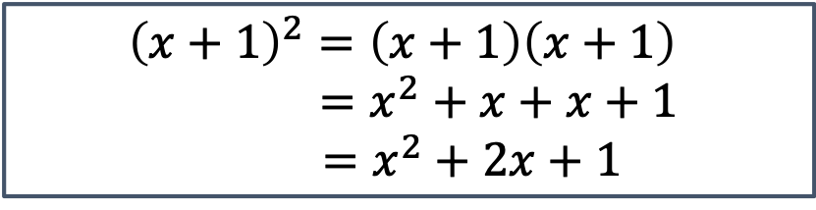
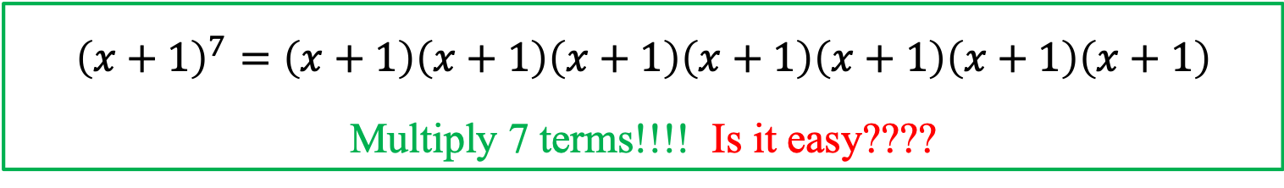
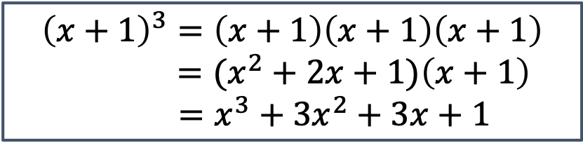
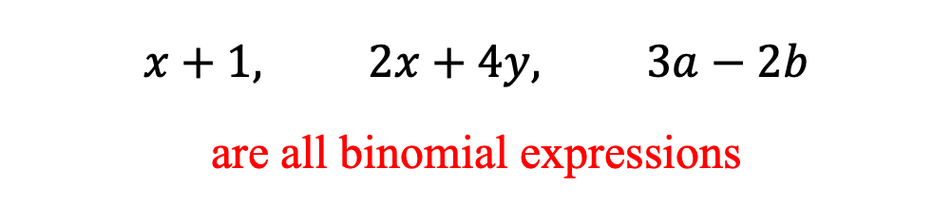
Introduction
A binomial expression is the sum or difference of two terms.
$$x+1, 2x+4y, 3a−2b$$
are all binomial expressions
How can we expand binomial expression ???
$${\left(x+1\right)}^{2}=\left(x+1\right)\left(x+1\right)$$
$$=x^{2}+x+x+1$$
$$=x^{2}+2x+1$$
$${\left(x+1\right)}^{3}=\left(x+1\right)\left(x+1\right)\left(x+1\right)$$
$$=(x^{2}+2x+1)\left(x+1\right)$$
$$=x^{3}+3x^{2}+3x+1$$
$${\left(x+1\right)}^{7}=\left(x+1\right)\left(x+1\right)\left(x+1\right)\left(x+1\right)\left(x+1\right)\left(x+1\right)\left(x+1\right)$$
Multiply 7 terms!!!! Is it easy????

Slide 3
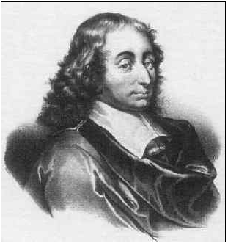
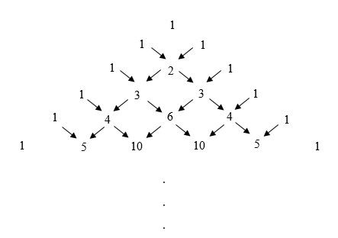
Pascal’s triangle
Pascal’s triangle starts with 1.
Each row of the triangle begins and ends with 1.
Each term is sum of the two numbers above it.
Pascal’s triangle determines the coefficients of each term in binomial expansion.
Row
0
1
Blaise Pascal (1623-1662)
2
3
4
5
This triangle is called Pascal’s Triangle (named after mathematician Blaise Pascal)

Slide 4


Pascal’s triangle to expand binomial expression
We can expand the binomial expression ${\left(a+b\right)}^{n}$ by Pascal’s triangle easily by the following procedure:
The row number in Pascal’s Triangle represents the exponent n of the binomial.
Each number in that row of Pascal’s triangle represents the coefficients of each term when expanded.
The exponents of a decrease by 1 in every term, and the exponents of b increase by 1in every term.
$${\left(a+b\right)}^{4}=1a^{4}b^{0}+4a^{3}b^{1}+6a^{2}b^{2}+4a^{1}b^{3}+1a^{0}b^{4}$$
$$=a^{4}+4a^{3}b+6a^{2}b^{2}+4ab^{3}+b^{4}$$
Row
For example, take ${\left(a+b\right)}^{4}.$
In this expression exponent is 4 so we will use 4th row in pascal’s triangle.
$${\left(a+b\right)}^{4}=1a^{4}b^{0}+4a^{3}b^{1}+6a^{2}b^{2}+4a^{1}b^{3}+1a^{0}b^{4}$$
$$=a^{4}+4a^{3}b+6a^{2}b^{2}+4ab^{3}+b^{4}$$
0
1
2
3
4
5

Slide 5
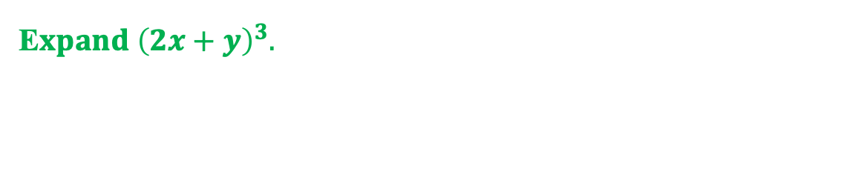
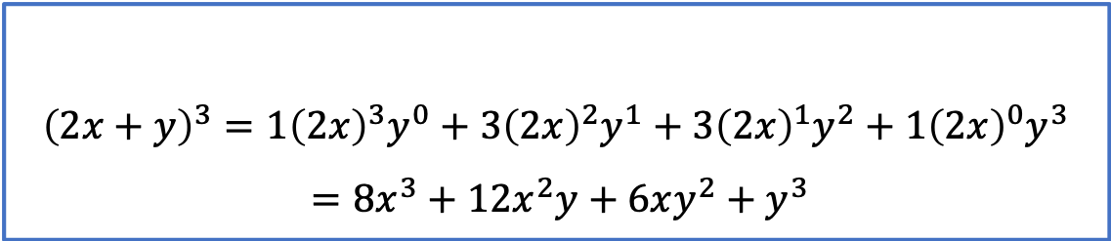
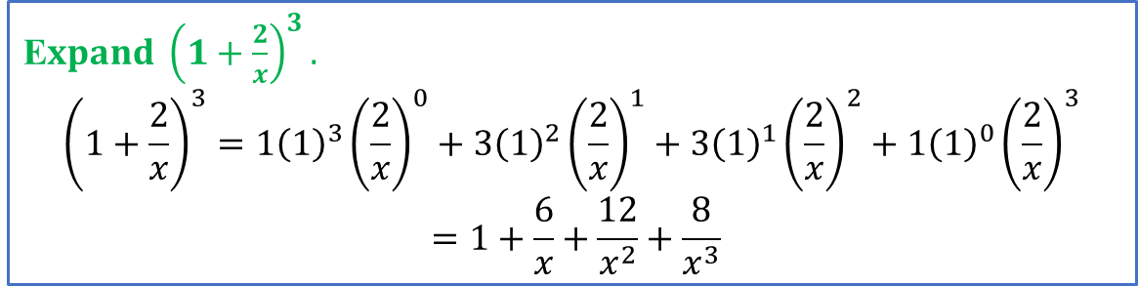
Examples of binomial expansion (using Pascal’s triangle)
E$xpand {\left(2x+y\right)}^{3}.$
$${\left(2x+y\right)}^{3}=1{\left(2x\right)}^{3}y^{0}+3{\left(2x\right)}^{2}y^{1}+3{\left(2x\right)}^{1}y^{2}+1{\left(2x\right)}^{0}y^{3}$$
$$=8x^{3}+12x^{2}y+6xy^{2}+y^{3}$$
Row
0
1
E$xpand {\left(1+\frac{2}{x}\right)}^{3}.$
$${\left(1+\frac{2}{x}\right)}^{3}=1{\left(1\right)}^{3}{\left(\frac{2}{x}\right)}^{0}+3{\left(1\right)}^{2}{\left(\frac{2}{x}\right)}^{1}+3{\left(1\right)}^{1}{\left(\frac{2}{x}\right)}^{2}+1{\left(1\right)}^{0}{\left(\frac{2}{x}\right)}^{3}$$
$$=1+\frac{6}{x}+\frac{12}{x^{2}}+\frac{8}{x^{3}}$$
2
3
4
5

Slide 6
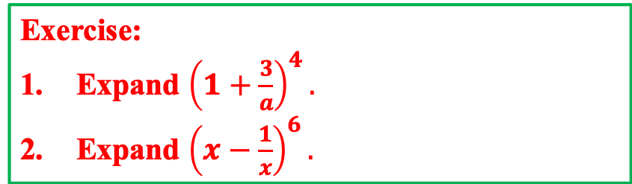
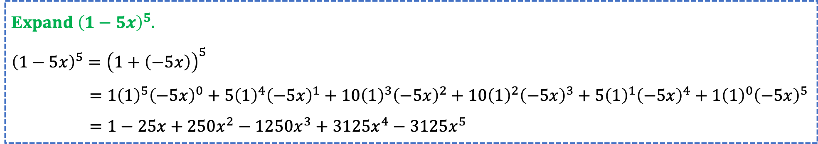
Examples of binomial expansion (using Pascal’s triangle) (cont.…)
E$xpand {\left(1−5x\right)}^{5}.$
$${\left(1−5x\right)}^{5}={\left(1+\left(−5x\right)\right)}^{5}$$
$=1{\left(1\right)}^{5}{\left(−5x\right)}^{0}+5{\left(1\right)}^{4}{\left(−5x\right)}^{1}+10{\left(1\right)}^{3}{\left(−5x\right)}^{2}+10{\left(1\right)}^{2}{\left(−5x\right)}^{3}+5{\left(1\right)}^{1}{\left(−5x\right)}^{4}+1{\left(1\right)}^{0}{\left(−5x\right)}^{5}$
$=1−25x+250x^{2}−1250x^{3}+3125x^{4}−3125x^{5}$
Row
0
1
2
3
Exercise:
Expand ${\left(1+\frac{3}{a}\right)}^{4}.$
Expand ${\left(x−\frac{1}{x}\right)}^{6}.$
4
5

Slide 7
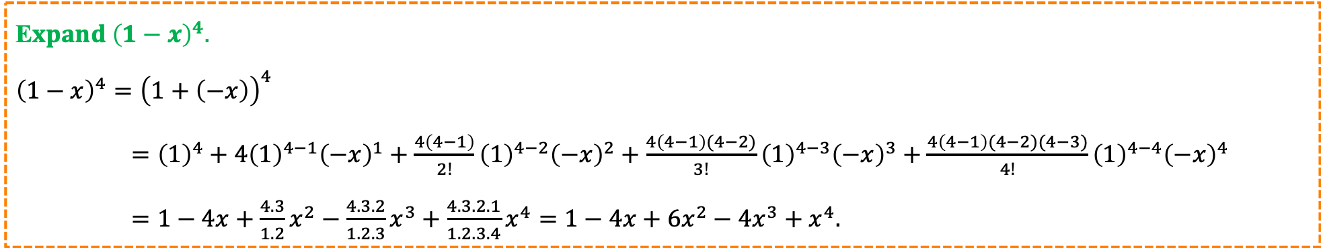
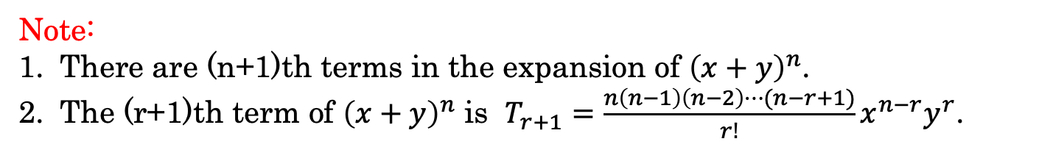
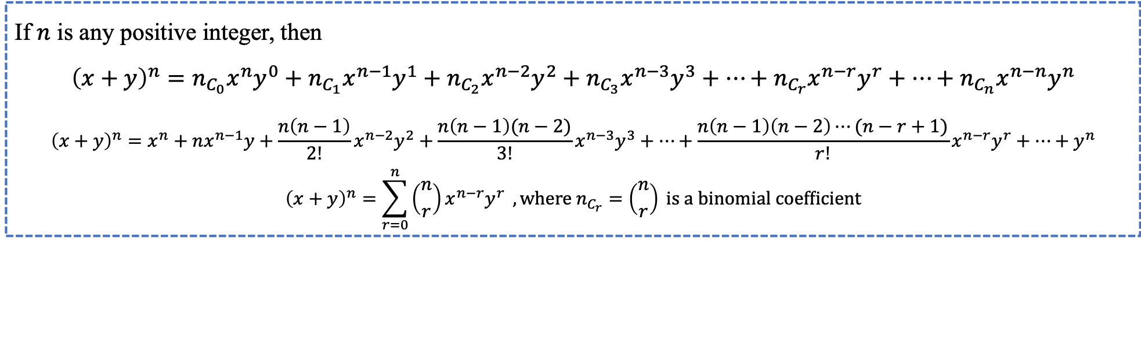
Binomial Theorem
If $n$ is any positive integer, then
$${\left(x+y\right)}^{n}=n_{C_{0}}x^{n}y^{0}+n_{C_{1}}x^{n−1}y^{1}+n_{C_{2}}x^{n−2}y^{2}+n_{C_{3}}x^{n−3}y^{3}+⋯+{n_{C_{r}}x}^{n−r}y^{r}+⋯+n_{C_{n}}x^{n−n}y^{n}$$
$${\left(x+y\right)}^{n}=x^{n}+nx^{n−1}y+\frac{n\left(n−1\right)}{2!}x^{n−2}y^{2}+\frac{n\left(n−1\right)(n−2)}{3!}x^{n−3}y^{3}+⋯+{\frac{n\left(n−1\right)\left(n−2\right)⋯(n−r+1)}{r!}x}^{n−r}y^{r}+⋯+y^{n}$$
$${\left(x+y\right)}^{n}=\sum_{r=0}^{n}{\left({n \atop r}\right)x^{n−r}y^{r} }, where n_{C_{r}}=\left({n \atop r}\right) is a binomial coefficient$$
Note:
There are (n+1)th terms in the expansion of ${\left(x+y\right)}^{n}$.
The (r+1)th term of ${\left(x+y\right)}^{n}$ is $T_{r+1}={\frac{n\left(n−1\right)\left(n−2\right)⋯(n−r+1)}{r!}x}^{n−r}y^{r}$.
E$xpand {\left(1−x\right)}^{4}.$
$${\left(1−x\right)}^{4}={\left(1+\left(−x\right)\right)}^{4}$$
$={\left(1\right)}^{4}+{4\left(1\right)}^{4−1}{\left(−x\right)}^{1}+\frac{4\left(4−1\right)}{2!}{\left(1\right)}^{4−2}{\left(−x\right)}^{2}+\frac{4\left(4−1\right)(4−2)}{3!}{\left(1\right)}^{4−3}{\left(−x\right)}^{3}+\frac{4\left(4−1\right)(4−2)(4−3)}{4!}{\left(1\right)}^{4−4}{\left(−x\right)}^{4}$
$=1−4x+\frac{4.3}{1.2}x^{2}−\frac{4.3.2}{1.2.3}x^{3}+\frac{4.3.2.1}{1.2.3.4}x^{4}=1−4x+6x^{2}−4x^{3}+x^{4}.$

Slide 8
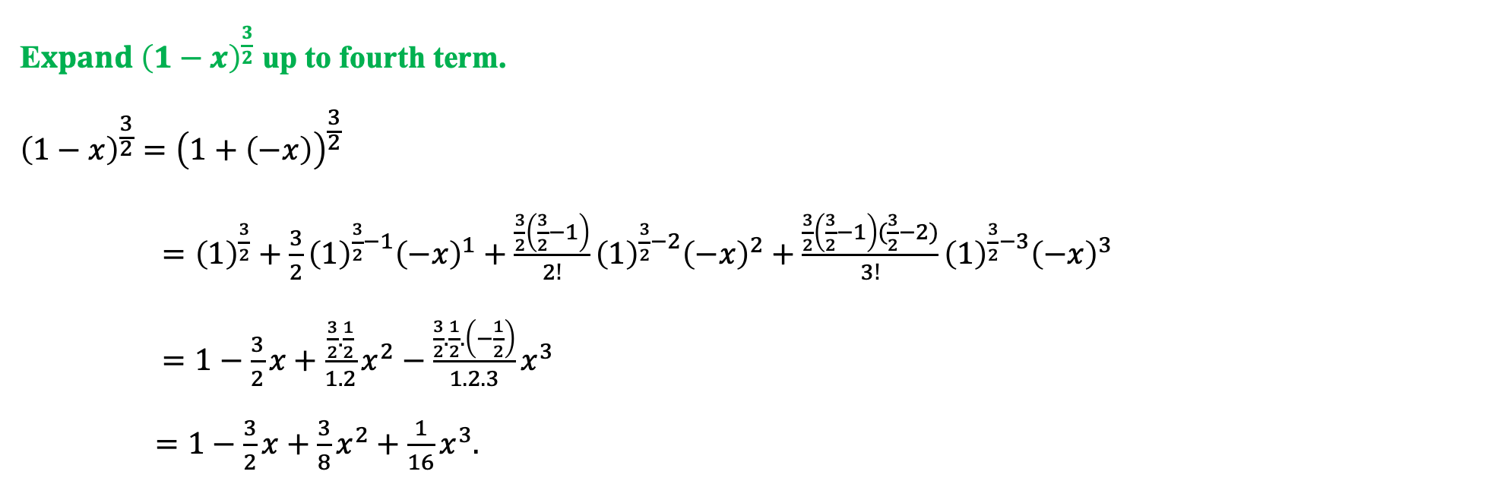
Examples
$${\left(x+y\right)}^{n}=x^{n}+nx^{n−1}y+\frac{n\left(n−1\right)}{2!}x^{n−2}y^{2}+\frac{n\left(n−1\right)(n−2)}{3!}x^{n−3}y^{3}+⋯+{\frac{n\left(n−1\right)\left(n−2\right)⋯(n−r+1)}{r!}x}^{n−r}y^{r}+⋯+y^{n}$$
E$xpand {\left(1−x\right)}^{\frac{3}{2}}$ up to fourth term.
$${\left(1−x\right)}^{\frac{3}{2}}={\left(1+\left(−x\right)\right)}^{\frac{3}{2}}$$
$={\left(1\right)}^{\frac{3}{2}}+{\frac{3}{2}\left(1\right)}^{\frac{3}{2}−1}{\left(−x\right)}^{1}+\frac{\frac{3}{2}\left(\frac{3}{2}−1\right)}{2!}{\left(1\right)}^{\frac{3}{2}−2}{\left(−x\right)}^{2}+\frac{\frac{3}{2}\left(\frac{3}{2}−1\right)(\frac{3}{2}−2)}{3!}{\left(1\right)}^{\frac{3}{2}−3}{\left(−x\right)}^{3}$
$=1−\frac{3}{2}x+\frac{\frac{3}{2}.\frac{1}{2}}{1.2}x^{2}−\frac{\frac{3}{2}.\frac{1}{2}.\left(−\frac{1}{2}\right)}{1.2.3}x^{3}$
$=1−\frac{3}{2}x+\frac{3}{8}x^{2}+\frac{1}{16}x^{3}.$

Slide 9
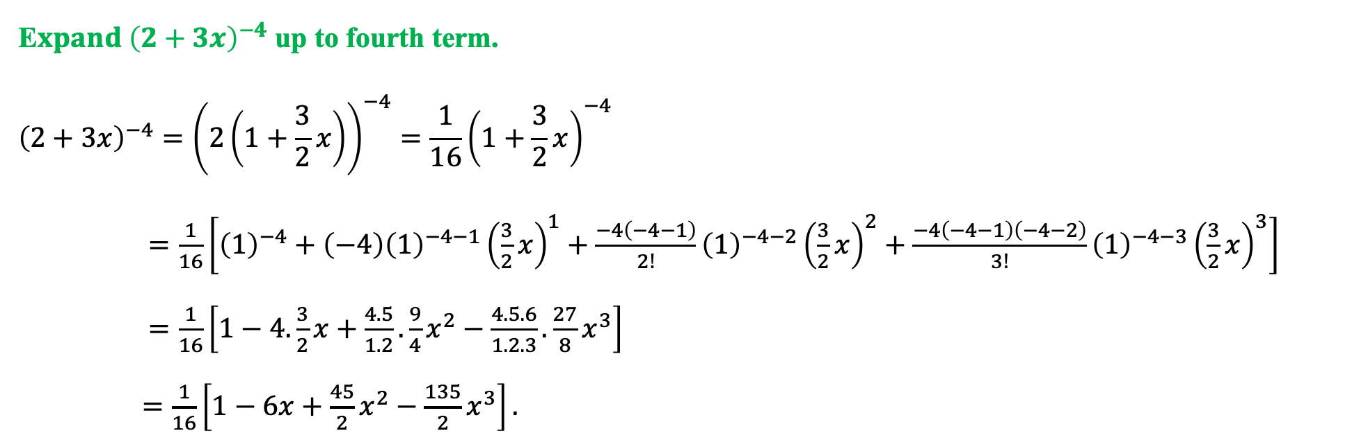
Examples (cont.…)
$${\left(x+y\right)}^{n}=x^{n}+nx^{n−1}y+\frac{n\left(n−1\right)}{2!}x^{n−2}y^{2}+\frac{n\left(n−1\right)(n−2)}{3!}x^{n−3}y^{3}+⋯+{\frac{n\left(n−1\right)\left(n−2\right)⋯(n−r+1)}{r!}x}^{n−r}y^{r}+⋯+y^{n}$$
E$xpand {\left(2+3x\right)}^{−4}$ up to fourth term.
$${\left(2+3x\right)}^{−4}={\left(2\left(1+\frac{3}{2}x\right)\right)}^{−4}={\frac{1}{16}\left(1+\frac{3}{2}x\right)}^{−4}$$
$=\frac{1}{16}\left[{\left(1\right)}^{−4}+{\left(−4\right)\left(1\right)}^{−4−1}{\left(\frac{3}{2}x\right)}^{1}+\frac{−4\left(−4−1\right)}{2!}{\left(1\right)}^{−4−2}{\left(\frac{3}{2}x\right)}^{2}+\frac{−4\left(−4−1\right)\left(−4−2\right)}{3!}{\left(1\right)}^{−4−3}{\left(\frac{3}{2}x\right)}^{3}\right]$
$=\frac{1}{16}\left[1−4.\frac{3}{2}x+\frac{4.5}{1.2}.\frac{9}{4}x^{2}−\frac{4.5.6}{1.2.3}.\frac{27}{8}x^{3}\right]$
$=\frac{1}{16}\left[1−6x+\frac{45}{2}x^{2}−\frac{135}{2}x^{3}\right].$

Slide 10
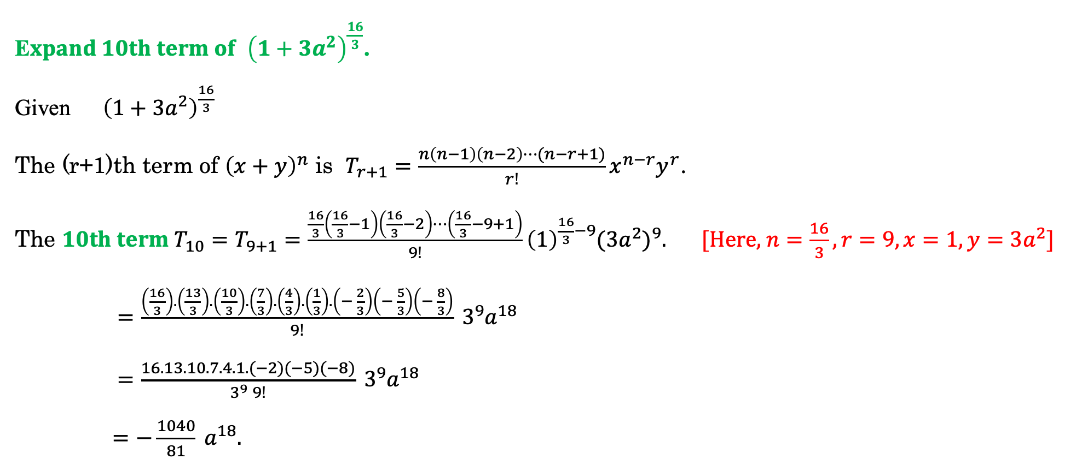
Examples (cont.…)
E$xpand 10th term of {\left(1+3a^{2}\right)}^{\frac{16}{3}}$.
Given ${\left(1+3a^{2}\right)}^{\frac{16}{3}}$
The (r+1)th term of ${\left(x+y\right)}^{n}$ is $T_{r+1}={\frac{n\left(n−1\right)\left(n−2\right)⋯(n−r+1)}{r!}x}^{n−r}y^{r}$.
The $10th term {T_{10}=T}_{9+1}={\frac{\frac{16}{3}\left(\frac{16}{3}−1\right)\left(\frac{16}{3}−2\right)⋯\left(\frac{16}{3}−9+1\right)}{9!}\left(1\right)}^{\frac{16}{3}−9}{(3a^{2})}^{9}$.[Here, $n=\frac{16}{3}, r=9, x=1, y=3a^{2}]$
$=\frac{\left(\frac{16}{3}\right).\left(\frac{13}{3}\right).\left(\frac{10}{3}\right).\left(\frac{7}{3}\right).\left(\frac{4}{3}\right).\left(\frac{1}{3}\right).\left(− \frac{2}{3}\right)\left(− \frac{5}{3}\right)\left(− \frac{8}{3}\right)}{9!} 3^{9}a^{18}$
$=\frac{16.13.10.7.4.1.(−2)(−5)(−8)}{3^{9} 9!} 3^{9}a^{18}$
$=−\frac{1040}{81} a^{18}.$

Slide 11
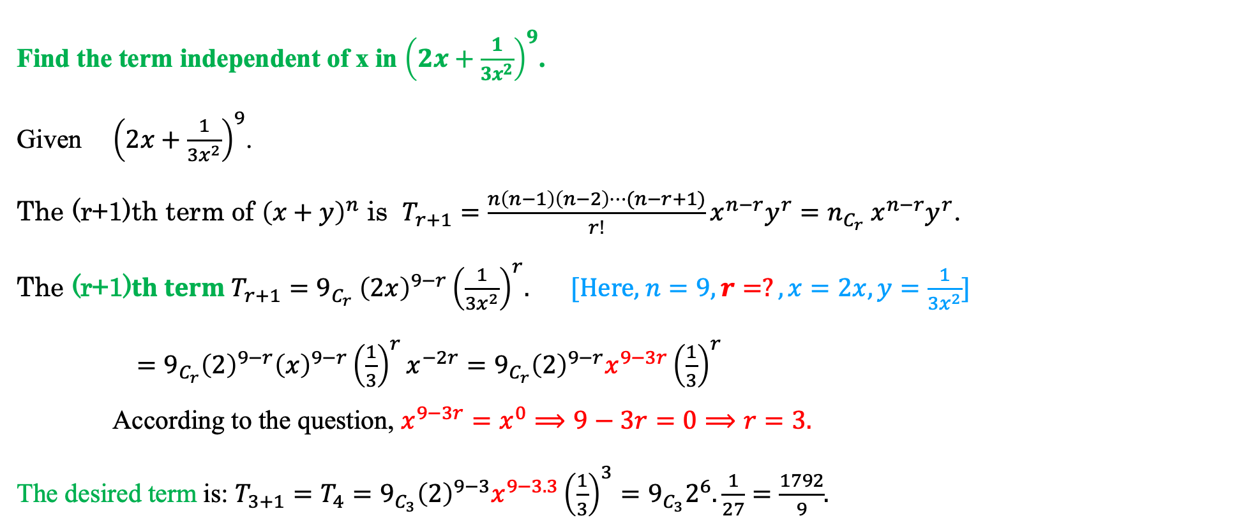
Examples (cont.…)
Find the term independent of x in ${\left(2x+\frac{1}{3x^{2}}\right)}^{9}$.
Given ${\left(2x+\frac{1}{3x^{2}}\right)}^{9}$.
The (r+1)th term of ${\left(x+y\right)}^{n}$ is $T_{r+1}={\frac{n\left(n−1\right)\left(n−2\right)⋯(n−r+1)}{r!}x}^{n−r}y^{r}={n_{C_{r}} x}^{n−r}y^{r}$.
The (r+1)$th term T_{r+1}={9_{C_{r}} \left(2x\right)}^{9−r}{\left(\frac{1}{3x^{2}}\right)}^{r}$.[Here, $n=9, r=?, x=2x, y=\frac{1}{3x^{2}}]$
$=9_{C_{r}}{\left(2\right)}^{9−r}{\left(x\right)}^{9−r}{\left(\frac{1}{3}\right)}^{r}x^{−2r}=9_{C_{r}}{\left(2\right)}^{9−r}x^{9−3r}{\left(\frac{1}{3}\right)}^{r}$
According to the question, $x^{9−3r}=x^{0}⟹9−3r=0⟹r=3.$
The desired term is: $T_{3+1}=T_{4}=9_{C_{3}}{\left(2\right)}^{9−3}x^{9−3.3}{\left(\frac{1}{3}\right)}^{3}=9_{C_{3}}2^{6}.\frac{1}{27}=\frac{1792}{9}$.

Slide 12
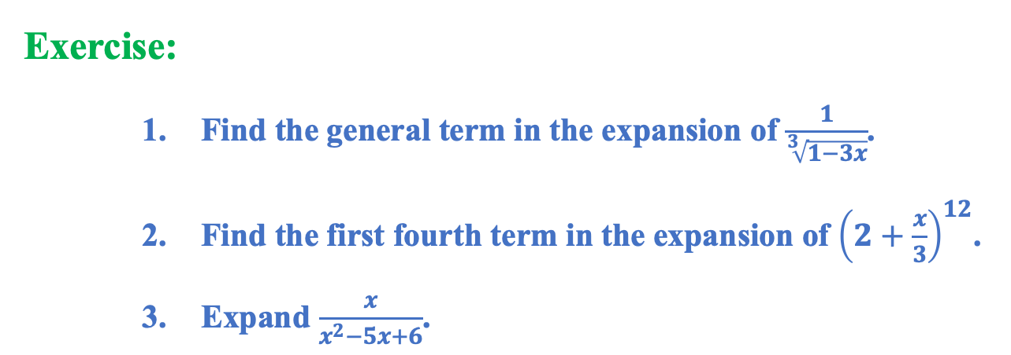
Examples (cont.…)
Exercise:
    Find the general term in the expansion of $\frac{1}{\sqrt[3]{1−3x}}$.
    Find the first fourth term in the expansion of ${\left(2+\frac{x}{3}\right)}^{12}$.
    Expand $\frac{x}{x^{2}−5x+6}$.

