Slide 1
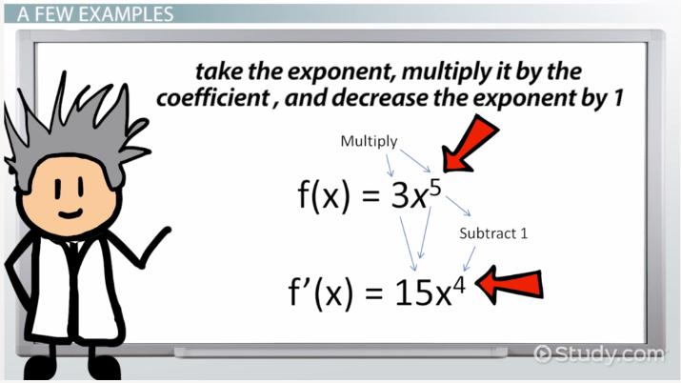
Welcome To My Lecture
Differentiation by Masuma Parvin

Slide 2
Differentiation
The derivative is a mathematical operator, which measures the rate of change of a quantity relative to another quantity. The process of finding a derivative is called differentiation.
There are many phenomena related changing quantities such as speed of a particle, inflation of currency, intensity of an earthquake and voltage of an electrical signal etc. in the world. In this chapter we will discuss about various techniques of derivative

Slide 3
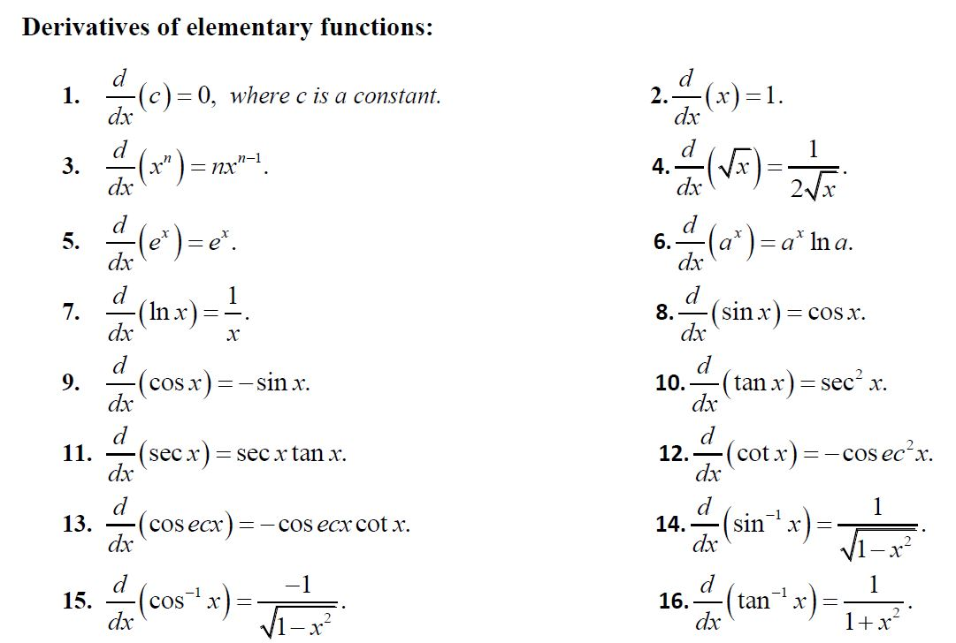

Slide 4
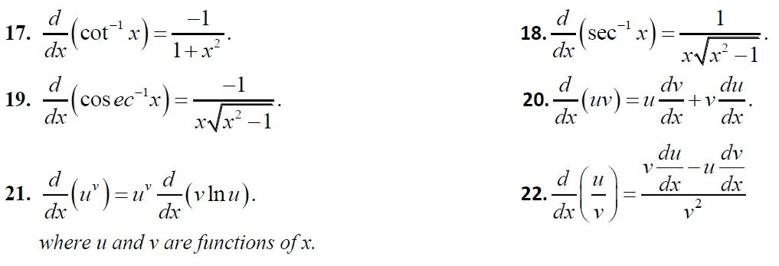

Slide 5

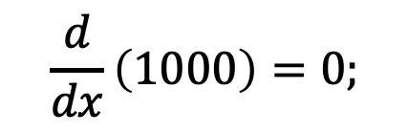
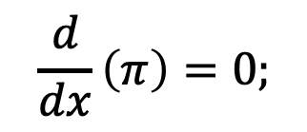
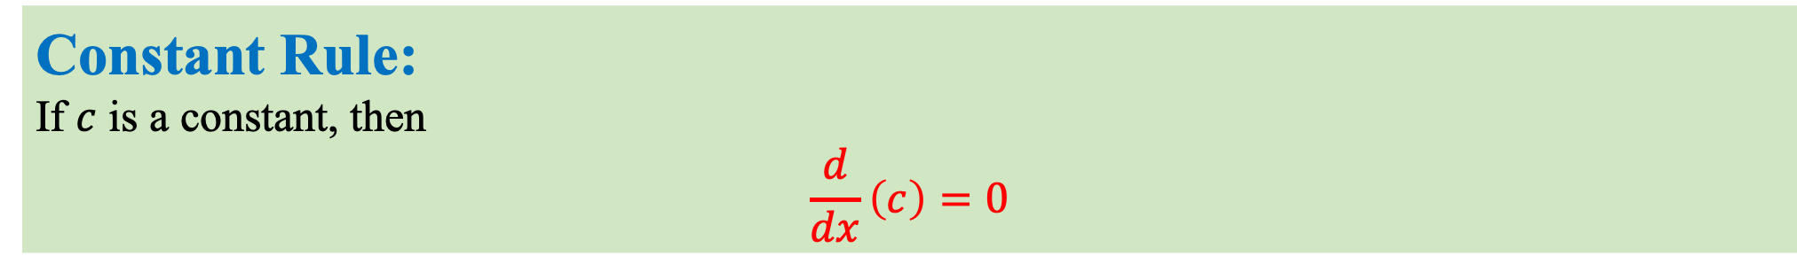
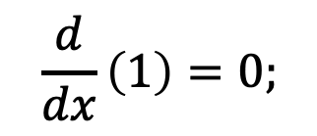
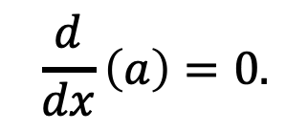
Example:
Constant Rule:
If $c$ is a constant, then
$$\frac{d}{dx}\left(c\right)=0$$
$$\frac{d}{dx}\left(1\right)=0;$$
$$\frac{d}{dx}\left(π\right)=0;$$
$$\frac{d}{dx}\left(1000\right)=0;$$
$$\frac{d}{dx}\left(a\right)=0.$$

Slide 6
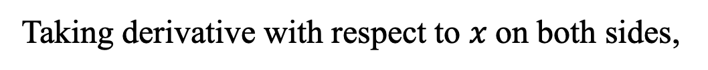
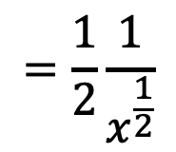
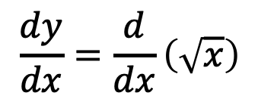
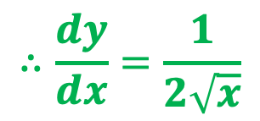
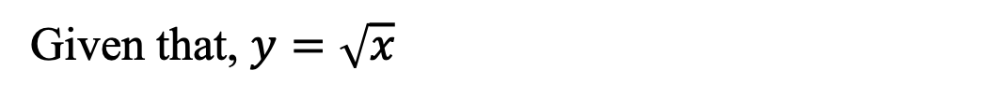
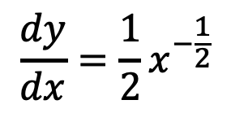
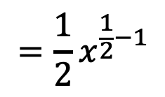
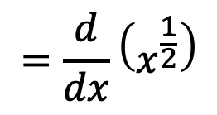

Example: Find $\frac{dy}{dx}$ for the function $y=\sqrt{x}$
Power Rule:
$$\frac{d}{dx}\left(x^{n}\right)=nx^{n−1}$$
Given that,$y=\sqrt{x}$
Taking derivative with respect to $x$on both sides,
$$\frac{dy}{dx}=\frac{d}{dx}\left(\sqrt{x}\right)$$
$$\frac{dy}{dx}=\frac{1}{2}x^{−\frac{1}{2}}$$
$$=\frac{1}{2}\frac{1}{x^{\frac{1}{2}}}$$
$$=\frac{d}{dx}\left(x^{\frac{1}{2}}\right)$$
$$=\frac{1}{2}x^{\frac{1}{2}−1}$$
$$∴\frac{dy}{dx}=\frac{1}{2\sqrt{x}}$$

Slide 7
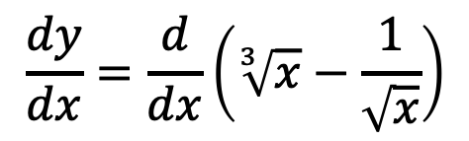
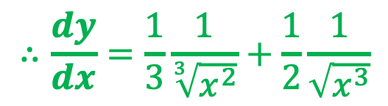
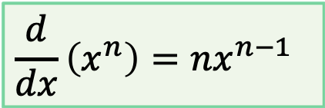
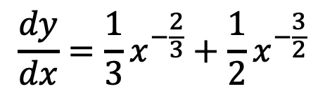

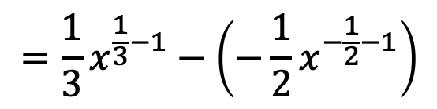
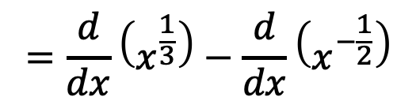
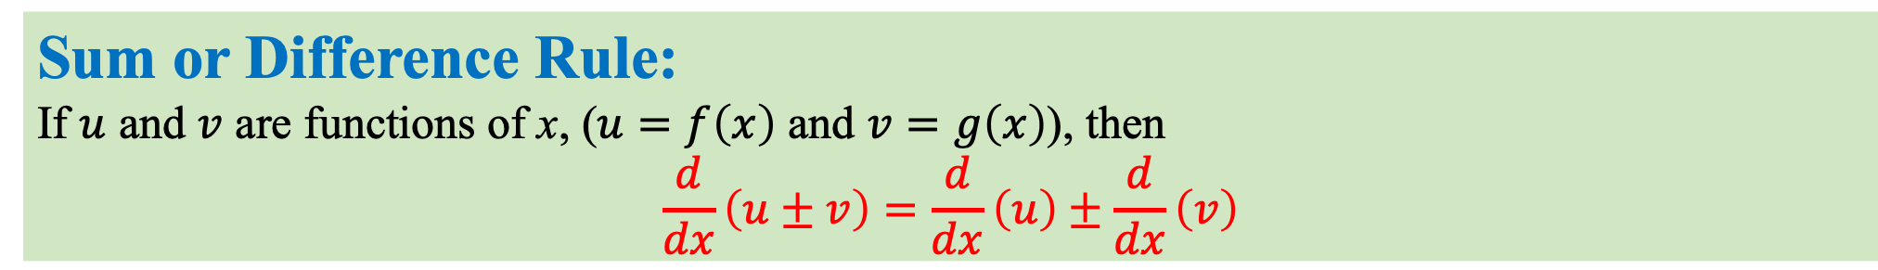
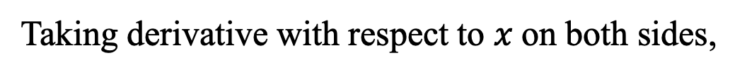
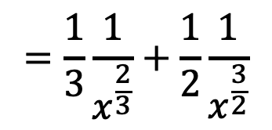
Sum or Difference Rule:
If $u$ and $v$ are functions of x, ($u=f\left(x\right)$ and $v=g\left(x\right)$), then
$$\frac{d}{dx}\left(u±v\right)=\frac{d}{dx}\left(u\right)±\frac{d}{dx}\left(v\right)$$
Example 1: Find $\frac{dy}{dx}$ for the function $y=\sqrt[3]{x}−\frac{1}{\sqrt{x}}$
Given that,$y=\sqrt[3]{x}−\frac{1}{\sqrt{x}}$
$$\frac{dy}{dx}=\frac{1}{3}x^{−\frac{2}{3}}+\frac{1}{2}x^{−\frac{3}{2}}$$
Taking derivative with respect to $x$on both sides,
$$=\frac{1}{3}\frac{1}{x^{\frac{2}{3}}}+\frac{1}{2}\frac{1}{x^{\frac{3}{2}}}$$
$$\frac{dy}{dx}=\frac{d}{dx}\left(\sqrt[3]{x}−\frac{1}{\sqrt{x}}\right)$$
$$=\frac{d}{dx}\left(x^{\frac{1}{3}}\right)−\frac{d}{dx}\left(x^{−\frac{1}{2}}\right)$$
$$∴\frac{dy}{dx}=\frac{1}{3}\frac{1}{\sqrt[3]{x^{2}}}+\frac{1}{2}\frac{1}{\sqrt{x^{3}}}$$
$$\frac{d}{dx}\left(x^{n}\right)=nx^{n−1}$$
$$=\frac{1}{3}x^{\frac{1}{3}−1}−\left(−\frac{1}{2}x^{−\frac{1}{2}−1}\right)$$

Slide 8
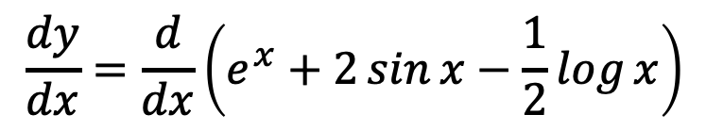
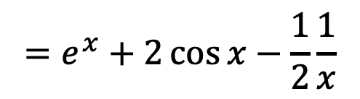
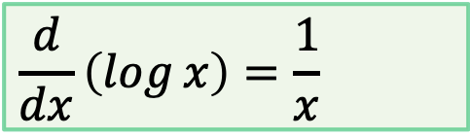
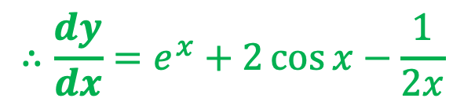
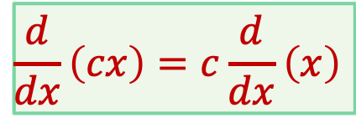
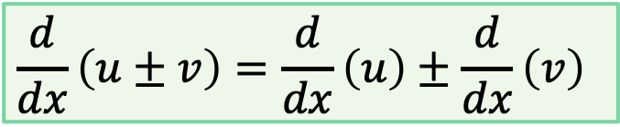

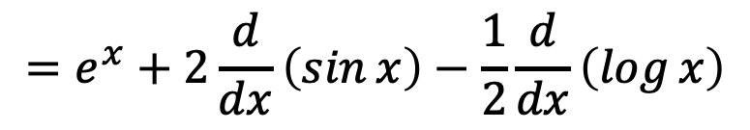
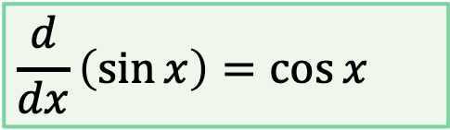
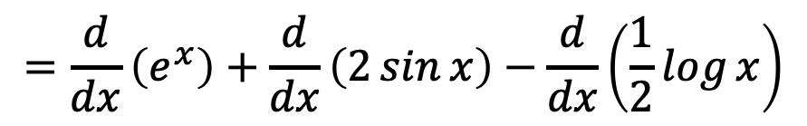
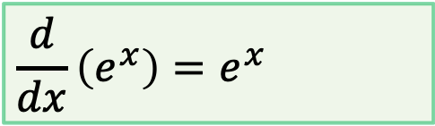
Example 2: Find $\frac{dy}{dx}$ for the function $y=e^{x}+2\sin{x}−\frac{1}{2}\log{x}$
Sum or Difference Rule: (Cont...)
Given that, $y=e^{x}+2\sin{x}−\frac{1}{2}\log{x}$
Taking derivative with respect to $x$on both sides,
$$\frac{dy}{dx}=\frac{d}{dx}\left(e^{x}+2\sin{x}−\frac{1}{2}\log{x}\right)$$
$$\frac{d}{dx}\left(u±v\right)=\frac{d}{dx}\left(u\right)±\frac{d}{dx}\left(v\right)$$
$$=\frac{d}{dx}\left(e^{x}\right)+\frac{d}{dx}\left(2\sin{x}\right)−\frac{d}{dx}\left(\frac{1}{2}\log{x}\right)$$
$$\frac{d}{dx}\left(e^{x}\right)=e^{x}$$
$$\frac{d}{dx}\left(cx\right)=c\frac{d}{dx}\left(x\right)$$
$$=e^{x}+2\frac{d}{dx}\left(\sin{x}\right)−\frac{1}{2}\frac{d}{dx}\left(\log{x}\right)$$
$$\frac{d}{dx}\left(\sin{x}\right)=\cos{x}$$
$$=e^{x}+2\cos{x}−\frac{1}{2}\frac{1}{x}$$
$$\frac{d}{dx}\left(\log{x}\right)=\frac{1}{x}$$
$$∴\frac{dy}{dx}=e^{x}+2\cos{x}−\frac{1}{2x}$$

Slide 9
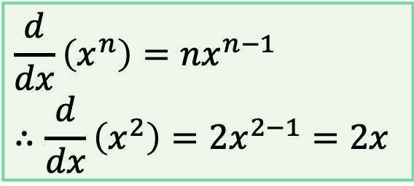
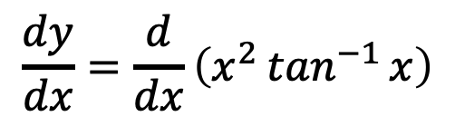
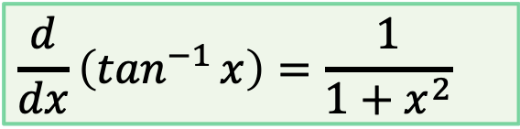
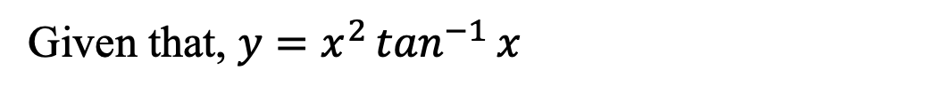
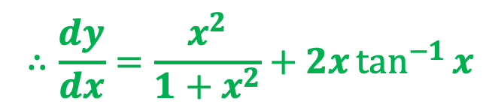
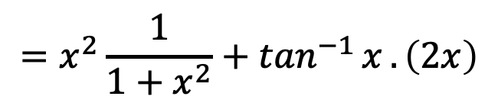
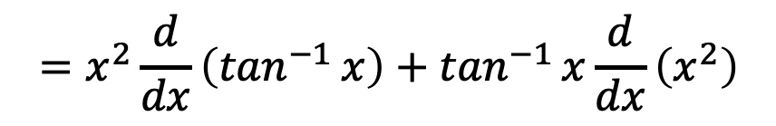
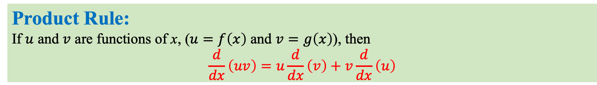
Example: Find $\frac{dy}{dx}$ for the function $y=x^{2}\tan^{−1}{x}$
Product Rule:
If $u$ and $v$ are functions of x, ($u=f\left(x\right)$ and $v=g\left(x\right)$), then
$$\frac{d}{dx}\left(uv\right)=u\frac{d}{dx}\left(v\right)+v\frac{d}{dx}\left(u\right)$$
Given that, $y=x^{2}\tan^{−1}{x}$
Taking derivative with respect to $x$on both sides,
$$\frac{dy}{dx}=\frac{d}{dx}\left(x^{2}\tan^{−1}{x}\right)$$
$$\frac{d}{dx}\left(\tan^{−1}{x}\right)=\frac{1}{1+x^{2}}$$
$$=x^{2}\frac{d}{dx}\left(\tan^{−1}{x}\right)+\tan^{−1}{x}\frac{d}{dx}\left(x^{2}\right)$$
$$\frac{d}{dx}\left(x^{n}\right)=nx^{n−1}$$
$$∴\frac{d}{dx}\left(x^{2}\right)=2x^{2−1}=2x$$
$$=x^{2}\frac{1}{1+x^{2}}+\tan^{−1}{x}.\left(2x\right)$$
$$∴\frac{dy}{dx}=\frac{x^{2}}{1+x^{2}}+2x\tan^{−1}{x}$$

Slide 10
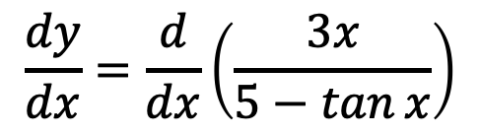
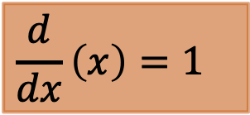

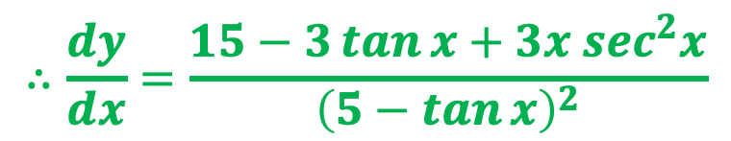
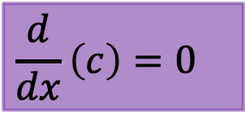
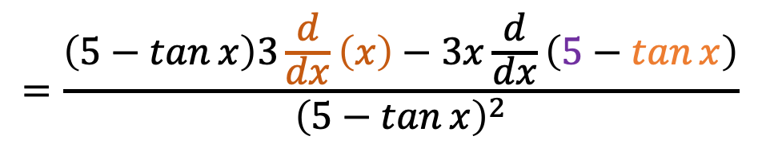
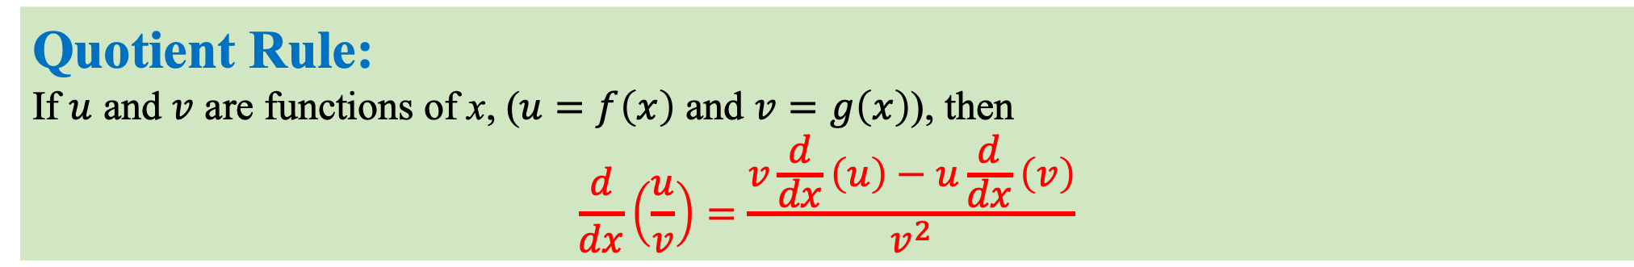
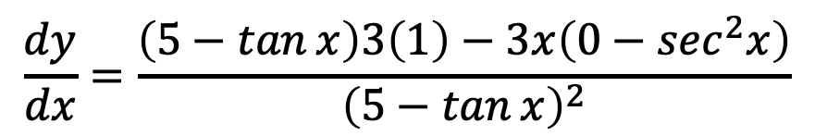



Example: Find $\frac{dy}{dx}$ for the function $y=\frac{3x}{5−\tan{x}}$
Quotient Rule:
If $u$ and $v$ are functions of x, ($u=f\left(x\right)$ and $v=g\left(x\right)$), then
$$\frac{d}{dx}\left(\frac{u}{v}\right)=\frac{v\frac{d}{dx}\left(u\right)−u\frac{d}{dx}\left(v\right)}{v^{2}}$$
$$\frac{d}{dx}\left(x\right)=1$$
$$\frac{d}{dx}\left(c\right)=0$$
Given that, $y=\frac{3x}{5−\tan{x}}$
$$\frac{d}{dx}\left(\tan{x}\right)=\sec^{2}x$$
Taking derivative with respect to $x$on both sides,
$$\frac{dy}{dx}=\frac{d}{dx}\left(\frac{3x}{5−\tan{x}}\right)$$
$$\frac{dy}{dx}=\frac{\left(5−\tan{x}\right)3\left(1\right)−3x\left(0−\sec^{2}x\right)}{{\left(5−\tan{x}\right)}^{2}}$$
$$=\frac{\left(5−\tan{x}\right)\frac{d}{dx}\left(3x\right)−3x\frac{d}{dx}\left(5−\tan{x}\right)}{{\left(5−\tan{x}\right)}^{2}}$$
$$∴\frac{dy}{dx}=\frac{15−3\tan{x}+3x \sec^{2}x}{{\left(5−\tan{x}\right)}^{2}}$$
$$=\frac{\left(5−\tan{x}\right)3\frac{d}{dx}\left(x\right)−3x\frac{d}{dx}\left(5−\tan{x}\right)}{{\left(5−\tan{x}\right)}^{2}}$$

Slide 11











Chain Rule:
If $y$ is a function of $u$, ($y=f\left(u\right)$) and $u$ is a function of x, ($u=g\left(x\right)$), then
$$\frac{dy}{dx}=\frac{dy}{du}∙\frac{du}{dx}$$
Example: Find $\frac{dy}{dx}$ for the function $y=e^{2\cos^{−1}{x}}$
$$\frac{d}{dx}\left(\cos^{−1}{x}\right)=\frac{−1}{\sqrt{1−x^{2}}}$$
Given that, $y=e^{2\cos^{−1}{x}}$
Suppose $u=2\cos^{−1}{x}$
So $y=e^{u}$
By Chain Rule,
$$\frac{dy}{dx}=\frac{dy}{du}∙\frac{du}{dx}$$
$$\frac{dy}{dx}=\left(e^{2\cos^{−1}{x}}\right)∙2\frac{−1}{\sqrt{1−x^{2}}}$$
$$∴\frac{dy}{dx}=\frac{−{2e}^{2\cos^{−1}{x}}}{\sqrt{1−x^{2}}}$$
$$\frac{dy}{dx}=\frac{d}{du}(e^{u})∙\frac{d}{dx}\left(2\cos^{−1}{x}\right)$$
$$=e^{u}∙2\frac{d}{dx}\left(\cos^{−1}{x}\right)$$
$$\frac{d}{dx}\left(e^{x}\right)=e^{x}$$

Slide 12












Find $\frac{dy}{dx}$ for the functions $x=acos θ+bsin θ$and $y=bsin θ$
Given parametric equations,
$$x=acos θ+bsin θ$$
and $y=bsin θ$
$$\text{Again}\text{,} y=bsin θ$$
$$\frac{dy}{dθ}=\frac{d}{dθ}\left(bsin θ\right)$$
$$\frac{dx}{dθ}=\frac{d}{dθ}\left(acos θ+bsin θ\right)$$
$$=b\frac{d}{dθ}\left(sin θ\right)$$
$$∴\frac{dy}{dθ}=bcos θ$$
$$=\frac{d}{dθ}\left(acos θ\right)+\frac{d}{dθ}\left(bsin θ\right)$$
$$=a\frac{d}{dθ}\left(cos θ\right)+b\frac{d}{dθ}\left(sin θ\right)$$
By Chain Rule,
$$\frac{dy}{dx}=\frac{dy}{dθ}∙\frac{dθ}{dx}=bcos θ∙\frac{1}{bcos θ−asin{θ}}$$
$$=a(−sin{θ})+bcos θ$$
$$∴\frac{dx}{dθ}=bcos θ−asin{θ}$$
$$∴\frac{dy}{dx}=\frac{bcos θ}{bcos θ−asin{θ}}$$

Slide 13












Example: Find $\frac{dy}{dx}$ for the function $x^{y}+y^{x}=1$
Function as Power of another Function:
If $u$ and $v$ are functions of x, ($u=f\left(x\right)$ and $v=g\left(x\right)$), then
$$\frac{d}{dx}\left(u^{v}\right)=u^{v}\frac{d}{dx}\left(v ln\left(u\right)\right)$$
$$\frac{d}{dx}\left(uv\right)=u\frac{d}{dx}\left(v\right)+v\frac{d}{dx}\left(u\right)$$
Given that, $x^{y}+y^{x}=1$
Taking derivative with respect to $x$on both sides,
$$\frac{d}{dx}\left(x^{y}\right)+\frac{d}{dx}\left(y^{x}\right)=\frac{d}{dx}\left(1\right)$$
$$\frac{dy}{dx}\left(x^{y}\ln{x}+y^{x−1}x\right)=−x^{y−1}y−y^{x}\ln{y}$$
$${⇒x}^{y} \frac{d}{dx}\left(y\ln{x}\right)+y^{x} \frac{d}{dx}\left(x\ln{y}\right)=0$$
$$\frac{dy}{dx}=\frac{−x^{y−1}y−y^{x}\ln{y}}{x^{y}\ln{x}+y^{x−1}x}$$
$${⇒x}^{y}\left(y\frac{1}{x}+\ln{x}\frac{dy}{dx}\right)+y^{x} \left(x\frac{1}{y}\frac{dy}{dx}+\ln{y}\right)=0$$
$$∴\frac{dy}{dx}=\frac{−\left(x^{y−1}y+y^{x}\ln{y}\right)}{x^{y}\ln{x}+y^{x−1}x}$$
$${⇒x}^{y}yx^{−1}+x^{y}\ln{x}\frac{dy}{dx}+y^{x}xy^{−1}\frac{dy}{dx}+y^{x}\ln{y}=0$$
$${⇒x}^{y−1}y+x^{y}\ln{x}\frac{dy}{dx}+y^{x−1}x\frac{dy}{dx}+y^{x}\ln{y}=0$$

Slide 14

Exercise
(a) Find the derivative of the following functions :
                $y=\left(e^{x}+1\right)\tan{x}$
                $y=a^{x}x^{3}\sin^{−1}{x}$
                $y=\frac{\sin{x}}{x}$
                $y=\frac{e^{x}}{1+x}$
                $y=\ln\left(1+e^{x}\right)$
(b) Find $\frac{dy}{dx}$ of the parametric equations:
$x=e^{\tan^{−1}{t}}$and $y={\left(1+t^{2}\right)}^{5}$.

Slide 15
Thanks

