Slide 1

Integration
(Part – 1)
Shirin Sultana
Lecturer
Department of GED
Daffodil International University

Slide 2
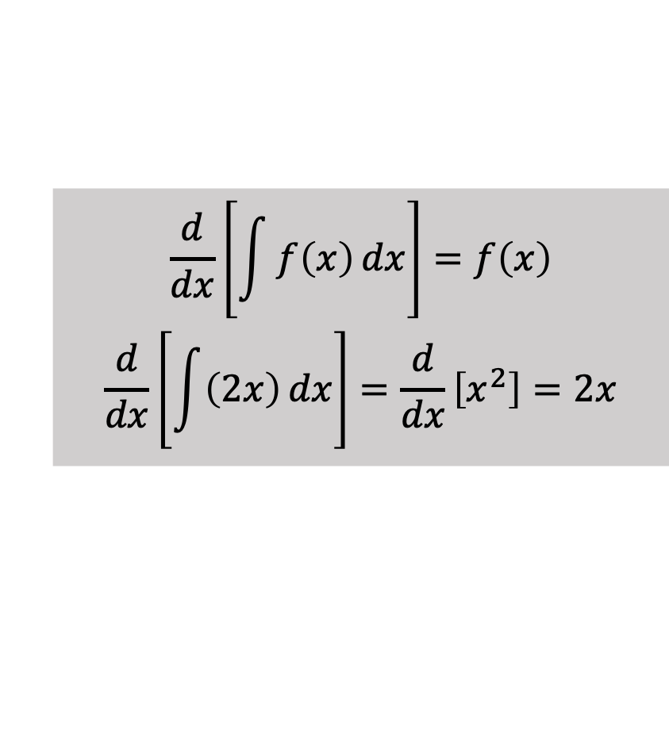
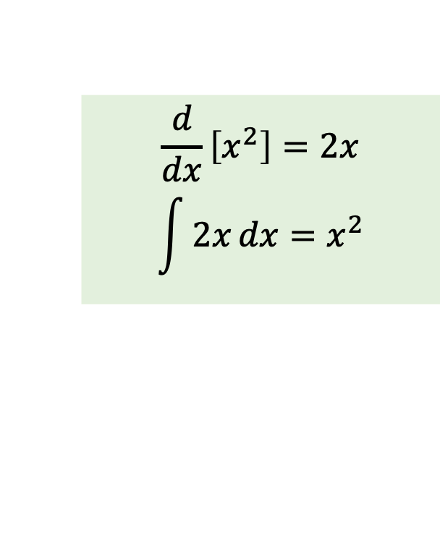
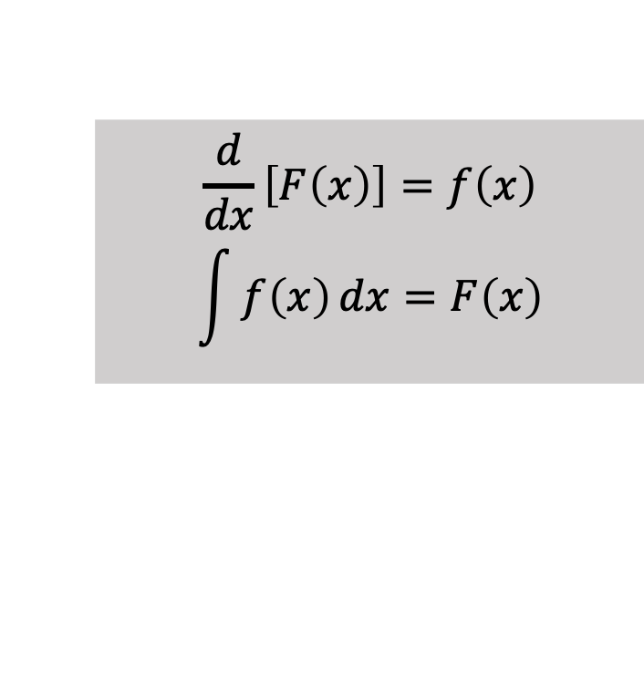



Concept of Integration
Any operation in mathematics has an inverse operation such as
Addition $↔$ Subtraction
Multiplication $↔$ Division
$f$ (function) $↔$ $f^{−1}$ (inverse function)
$A$ (matrix) $↔$ $A^{−1}$ (inverse matrix)
The reverse process of differentiation is defined as anti-differentiation or simply integration
$$\frac{d}{dx}\left[F\left(x\right)\right]=f\left(x\right)$$
$$\int{f\left(x\right)}dx=F\left(x\right)$$
$$\frac{d}{dx}\left[\int{f\left(x\right)}dx\right]=f\left(x\right)$$
$$\frac{d}{dx}\left[\int{\left(2x\right)}dx\right]=\frac{d}{dx}\left[x^{2}\right]=2x$$
Integral
$$\frac{d}{dx}\left[x^{2}\right]=2x$$
$$\int{2x}dx=x^{2}$$
$$x^{2}$$
$$2x$$
Derivative

Slide 3

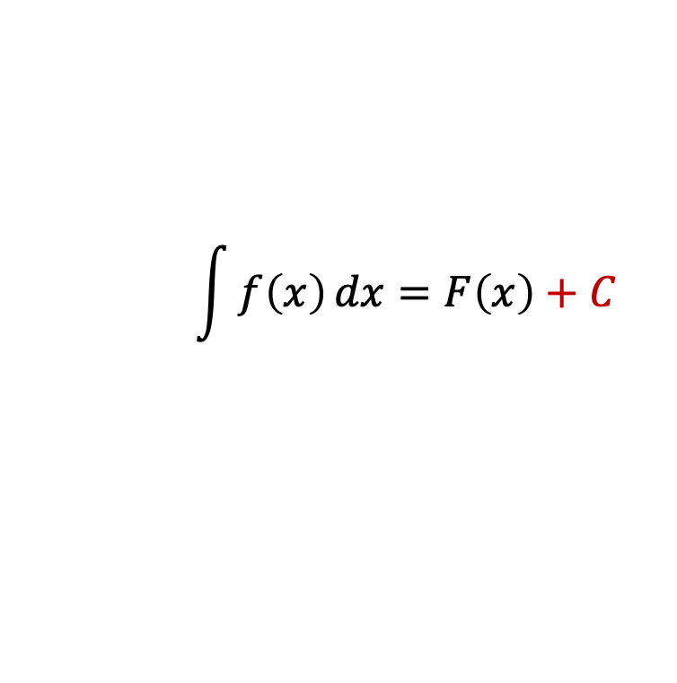
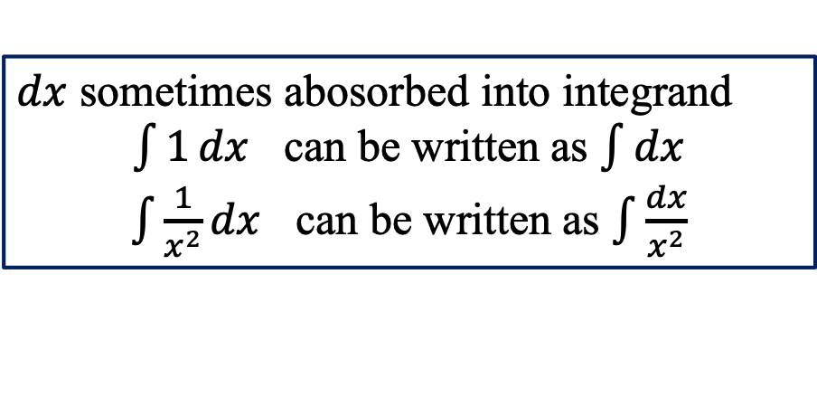

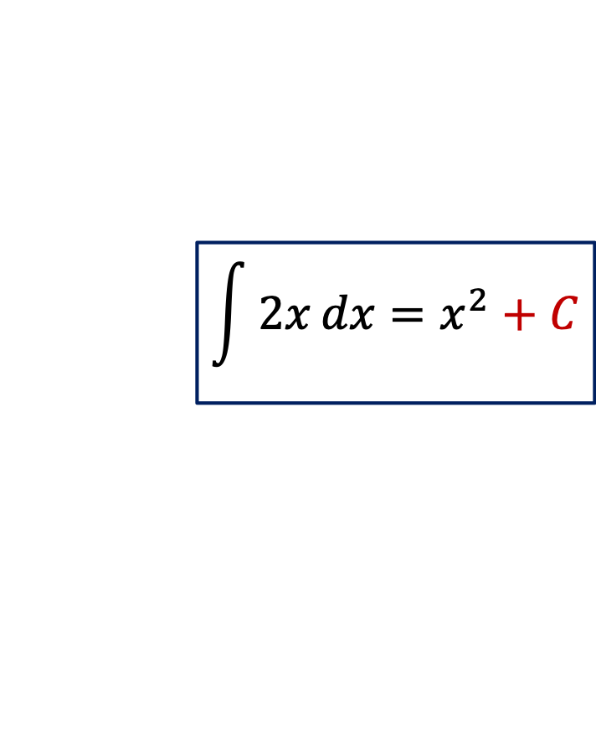
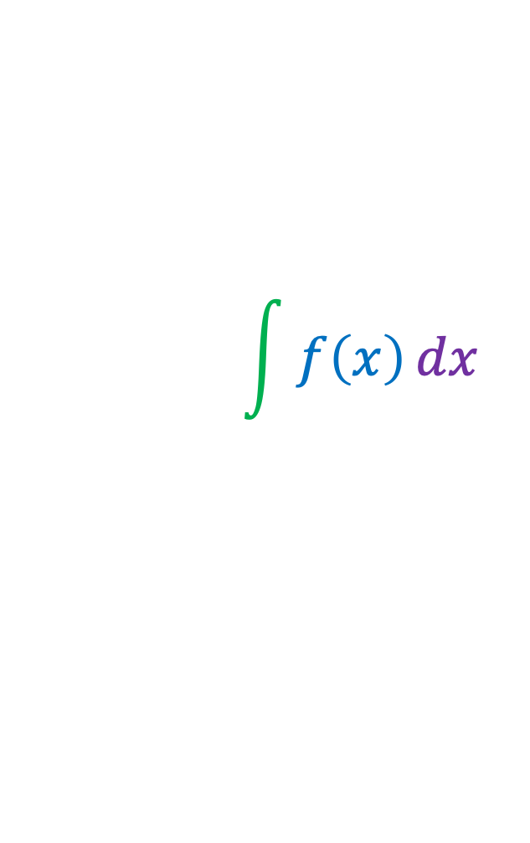

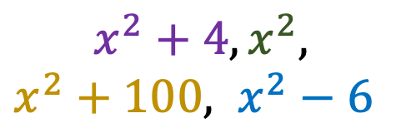
Concept of Integration (cont.…)
Integral Symbol
Integral with respect to $x$
$dx$ sometimes abosorbed into integrand
$\int{1}dx$ can be written as $\int{dx}$
$\int{\frac{1}{x^{2}}}dx$ can be written as $\int{\frac{dx}{x^{2}}}$
$$\int{f\left(x\right)}dx$$
$$\int{f\left(x\right)}dx=F\left(x\right)+C$$
Constant of integration
Integrand
(function we want to integrate)
Why “+ C” ???
Integral
$$x^{2}$$
$$\int{2x}dx=x^{2}+C$$
$$x^{2}+4, x^{2},$$
$x^{2}+100, x^{2}−6$
$$2x$$
Derivative

Slide 4
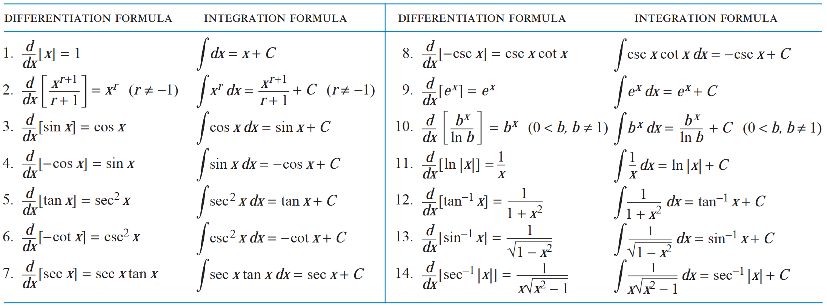
Integration Formulas
Source: Calculus, 10th Edition. Author: Howard Anton, Irl C. Bivens, Stephen Davis, page. 324.

Slide 5


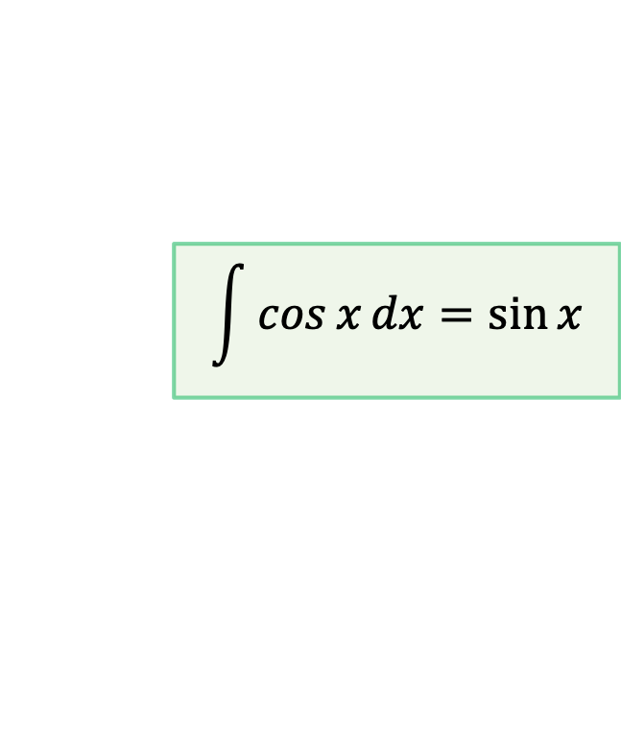
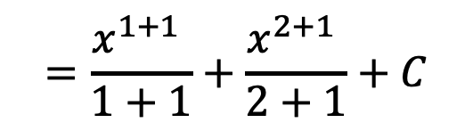
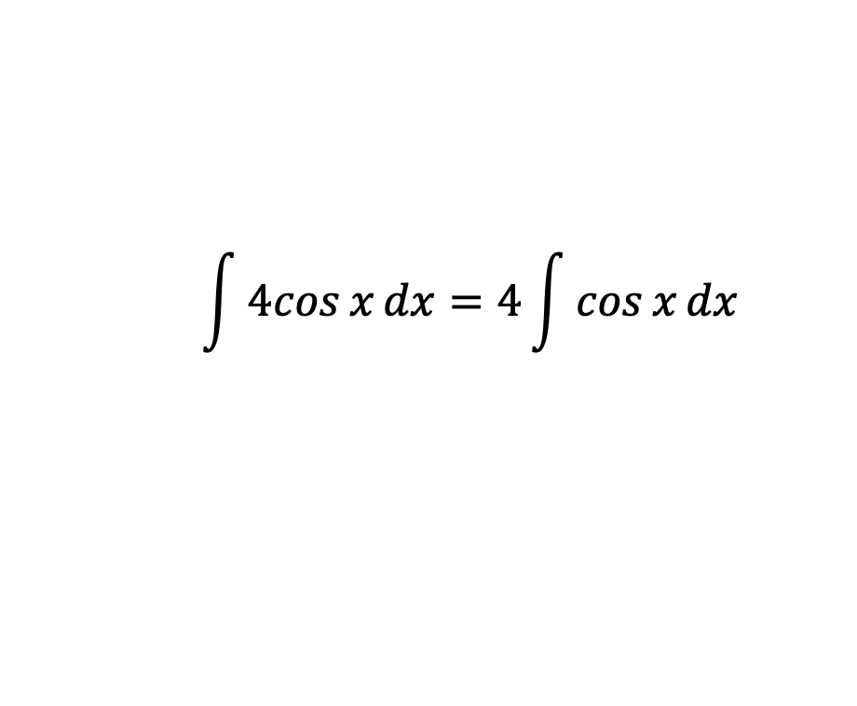

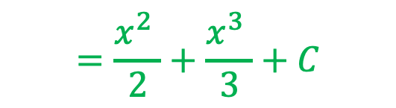
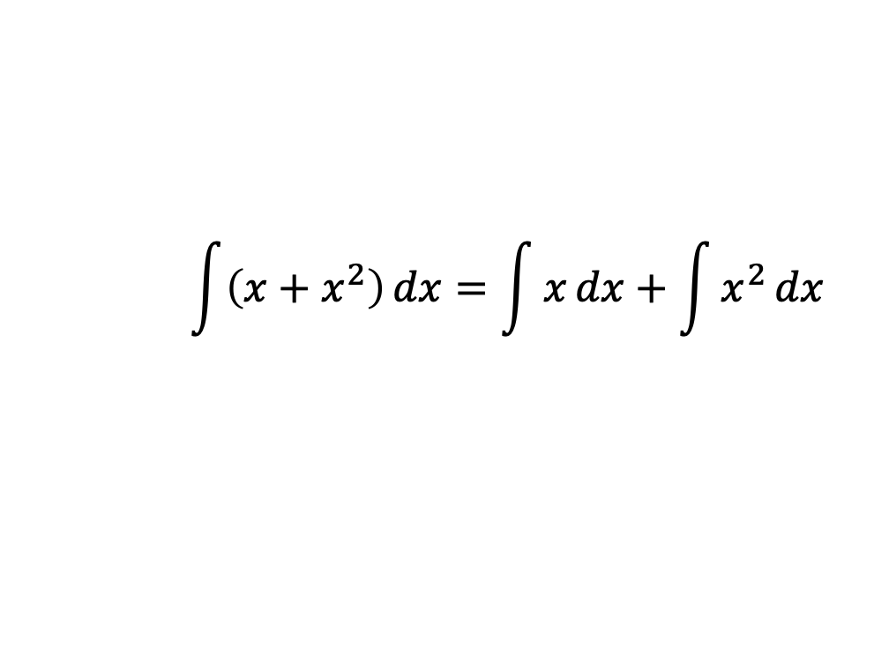


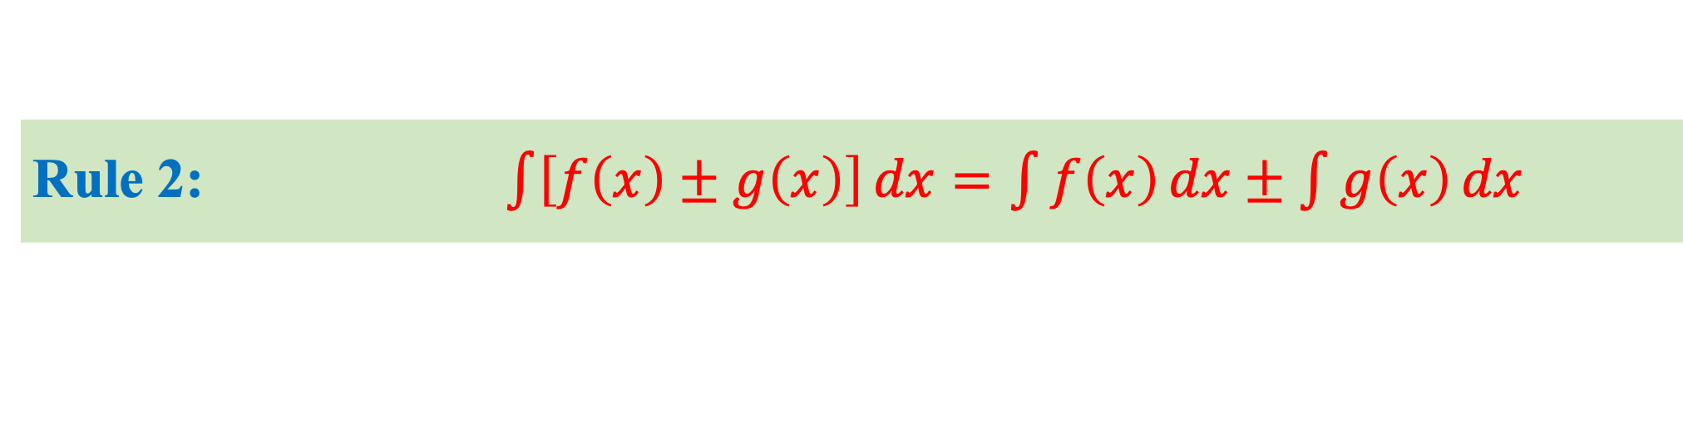
Rule 1: $\int{cf\left(x\right)}dx=c\int{f\left(x\right)}dx$
Example: E$valuate \int{4cos{x}}dx$
$$\int{4cos{x}}dx=4\int{\cos{x}}dx$$
$$\int{\cos{x}}dx=\sin{x}$$
$$=4\sin{x}+C$$
Rule 2: $\int{\left[f\left(x\right)±g\left(x\right)\right]}dx=\int{f\left(x\right)}dx±\int{g\left(x\right)}dx$
Example: E$valuate \int{\left(x+x^{2}\right)}dx$
$$\int{\left(x+x^{2}\right)}dx=\int{x}dx+\int{x^{2}}dx$$
$$\int{x^{n}}dx=\frac{x^{n+1}}{n+1}, n≠−1$$
$$=\frac{x^{1+1} }{1+1}+\frac{x^{2+1} }{2+1}+C$$
$$=\frac{x^{2} }{2}+\frac{x^{3} }{3}+C$$

Slide 6
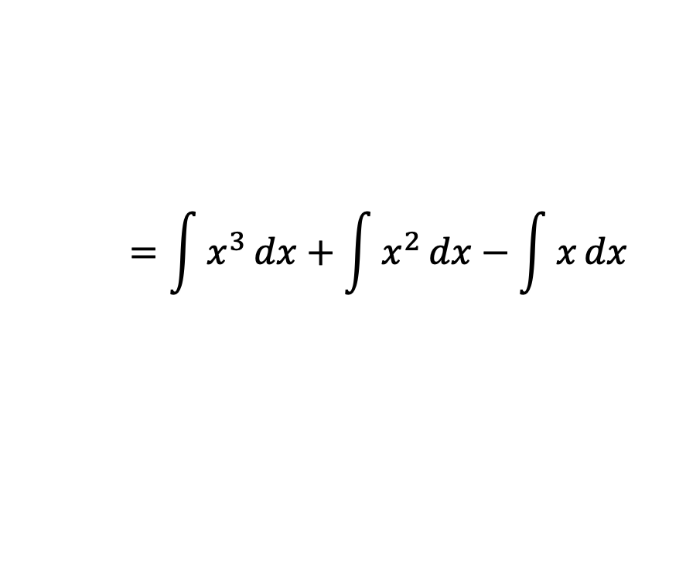

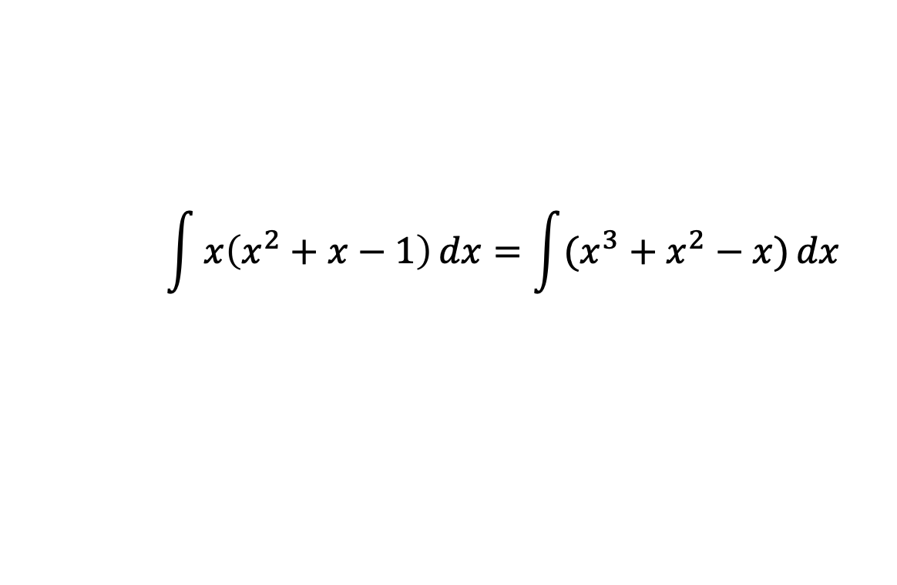
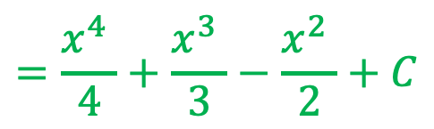
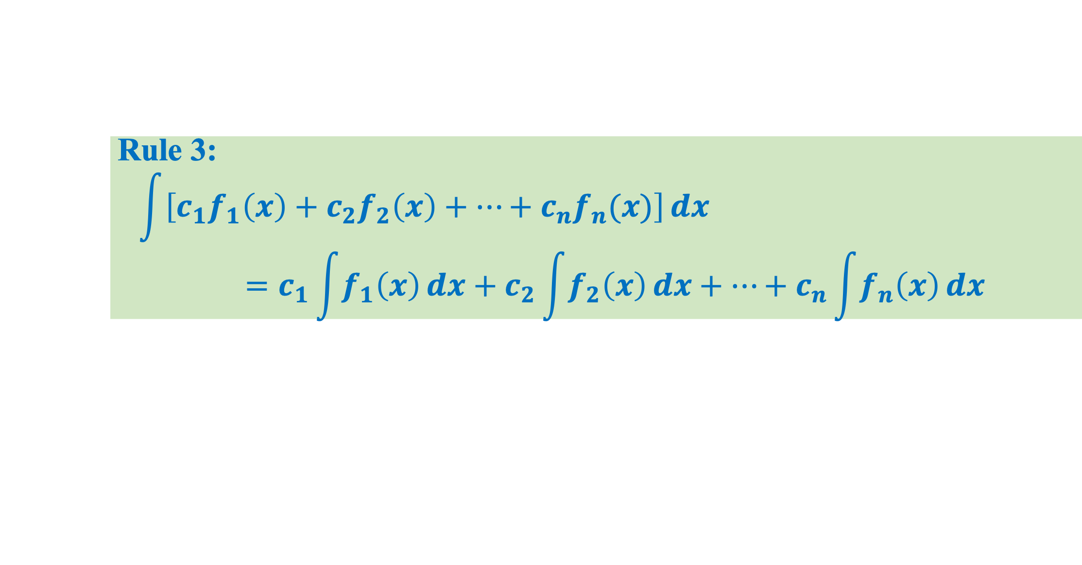

Rule 3:
$$\int{\left[c_{1}f_{1}\left(x\right)+c_{2}f_{2}\left(x\right)+⋯+c_{n}f_{n}(x)\right]}dx \\ =c_{1}\int{f_{1}\left(x\right)}dx+c_{2}\int{f_{2}\left(x\right)}dx+⋯+c_{n}\int{f_{n}\left(x\right)}dx$$
Example 1: E$valuate \int{x\left(x^{2}+x−1\right)}dx$
$$\int{x\left(x^{2}+x−1\right)}dx=\int{(x^{3}+x^{2}−x)}dx$$
$$=\int{x^{3}}dx+\int{x^{2}}dx−\int{x}dx$$
$$\int{x^{n}}dx=\frac{x^{n+1}}{n+1}, n≠−1$$
$$=\frac{x^{4} }{4}+\frac{x^{3} }{3}−\frac{x^{2} }{2}+C$$

Slide 7
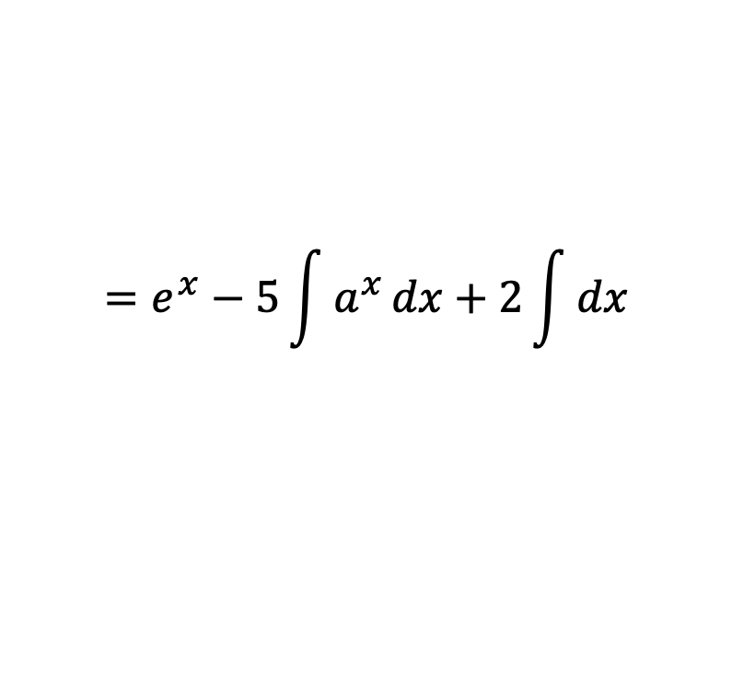

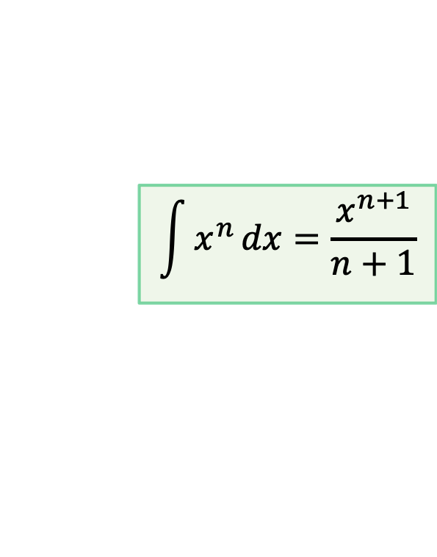


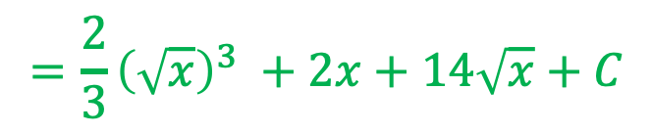
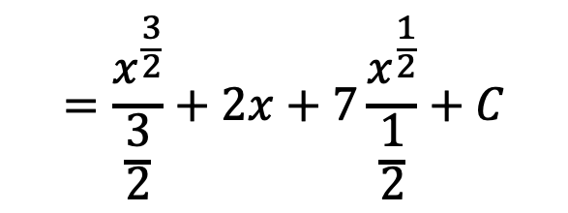
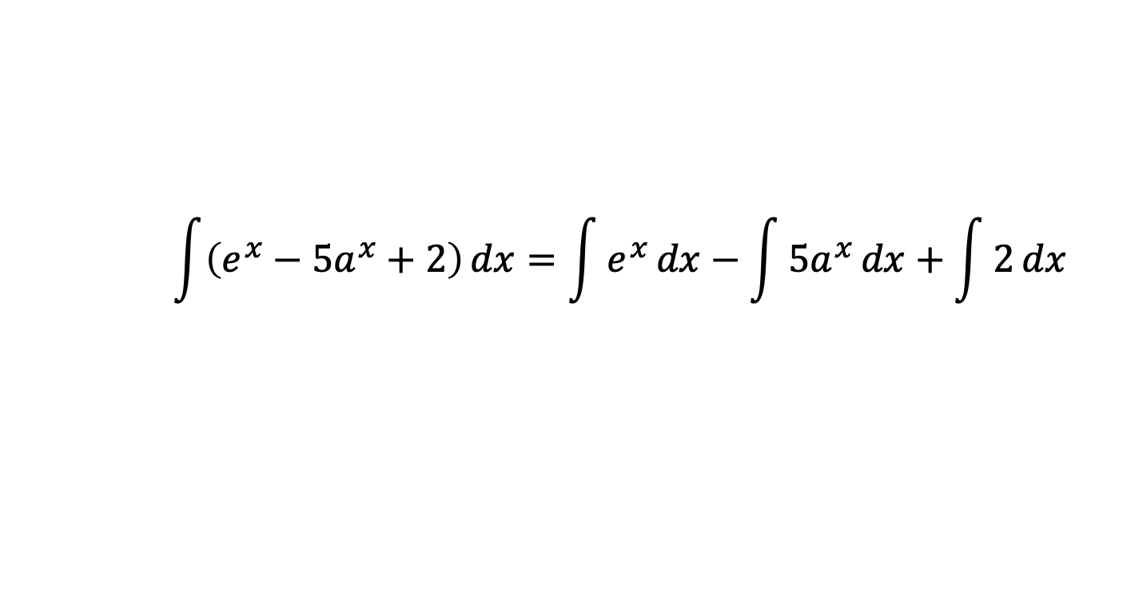

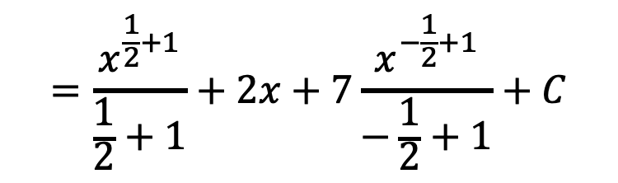
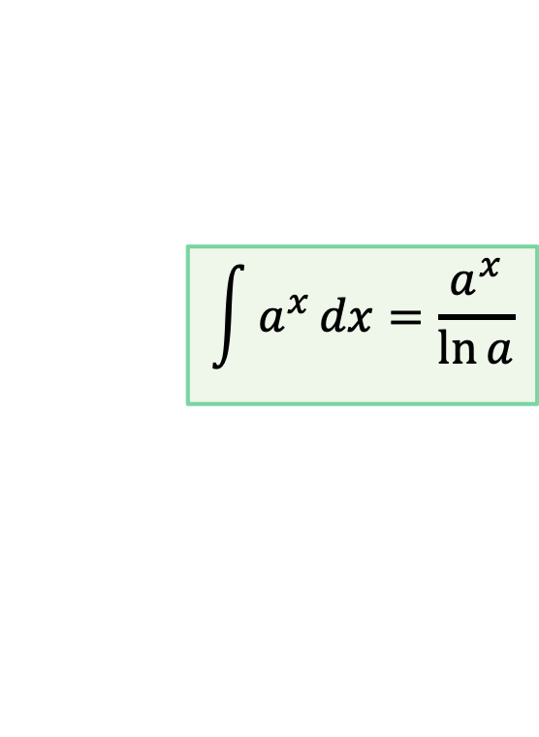

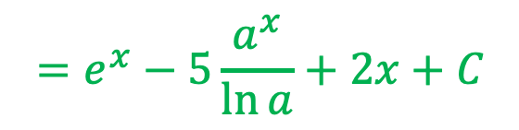
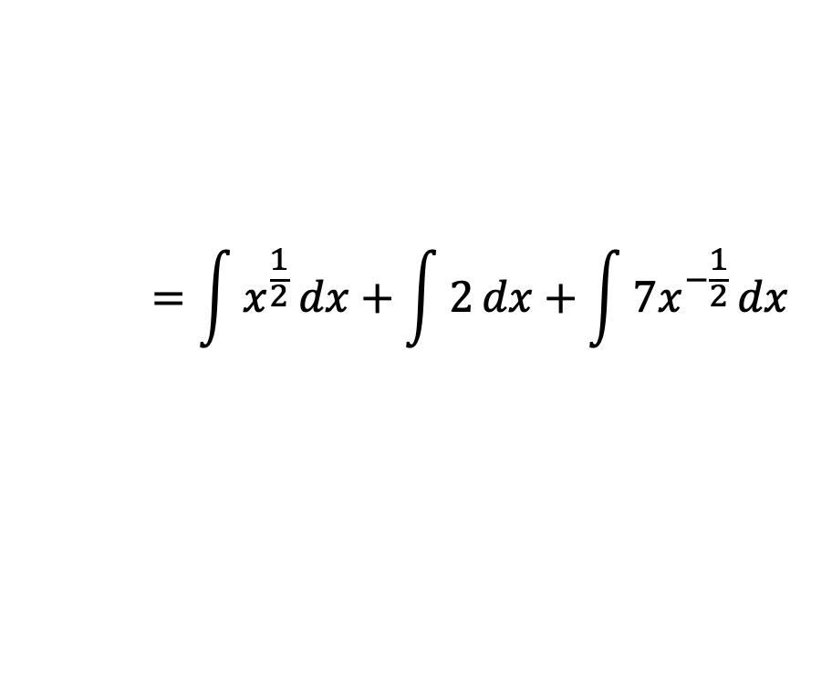
Example 2: E$valuate \int{\left(e^{x}−5a^{x}+2\right)}dx$
$$\int{\left(e^{x}−5a^{x}+2\right)}dx=\int{e^{x}}dx−\int{5a^{x}}dx+\int{2}dx$$
$$\int{e^{x}}dx=e^{x}$$
$$=e^{x}−5\int{a^{x}}dx+2\int{dx}$$
$$\int{a^{x}}dx=\frac{a^{x}}{\ln{a}}$$
$$\int{dx}=x$$
$$=e^{x}−5\frac{a^{x}}{\ln{a}}+2x+C$$
Example 3: E$valuate\int{\frac{x+2\sqrt{x}+7}{\sqrt{x}}}dx$
$$\int{\frac{x+2\sqrt{x}+7}{\sqrt{x}}}dx=\int{\left(\frac{x}{\sqrt{x}}+\frac{2\sqrt{x} }{\sqrt{x}}+\frac{7}{\sqrt{x}}\right)}dx=\int{\left({ x}^{\frac{1}{2}}+2+7x^{−\frac{1}{2}}\right)}dx$$
$$=\int{x^{\frac{1}{2}}}dx+\int{2}dx+\int{7x^{−\frac{1}{2}}}dx$$
$$=\frac{x^{\frac{1}{2}+1}}{\frac{1}{2}+1}+2x+7\frac{x^{−\frac{1}{2}+1}}{−\frac{1}{2}+1}+C$$
$$\int{x^{n}}dx=\frac{x^{n+1}}{n+1}$$
$$=\frac{x^{\frac{3}{2}}}{\frac{3}{2}}+2x+7\frac{x^{\frac{1}{2}}}{\frac{1}{2}}+C$$
$$=\frac{2}{3}{\left(\sqrt{x}\right)}^{3} +2x+14\sqrt{x}+C$$

Slide 8



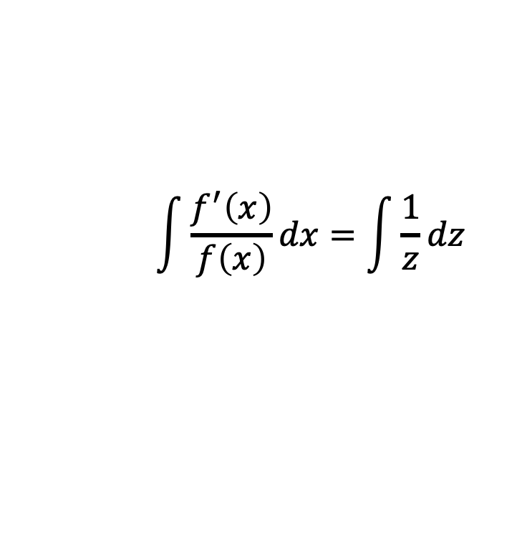





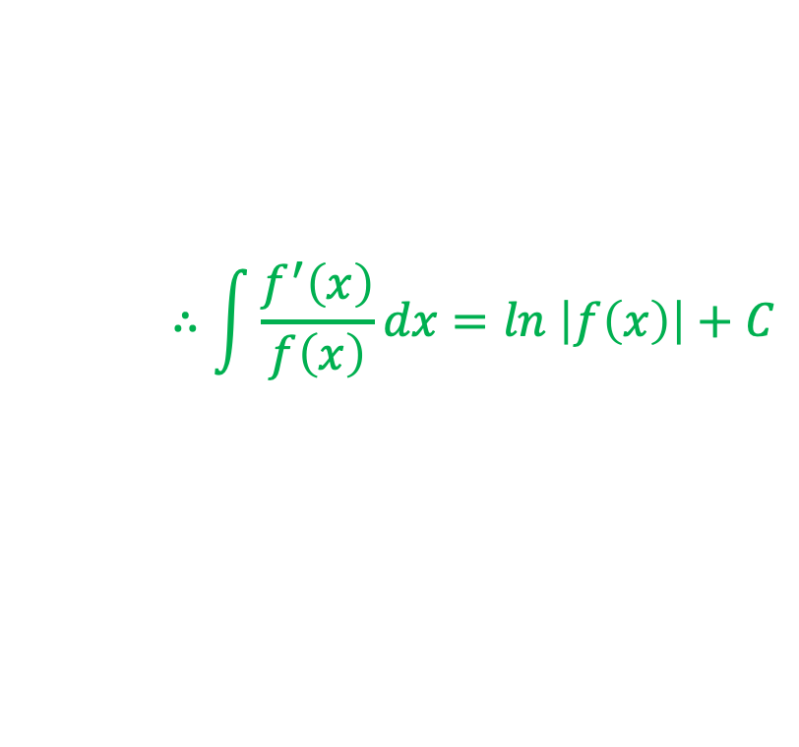
Prove that $\int{\frac{f^{′}\left(x\right)}{f\left(x\right)}}dx=ln \left|f\left(x\right)\right|+C$
Proof
Suppose
$$f\left(x\right)=z$$
$$\frac{d}{dx}\left[f\left(x\right)\right]=\frac{d}{dx}\left(z\right)$$
$$f^{′}\left(x\right)=\frac{dz}{dx}$$
$$∴f^{′}\left(x\right)dx=dz$$
$$\int{\frac{f^{′}\left(x\right)}{f\left(x\right)}}dx=\int{\frac{1}{z}}dz$$
So,
$$\int{\frac{1}{x}}dx=\ln\left|x\right|$$
$$=\ln\left|z\right|+C$$
$$=\ln\left|f\left(x\right)\right|+C$$
$$∴\int{\frac{f^{′}\left(x\right)}{f\left(x\right)}}dx=ln \left|f\left(x\right)\right|+C$$

Slide 9
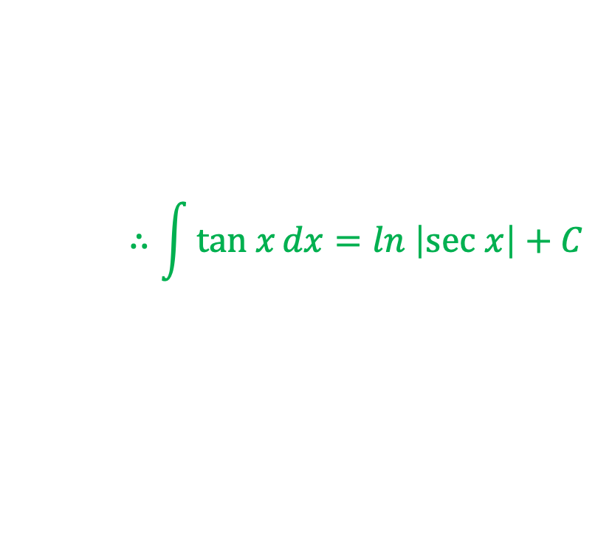
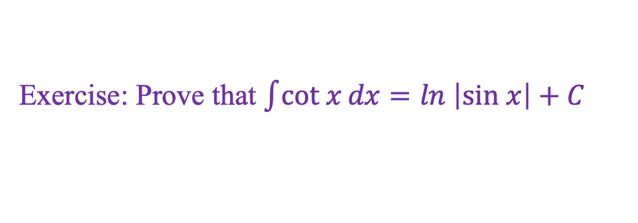
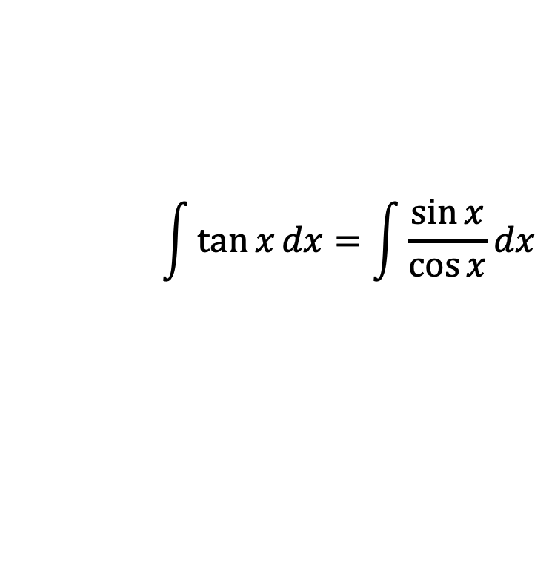

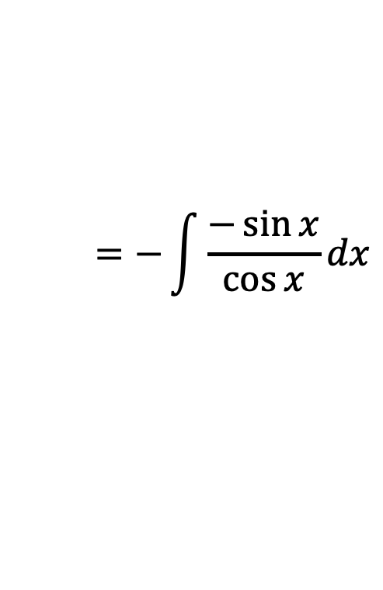

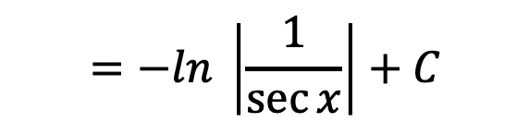



Prove that $\int{tan x}dx=ln \left|sec x\right|+C$
Proof
$$\int{\tan{x}}dx=\int{\frac{\sin{x}}{\cos{x}}}dx$$
Now,
$$=−\int{\frac{−\sin{x}}{\cos{x}}}dx$$
$$\int{\frac{f^{′}\left(x\right)}{f\left(x\right)}}dx=ln \left|f\left(x\right)\right|+C$$
$$=−ln \left|\cos{x}\right|+C$$
$$=−ln \left|\frac{1}{\sec{x}}\right|+C$$
$$=−\left(ln \left|1\right|−ln \left|\sec{x}\right|\right)+C$$
$$=−\left(0−ln \left|\sec{x}\right|\right)+C$$
$$∴\int{tan x}dx=ln \left|sec x\right|+C$$
Exercise: Prove that $\int{cot x}dx=ln \left|sin x\right|+C$

Slide 10
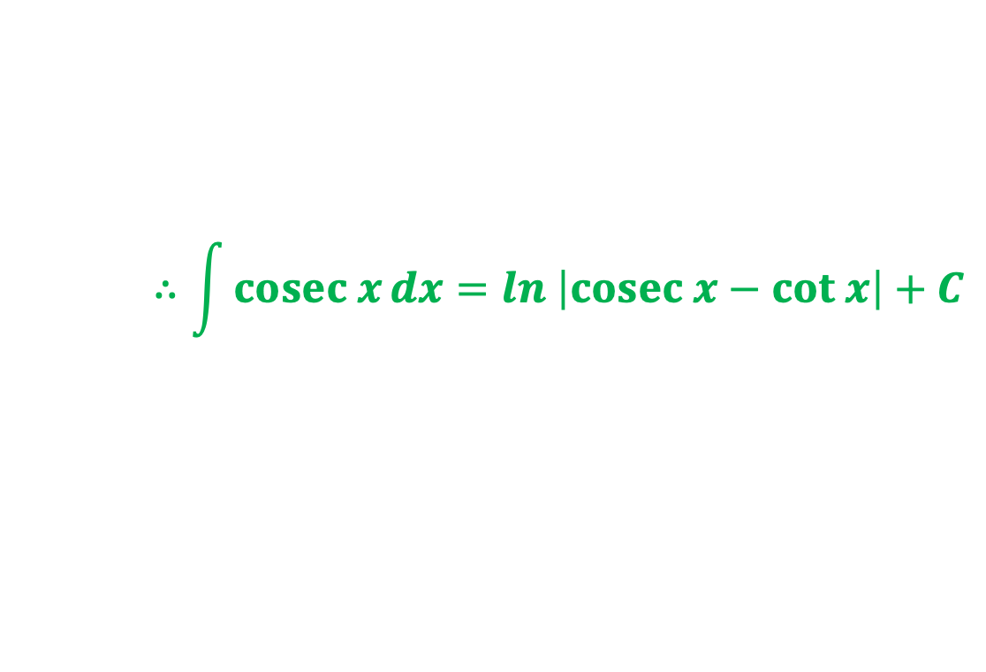

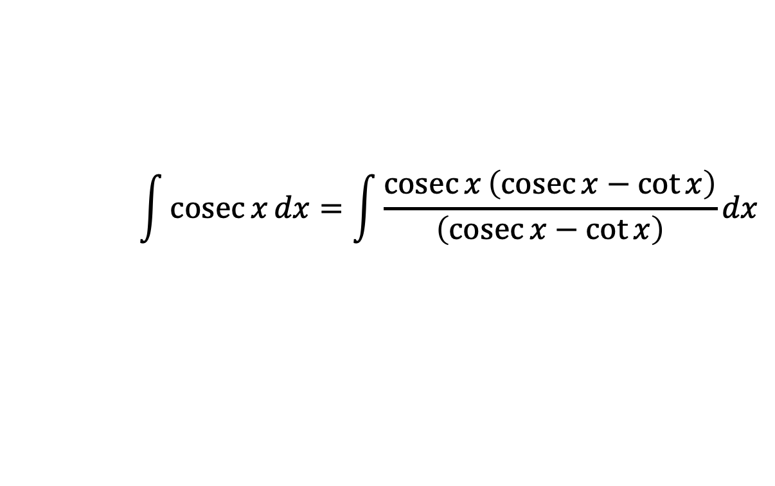

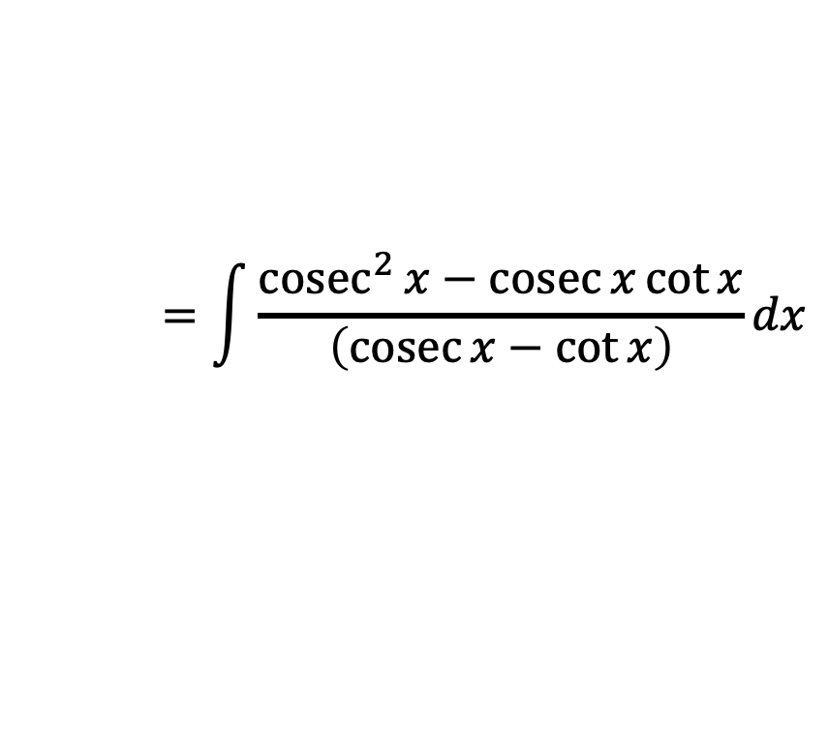
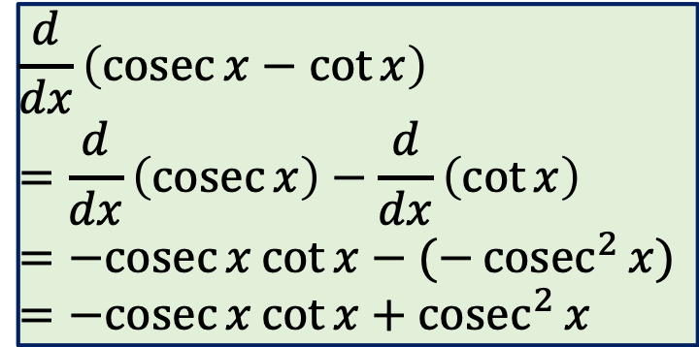
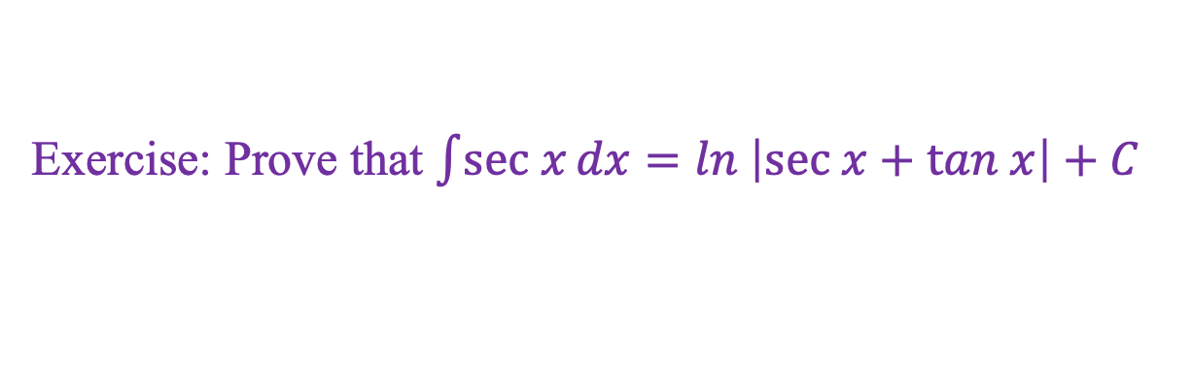

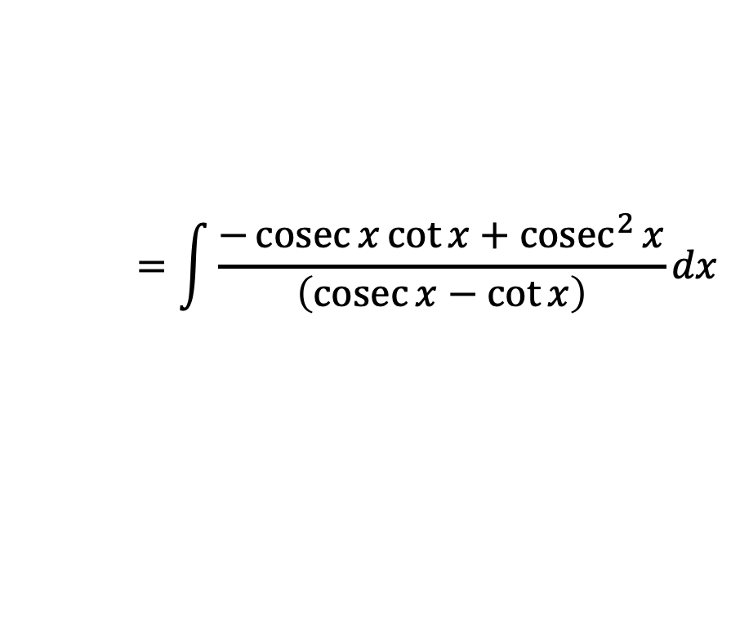
Prove that $\int{cosec x}dx=ln \left|cosec x−cot x\right|+C$
Proof
$$\int{\operatorname{cosec}{x}}dx=\int{\frac{\operatorname{cosec}{x}\left(\operatorname{cosec}{x}−\cot{x}\right)}{\left(\operatorname{cosec}{x}−\cot{x}\right)}}dx$$
Now,
$$=\int{\frac{{cosec}^{2}{x}−\operatorname{cosec}{x}\cot{x}}{\left(\operatorname{cosec}{x}−\cot{x}\right)}}dx$$
$$\frac{d}{dx}\left(\operatorname{cosec}{x}−\cot{x}\right)$$
$$=\frac{d}{dx}\left(\operatorname{cosec}{x}\right)−\frac{d}{dx}\left(\cot{x}\right)$$
$$=−cosec{x}\cot{x}−(−{cosec}^{2}{x})$$
$$=−cosec{x}\cot{x}+{cosec}^{2}{x}$$
$$=\int{\frac{−\operatorname{cosec}{x}\cot{x}+{cosec}^{2}{x}}{\left(\operatorname{cosec}{x}−\cot{x}\right)}}dx$$
$$=ln \left|cosec x−cot x\right|+C$$
$$\int{\frac{f^{′}\left(x\right)}{f\left(x\right)}}dx=ln \left|f\left(x\right)\right|+C$$
$$∴\int{cosec x}dx=ln \left|cosec x−cot x\right|+C$$
Exercise: Prove that $\int{sec x}dx=ln \left|sec x+tan x\right|+C$

