Slide 1

Integration
(Part – 2)
(Method of Substitution)
Department of GED
Daffodil International University

Slide 2
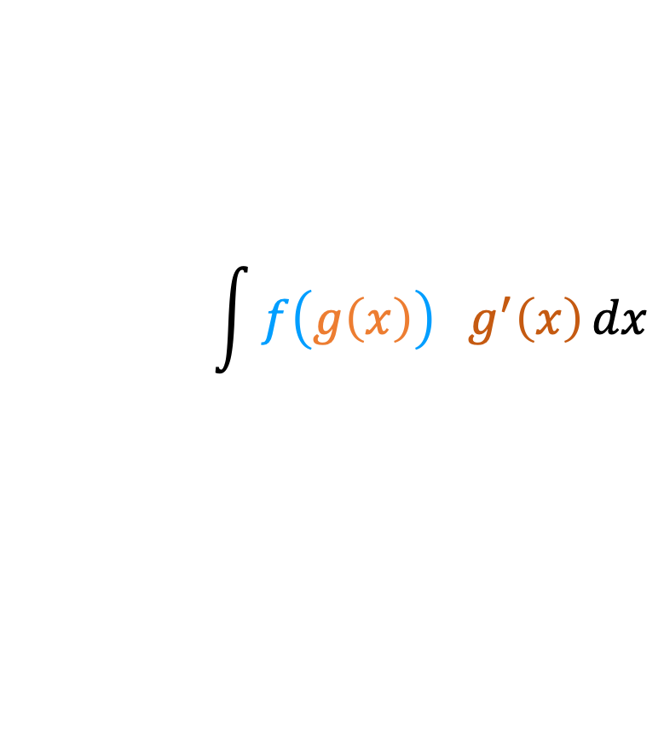
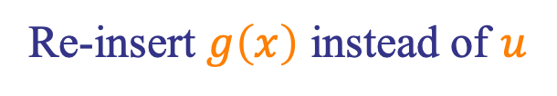
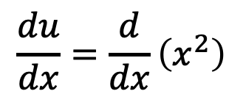

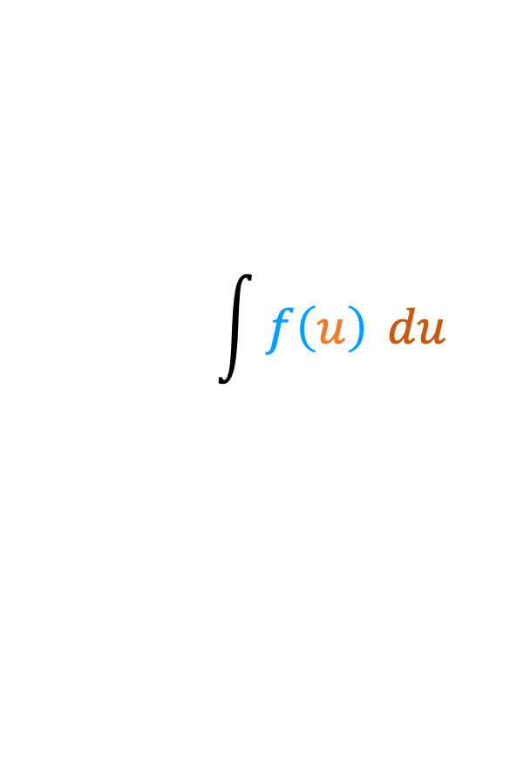
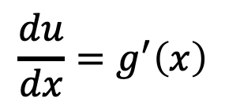



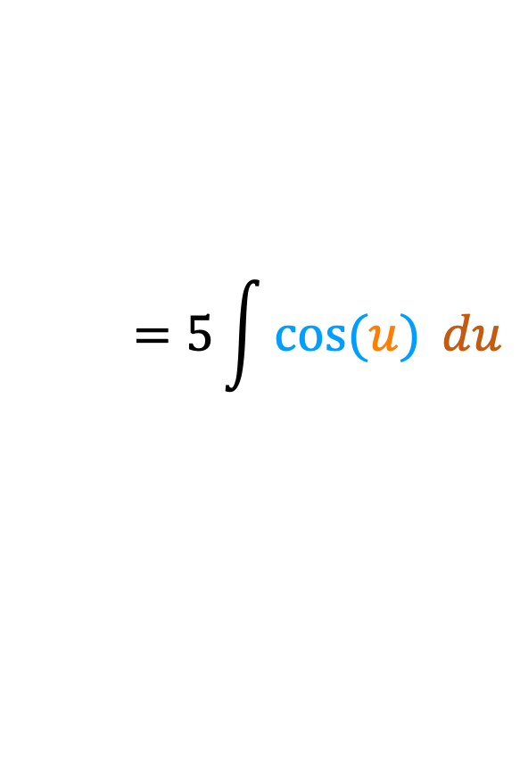
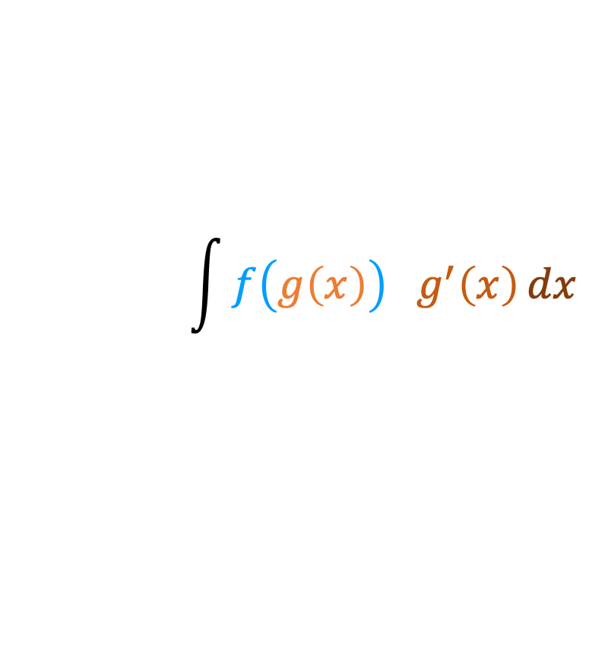
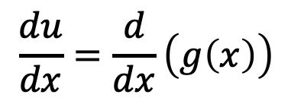

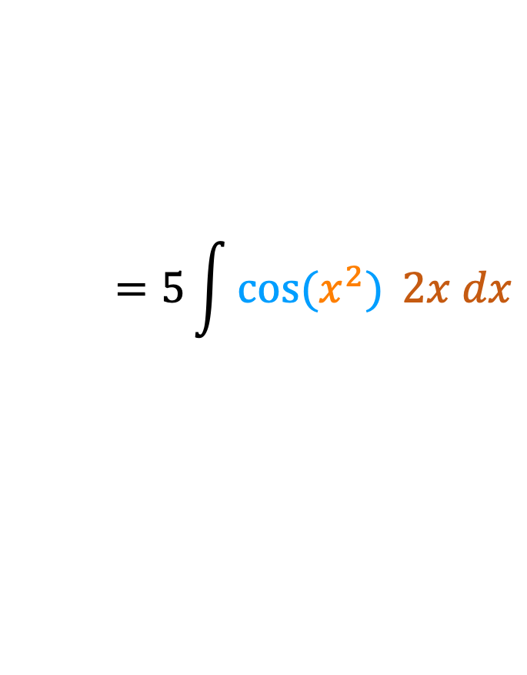


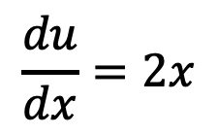

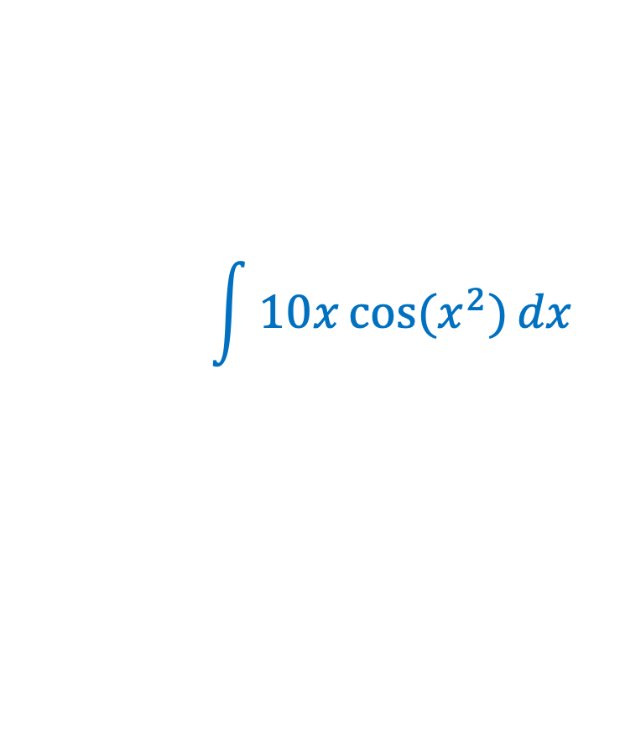

I$ntegration by Method of Substitution$
Step 1
$$f( )=cos⁡( )$$
$$\int{f\left(g\left(x\right)\right) g^{′}\left(x\right)}dx$$
$$\int{10x\cos{(x^{2})}}dx$$
$$g(x)=x^{2}$$
$$=5\int{\cos{(x^{2})} }2x dx$$
$$g^{′}(x)=2x$$
Step 2
$$u=g\left(x\right)$$
$$\int{f\left(g\left(x\right)\right) g^{′}\left(x\right)}dx$$
$$u=x^{2}$$
$$\frac{du}{dx}=\frac{d}{dx}\left(g\left(x\right)\right)$$
$$=5\int{\cos{(u)} }du$$
$$\frac{du}{dx}=\frac{d}{dx}\left(x^{2}\right)$$
$$\int{f\left(u\right) }du$$
$$\frac{du}{dx}=g^{′}\left(x\right)$$
$$\frac{du}{dx}=2x$$
$$=5\sin\left(u\right)+C$$
$$du=g^{′}\left(x\right)dx$$
$$du=2xdx$$
$$=5\sin\left(x^{2}\right)+C$$
Step 3
Re-insert $g\left(x\right)$ instead of $u$

Slide 3

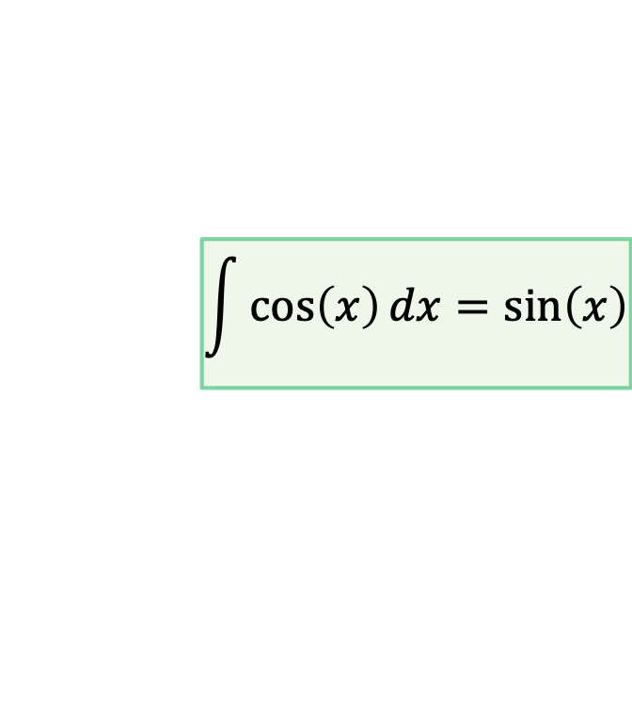
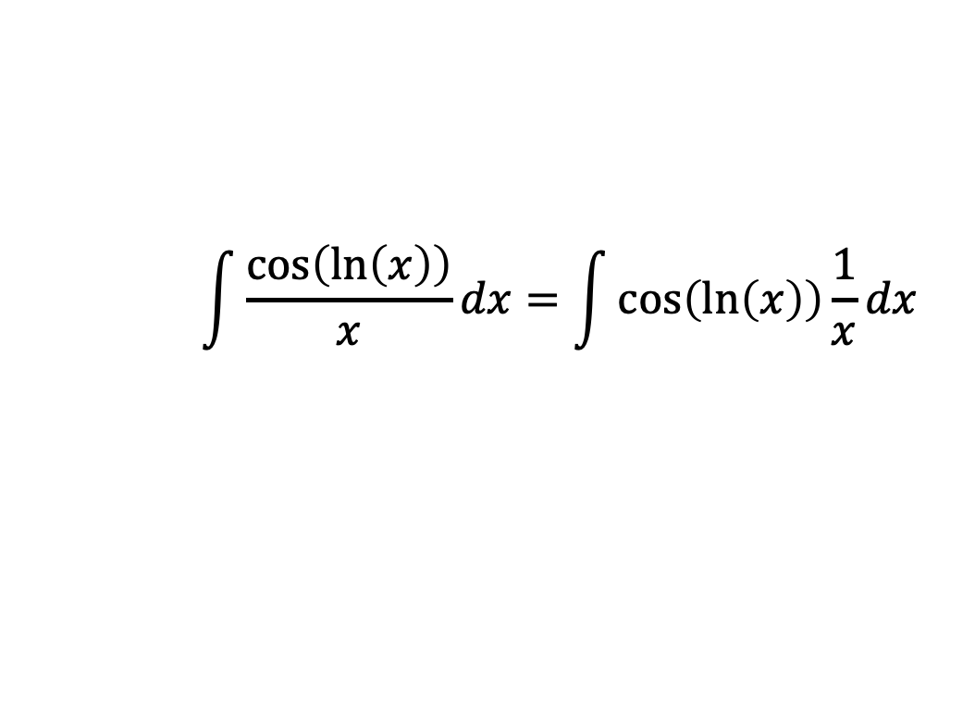
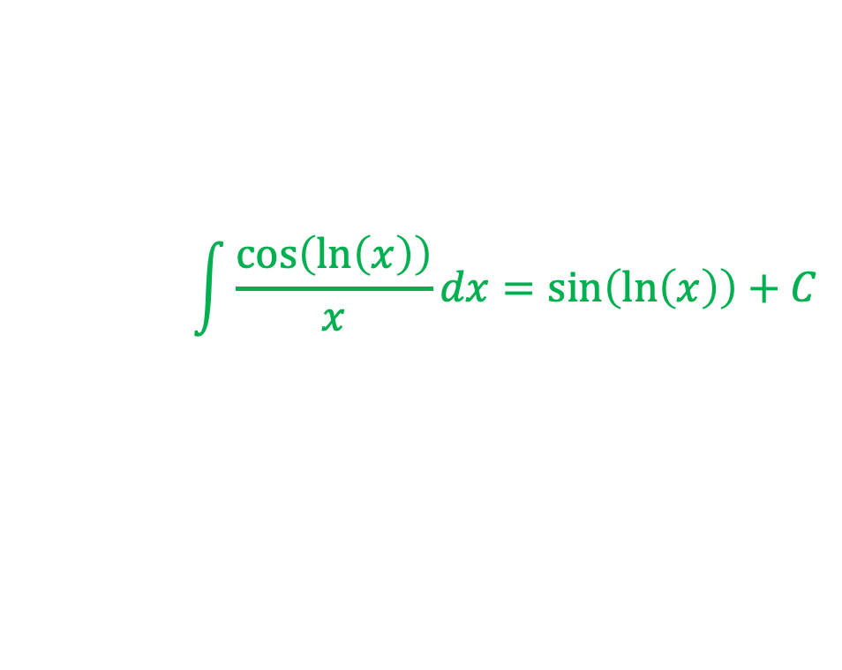


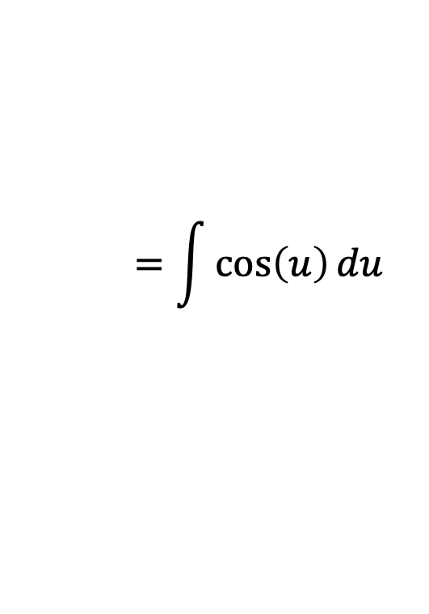
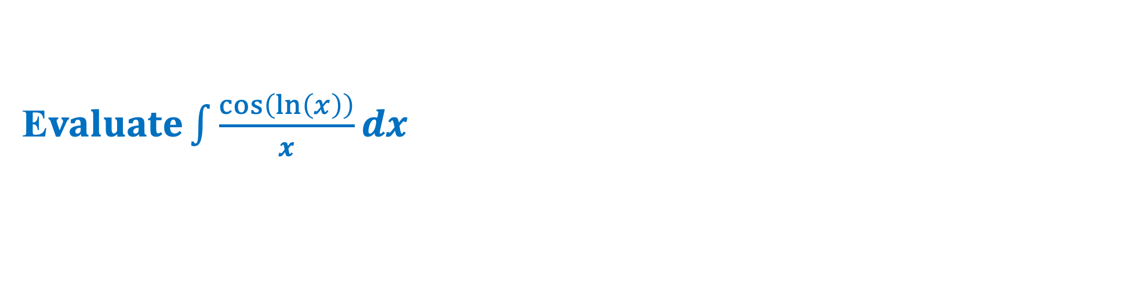
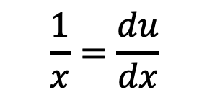
E$valuate\int{\frac{\cos\left(\ln\left(x\right)\right)}{x}}dx$
Here,
$$\int{\frac{\cos\left(\ln\left(x\right)\right)}{x}}dx=\int{\cos\left(\ln\left(x\right)\right)}\frac{1}{x}dx$$
Suppose
$\ln\left(x\right)=u$
$$=\int{\cos\left(u\right)}du$$
$$\frac{1}{x}=\frac{du}{dx}$$
$$\int{\cos\left(x\right)}dx=\sin\left(x\right)$$
$$=\sin\left(u\right)+C$$
$$∴du=\frac{1}{x}dx$$
$$\int{\frac{\cos\left(\ln\left(x\right)\right)}{x}}dx=\sin\left(\ln\left(x\right)\right)+C$$

Slide 4

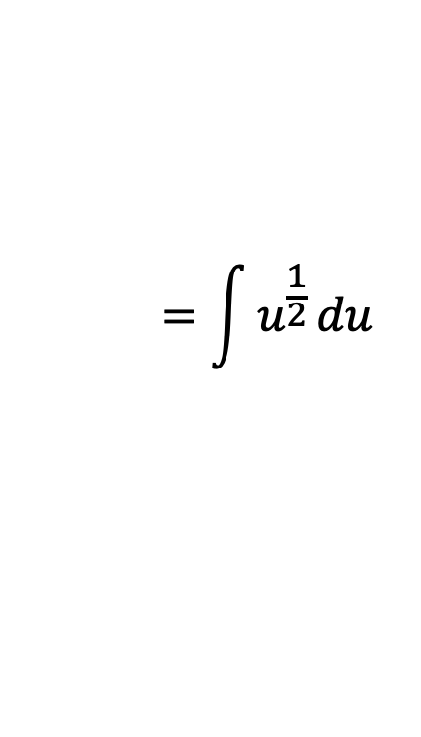
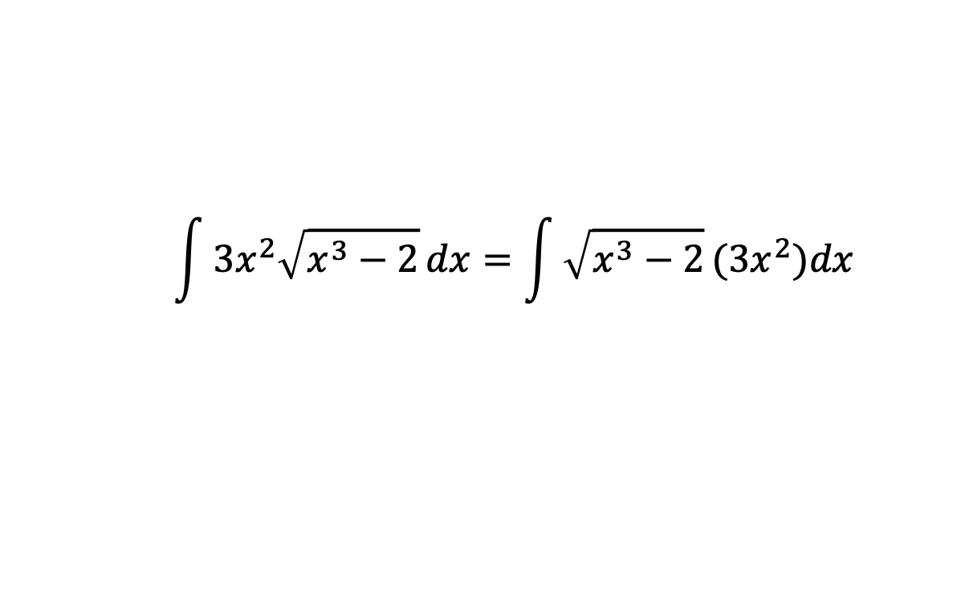
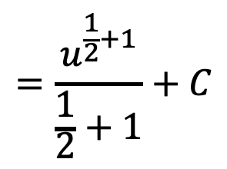


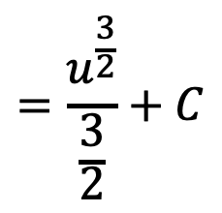
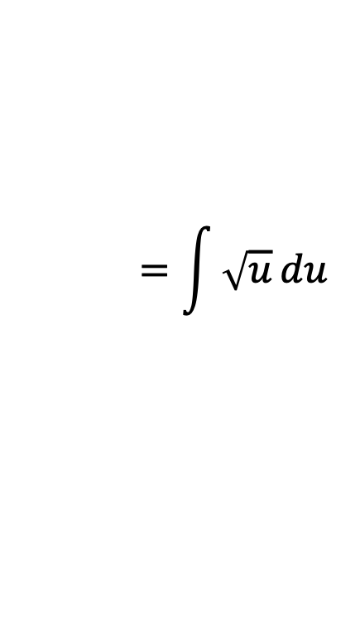
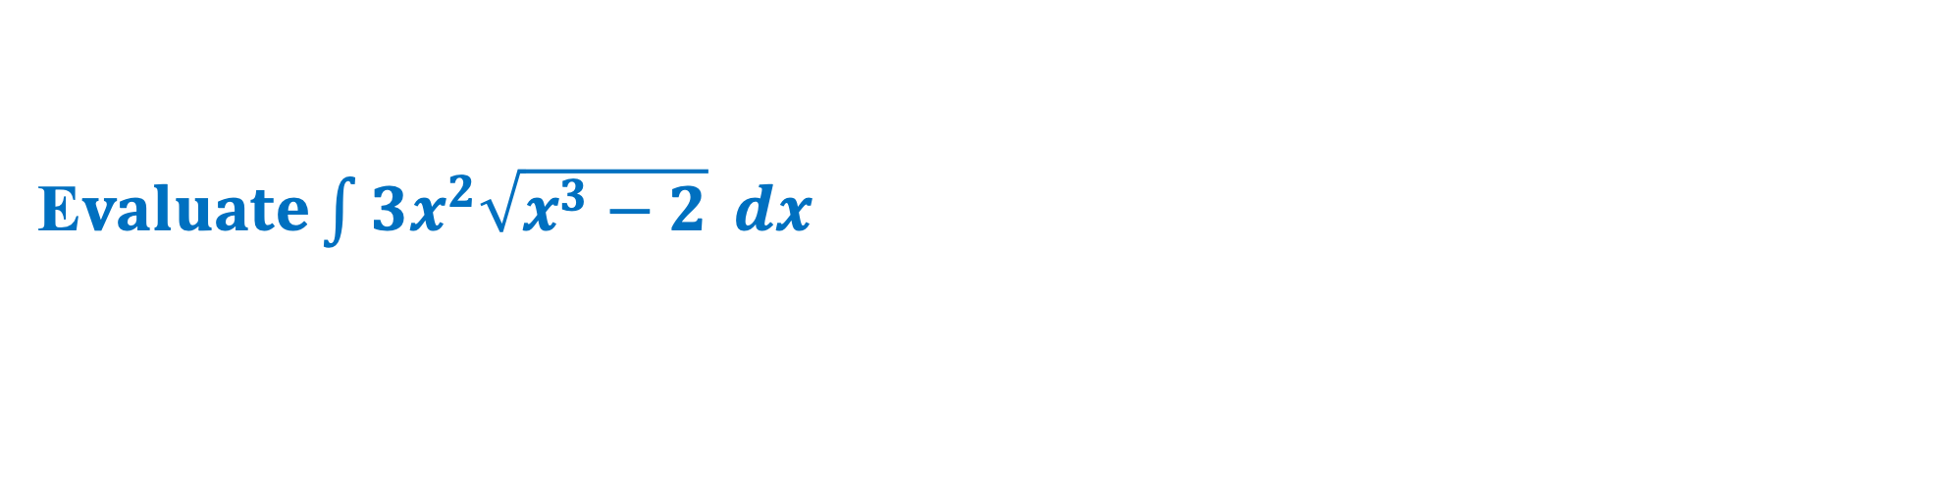

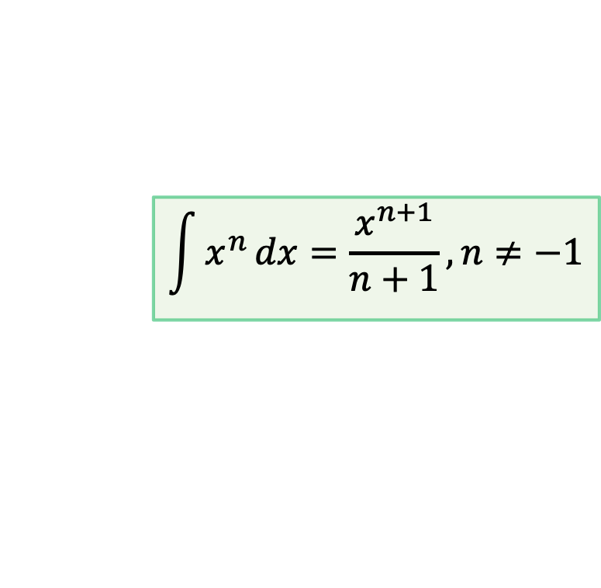
E$valuate\int{3x^{2}\sqrt{x^{3}−2}} dx$
Here,
$$\int{3x^{2}\sqrt{x^{3}−2}}dx=\int{\sqrt{x^{3}−2}}{(3x}^{2})dx$$
Suppose
$$=\int{\sqrt{u}}du$$
$$x^{3}−2=u$$
$$=\int{u^{\frac{1}{2}}}du$$
$$3x^{2}=\frac{du}{dx}$$
$$=\frac{u^{\frac{1}{2}+1}}{\frac{1}{2}+1}+C$$
$$∴du=3x^{2}dx$$
$$\int{x^{n}}dx=\frac{x^{n+1}}{n+1}, n≠−1$$
$$=\frac{u^{\frac{3}{2}}}{\frac{3}{2}}+C$$
$$\int{3x^{2}\sqrt{x^{3}−2}}dx=\frac{2}{3}{\left(x^{3}−2\right)}^{\frac{3}{2}}+C$$

Slide 5

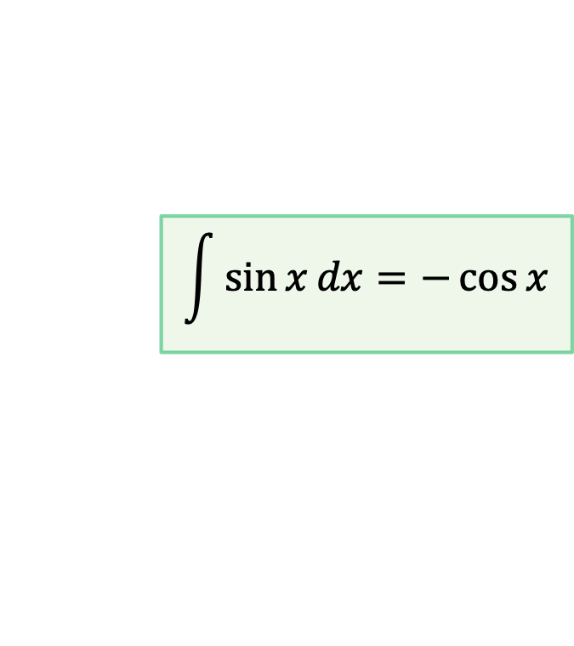
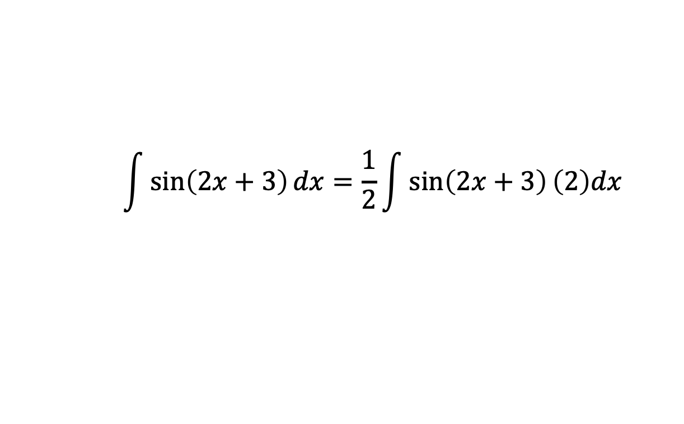
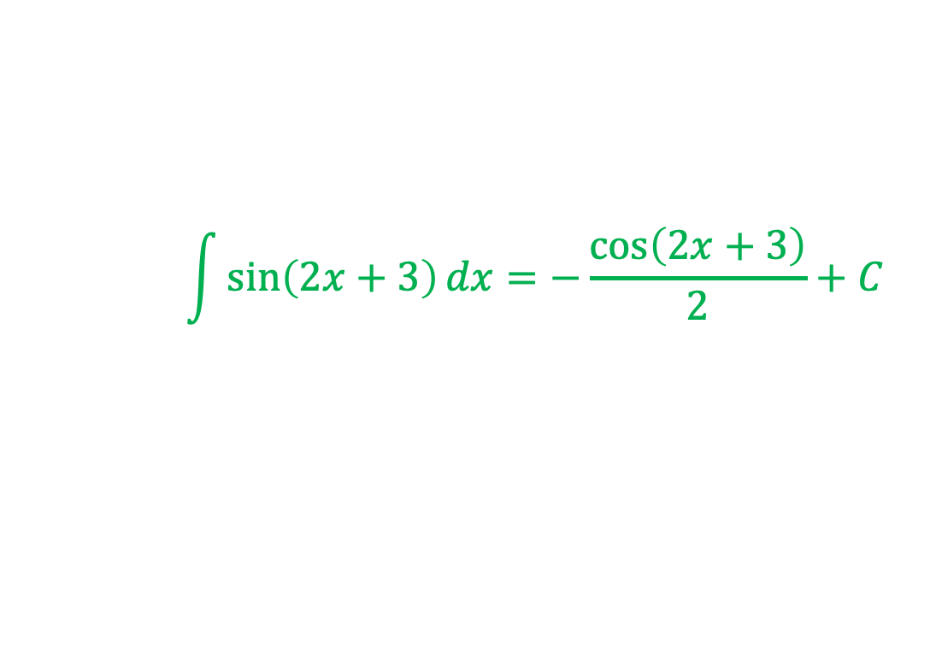

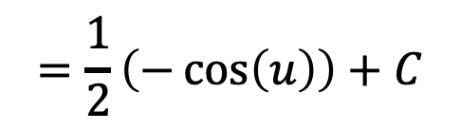
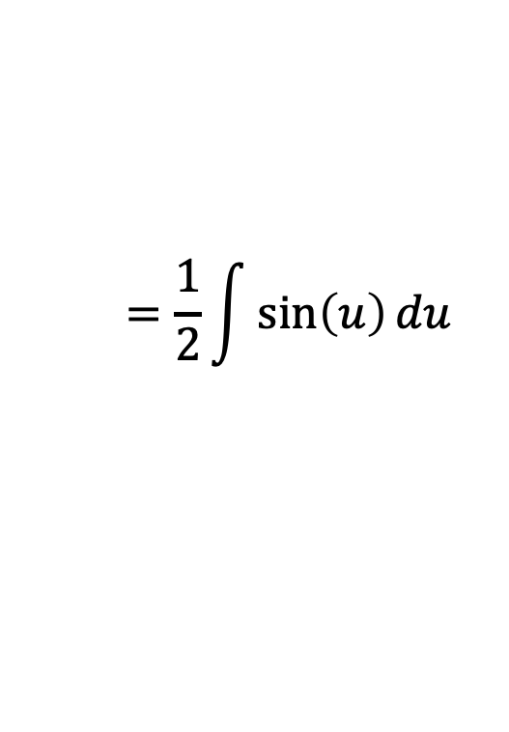
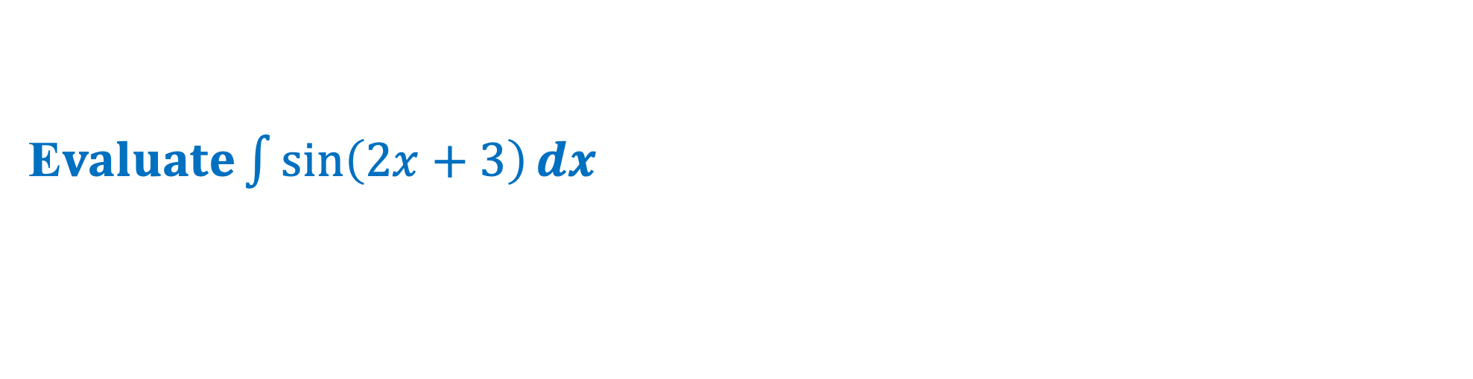

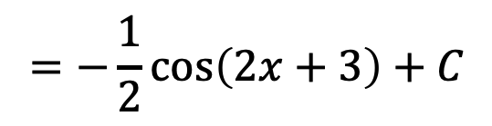
E$valuate\int{\sin\left(2x+3\right)}dx$
Here,
$$\int{\sin\left(2x+3\right)}dx=\frac{1}{2}\int{\sin\left(2x+3\right)}\left(2\right)dx$$
Suppose
$$2x+3=u$$
$$=\frac{1}{2}\int{\sin\left(u\right)}du$$
$$2=\frac{du}{dx}$$
$$\int{\sin{x}}dx=−\cos{x}$$
$$=\frac{1}{2}\left(−\cos\left(u\right)\right)+C$$
$$∴du=2dx$$
$$=−\frac{1}{2}\cos\left(2x+3\right)+C$$
$$\int{\sin\left(2x+3\right)}dx=−\frac{\cos\left(2x+3\right)}{2}+C$$

Slide 6


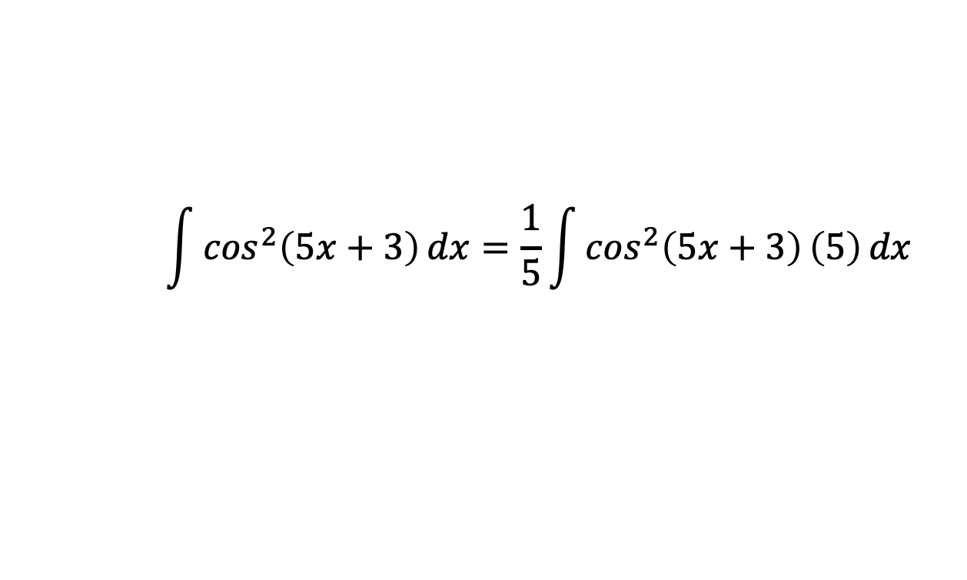
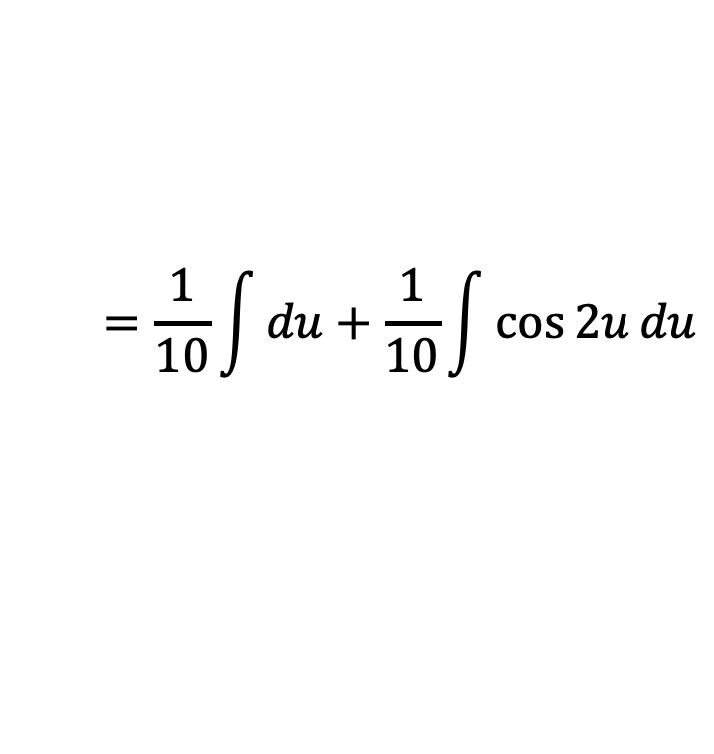
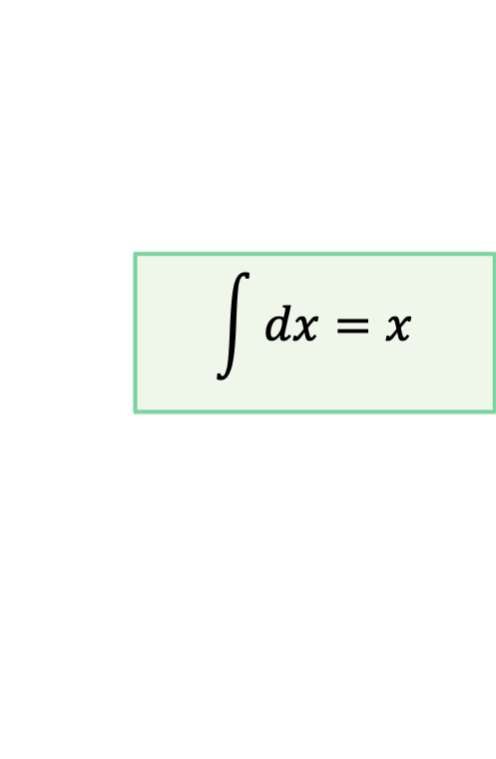


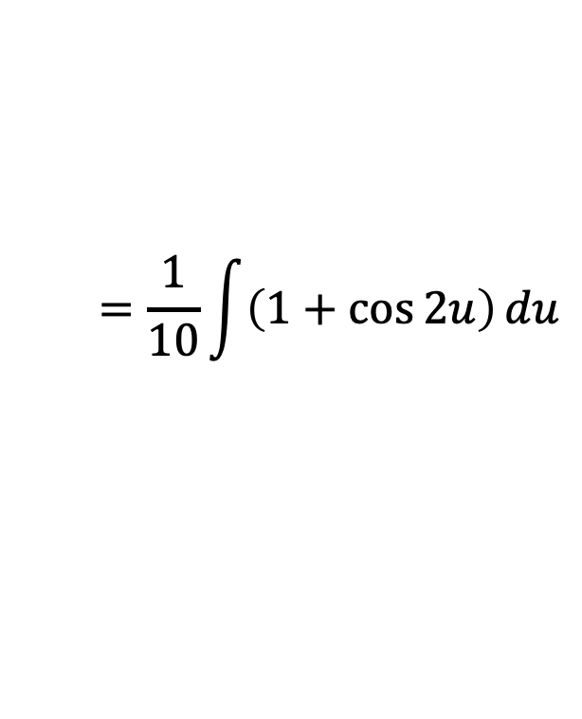
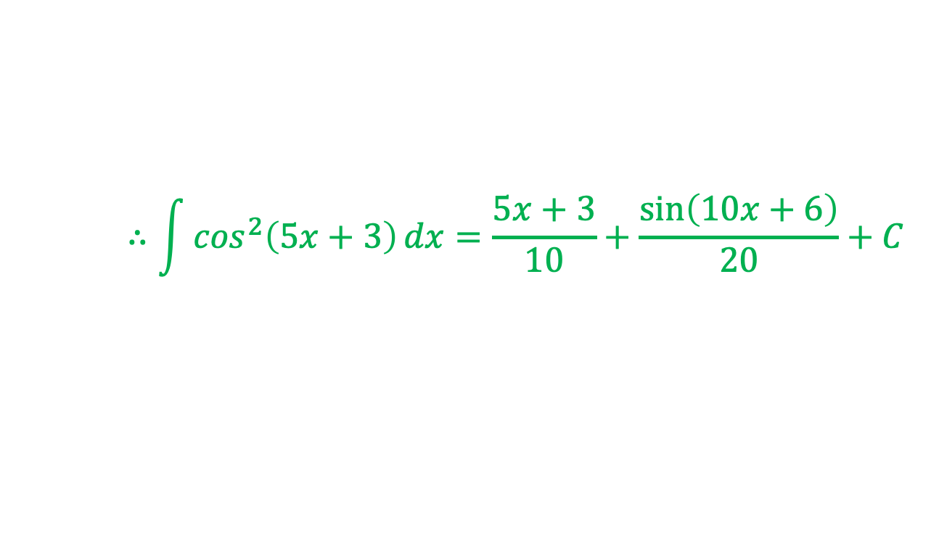
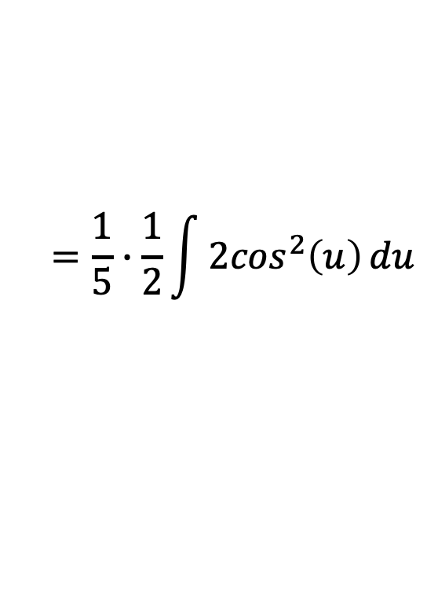
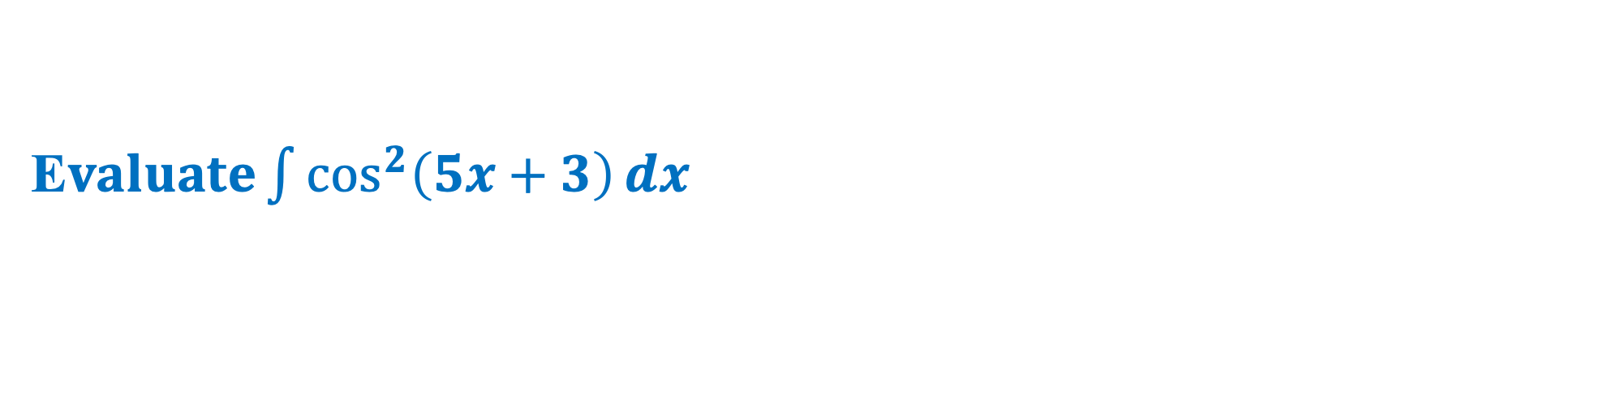

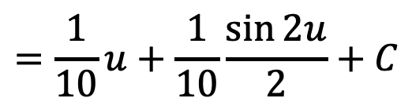
E$valuate\int{\cos^{2}\left(5x+3\right)}dx$
Here,
$$\int{\cos^{2}\left(5x+3\right)}dx=\frac{1}{5}\int{\cos^{2}\left(5x+3\right)\left(5\right)}dx$$
Suppose
$$=\frac{1}{5}∙\frac{1}{2}\int{{2cos}^{2}\left(u\right)}du$$
$$\int{dx}=x$$
$$5x+3=u$$
$$5=\frac{du}{dx}$$
$$=\frac{1}{10}\int{\left(1+\cos{2u}\right)}du$$
$$\int{\cos\left(mx\right)}dx=\frac{\sin\left(mx\right)}{m}$$
$$∴du=5dx$$
$$=\frac{1}{10}\int{du}+\frac{1}{10}\int{\cos{2u}}du$$
$$=\frac{1}{10}u+\frac{1}{10}\frac{\sin{2u}}{2}+C$$
$$2\cos^{2}{θ}=1+cos{2θ}$$
$$∴\int{\cos^{2}\left(5x+3\right)}dx=\frac{5x+3}{10}+\frac{\sin\left(10x+6\right)}{20}+C$$

Slide 7


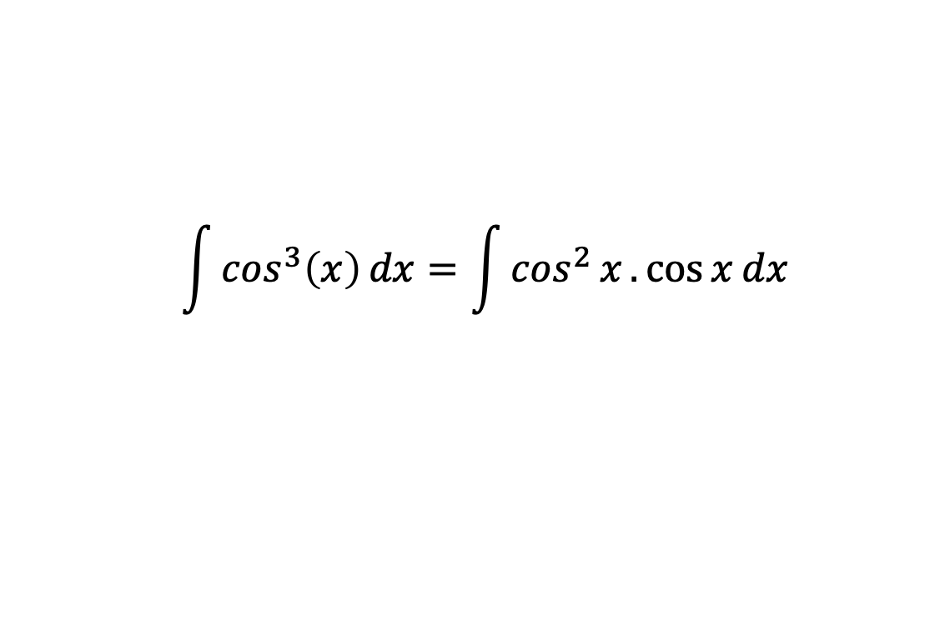
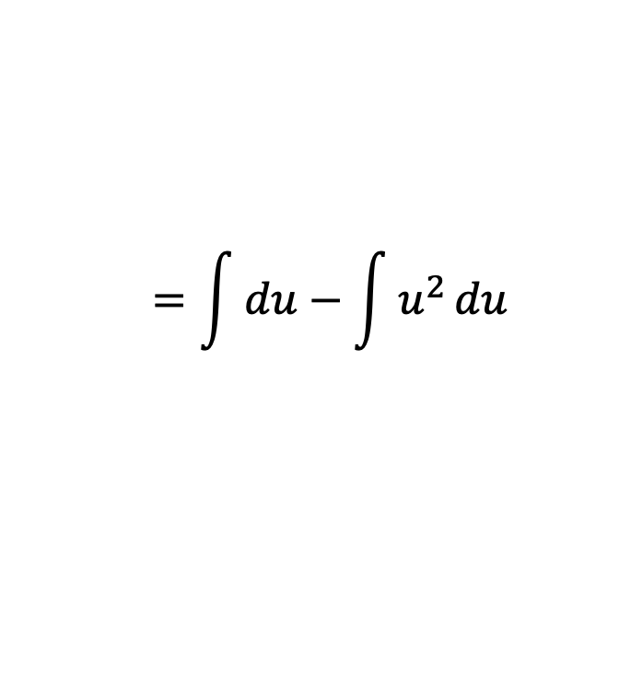


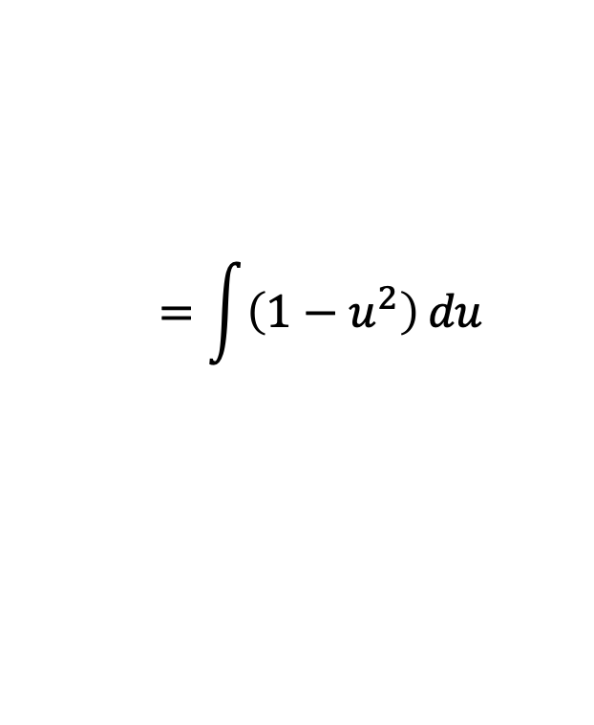

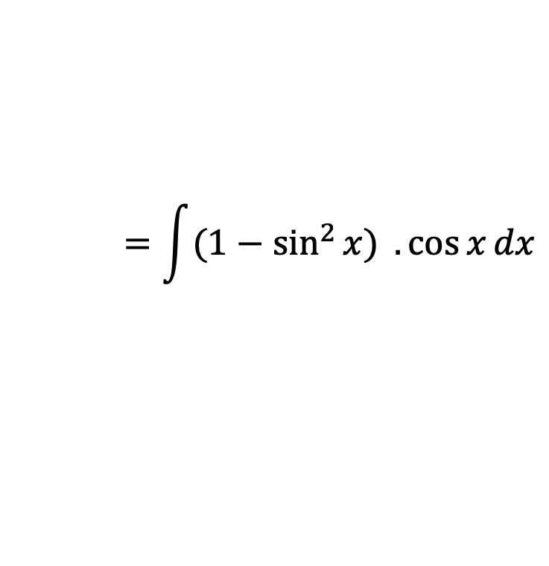
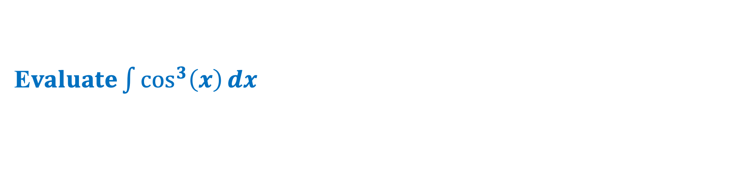


E$valuate\int{\cos^{3}\left(x\right)}dx$
Here,
$$\int{\cos^{3}\left(x\right)}dx=\int{\cos^{2}{x}.\cos{x}}dx$$
Suppose
$$=\int{(1−\sin^{2}{x) }.\cos{x}}dx$$
$$\sin{x}=u$$
$$\int{dx}=x$$
$$=\int{\left(1−u^{2}\right)}du$$
$$\cos{x}=\frac{du}{dx}$$
$$\int{x^{n}}dx=\frac{x^{n+1}}{n+1}, n≠−1$$
$$=\int{du}−\int{u^{2}}du$$
$$∴du=\cos{x}dx$$
$$=u−\frac{u^{3}}{3}+C$$
$$∴\int{\cos^{3}\left(x\right)}dx=\sin{x}−\frac{\sin^{3}{x}}{3}+C$$

Slide 8








E$valuate\int{\cos^{2}\left(x\right)}dx$
Here,
$$\int{\cos^{2}\left(x\right)}dx=\frac{1}{2}\int{2\cos^{2}{x}}dx$$
$${2cos}^{2}{θ}=1+\cos{2θ}$$
$$=\frac{1}{2}\int{\left(1+\cos{2x}\right)}dx$$
$$=\frac{1}{2}\left[\int{dx}+\int{\cos{2x}}dx\right]$$
$$\int{\cos\left(mx\right)}dx=\frac{\sin\left(mx\right)}{m}$$
$$=\frac{1}{2}\left[x+\frac{\sin{2x}}{2}\right]+C$$
$$∴\int{\cos^{2}\left(x\right)}dx=\frac{x}{2}+\frac{\sin{2x}}{4}+C$$

Slide 9













E$valuate\int{\sin^{4}\left(x\right)}dx$
$${2cos}^{2}{θ}=1+\cos{2θ}$$
$${2sin}^{2}{θ}=1−\cos{2θ}$$
Here,
$$\int{\sin^{4}\left(x\right)}dx=\frac{1}{4}\int{{(2\sin^{2}{x})}^{2}}dx$$
$$=\frac{1}{4}\int{{\left(1−\cos{2x}\right)}^{2}}dx$$
$$\int{\sin^{4}\left(x\right)}dx=\frac{1}{4}\left[x−\sin{2x}+\frac{1}{2}x+\frac{1}{2}\frac{\sin{4x}}{4}\right]+C$$
$$=\frac{1}{4}\int{\left(1−2\cos{2x}+\cos^{2}{2x}\right)}dx$$
$$=\frac{1}{4}\left[\int{dx}−\int{2\cos{2x}}dx+\int{\cos^{2}{2x}} dx\right]$$
$$=\frac{1}{4}\left[\frac{3}{2}x−\sin{2x}+\frac{\sin{4x}}{8}\right]+C$$
$$=\frac{1}{4}\left[x−2\int{\cos{2x}}dx+\frac{1}{2}\int{2\cos^{2}{2x}} dx\right]$$
$$=\frac{3}{8}x−\frac{\sin{2x}}{4}+\frac{\sin{4x}}{32}+C$$
$$=\frac{1}{4}\left[x−2\frac{\sin{2x}}{2}+\frac{1}{2}\int{(1+\cos{4x})} dx\right]$$
$$∴\int{\sin^{4}\left(x\right)}dx=\frac{3}{8}x−\frac{\sin{2x}}{4}+\frac{\sin{4x}}{32}+C$$
$$=\frac{1}{4}\left[x−\sin{2x}+\frac{1}{2}\int{dx}+\frac{1}{2}\int{\cos{4x}} dx\right]$$

Slide 10









E$valuate\int{\frac{\sin{x}+\cos{x}}{\sqrt{1+\sin{2x}}}}dx$
Here,
$$\int{\frac{\sin{x}+\cos{x}}{\sqrt{1+\sin{2x}}}}dx$$
$$=\int{\frac{\sin{x}+\cos{x}}{\sqrt{\sin^{2}{x}+\cos^{2}{x}+2\sin{x}\cos{x}}}}dx$$
$$\sin{2x}=2\sin{x}\cos{x}$$
$$=\int{\frac{\sin{x}+\cos{x}}{\sqrt{{\left(\sin{x}+\cos{x}\right)}^{2}}}}dx$$
$$=\int{\frac{\left(\sin{x}+\cos{x}\right)}{(sin{x}+\cos{x})}}dx$$
$$=\int{1}dx$$
$$=x+C$$
$$∴\int{\frac{\sin{x}+\cos{x}}{\sqrt{1+\sin{2x}}}}dx=x+C$$

Slide 11

Exercise
Evaluate the followings:
    $\int{\left(2x+1\right)\left(x^{2}+x\right)}dx$
    $\int{\sin^{2}\left(2x+5\right)}dx$
    $\int{\sin^{3}\left(x\right)}dx$
    $\int{\cos^{2}\left(x\right)\sin{x}}dx$
    $\int{\cos^{2}\left(x\right)}dx$
    $\int{\cos^{4}\left(x\right)}dx$

